Slide 1
Cardiology in Darling Downs
(Public)
Darling Downs General Practitioner Symposium
Dr Robert Gluer

Slide 2
Overview
Community-based investigation and management of potentially cardiac symptoms
Focus on ‘reality on the ground’, not state-of-the-art academics
  Photon counting CT will not be further discussed after this slide
  Health Pathways
Accessing cardiology services
  And cardiac investigations – different referral!
Burning questions – please jump in

Slide 3
Guiding Principles and Objective Reality
Outpatient waitlist
Outpatient referral numbers
What can you do to help your patient and the community
  Working up patients to see if they need specialist outpatients
    And which specialist outpatients
  Confidence in your clinical acumen
    Not referring patients who don’t need specialist outpatients
  Clarity in referrals vs. requests

Slide 4
Referral Bugbears
Smart Referrals
Referrals because of test results
  Without the test result attached
Referrals to cardiology outpatients asking for a test to be arranged
  Where the test is directly available on GP request
    Which tests are directly available?
  Where the patient is seeing a private cardiologist, who has recommended a test
    Cardiology outpatients doesn’t perform CT, MRI, or invasive angiography
    Private cardiologists can request investigations in the public system
    Duplication, fragmentation, preventing other patients from accessing clinic

Slide 5
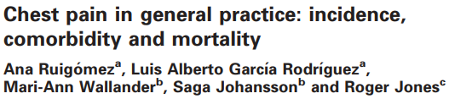
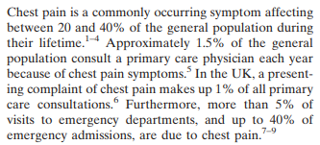
Non-Acute Chest Pain
Audience participation:
  Lifetime prevalence of chest pain?
  Annual incidence of chest pain presenting to GP?

Slide 6

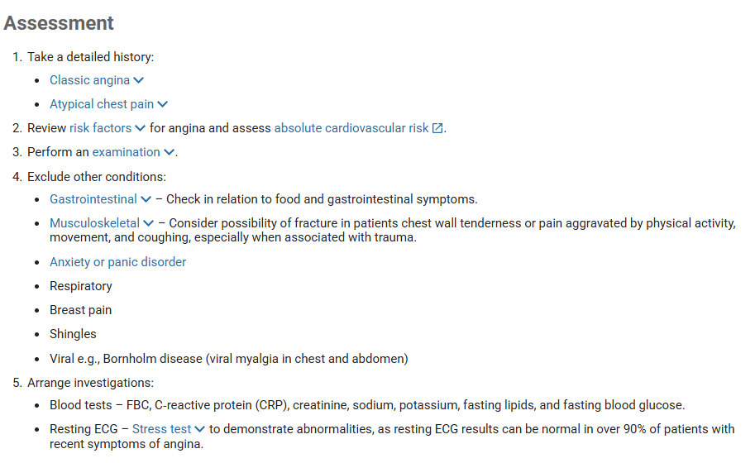
Non-Acute Chest Pain

Slide 7
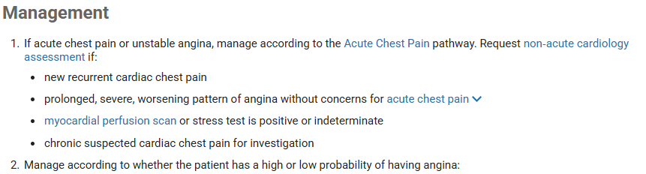
Non-Acute Chest Pain

Slide 8
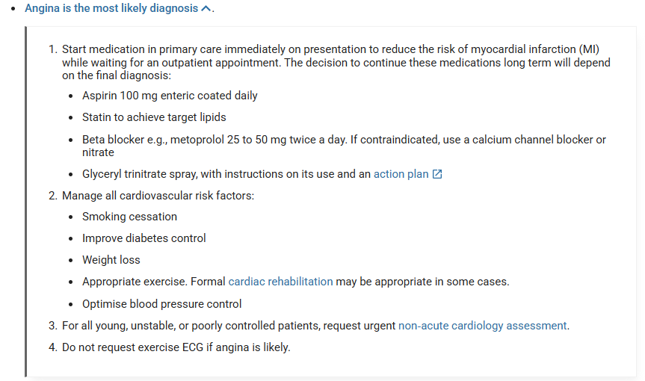
Non-Acute Chest Pain

Slide 9
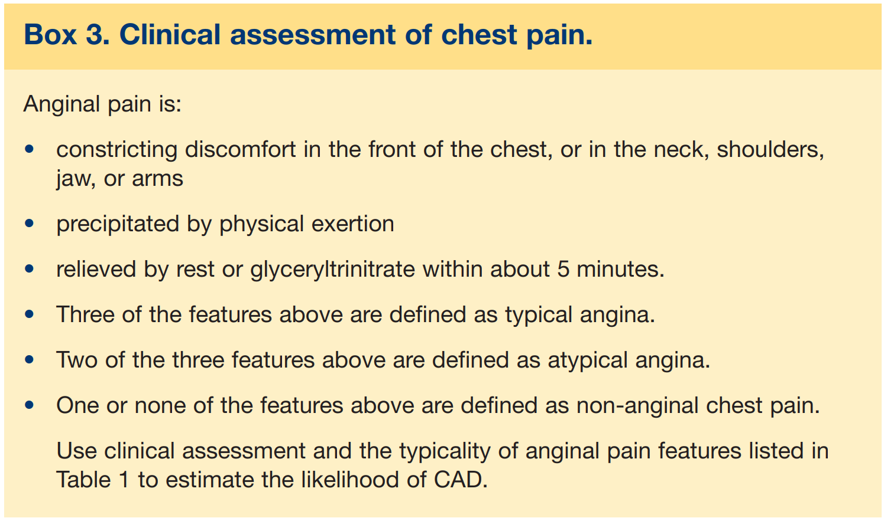
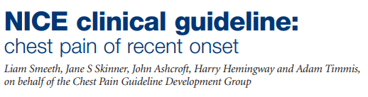
Non-Acute Chest Pain

Slide 10
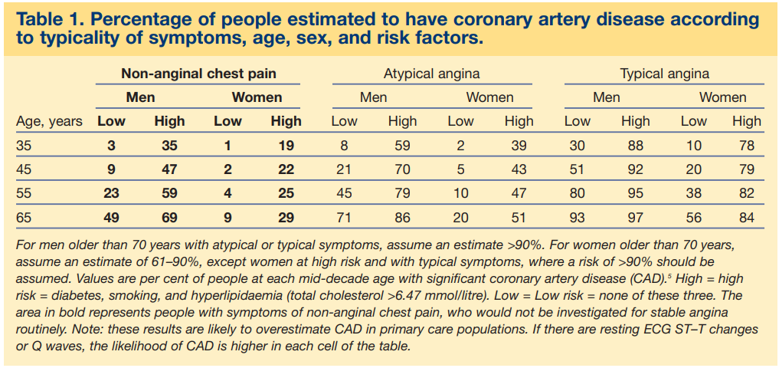

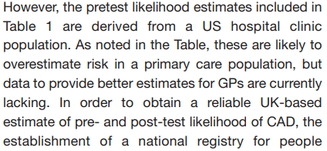
Non-Acute Chest Pain

Slide 11
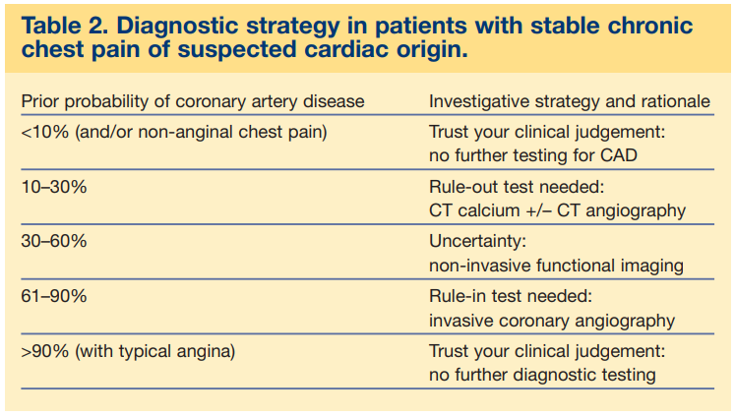
Non-Acute Chest Pain
NB – this guideline is focussed on diagnosis of CAD - >90% probability with typical angina needs management and prognostic evaluation

Slide 12
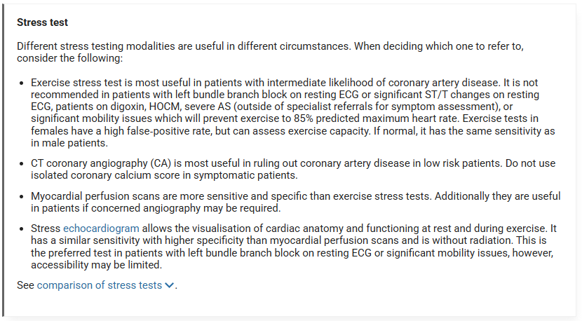
Non-Acute Chest Pain

Slide 13
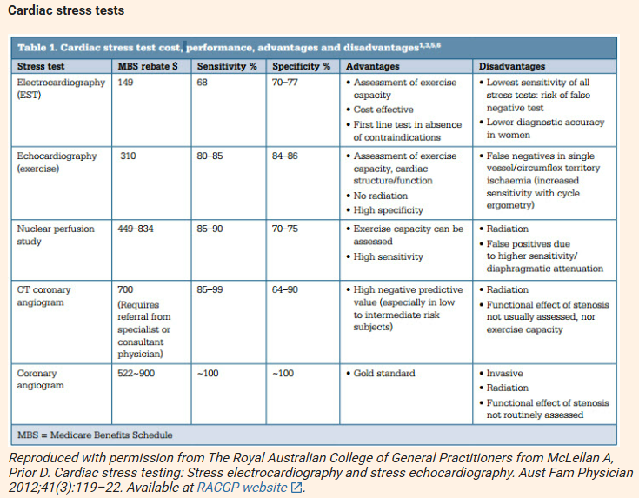
Non-Acute Chest Pain

Slide 14
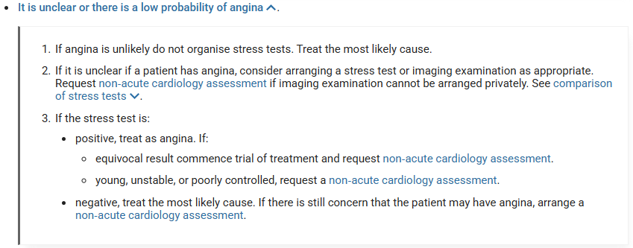
Non-Acute Chest Pain

Slide 15
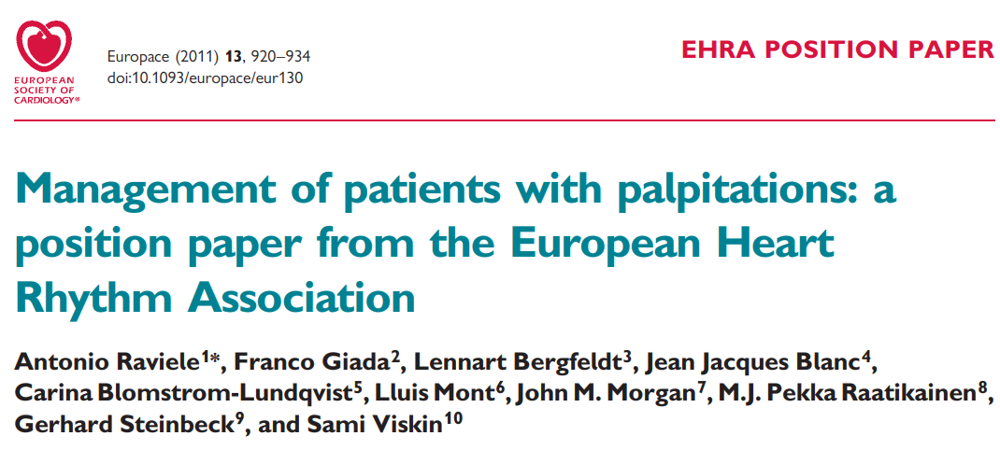
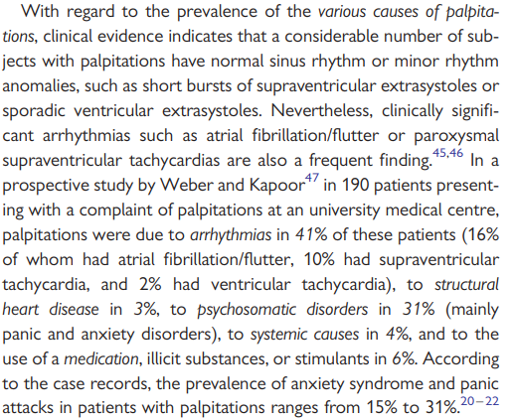
Palpitations
Audience participation:
  What proportion of patient complaints of palpitations are due to arrhythmias?
  What benefit of a cardiologist for non-arrhythmic palpitations?

Slide 16
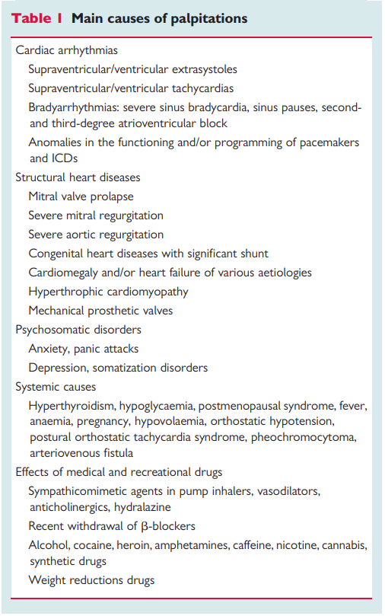
Palpitations
Available investigations
  Holter
  External loop / Event monitor
  Home Arrhythmia Monitor
  Smart watches / devices
Palpitations during normal sinus rhythm

Slide 17
Heart Failure
Dyspnoea
Not all dyspnoea is heart failure

Slide 18
GP Access to Bulk Billed Echocardiography

Slide 19
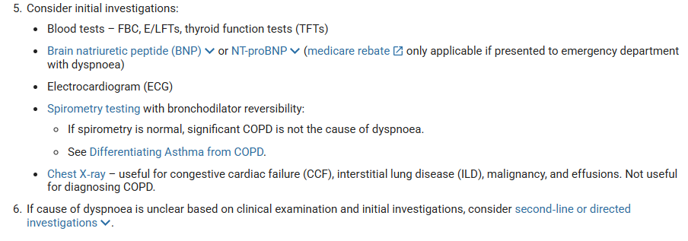
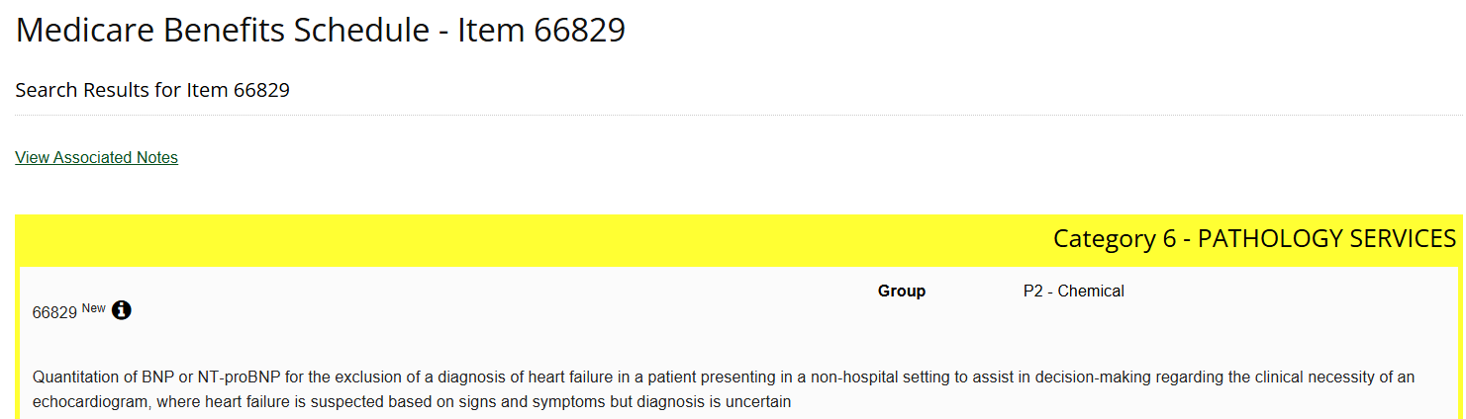
Dyspnoea

Slide 20
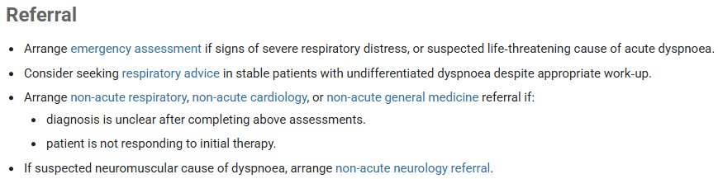
Dyspnoea

Slide 21
Right sided heart failure from pulmonary disease
Manage the pulmonary disease
Frusemide / diuresis

Slide 22
Questions?

