Slide 1
West Moreton is one of the fastest growing regions in the country growing 18% from 2016 to 2021,
We have a higher than average fertility rate more than 1.79% compared to Queensland (1.72%) and Australia (1.63%).

Slide 2
We have a higher that the national average rate of smoking, obesity, teenage pregnancies
We have lower than average antenatal visits versus other regions
Notes:
The lowest percentage is 13.7% in the region, still higher than Queensland (11.5%) and Australia (8.9%),
The region also has poor antenatal attendance, such as percentage of women did not attend antenatal care within the first 10 weeks. For example, Lockyer Valley in the region has a very high percentage (48,6%), compared to Queensland (38.4%) and Australia (41%).

Slide 3
We have poor maternal and neonatal outcomes as many of our patients do not seek early and ongoing antenatal care
LBW Australia (6.5%) and Queensland (6.7%)
Notes:
West Moreton also has poor neonatal and maternity outcomes. Especially, an average annual infant mortality rate in Ipswich LGA (4.7%) and Lockyer Valley (5.3%), much higher than in Queensland (3.9%) and Australia (3.2%).
In addition, some LGAs in the region have percentage of low birthweight babies, higher than Australia (6.5%) and Queensland (6.7%),
If we increase our antenatal care even opportunistically for our patients in the West Moreton region, we may be able to improve these outcomes.

Slide 4
What outcomes do we want? Improved maternal and neonatal outcomes
Person centred pregnancy care
More than 5 antenatal visits per pregnancy
Increased utilisation of My Health Record to improve timely decision making for GP’s and hospital specialists and midwives
Opportunistic screening of all pregnant women who may see a GP at any stage of their pregnancy

Slide 5
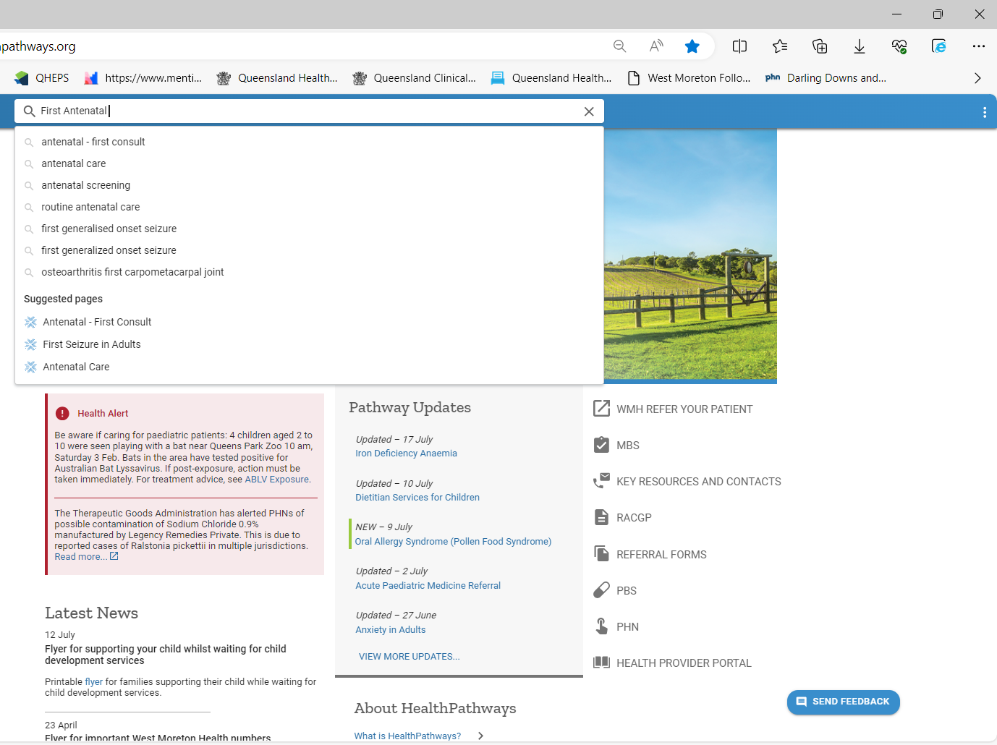
West Moreton HealthPathways Username: wmuser Password: wmpassword

Slide 6
Assessment First Antenatal visit : Assessment can be completed over 2 visits.
Take a history:
Current pregnancy
Obstetric history
Gynaecological history
Medical and surgical
Personal or family genetic disorders.
Immunisation history for pertussis, hepatitis B, rubella, and varicella. A past history of chickenpox will provide some immunity even if varicella vaccination status is negative.
Review medications (including herbal and over-the-counter) and check their safety in pregnancy. See also Medications in Pregnancy and Breastfeeding.
Consider workplace exposure to chemicals, solvents or radiation, or other potential risks that may cause harm.
Ask about lifestyle factors that may affect the pregnancy e.g., tobacco, alcohol and other substance use, nutrition, physical activity, exposure to cat faeces.
Assess mental health, social and emotional well-being, including screening for domestic violence. Complete the domestic violence screening form.
Perform physical examination:
Record baseline blood pressure, height, weight, and body mass index (BMI).
Check for pallor, peripheral oedema.
Check fundal height from 20 weeks.
Check fetal heart rate from 16 weeks.
Must do: breast, gynaecological, thyroid, cardiac, respiratory, and dental examination.

Slide 7
First Antenatal Visit: Blood tests and Scans Initial Referral from GP to be sent as soon as you have a Dating Scan, Assessment, Routine bloods below: GPSR, Fax -
Blood group (BG) and blood group antibodies (BGA) tests
FBC and Ferritin
Hepatitis B (HBsAg)
Hepatitis C serology
Syphilis – rapid plasma reagin (RPR), treponema pallidum hemagglutination assay (TPHA). Dry swab lesion
HIV serology (with pre-test counselling, verbal consent).
Rubella antibody
First trimester screening test and Cervical length
MSU- treat asymptomatic bacteriuria
If needed:
TFT eg.>30, BMI>30
Chlamydia if <30 or area of high prevalence
OGTT or HbA1c(12/40) if OGTT not tolerated
E/LFT and urine protein:creatinine ratio if BMI > 30, age > 40 years, hypertension, previous pre-eclampsia
Vit D for specific indications only
Varicella serology (if no history of Varicella or vaccination)
Cervical Screening Test

Slide 8
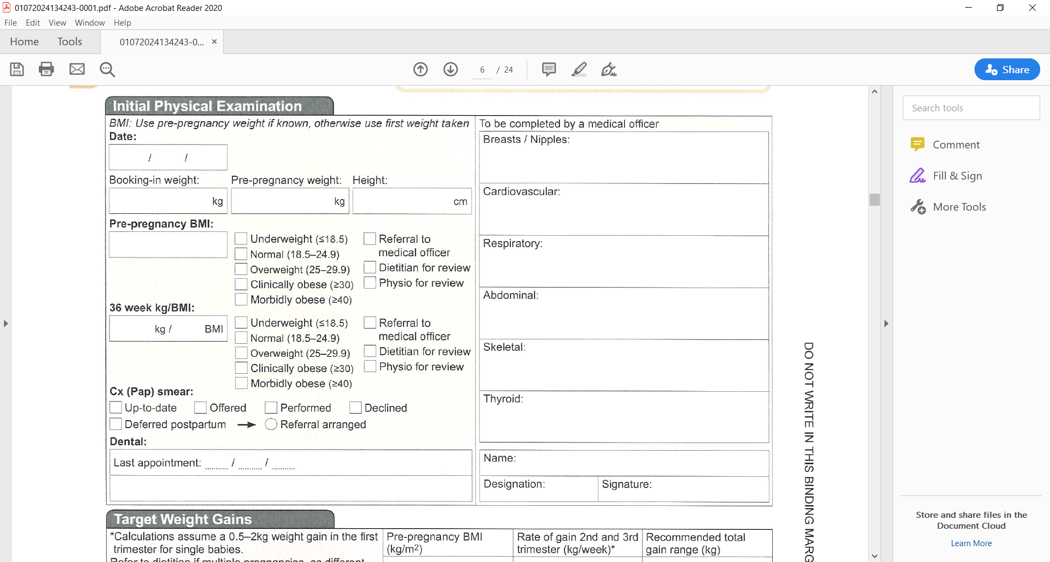
Pregnancy Health Record

Slide 9
Symphysis to Fundal height Graph from 20/40
Pregnancy Blue book + PHR will be posted to patient after ANC appt
Practice point: Safer baby bundle, SFH graph is in PHR – plot from 20 weeks onwards
Please complete this when you see a patient or print your notes
Notes:
Arrange non-acute obstetric referral and mark as urgent if:from 24 weeks, serial symphysis-fundal height (SFH) measurements are 3 cm or more higher or lower than the expected for gestational age.

Slide 10
GP Maternity Shared Care is the patient’s choice
Thank you for referring (patients name ) to IGH for Antenatal care, who has been booked into birth at IGH.
We are pleased to confirm that to encourage continuity of care your patient has been identified as being suitable for shared care with Ipswich Hospital. Please refer to the Pregnancy Health Record for the schedule of visits for the duration of the pregnancy. We would also encourage you to consult West Moreton Health Pathways (search Pregnancy) for more clinical information and referral pathways for antenatal care in our region
Home - Community HealthPathways West Moreton
Username : wmuser Password: wmpassword
We will make an appointment for 36 weeks and 40 weeks gestation here at the hospital however all other appointments will be at your practice. Please could you ensure that you document all such visits in the Pregnancy Health Record or print a copy of your antenatal visit record for the patient for continuity of care. Our Electronic medical record of each visit will be printed including booking in, week 36 and week 40 and included as a printout as part of shared care. Important information will be highlighted.
May we emphasise the need to also plot all the fundal height measurements on the fundal height chart attached to the Pregnancy Health Record and to record the results of the 26-28 weeks investigations.
If you have any concerns about care at any stage during the pregnancy, please feel free to contact the O & G on call team on 3413 7692/3413 7609 at any time.
Yours sincerely , Director of Obstetrics and Gynaecology

Slide 11
MBS Items:Practice hints
MBS Item
4001 92136 92138 | RACGP and ACCRM training Video Telephone | $87.25 $87.25 $87.25
16500 | Antenatal Attendance in clinic | $53.70
91853 | Antenatal Attendance Video | $53.70
91858 | Antenatal Attendance Telephone | $53.70
16591- Shared Care | (a) the pregnancy has progressed beyond 28 weeks gestation; and (b) the service includes a mental health assessment | 162.50
16407 | Post-Partum check 4-8 weeks post partum | 81.70
16408 | Home visit -20 minutes | 60.85
Can also bill together with item 23 if appropriate e.g. also c/o sore foot or URTI. - document appropriately and time stamp notes and billing
Notes:
16500 Rebate $53.70 Antenatal Attendance 91853 (video: $53.70) 91858 (telephone: $53.70) equivalent of 16500 16591 Rebate $162.50 “Planning and management, by a practitioner, of a pregnancy if:
(a) the pregnancy has progressed beyond 28 weeks gestation; and
(b) the service includes a mental health assessment (including screening for drug and alcohol use and domestic violence) of the patient; and
(c) a service to which item 16590* applies is not provided in relation to the same pregnancy Payable once only for a pregnancy”
(16590 = planning to undertake the delivery for a privately admitted patient)
16407
Postnatal professional attendance (other than a service to which any other item applies) if the attendance:
(a) is by an obstetrician or general practitioner; and
(b) is in hospital or at consulting rooms; and
(c) is between 4 and 8 weeks after the birth; and
(d) lasts at least 20 minutes; and
(e) includes a mental health assessment (including screening for drug and alcohol use and domestic violence) of the patient; and
(f) is for a pregnancy in relation to which a service to which item 82140 applies is not provided (participating RM) Payable once only for a pregnancy
Fee: $81.70
16408
Home visit for woman who was admitted privately for the birth. Midwife (on behalf of and under the supervision of the medical practitioner who attended the birth) Obstetrician or GP can claim. 1-4 weeks post partum, at least 20 min duration
Fee: $60.85

Slide 12
GP Resources
HealthPathways
First Antenatal visit – risk assessment determines model of care so this is the most important step
Pre conception counselling
Shared Maternity Care
Medical, Past obstetric history, First Nations, Multicultural…
GP’s in a POD- Spotify
GP resources in your symposium bag – all available on HealthPathways

Slide 13
CPR Game
Username : wmuser
Password : wmpassword
Search : -Antenatal First Consult –
What is in the red flag box?

Slide 14
Pre-conception Counselling What is in The Clinical Editors note?
Folate and iodine supplementation
Rubella serology +/- vaccination
Varicella serology if no history +/- vaccination
Influenza vaccination in season
Cervical Screening Test if due
Chlamydia if age <30
Syphilis testing
Smoking cessation and Alcohol cessation
Discuss genetic carrier screening
Consider preconception clinic or genetic service? at hospital if medical condition

Slide 15
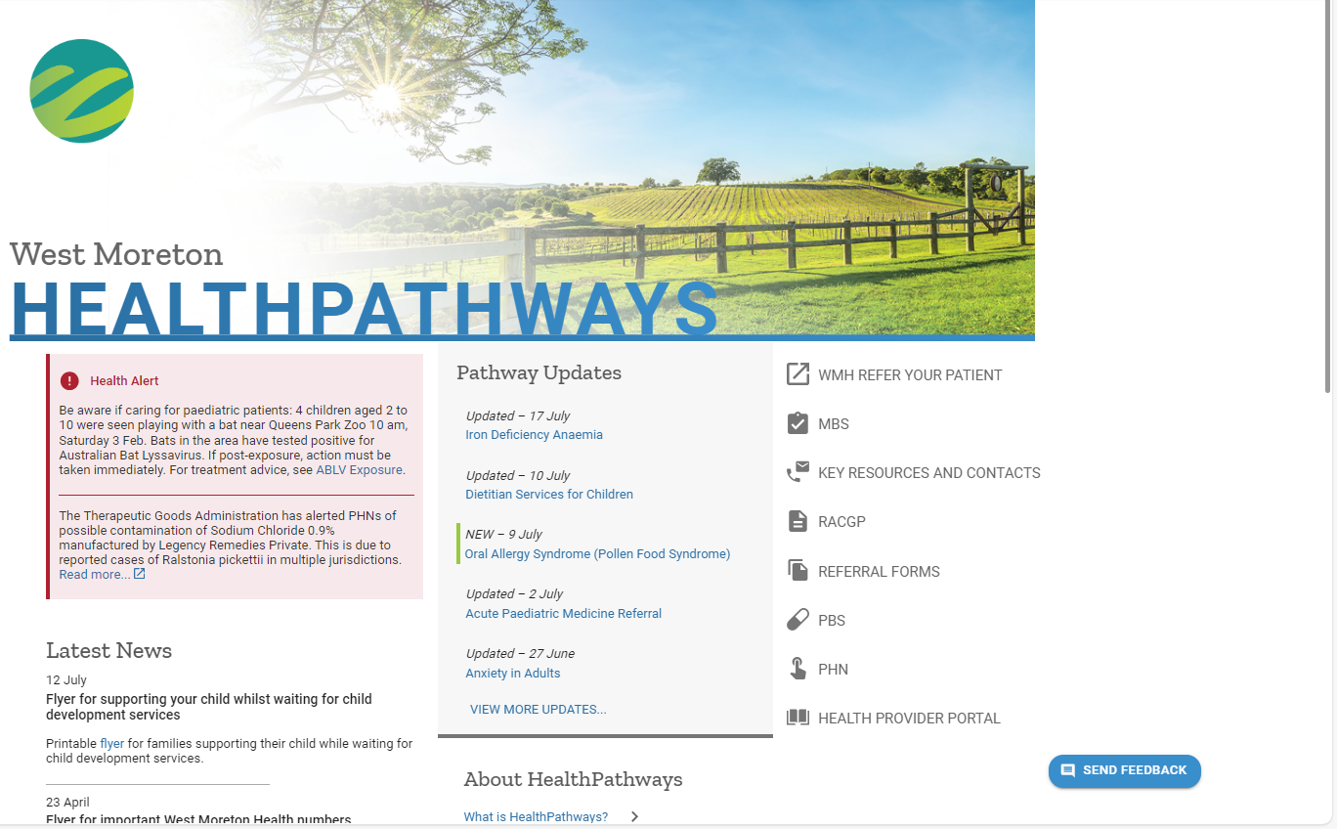
Under Key resources and Contacts on landing page What is the for O and G on-call number?

Slide 16
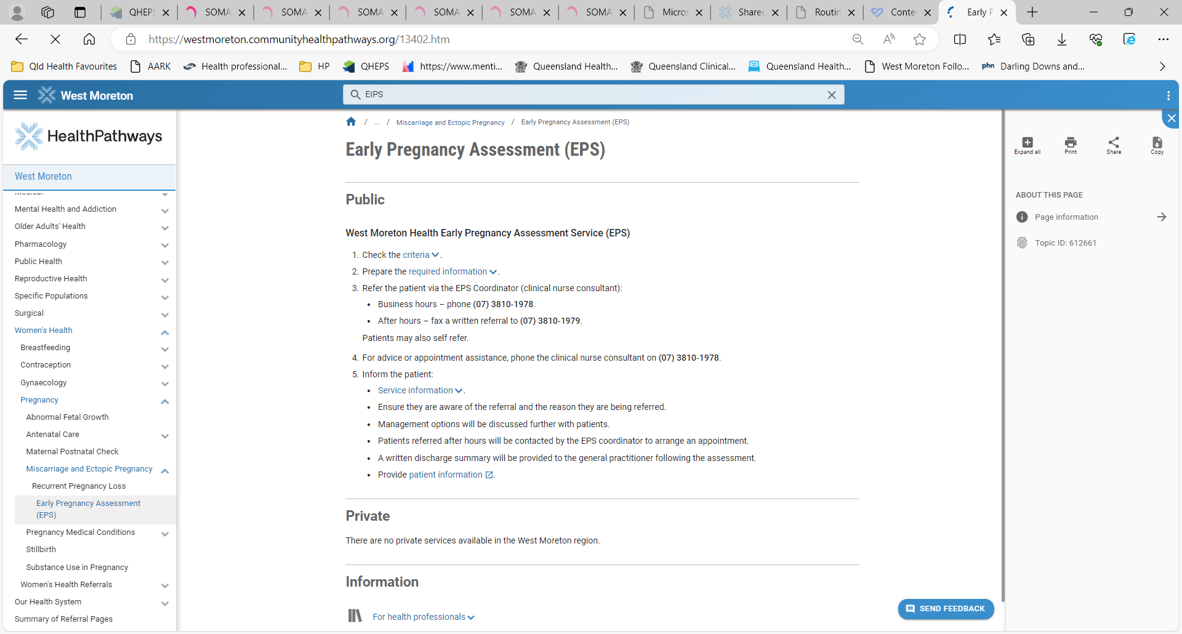
What Cervical length should you refer to obstetrics for review?
Hint: Shared maternity care
Expand all then Control F- Cervical length
What is the Telephone number for the Early Pregnancy Service?

Slide 17
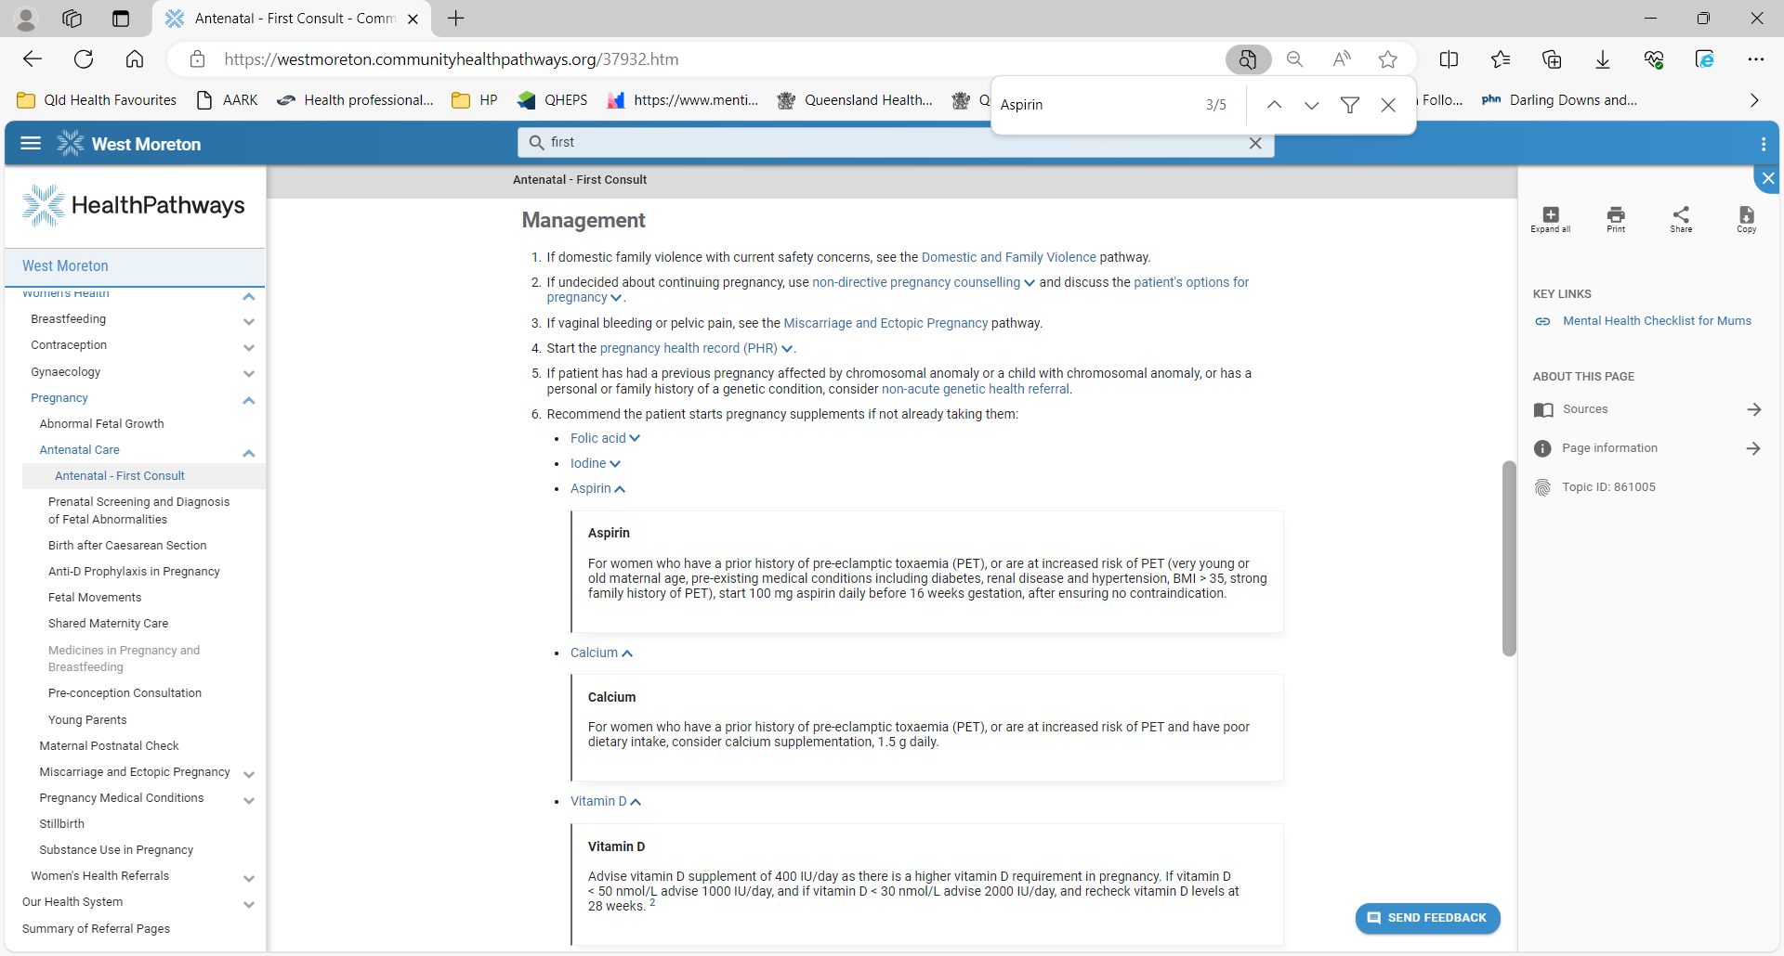
Whats new?
Clinical Updates: Will be covered by our speakers
Calcium
Vitamin D
Aspirin
PV progesterone- request Cervical length on US
Syphilis screening for all pregnant women x 3
Chlamydia for all women <30 years old
Safer Baby Bundle
Preterm prevention
New GDM cut offs
VTE prophylaxis
BMI cut offs for high risk pregnancies – especially with Telehealth
Cervical length <25mm urgent referral to obstetrics
Early GDM screening for high risk
TSH for women>30 years BMI>30
Notes:
Arrange non-acute obstetric referral and mark as urgent if:
from 24 weeks, serial symphysis-fundal height (SFH) measurements are 3 cm or more higher or lower than the expected for gestational age.
systolic blood pressure 140 to < 160 mmHg and/or diastolic blood pressure 90 to < 110 mmHg.
cervical length 10 to 25 mm.

Slide 18
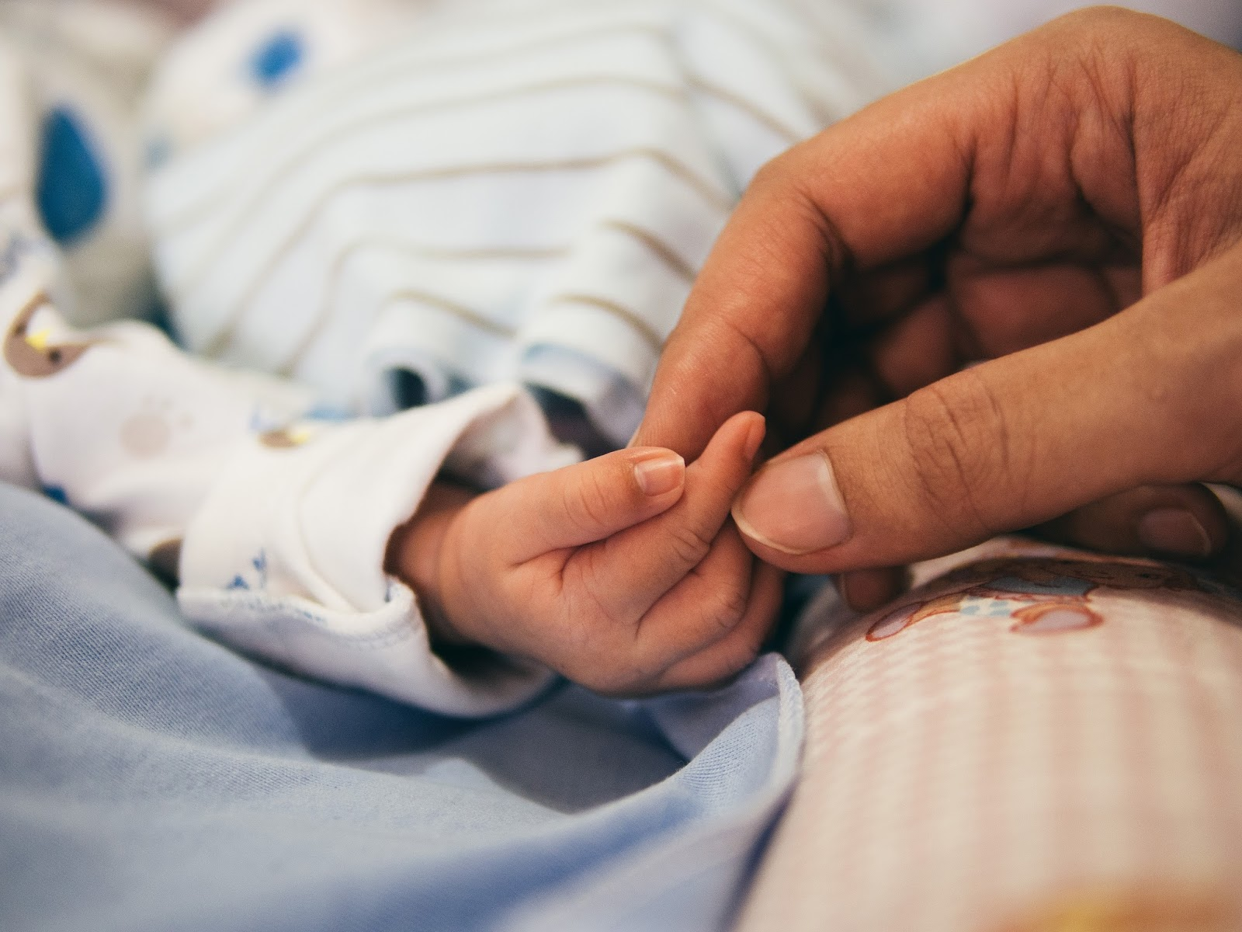
Maternity Symposium West Moreton HHS
Julie Eaton MUM ANC
This Photo by Unknown Author is licensed under CC BY-NC-ND

Slide 19
Models of care
GP Shared care
Low Risk Midwives Clinic
Ipswich Hospital Mondays, Tuesdays, Thursdays and Fridays
Ripley Satellite Hospital Tuesdays and Thursdays
Laidley Hospital Wednesdays
Redbank Community Centre Thursdays
Goodna Community Centre Fridays
Springfield High School Fridays
High Risk Midwives Clinic Wednesdays

Slide 20
Models of care continued:
Pasifika Liaison Midwife
Redbank Community Centre Tuesday
Goodna Community Clinic HR with consultant Wednesday
Goodna Community Centre Wed PM & Thursday
Friday Goodna Community Centre
Multicultural Liaison Midwife
Goodna Community Centre Mondays AM
Goodna Community Centre Tuesday PM
Goodna Community Clinic HR with consultant Wednesday
Ipswich Hospital Thursday AM
Redbank Community Centre Friday

Slide 21
Models of care continued:
Bereavement Liaison Midwife
All women who have experienced a loss in pregnancy are referred to this model of care and seen antenatally through the next pregnancy
If a loss is experienced in the current pregnancy the midwife connects with these women and offers follow up postnatally
Bereavement midwife will also support if a woman is being seen for a termination of pregnancy for various reasons
MCAL (midwifery care after loss) clinic Wednesdays at Ipswich

Slide 22
Models of care continued:
Midwifery Group Practice currently x 2 groups (9 midwives)
Each Midwife takes 37 women a year and gives all care throughout pregnancy, birth and up to 6 weeks postpartum and works an on call roster
South Ripley team runs clinics on Tuesdays at Ripley Satellite Hospital
Goodna Team runs clinics from Goodna Community Centre on Thursdays

Slide 23
Other clinics at Ipswich:
Low Risk Doctors Clinic
Ipswich Hospital Mondays all day
High Risk Doctors Clinic
Ipswich Hospital Wednesday all day
GDM Doctors Clinic
Ipswich Hospital Thursday all day (Type 1 & 2 in PM)
GDM Midwife Clinic
Ipswich Hospital Thursday AM
Maternity Day Assessment Unit (MDAU) 3413 5788 BS Reg 3413 5789 Call reg for advice or to handover patients. 3413 7609 Consultant on call.

Slide 24
Midwifery Services offered
Midwifery Navigator service who looks after high risk and maternal diabetes in pregnancy. The navigator once referral is received will link in with the women and often has some contact in the postnatal period for a short time.
Early Pregnancy Service (EPS) now 7-day service 0800-1630. One of 2 midwives see women with concerns in their pregnancy up to 20 weeks' gestation i.e. bleeding and subsequent loss. There is the option to have the products of conception collected by the woman once they are returned by pathology or to have the products included in the memorial once a month that is attended by EPS and the hospital Chaplain on a Wednesday. Women are invited to this by EPS.
Termination of pregnancy – all TOP’s to be referred to Marie Stopes under 16 weeks – please follow pathway on referring patients

Slide 25
Booking in visit
Please refer early once dating scan shows viable pregnancy. Please include all relevant blood tests and ultrasound reports. Please also highlight any complex medical conditions or poor obstetric outcomes in a previous pregnancy. If woman is requesting MGP please write this on referral as early referral is best as places book up quickly.
Women will be contacted by the hospital for a booking in appointment which is done by Telehealth unless over 22 weeks then will be face to face. Gold standard is to book women into to the hospital by 12-14 weeks.
History is taken by the midwife and asks the woman her expectations of her care for the pregnancy. All women are then discussed with a consultant and a model of care agreed upon. If the woman would like GP shared care - further appointments are made at 36 weeks and 40 weeks for the woman and then back to GP care for all appointments as per the AN schedule. Any appointments made here are written on the back of the PHR.

Slide 26
Midwifery Postnatal Service (MPS)
Postnatal care is offered for up to 10 days postpartum
All women within 35 kms of the hospital are offered home visit, phone call or Telehealth appointment. Visit often includes the NNST if within timeframe 48-72 hrs.
Women outside of 35 kms are offered phone call or Telehealth appointment.
Women are advised to see GP at 7 days of age
Women generally offered 1 visit and then phone call or Telehealth follow up until discharge at approx. 10 days earlier if the woman declines any further contact.

Slide 27
Safer Baby Bundle
5 elements were introduced to reduce stillbirth by 20% over the period of the project (2 years). Ipswich Hospital are an implementation site. We are also part of the PreTerm Birth alliance which is about timing of birth.

Slide 29
Pre term Birth alliance resource that is given to discuss timing of birth. Free to download from www.everyweekcounts.com.au Available in multiple languages

Slide 30
