Slide 1
Pre-natal and antenatal screening and MTOP pathways
Dr Sarika Bhadange
MBBS, FRANZCOG
Consultant Obstetrician & Gynaecologist
Ipswich Hospital

Slide 2
Antenatal pathology tests
FBC, Blood Group and Antibodies
Syphilis serology
Rubella serology
Varicella serology
HIV & Hepatitis B & C Serology
CST if due
Ferritin levels/Iron studies
Diabetes screening if indicated
Chlamydia investigation for patients 25 years or under
eLFTS- If BMI >30, HTN, known renal/liver diseases
TSH for pre-existing hypothyroidism
Vit D levels
Midstream urine MCS, Proteinuria testing if indicated

Slide 4
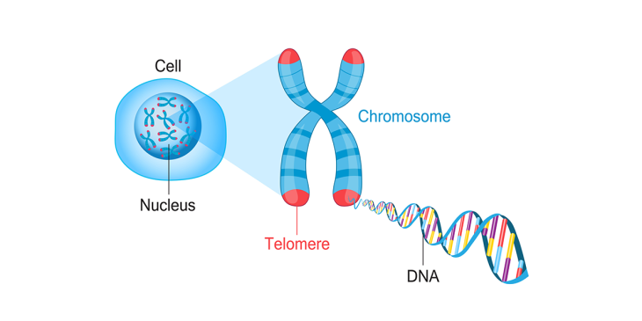
Preconception/prenatal Genetic screening
Prenatal chromosomal screening- offered during pregnancy.
RGCS- Reproductive genetic carrier screening- ideally offered preconception, provides information about the chance of having children with an inherited autosomal or X linked genetic condition.
Can be considered by anyone planning a pregnancy or in early pregnancy.
If someone has child with a genetic condition or a strong family history, then refer to a specialist clinical genetics service.
It is optional.

Slide 5
Three condition RGCS covers- SMA, FXS, CF
Prenatal screening- Trisomy 21, 12, 13, sex chromosome conditions

Slide 6
CF and SMA are autosomal recessive conditions.
For a child to have CF or SMA, both reproductive partners should be carriers for that condition.
If the female is a carrier, the status of the male reproductive partner is required to estimate the chance of having children with the condition.
If both are carriers, there is a 1 in 4 (25%) chance for the foetus to have the condition.
Recommend genetic counselling to discuss reproductive options may include PGT-M using IVF, donor gametes, adoption, fostering, or choosing not to have children.
Reproductive partners may choose to conceive without further testing.
**PGT-M-Preimplantation genetic testing for monogenic/single gene defect

Slide 8
Prenatal result - If both partners are identified as carriers of CF or SMA during the current pregnancy, recommend genetic counselling to inform and support decision-making including the option of invasive and diagnostic testing (CVS or amniocentesis).
If the male reproductive partner declines or is unavailable for screening, discuss options for diagnostic testing.
Implications for blood relatives -Advise carriers that blood relatives also have an increased chance of being carriers- cascade testing.
Limitations- Not all people who are carriers will be detected (it is a risk reduction not a risk elimination screening test)• CF and SMA may arise de novo (rare and complex).

Slide 9
FXS is inherited in an X linked pattern.
The result may have potential health premutation associated with primary ovarian insufficiency(FXPOI) and fragile X associated tremor/ataxia syndrome (FXTAS)
Female carrier -Premutation and full mutation carriers have an increased-chance of having children with FXS.
Male partner screening - Male reproductive partner screening is not required.
Referral to an endocrinologist and/or fertility specialist may assist assessment of FXPOI symptoms, Reproductive options may include PGT-M using IVF, donor gametes, adoption, fostering, or choosing not to have children.
People may choose to conceive without further testing.
Prenatal result - Recommend genetic counselling to discuss options for the pregnancy and support decision-making including the option of invasive diagnostic testing (CVS or amniocentesis).

Slide 10
Foetal anomaly screening
Combined 1st Trimester screen- CFTs
Free BHCG & Papp A :after 10 completed weeks and preferably 3-5 days prior to Nuchal scan.
Nuchal Translucency: 11-13+6 wks
NIPT- greater specificity
Early foetal anomaly scan: can be done as a part of cFTS or at 13-14 weeks (for women who chooses NIPT or declines aneuploidy scan- chorionicity +anomaly detection)
Triple Test: at 15-22 wks, AFP, Oestriol, HCG- not for twins/DM (overall 75% sensitivity)
Diagnostic morphology scan:18-20 weeks
Diagnostic testing:
CVS-11-13 weeks
Amniocentesis: 16-18 weeks

Slide 12
Interpretation of CFTS
Low chance: less than 1 in 300
Intermediate chance: 1 in 300 up to 1 in 1000
Increased chance: more than 1 in 300
If NT greater than 3.5 mm or PAPP-A less than 0.4 MoM or nasal bone is absent/structural anomaly demonstrated= chance of aneuploidy intermediate or increased (i.e. more than 1:300)
CFTS performs better than any single component (e.g. NT alone)
Detects approximately 85% of T21 with a false positive rate of 5%, Limited data for T13&T18 Advantages:- Provides early detection and maximises time for decision-making, USS confirms foetal number, gestation, viability and structural development.
Pre-eclampsia and foetal growth restriction screening can be performed at the same time (adding uterine artery Doppler)
Limitations : Not as accurate as NIPT

Slide 13
NIPT
Screening for -T21 (Down syndrome), T18 (Edwards syndrome) and T13 (Patau syndrome) and Sex chromosome conditions (e.g. monosomy X)
Some NIPT/NIPS may also screen (upon request) for other less common chromosomal variances (at additional cost)
Timing-from 10 weeks gestation (foetal fraction increases with gestation)
Result -reported as increased-chance or low-chance, or no-result.
Higher performance (sensitivity/specificity) compared to CFTS as a screening test.
If ‘no result’ test (no-call result), recommend referral to specialist care as associated with an increased risk of aneuploidy
Advantages : Higher test performance characteristics than alternatives (e.g. CFTS) may mean fewer women require invasive diagnostic procedures, False positive rate (specificity) is age independent (unlike CFTS)
Limitations : Requires enough foetal cfDNA in the maternal blood for analysis, (typically reached after 10 weeks gestation), If foetal fraction is low, may return a false negative or no result, low foetal fraction (less than 4%) increases with increasing maternal weight.

Slide 14
NIPT
Unreliable if H/O organ transplantation/recent whole blood transfusion.
False positive results may occur due to placental mosaicism, co-twin demise and maternal chromosomal variations.
Incurs a financial cost as no MBS rebate.
In multiple pregnancy, the overall foetal fraction is higher but the individual contribution for each foetus is lower, making analysis more complex.
In non-identical multiple pregnancy, result unable to report if a foetal sex or a chromosome condition applies to one or more foetuses.
Can be used as a second-tier screening test before progressing to CVS or amniocentesis in some clinical circumstances.
Discuss implications for foetal sex identification.

Slide 15
Questions?

Slide 16
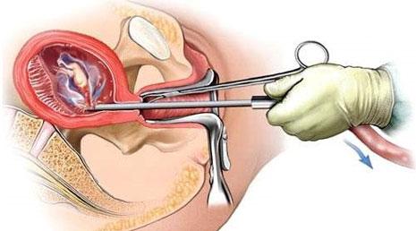
TOP

Slide 17
ToP Act 2018 QLD
Under ToP Act 2018 –termination of pregnancy can be performed by a registered medical practitioner- Less than or equal to 22+0 weeks.
At or after 22+1 weeks – If the medical practitioner considers that, in all circumstances, the termination should be performed and the medical practitioner has consulted with another medical practitioner who considers that, an all the circumstances, the termination should be performed after considering current and future physical, psychological and social circumstances of women requesting it.

Slide 18
MTOP pathway
Patients have to be in our catchment area.
All TOPs below 16 weeks are referred to external providers by either self referral or GP-
We facilitate MTOP after 16 weeks until 24 weeks.
Early TOPs with financial hardships can be funded by the hospital.
Referral comes to NUM- bereavement midwife contacts patient and made them aware of the appointment.
Social TOPs after 22 weeks are seen by social workers, 2 consultants need to approve, psychology review is considered, then goes to RBWH for feticide and again comes back to our service for further care.

Slide 19
Obtaining consent
Mental Health condition/illness- Capacity assessment is necessary from a psychiatrist. If no capacity- consult legal services, consent must come from court or QCAT.
Minor-under 14- determine Gillick competency.
If competent- pt van give consent.
If not- parent can consent.

Slide 20
Conscientious objection
If a registered practitioner has conscientious objection to the performance of the termination or providing advice about termination, then the registered health practitioner has a legal obligation to -
Inform the patient of the conscientious objection.
Refer the patient to another staff member in their discipline, who does not have the objection.

Slide 24
NGO provider information
Abortion Online
Children by Choice For counselling, information and referral Phone 1800 177 725 Queensland-wide
Marie Stopes Brisbane, for a surgical or medical ToP Phone: 1300 323 197
True Relationships Ipswich, for a medical ToP Phone (07) 3281 4088

Slide 25
Options Clinic True Relationships & Reproductive Health SkyArch Medical clinic MSI Brisbane Abortion & contraception clinic

Slide 26
Cost of TOP
People with Health Care Card- Your starting price is $740
People with Medicare Card-Your starting price is $775
People without Medicare-Your starting price is $1,185
Insertion of LRAC (Implanon, Mirena, Depot-provera)
is free with surgical abortion-BYO

