Slide 1
Neonatal day 7 Assessment
Dr John Waugh

Slide 2


Acknowledgement of Traditional Owners
I would like to acknowledge and pay my respects to the Jagera (jag-er-a), Yuggera (yug-er-a) and Ugarapul (U-ga-ra-pul) Peoples, the Traditional Owners and Custodians of the land on which we are meeting today and recognise their continuing connection to land, waters and community.
I would like to pay my respects to elders’ past, present and emerging.

Slide 3
Neonatal assessment on Day 7
Evolving issues
  hydration and feeding.
  Jaundice
New detectable diagnoses
  Congenital heart disease
  Cholestasis (conjugated hyperbilirubinaemia)
Things missed at discharge from hospital.
  Colobomas, genitals, soft palate clefts, erb’s palsy, feet.

Slide 4
Hydration, feeding and jaundice
Cochrane review 2021 of the effect of early postnatal discharge showed moderate certainty evidence for increased rate of readmission for Jaundice, dehydration, infections within the first 28 days (RR 1.59).
Risk is likely reduced by postnatal home visiting by a midwife.
Day 7 check safety net.
Early intervention reduces severity for jaundice and dehydration.

Slide 5
Hydration and feeding
Dehydration in neonates is difficult to detect on examination.
  Dry mouth, sunken fontanelle but unreliable.
  History of feeding, output, state of alertness, weight are more reliable.
Output – stool or urine 4 times per day plus overnight.
Weight – 10 % loss from birth is “consider action” line but decide if rising or falling weight. Intervene if falling.

Slide 6
Dehydration
Breast feeding assessment of intake requires assessment of feeding behaviour and milk supply.
Babies may attempt to feed vigorously but get nothing.
Decide how you will assess supply
  Did the breasts fill postnatally – period of engorgement.
  Is there a feeling of let down?
  Is there leaking of milk from the opposite breast during feeding?
  Do the breasts fill and empty with feeds?
  Does the baby feed with swallowing and good suck?

Slide 7
Dehydration
Assess severity – weight/output/examination +/- serum sodium. Hypernatraemic dehydration is common in newborns. Sodium > 145 – refer to ED
If very concerned – send to ED. Readmission due to dehydration + jaundice is common.
Engage lactation expert early – child health/home midwife service/private LC.
Lactation support medication – metoclopramide 10 mg tds

Slide 8
Dehydration
Top up feeding – avoid if possible and rely on LC advice if available.
If continuing loss despite LC input or LC unavailable + >10% weight loss and ongoing concern commence 80ml/kg/day (1/2 quota and enough to meet fluid requirement) post breast feeds 4 hourly.
Multiple risks including reduced lactation, mastitis, nipple confusion and breastfeeding failure.

Slide 9
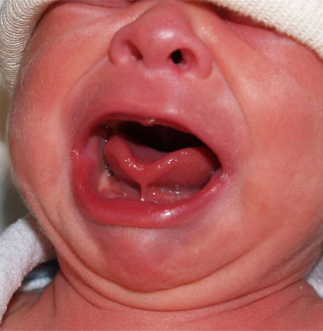
Tongue tie
Release can make a dramatic difference to infant feeding and maternal pain with feeding.
Anatomy has weak correlation with functional impact.
Sometimes release gives no improvement.
Controversial area for diagnosis and approach to management.
Refer to speech therapist/feeding clinic and then to paediatric surgeon.

Slide 10
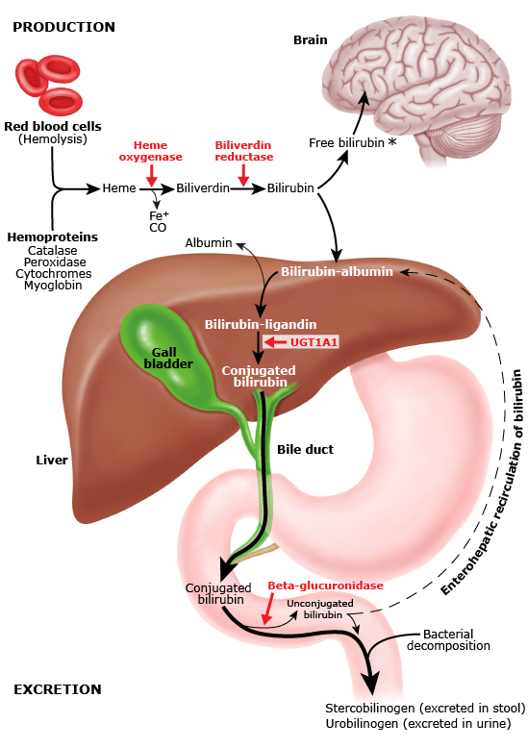

Slide 11
Jaundice at 7 days
Common, probably 50% of term infants.
Unconjugated bilirubin rise due to
  High turnover of red cells in newborn
  slow onset of glucaronyl transferase activity
  Enterohepatic bilirubin circulation in neonates

Slide 12
Unconjugated hyperbilirubinaemia
Bilirubin Induced Neurological Disorders (BIND) (acute and chronic disorders of vision, hearing and movement (cerebral palsy)) = Kenicterus
Acute BIND = 0.4-1.0 per 100,000. Chronic BIND 0.4-2.3 per 100,000.
Rare but most severely affected in rich countries are related to late presentation due to social disadvantage and social isolation not severe haemolytic disease.

Slide 13
Jaundice at 7 days
Treatment graphs are complex.
Cutoff for phototherapy > 5 days old without risk factors (haemolysis, sepsis, acidosis, asphyxia) –
  350 uM/l for infants born >38 weeks
  300 uM/l for infants born 35-37⁶ weeks
With risk factors
  300 uM/l for infants born >38 weeks
  250 uM/l for infants born 35-37⁶ weeks
Call the paediatric registrar if any doubt!
No evidence for safety or effect of indirect sunlight.
Google “maternity and neonatal guidelines QLD”

Slide 14
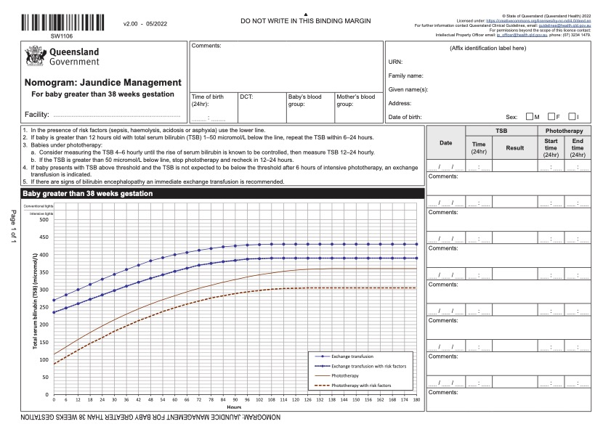
Jaundice at 7 days

Slide 15
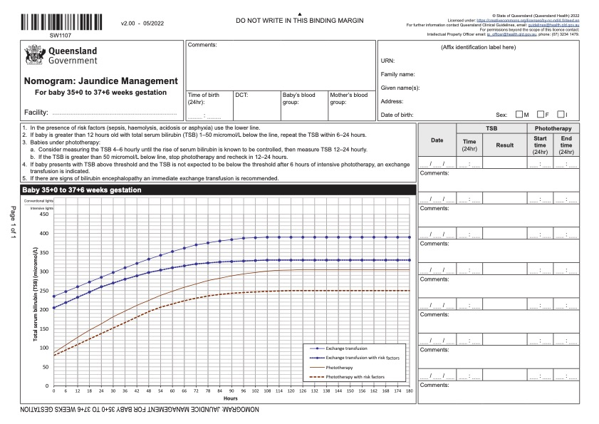

Slide 16
Flash Bilirubinometer
Accurate in range 150-250 only
Useful for serial measurement to see trend.
Not usable if baby has had phototherapy.
Useful to suggest if a blood test is required for bilirubin.
Cost around $7500

Slide 17
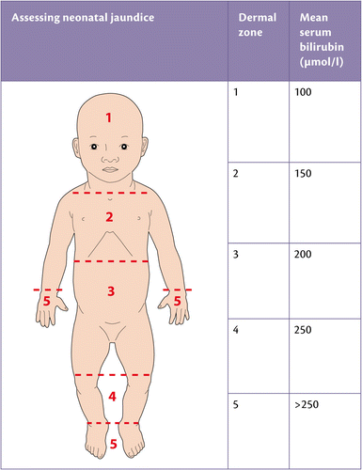
Kramer’s rule
Limited accuracy
Useful screen – jaundice to thighs is likely > 200

Slide 18
New diagnoses
(not reliably detectable at discharge)
Cholestatic Jaundice
Congenital Heart Disease

Slide 19
Conjugated hyperbilirubinaemia = Cholestatic Jaundice
Common neonatal jaundice is unconjugated (also termed Indirect bilirubin)
Conjugated hyperbilirubinaemia is always pathological, and usually very serious if a new discovery.
Conjugated hyperbilirubinaemia will still be mainly unconjugated bilirubin. Always look at the conjugated as well as the total.
Conjugated hyperbilirubinaemia = > 20% of total bilirubin or > 20 uM/l conjugated. (multiple definitions)
  Total bilirubin 80 and conjugated 19 = abnormal
  Total bilirubin 320 and conjugated 18 = normal
  Total bilirubin 320 and conjugated 30 = abnormal
Laboratory normal values won’t help. Call if unsure.

Slide 20
Conjugated hyperbilirubinaemia
Differential diagnosis:
  Biliary atresia – better prognosis with early surgery.
  UTI
  Hypothyroidism
  Neonatal hepatitis (infectious, autoimmune)
  Congenital syndromes eg Alagille (intrahepatic paucity of bile ducts)
  Metabolic disorders
  TRCH infections
  Syphilis and other infections.

Slide 21
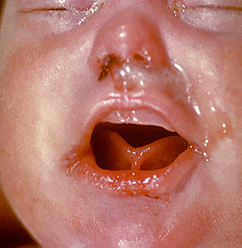
Syphilis – Easy to miss!
Snuffles
Chest infection/pneumonia
Hepatomegaly
Poor growth
Fevers
Eye – cataract, retinitis,
Rectal bleeding
Nephrotic syndrome
Sepsis from other organisms.
Painful osteitis – limb pain.

Slide 22
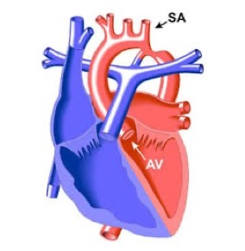
Congenital Heart Disease
Left to right shunts (VSD)
Coarctation of the aorta
Cyanotic Heart Disease

Slide 23
Congenital Heart Disease
Requires an oximeter for neonates.
Left to right shunt murmurs (VSD) not audible < 48 hours and rely on 7 day examination.
  Pulmonary vascular resistance high over first 48 hours, results in high right side blood pressure, equal to left and so no shunt across VSD therefore no murmur.
  As PVR falls, right heart pressure falls and left to right shunt commences with murmur.
  PVR continues to fall for 6 weeks, so increasing shunt and CCF develops > 6 weeks.

Slide 24
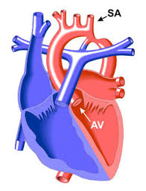
Coarctation of Aorta
Ductus arteriosus maintains circulation initially.
Closing duct abolishes alternative blood pathway and as the duct contracts it makes the coarctation worse.

Slide 25
Coarctation of the aorta
Requires an oximeter for neonates.
May be no signs while Ductus Arteriosus is open = Patent Ductus Arteriosus (PDA)
As PDA closes the coarctation obstruction may be increased and the alternate pathway through the duct is closed and the shortening fibres in the duct increase the coarctation.
Femoral pulses may be present at discharge and disappear by the 7 day check.
Critical diagnosis prior to deterioration to improve outcome.
Absent or weak femorals, active praecordium +/- murmur, may have reduced post ductal sats.

Slide 26
Cyanotic Heart Disease
Requires an oximeter for neonates.
Will probably not appear cyanotic at 7 day check. You cannot pick the colour of 90% vs 98%.
All babies have pre and post ductal sats recorded at discharge (right hand vs foot).
Right to left shunts may become more apparent over days, and the 7 day check is critical for early diagnosis.
Pre ductal saturation (right hand) should be 95% or better.
Post ductal saturation (either foot) should be 95% or better.
Difference between pre and post ductal should be <3% (so R hand 99% and foot 95% is abnormal, repeat in 1 hour)

Slide 27
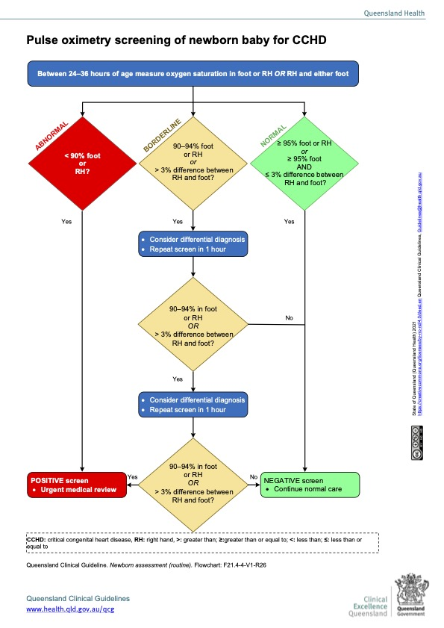

Slide 28

Stuff we get wrong
(oops)
Colobomas
Cleft Soft Palate
Erb’s palsy
Minor hypospadias and chordee
Mild but significant positional talipes

Slide 29
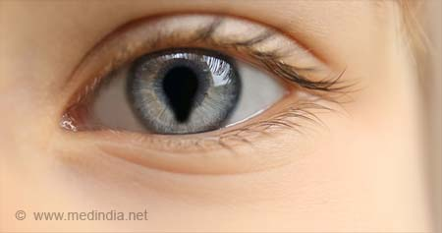
Coloboma

Slide 30
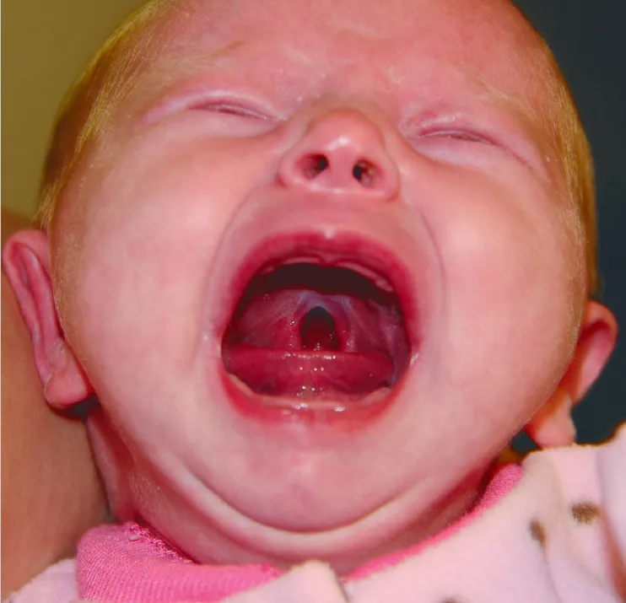
Posterior cleft soft palate

Slide 31
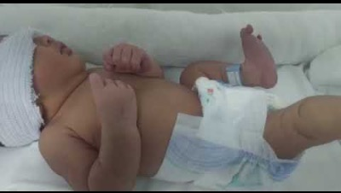
Erb’s Palsy - 15 – 40 sec 1:50 – 2:15

Slide 32
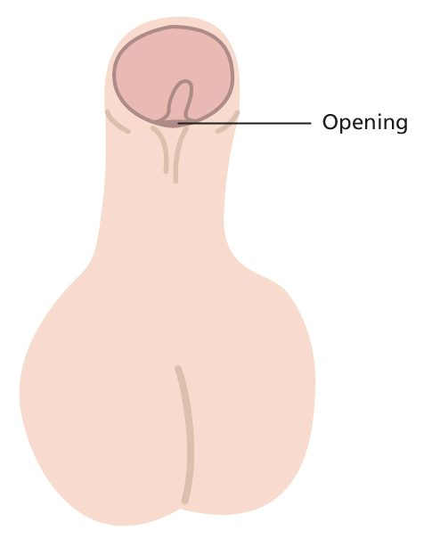
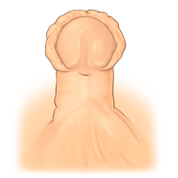
Mild hypospadias
May need surgical correction, depending on location of meatal orifice.

Slide 33
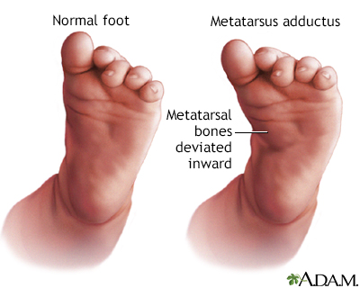
Metatarsus Adductus (Varus)

Slide 34
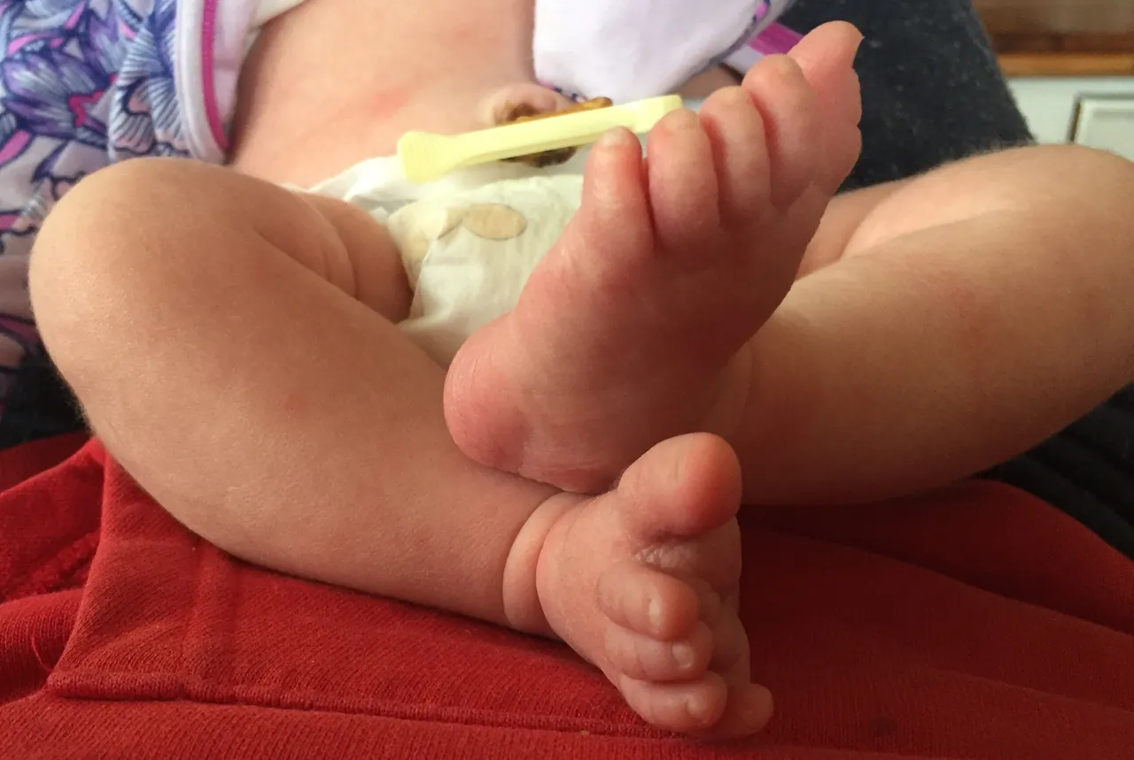
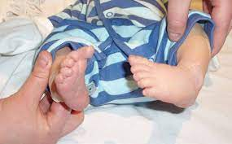
Positional talipes

Slide 35


