Slide 1
Melanoma.
Diagnosis to treatment
Dr Damian Fry
General Surgeon
Melanoma surgeon
Australia’s National Cancer

Slide 2
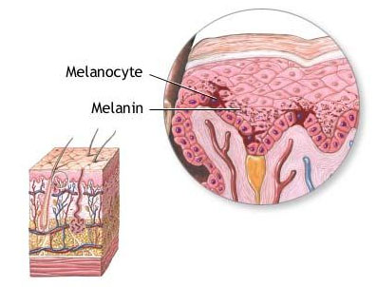
What is Melanoma?
Skin cancer arising from melanocytes
High potential for metastasis
Function of melanocytes is provide pigment to skin hair and eyes
Provides some protection against UVA/UVB rays

Slide 3
Melanoma Statistics in Australia
18,257 cases in 2023
1,340 deaths expected in 2024
The age-standardised incidence rate for melanoma increased by 120% between 1982 and 2019, from 29.UVU6 to 65 cases per 100,000 person
Melanoma is the most common cancer among Australians aged 20 to 39.

Slide 4
Risk Factors
UV exposure
UV apps on all phones 1-2
Governments provide little legislation over shade to be provided in public spaces
Fair skin, light eyes
Family history

Slide 5
Importance of Early Detection
90% curable if detected early
ABCDE self-examination
Use your smart phone – create a folder and discuss with your GP
New lumps and bumps especially neck/groin/axilla

Slide 6
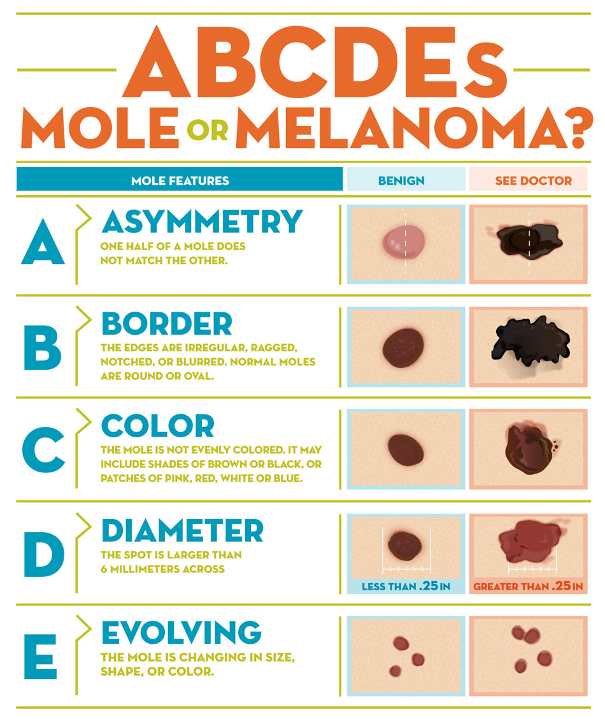

Slide 7
Diagnosis
Dermoscopy
Advanced imaging - Vectra
Excisional biopsy
SLNB for staging

Slide 8
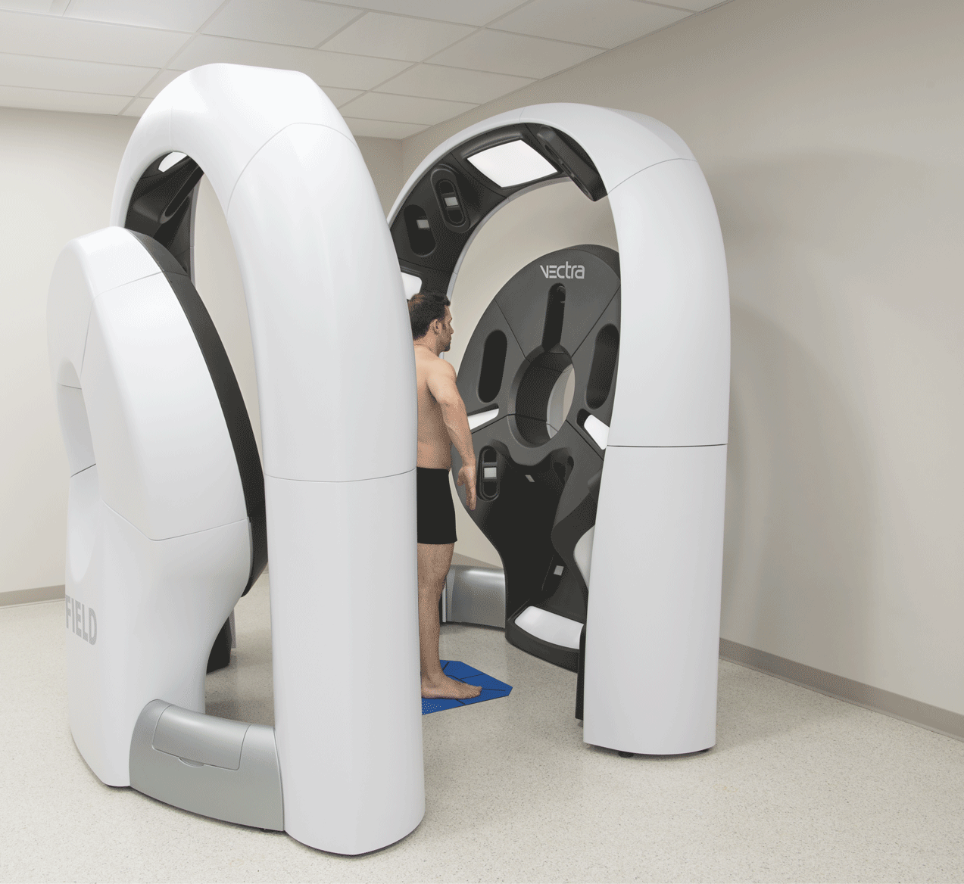
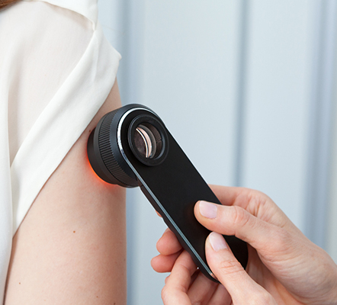

Slide 9
Surgical Treatment
Wide Local Excision (WLE)
Sentinel Lymph Node Biopsy (SLNB)
Regional dissection
    Axillary clearnce
    Groin dissection
    Neck dissection

Slide 10
Recommended Surgical Margins
Based on the Breslow thickness of the melanoma:
• In situ melanoma: 0.5–1.0 cm margin
• Melanomas ≤1 mm thick: 1 cm margin
• Melanomas 1.1–2 mm thick: 1–2 cm margin
• Melanomas >2 mm thick: 2 cm margin

Slide 11
Sentinel Lymph node biopsy
MLST-1
• Disease-Free Survival (DFS): The study found that patients with intermediate-thickness melanomas (1.2 to 3.5 mm) who underwent SLNB had a higher 10-year DFS rate compared to those in the observation group (71.3% vs. 64.7%). For patients with thick melanomas (>3.5 mm), the 10-year DFS was also higher in the SLNB group (50.7% vs. 40.5%).
aacrjournals.org
• Melanoma-Specific Survival (MSS): Overall, there was no significant difference in 10-year MSS between the SLNB and observation groups. However, among patients with intermediate-thickness melanomas who had metastases detected via SLNB and subsequently underwent CLND, there was an improvement in MSS compared to those who had nodal observation and later developed nodal metastases.

Slide 12
Magseed vs Hook Wire
More accurate
Less discomfort
Precise localisation
Improved surgical work flow
Reduced pain and discomfort
Better cosmesis
Multiple lesions
    Pacemakers
    Specialised expensive equipment and seeds

Slide 13
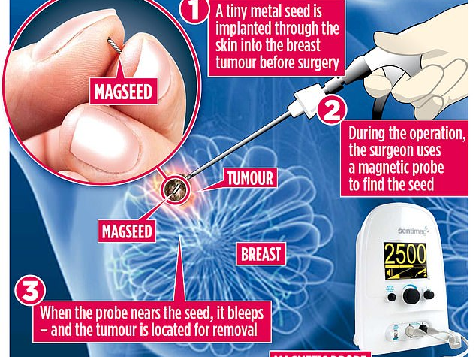

Slide 14
Biodegradable Temporising Matrix (BTM)
Used in reconstruction post-surgery
BTM (Biodegradable Temporising Matrix) is a synthetic dermal scaffold used in reconstructive surgery to promote wound healing in cases of full-thickness skin loss, such as burns, trauma, and surgical excisions. It provides a temporary dermal substitute, allowing neovascularization before definitive closure with a skin graft.

Slide 15
Advantages of BTM
Advantages of BTM
✔ Avoids need for autografts in the first stage, reducing donor site morbidity.
✔ Promotes neodermis formation, improving graft take and reducing contracture risk.
✔ Minimizes infection risk due to its closed-cell polyurethane structure.
Proper adherence to these steps ensures optimal wound healing, graft success, and functional skin restoration.

Slide 16
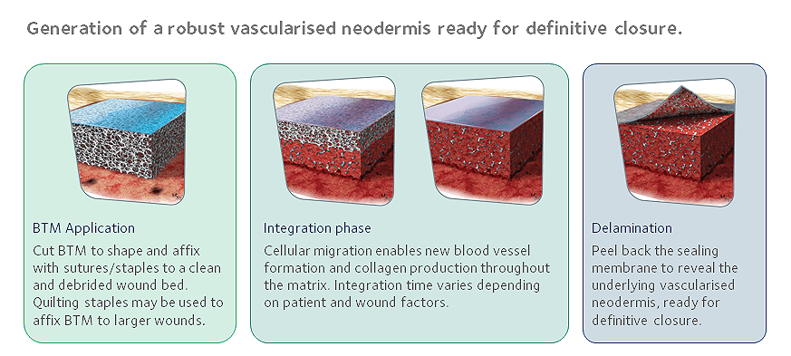

Slide 17
MLST-2 Trial Findings
MLST-2
• Survival Rates: There was no significant difference in melanoma-specific survival between the CLND and observation groups. This indicates that immediate CLND did not provide a survival advantage over observation with regular monitoring.
targetedonc.com
• Disease Control: The CLND group had a lower rate of regional lymph node recurrence compared to the observation group, suggesting better regional disease control. However, this did not translate into improved overall survival.
ascopost.com
• Morbidity: Patients undergoing CLND experienced higher rates of complications, particularly lymphedema, with 24% in the CLND group versus 6% in the observation group.

Slide 18
SWOG Melanoma Trial Overview
SWOG S1801 Trial:
• Objective: Assess the impact of administering pembrolizumab before surgery (neoadjuvant) followed by continued therapy after surgery (adjuvant) versus pembrolizumab only after surgery in patients with resectable stage IIIB-IV melanoma.
• Findings: The neoadjuvant–adjuvant approach led to a higher major pathologic response rate, with over 50% of patients achieving significant tumor reduction before surgery. This strategy also improved event-free survival compared to the adjuvant-only approach.

Slide 19
NADINA Melanoma Trial Overview
The NADINA trial is a phase III clinical study that evaluated the efficacy of neoadjuvant (pre-surgery) immunotherapy in patients with resectable, macroscopic stage III melanoma. The trial compared two treatment approaches:
• Neoadjuvant Arm: Patients received two cycles of ipilimumab plus nivolumab before surgery, followed by response-driven adjuvant therapy.
• Adjuvant Arm: Patients underwent surgery first, followed by 12 cycles of adjuvant nivolumab.

Slide 20
NADINA Trial Methodology
• Event-Free Survival (EFS): The neoadjuvant approach resulted in a significantly higher EFS rate. At 12 months, 83.7% of patients in the neoadjuvant arm were event-free, compared to 57.2% in the adjuvant arm.
• Distant Metastasis-Free Survival (DMFS): At 18 months of follow-up, the neoadjuvant arm demonstrated a DMFS rate of 85.7%, indicating a lower incidence of cancer spreading to distant sites.
• Pathologic Response: A significant proportion of patients in the neoadjuvant arm achieved a major pathologic response, with some able to avoid further adjuvant therapy, thereby reducing overall treatment duration.

Slide 21
NADINA Trial Findings
The NADINA trial's findings suggest that administering ipilimumab plus nivolumab before surgery, followed by response-based adjuvant therapy, offers superior outcomes compared to the traditional approach of surgery followed by adjuvant therapy. These results support the adoption of neoadjuvant immunotherapy as a new standard of care for patients with resectable stage III melanoma.

Slide 22
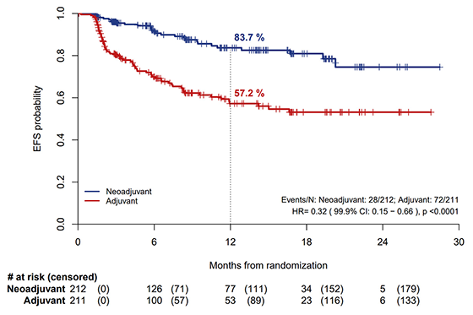

Slide 23
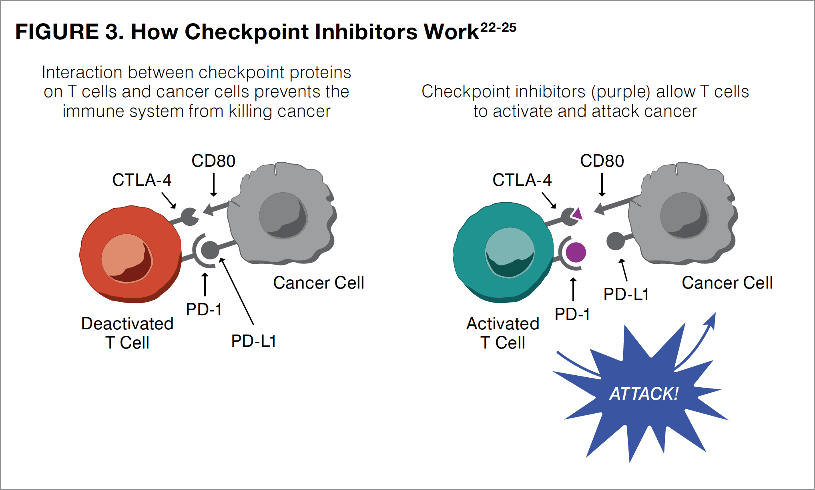

Slide 24
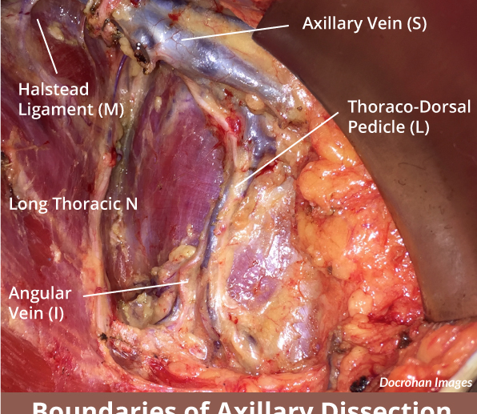
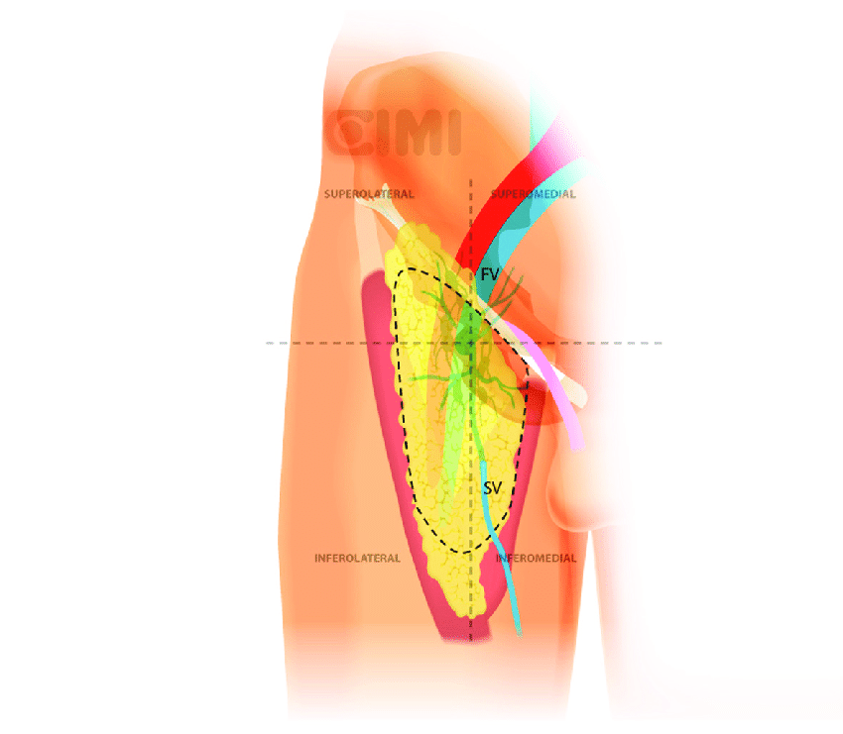

Clearance is it a dying art

Slide 25

Prevention Strategies
Slip, Slop, Slap campaign

Slide 26
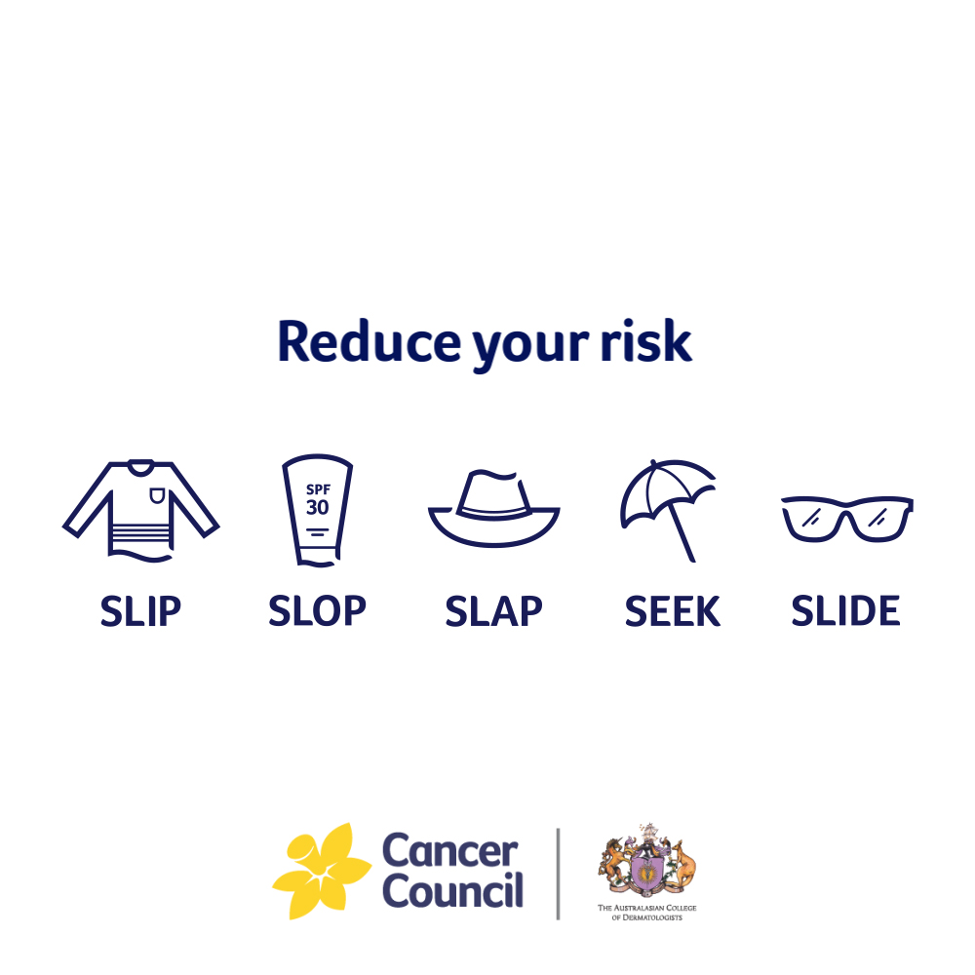

Slide 27
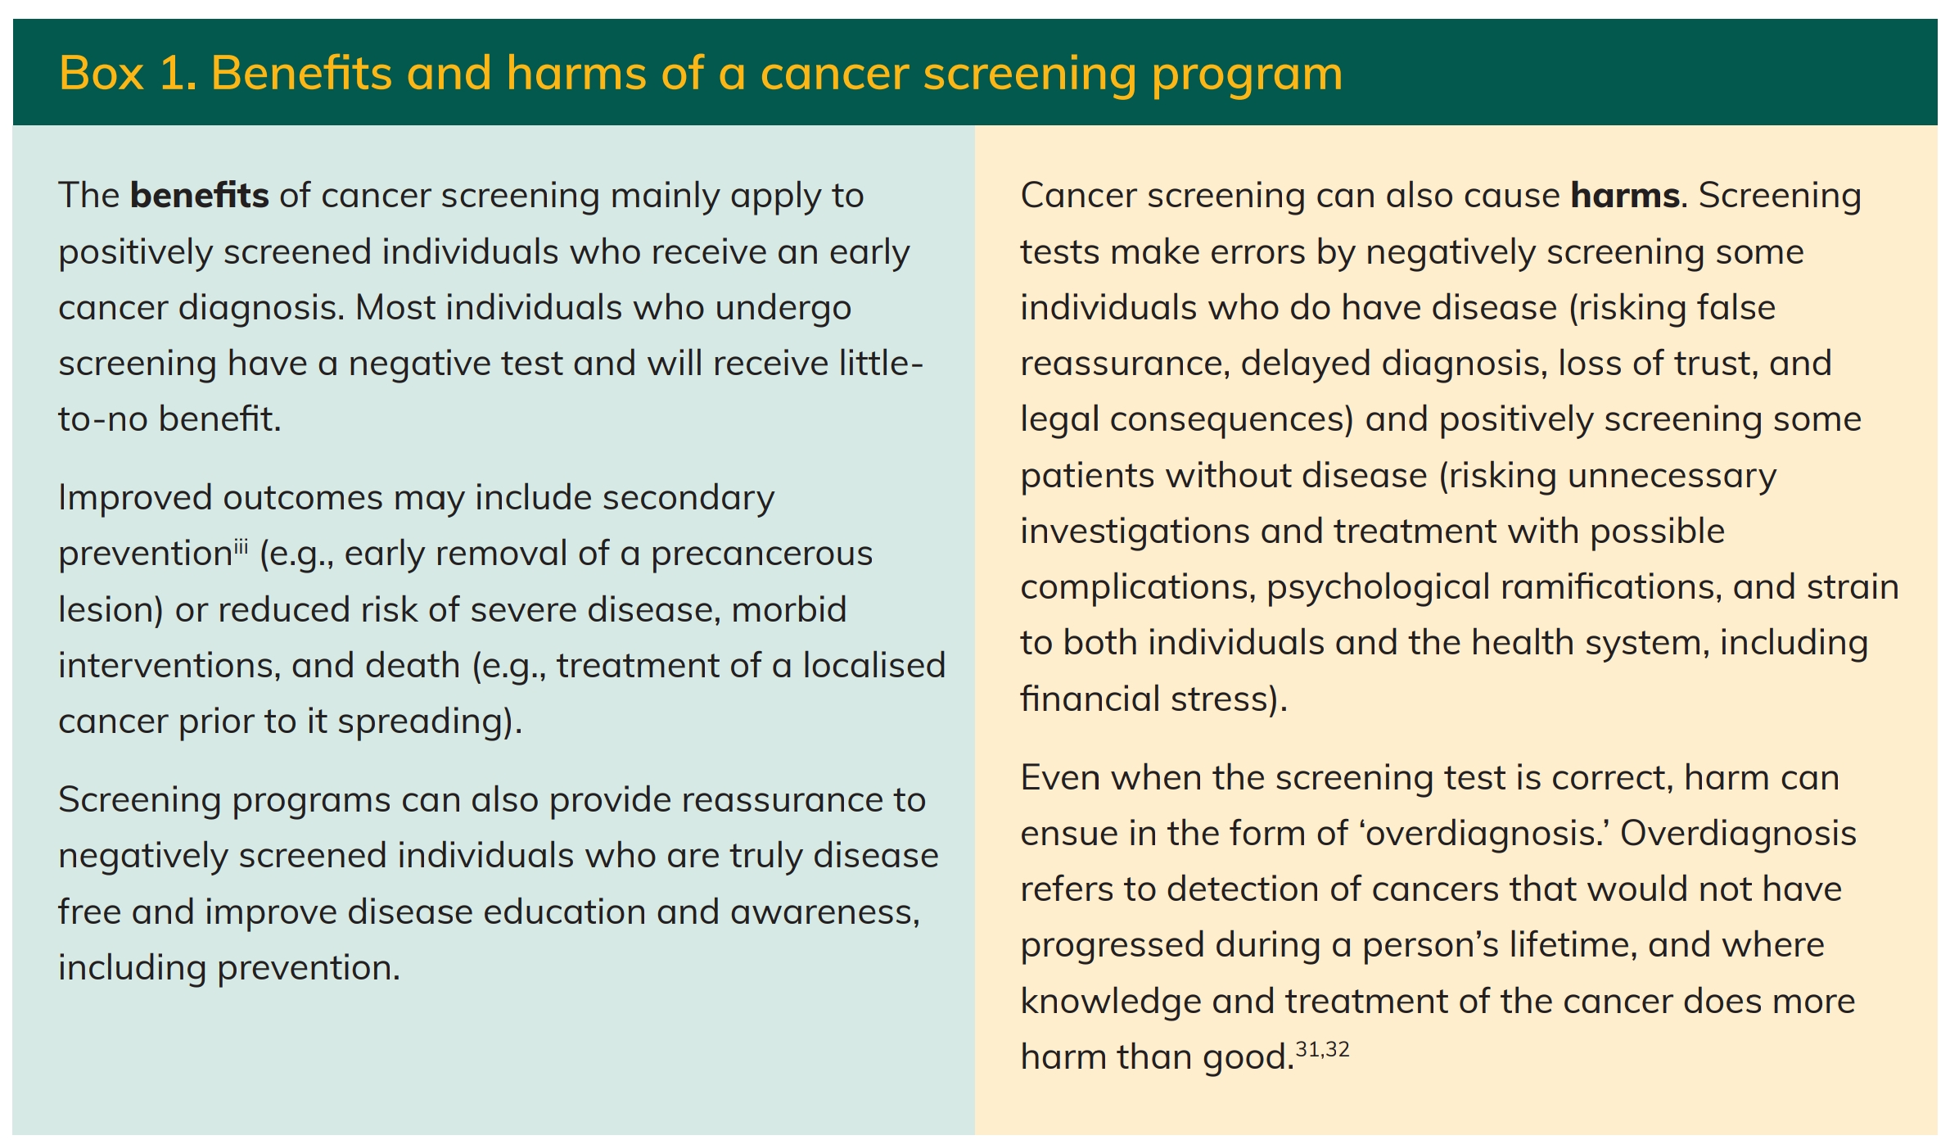
Melanoma Screening

Slide 28

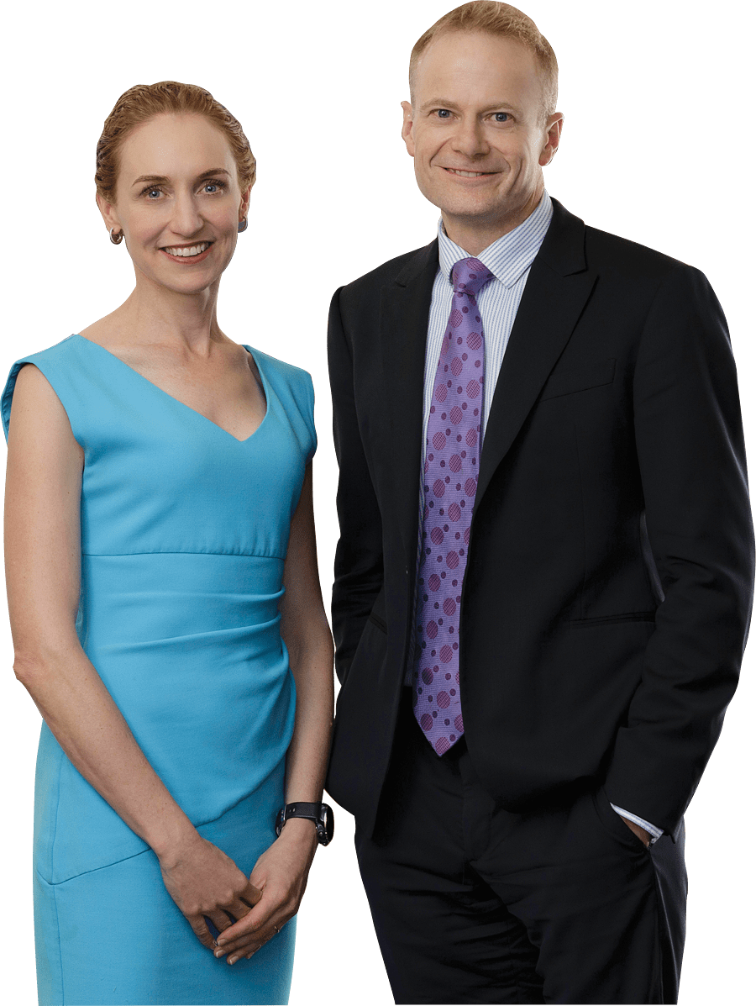

Slide 29
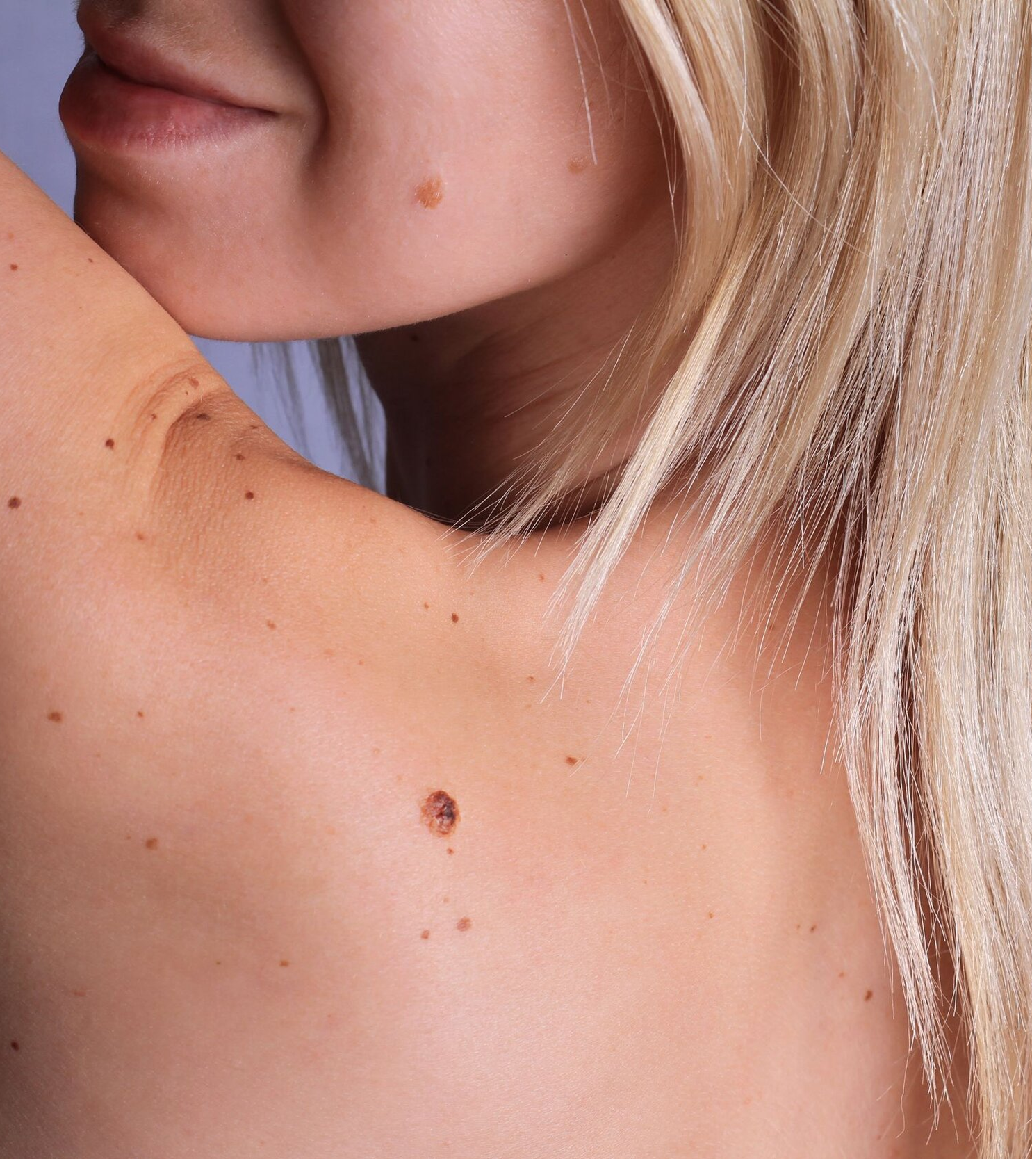
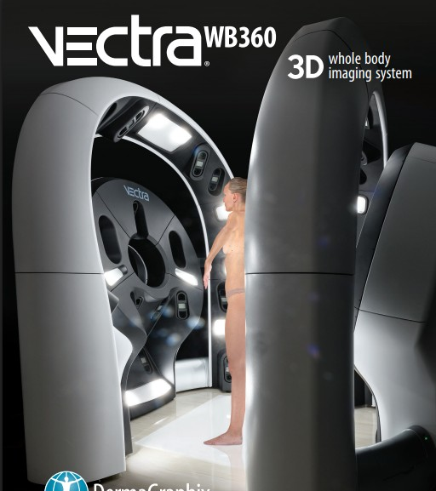
Darling Downs Melanoma Clinic
Coming Soon to Toowoomba Featuring Vectra WB360 imaging

Slide 30
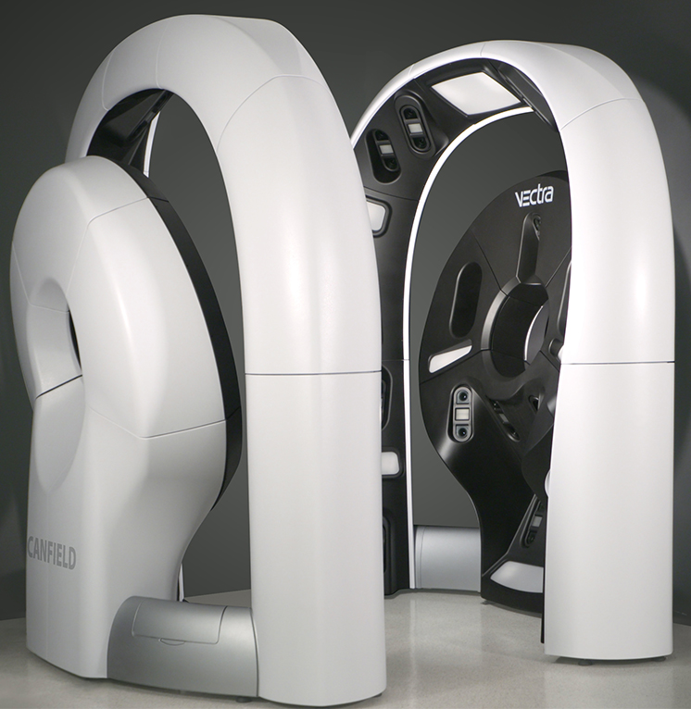
Vectra WB360
Whole body 3D imaging system
Captures entire exposed skin surface in macro quality resolution with single capture
92 high resolution cameras that flash simultaneously with cross-polarised light

Slide 31
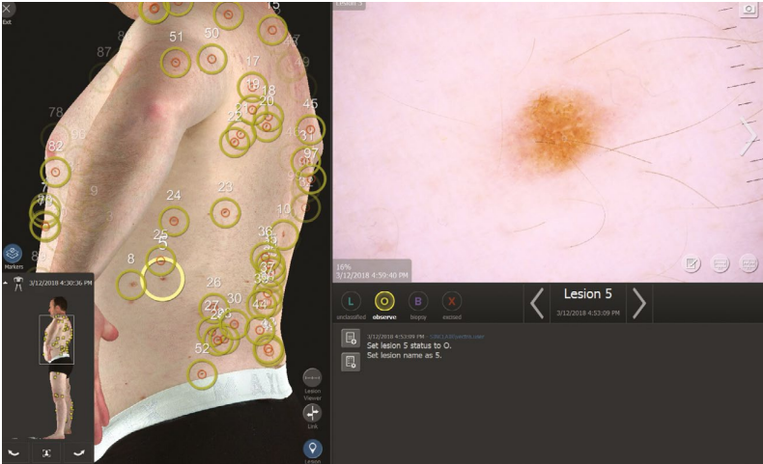
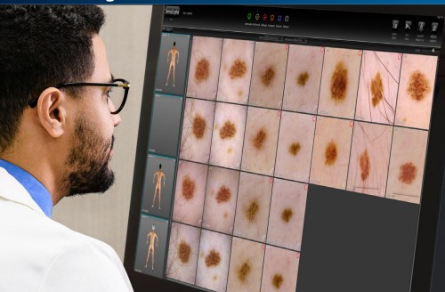
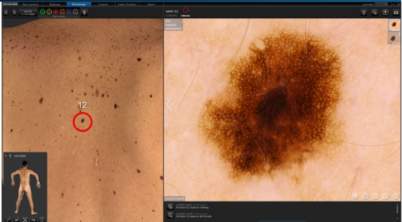
Vectra WB360 combines advanced 3D imaging and AI technology to create a full-body avatar, enabling precise mapping of moles and lesions with high-resolution accuracy.

Slide 32
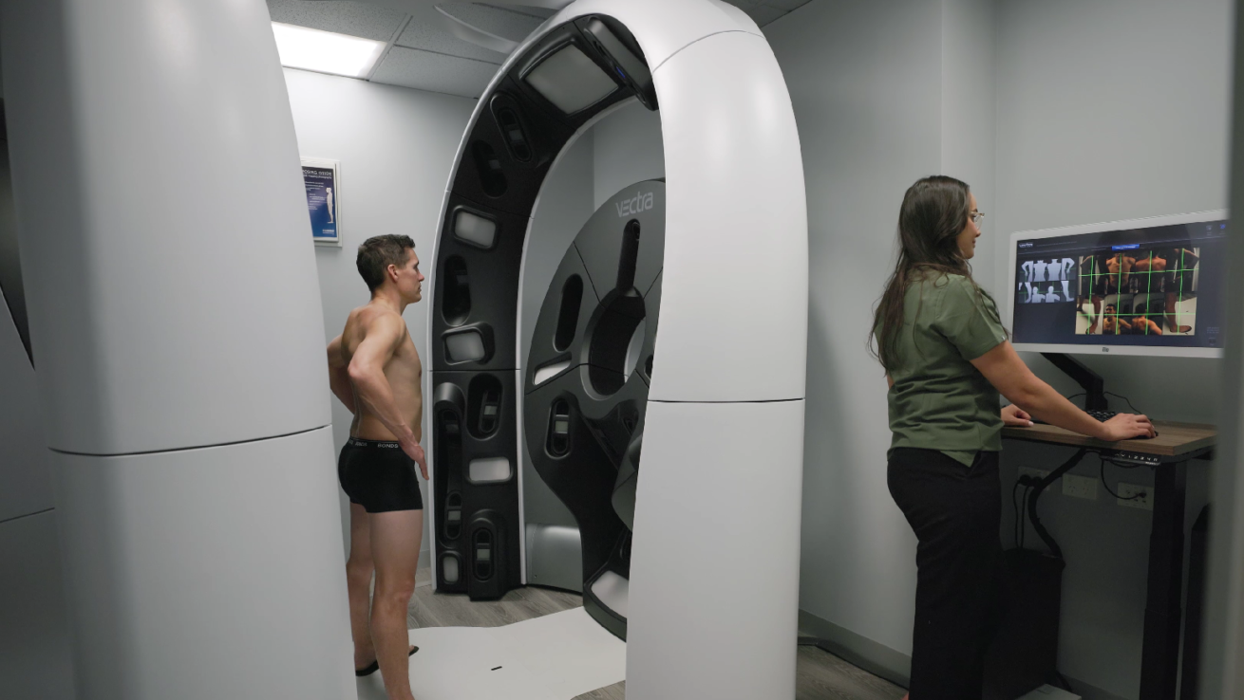
What it means to your General Practice?
No referral required
Improved diagnostic accuracy
Tracks subtle morphological changes over time
All scans stored securely with comprehensive reports with flagged lesions available to GPs

Slide 33
Melanoma Nurse Program- Toowoomba Base Hospital

Slide 34
Who am I
Registered Nurse for 9 years- predominantly in medical oncology and haematology
Previously worked The Princess Alexandra Hospital, Brisbane and The Royal Marsden, London
Grew up in Rural Queensland

Slide 35

National Melanoma Nurse’s Program
Federally funded role to support 30 Full Time Equivalent melanoma nurses by 2025-26
The National Melanoma Nurses Program is an initiative aimed at improving care and outcomes for melanoma patients in Australia through expert nursing care as part of the multidisciplinary team
Commenced in the role August 2024

Slide 36
National Melanoma Nurse’s Program
The program is focused on developing nursing skill and capability to provide expert nursing care to patients with complex clinical care needs.
Patients will be able to receive personalised nursing care, education on melanoma and treatment options and support throughout the pre- and post-surgical period, neoadjuvant and adjuvant therapy, radiotherapy, and advanced melanoma therapy.
Notes:
Nurses have been recruited in hospitals across Australia and receive training to provide specialised nursing care, education and support to patients with high-risk or advanced melanoma.

Slide 37
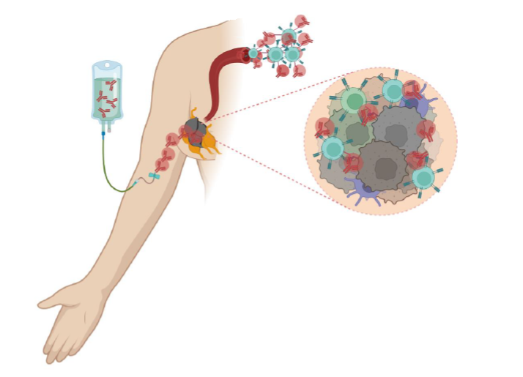
Medical Oncology Component
Review patients at oncology OPD and treatment
Complete mid cycle toxicity checks on patients
Problem solve any adhoc issues that may come up for patients
Point of contact at the hospital
Endeavour to keep oncology patients out of emergency department's- can toxicities be managed as an outpatient ?

Slide 38

Melanoma Clinic Surgical Component
Review all melanoma referrals
Complete MIA SLNBx calculator
Meet new melanoma patients in the melanoma clinic once a fortnight
Provide education around procedure, administrative tasks such as patient travel, sentinel lymph node biopsy procedure
Post Operative wound reviews - BTM, skin grafts, complex wounds

Slide 39
Summary of Key Points
Early detection
Prompt biopsy
Surgical assessmment
    WLE / SLNBx – Node Picking
Staging
MDT review
Follow up
Support
Research.

Slide 40
Q&A
Discussion and questions

