Slide 1
Diabetes, syphilis, pre-term birth & mortality
Lilantha Wedisinghe
FRANZCOG, FRCOG, MRCPI, MBBS, DFSRH, MMEd, PhD, CCT (UK)
Senior Staff Specialist in O&G, Ipswich Hospital
WM Maternity Symposium 2024

Slide 2
GDM vs DIP
Gestational diabetes mellitus (GDM) is:
• Glucose intolerance first recognised in pregnancy
• Usually resolves postpartum
Diabetes in pregnancy (DIP) if:
• Glucose level high enough to be diabetes mellitus diagnosis outside pregnancy
• Does not usually resolve postpartum

Slide 3
Prevalence of GDM
• In 2018 incidence: Australia14% (1 in 7)
• Rate has tripled since 2000–2001
• Incidence increases with socio-economic disadvantage
  (21% v 13%)
• In 2016/2017
  ◦ 32% required insulin
  ◦ 8% required metformin

Slide 4
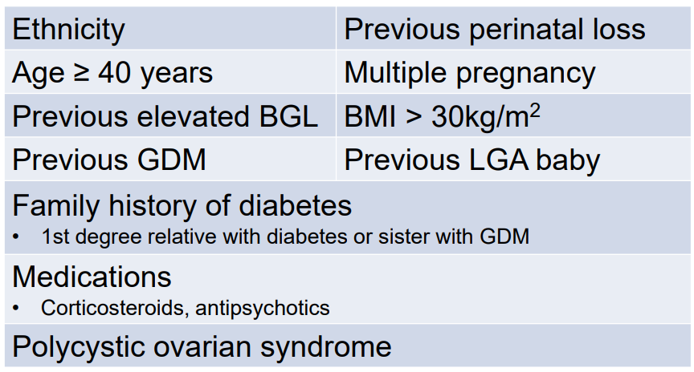
Risk factors

Slide 5
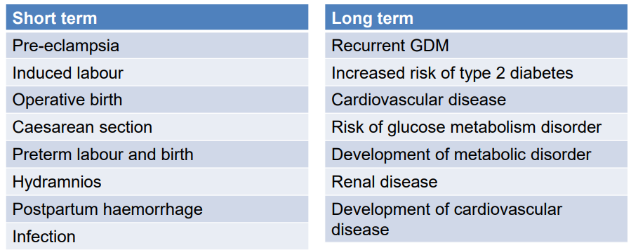
Maternal risks

Slide 6
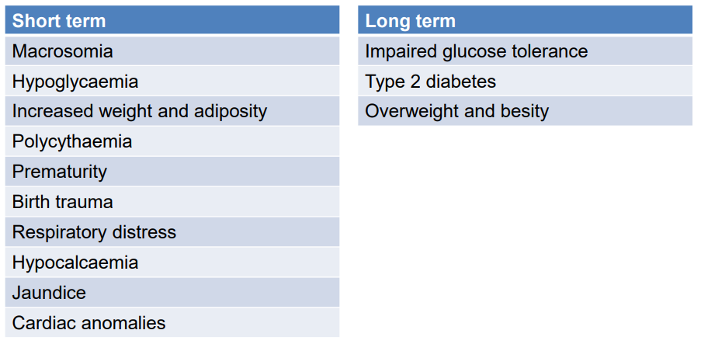
Fetal and baby risks

Slide 7
Screening
• If risk factors:
• OGTT (75 g) (or HbA1c) in first trimester with first antenatal bloods
• If normal, repeat OGTT at 24–28 weeks’ gestation
If no risk factors (and not diagnosed with GDM):
• OGTT at 24–28 weeks’ gestation
Alternatives:
Fasting plasma glucose and HbA1c
If HbA1c greater than or equal to 48 mmol/mol (6.5%), or fasting BGL is greater than or equal to 7.0 mmol/L, treat woman as if has type 2 diabetes

Slide 8
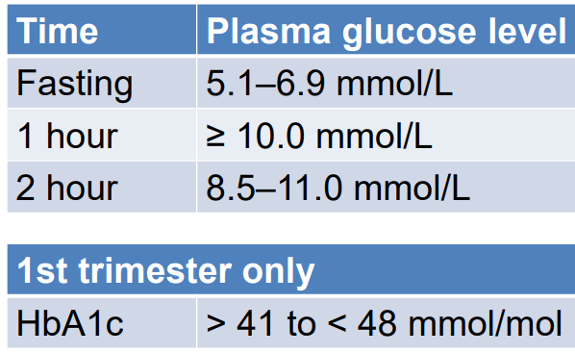
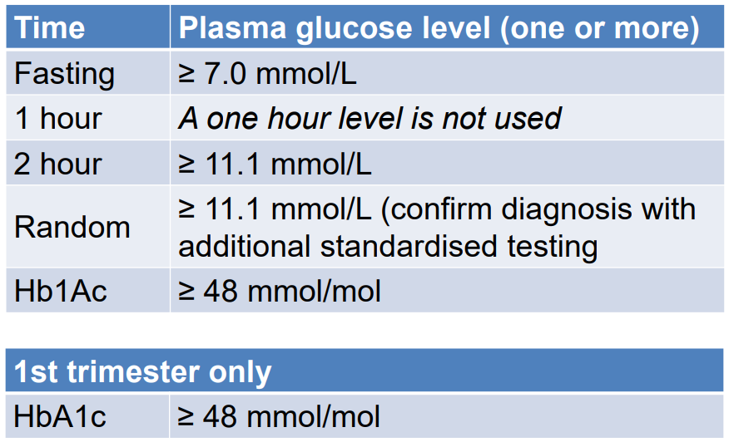
Diagnosis
GDM
DIP

Slide 9
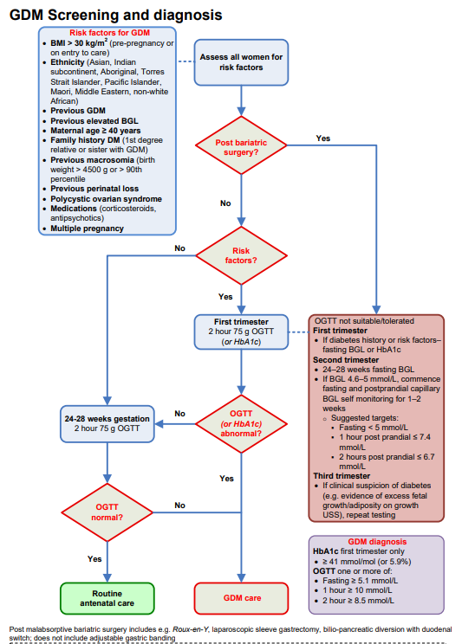
Diabetes in pregnancy

Slide 10
Treatment
• monitor sugar control, fetal growth and wellbeing
Deliver when indicated
  • diet controlled with no issues – no intervention
  • metformin – 39 weeks
  • insulin – 38 weeks
  • treated type 1 and 2 with complications – 37 weeks or less

Slide 11
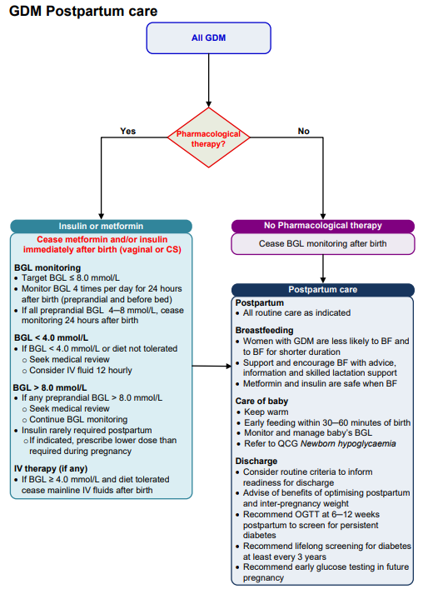
Postpartum

Slide 12
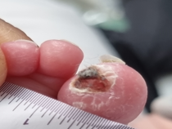
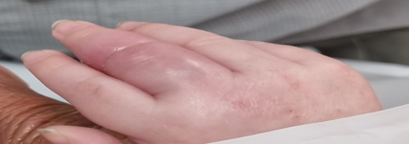
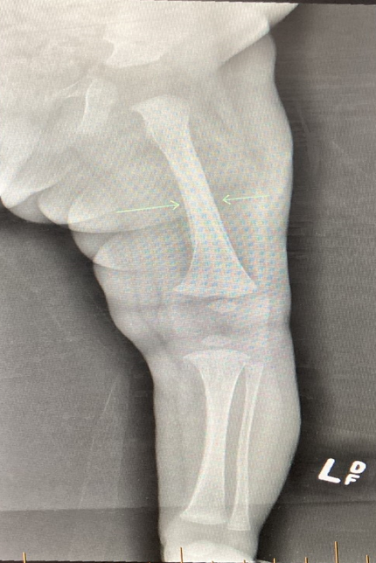
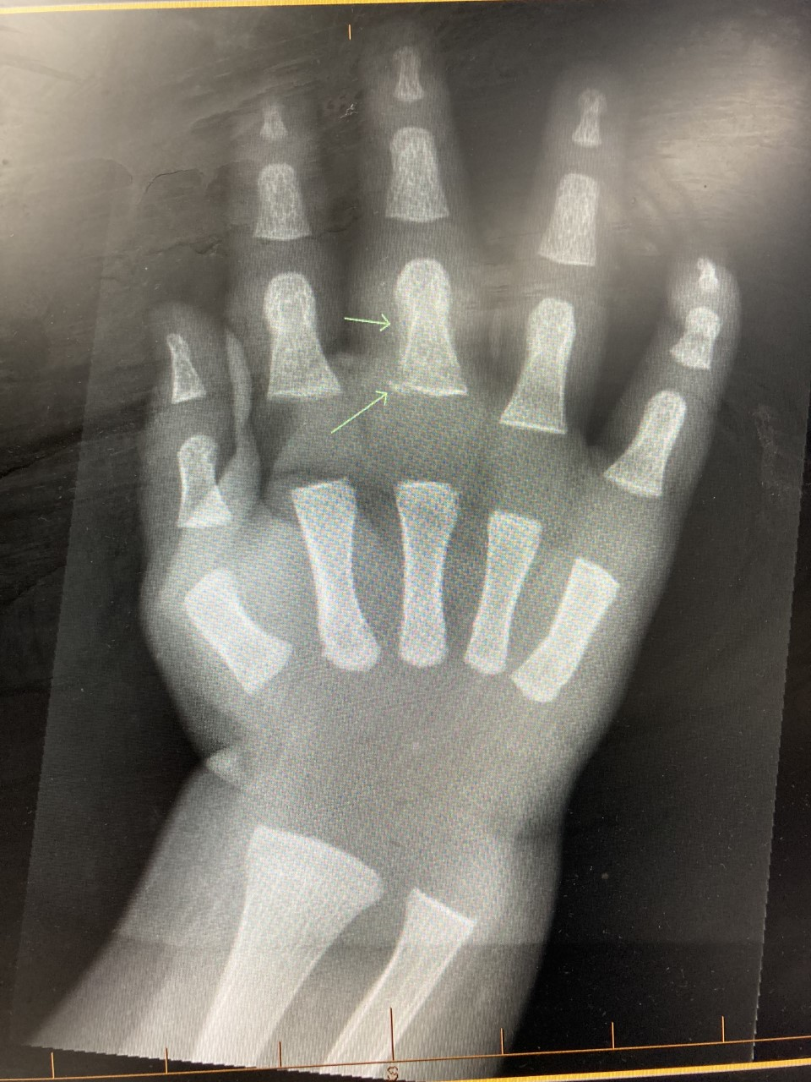
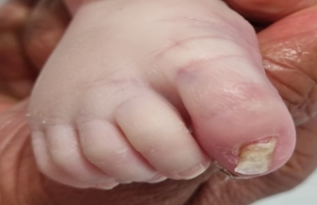
10 weeks old infant

Slide 13
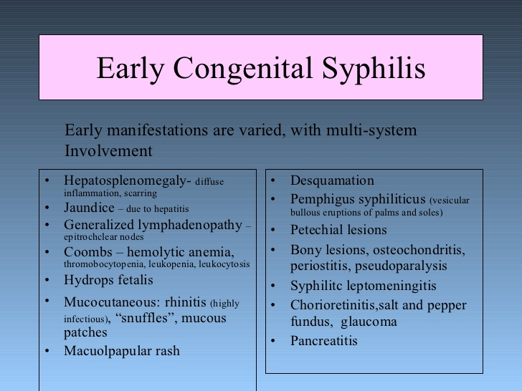

Slide 14
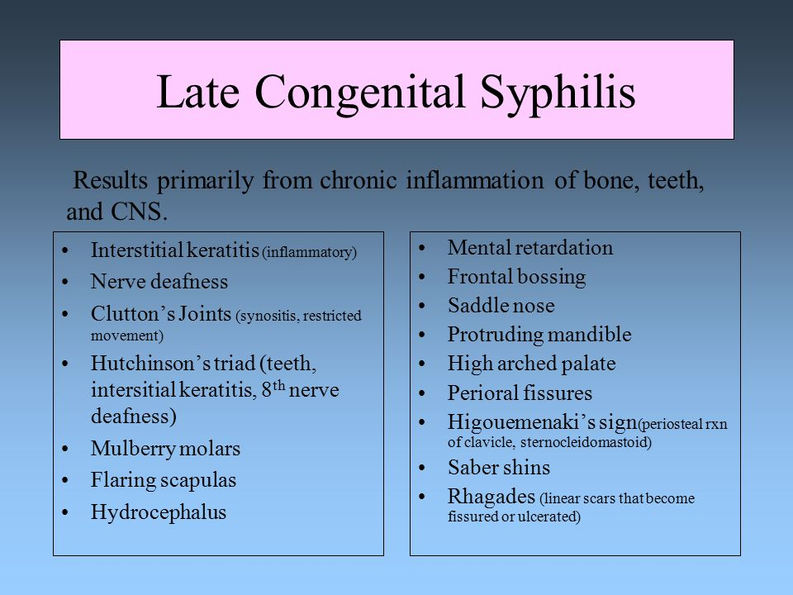

Slide 15
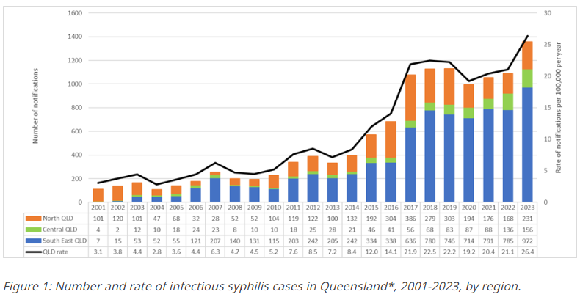
Infectious syphilis notification count & rate, Queensland, 2001–2022
North QLD HHS areas: Torres and Cape, North West, Cairns and Hinterland, Townsville, and Mackay
Central QLD HHS areas: Central Queensland, Central West, South West, Darling Downs and Wide Bay
South QLD HHS areas: Sunshine Coast, Metro North, West Moreton, Metro South, and Gold Coast

Slide 16
Antenatal

Slide 17
Syphilis positive

Slide 18
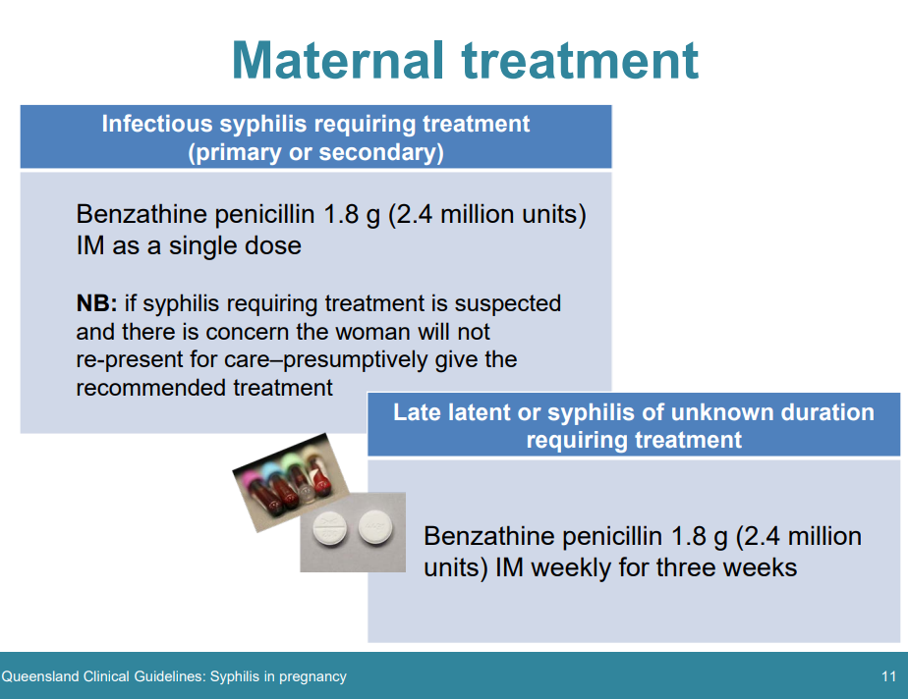

Slide 19
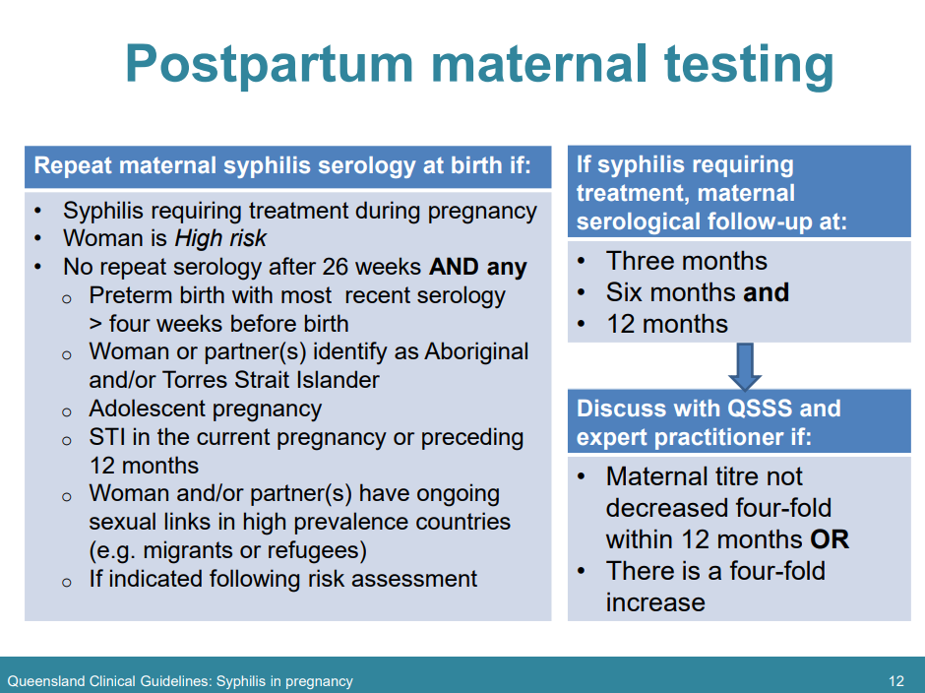

Slide 20
Newborn at risk

Slide 21
Newborn follow-up

Slide 22
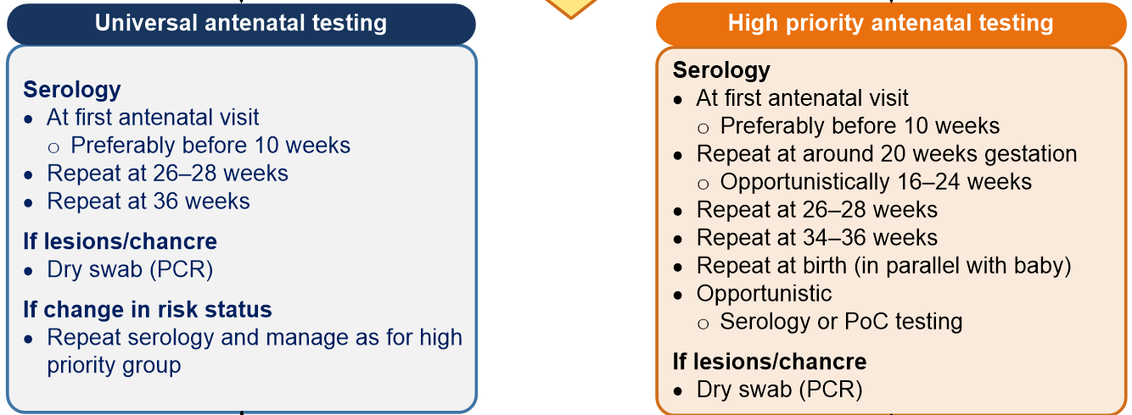
How to reduce syphilis burden in pregnancy?
Call Queensland Syphilis Surveillance Service (QSSS):
Phone: 1800 032 238

Slide 23
Pre-term (<37+0 weeks) birth
Incidence: 1 in 10
Extreme prematurity is associated with significant morbidity and mortality
No cause is identified in 50% cases
Majority of women with risk factors will not have PTB
Many women who have a PTB have no risk factors

Slide 24
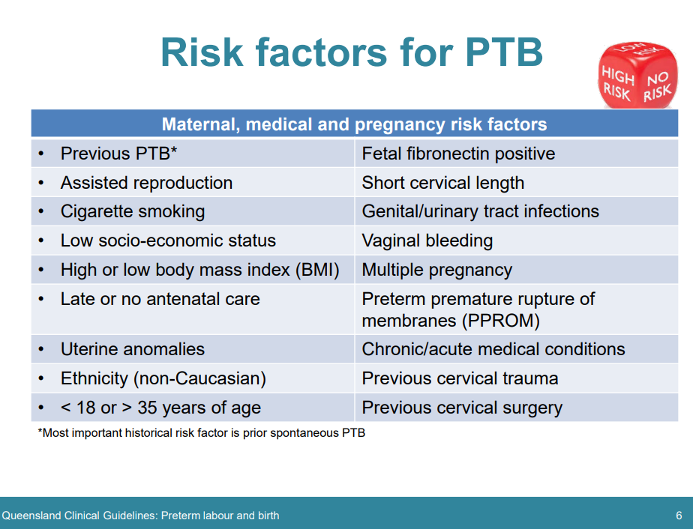

Slide 25
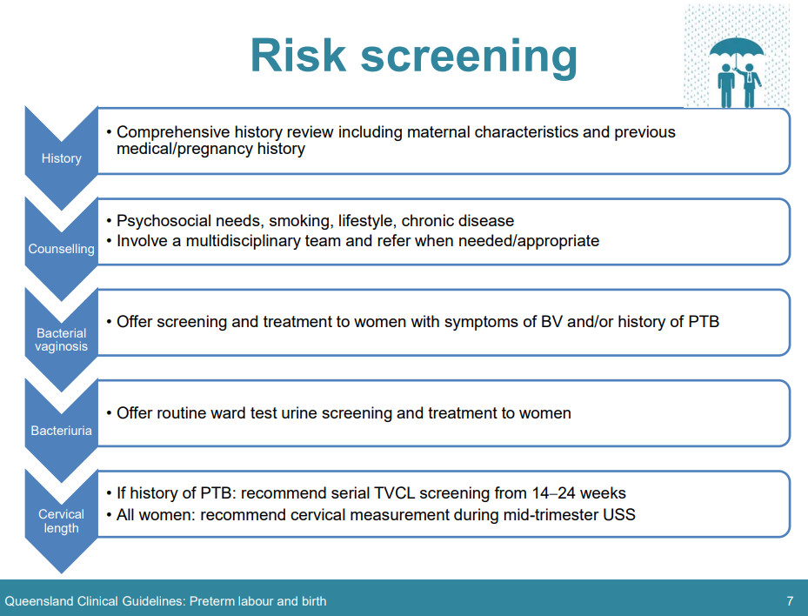

Slide 26
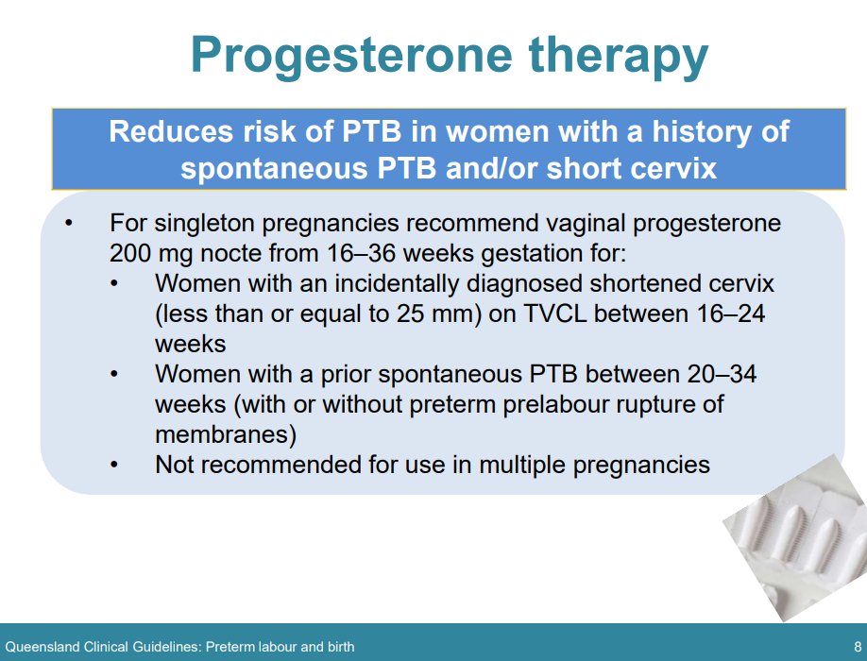

Slide 27
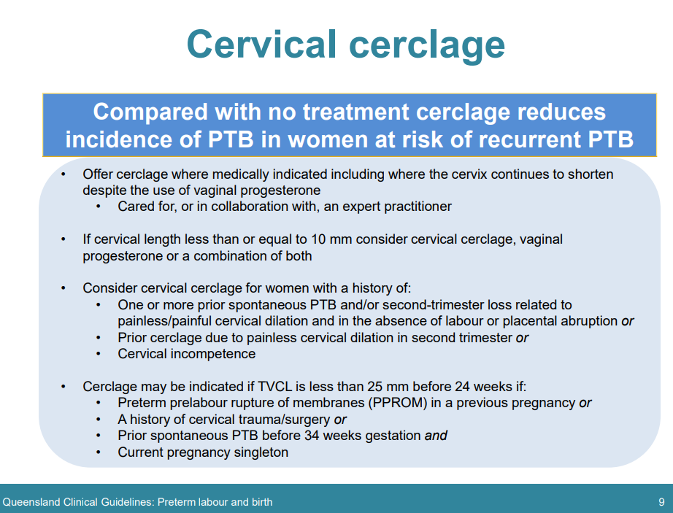

Slide 28
Pre-term birth treatment
Prepare for delivery – monitor cervical length, avoid precipitating factors, assess clinically, find a cot, steroids, MgSO4, tocolysis
Facilitate delivery as a premature baby’s reserves are little

Slide 29
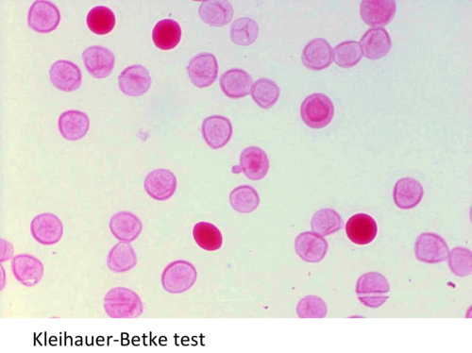
What is this test?
When is it necessary?

Slide 30
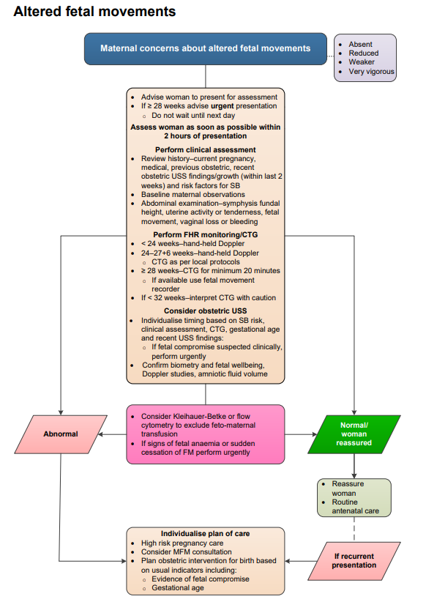

Slide 31
Maternal mortality rate in Australia 2018-20
Almost 900,000 women gave birth
50 maternal deaths
13 coincidental deaths were excluded
Rate is about 6 per 100,000 (6 vs 13 in 1975)
What is the stillbirth rate?

Slide 32
Why mothers died – timing

Slide 33
Mortality summary
Stillbirths rate 6 per 1000
Maternal mortality rate 6 per 100,000
A postnatal woman is 1300% more likely to die than an antenatal!

Slide 34
Summary
1. GDM (1 in 7 pregancies)
  Universal screening with 75g OGTT at 24-28 weeks
  Screen earlier if any risk factors
  Monitor glucose, fetal growth and wellbeing
  Deliver when indicated, generally between 37 and 41
2. Syphilis
  Uprising, congenital syphilis is potentially lethal (1 in 3)
  Screen everyone, every trimester.
  Screen more, treat more, if high-risk
  Call QSSS everytime 1800 032 238
3. Pre-term birth (1 in 10 pregnancies)
  Offer progesterone if risk-factors or shorter cervix
  Offer cerclage if <10mm or progressively shortening or history indicated (+ PR progesterone)
  Prepare for pre-term birth when inevitable

Slide 35
Thank you
Any questions?

