Slide 1
Trial Lower Limb OA model of care
Project ID 116905 NRER: EX/2025/QTDD/116905

Slide 3
Objectives
Introduction to referral and management pathways
Discussion of outcomes to date
Notes:
Centre of clinical redesign process around QA activity – PT infographic
Shorter presentation on purpose so attendees can get as much out of as possible

Slide 4
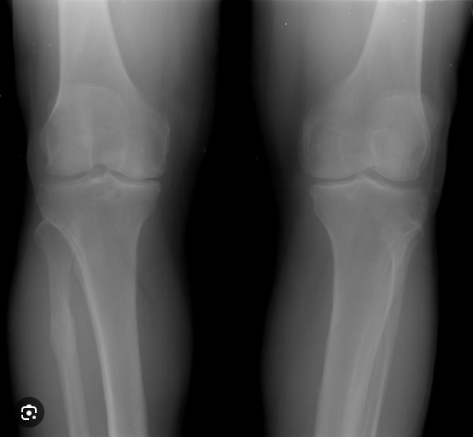
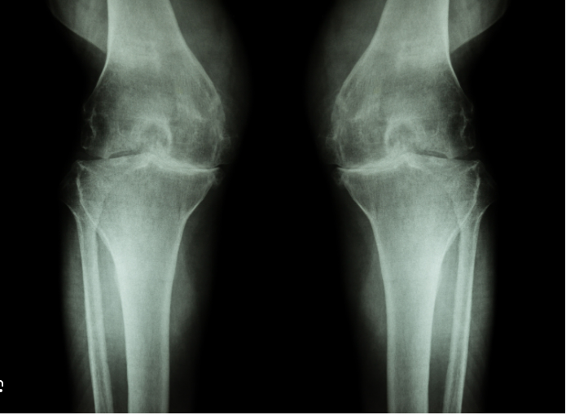
Who are we talking about? Referrals to orthopedics for management
Odds of poor response in tertiary setting increased with greater frontal plan varus alignment (OR 1.35) and Severe radiographic (compared to mild) changes (OR 3.11)(O'Leary, Raymer, Conroy et al. 2020)
Notes:
Discuss upgrades in Category – happening a lot
Kellgren and Lawrence scale
Correlation between imaging and symptoms poor – community studies
OA clinical prediction study did show worsening radiographic knee OA and varum angle – less likely to respond to clinical care in tertiary care setting
The odds of a poor response increased with a greater degree of varus frontal knee alignment (OR 1.35 (1.03 to 1.78) per 5° increase in varus angle) and a severe (compared with mild) radiological rating of medial compartment degenerative
change (OR 3.11 (1.04 to 9.3)) (p<0.05).

Slide 5
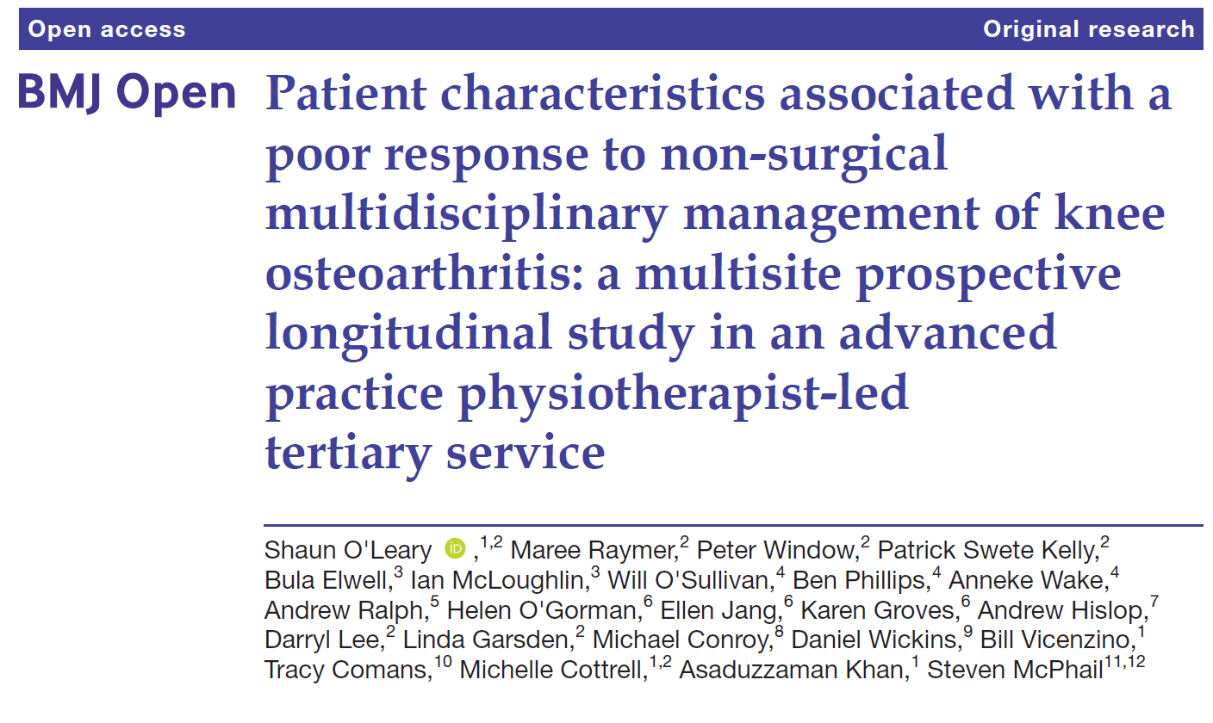
114/238 participants recorded a poor response to non-surgical treatment
Odds of poor response decreased with:
Higher expectations of benefit (OR 0.74)
Higher self reported knee function (0.67)
O'Leary, S., Raymer, M., Window, P et al.(2020). Patient characteristics associated with a poor response to non-surgical multidisciplinary management of knee osteoarthritis: a multisite prospective longitudinal study in an advanced practice physiotherapist-led tertiary service. BMJ Open, 10(10), e037070. https://doi.org/10.1136/bmjopen-2020-037070

Slide 6
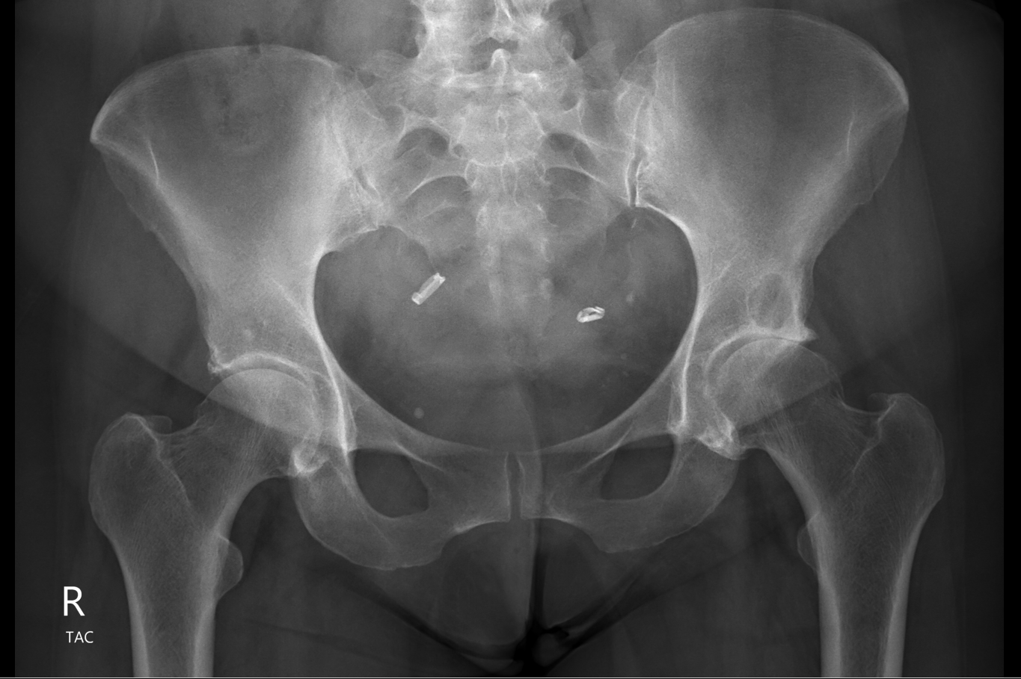
What are the metrics of success?
Email from Ortho GP
Coexisting CLBP, knee pain, neuropathic leg pain, depression, social stressors
OPSC – 4 x physio, 3 x OT, 2 x psych, social worker review pending
GP workup for diabetes, peripheral oedema Mx (via OT)
Patient functional/coping much better : ‘’not sure on arthroplasty yet’’
GP Ortho - ‘’patient centre, coordinate care to manage a complex patient, fantastic system”

Slide 7
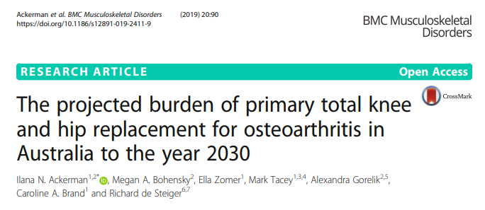
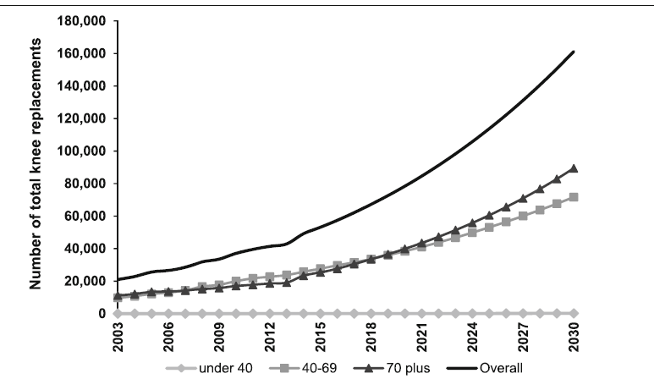
Healthcare problem (not unique to OA)
Cost of replacement Increase - $19k to $30K
Obesity and ageing populations
Increase obesity rates account for additional 25,000 additional TKRs by 2030
Notes:
Rising rates of obesity estimated at 25000 additional TKRs by 2030 – LANA report
Local outsourcing costs of surgical LWs circa $8 million (bed block, covid backlog etc) – reported by TH director TH grand grounds
- data available at SPR portal

Slide 8
Local Problem
35% decline in public hospital elective surgery since COVID (Wall, Vertullo et al. 2024)
Only 2% of patients experience clinical meaningful weight loss prior to surgery at DDH despite attempts(Wall, Lee et al. 2024)
Longer surgical waiting times increases the personal burden of pain and disability, reduce quality of life (QOL), and worsen post-operative outcomes(Lingard 2004)
Notes:
Average time to see a surgeon in 2024 was > 2 years, then you need to be booked a surgical waitlist (admin++ occurring in background, GP visits, access to private conservative care etc

Slide 9
Previous pathway
GP
Refer Cat 3
Ortho OPD
Sx WL or
Allied Health
Ortho OPD
Surgery or D/C
Is this pathway patient centred?
Notes:
OPSC wouldn’t traditionally see these patients
Talk about timeframes
When does GP refer – what treatments have they tried in primary care, can the patient access allied health in primary care
Cat 3s take ~ 2 years to be seen in ortho OPD, 100-150 lower OA referrals / month
Do orthopaedic surgeons understand what an appropriate trial of conservative care is?
AH have WLs and access issues. Refer both – changes the patients perspective belief system straight away (predictor for response to conservative care)
Has the patient been compliant / attended
Outcomes of Surgery are worse the when premorbid fx is worse and higher rates of obesity
Tuesday patient – GP put have referred to physio (didn’t+ and patient got better while waiting)

Slide 10
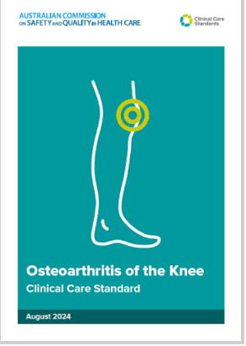
Osteoarthritis of the Knee Clinical Care Standard (2024) | Australian Commission on Safety and Quality in Health Care
‘’In 2013, the Commission established the Clinical Care Standards program to support clinical experts and consumers develop Clinical Care Standards on health conditions that would benefit from a national coordinated approach.’’
70% of patients referred to a public hospital for surgical opinion have not undergone an appropriate trial of conservative care

Slide 11
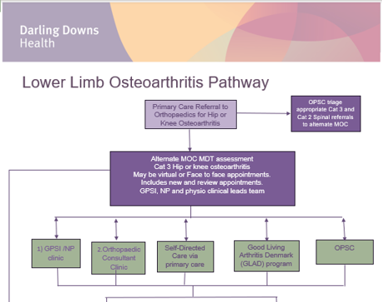
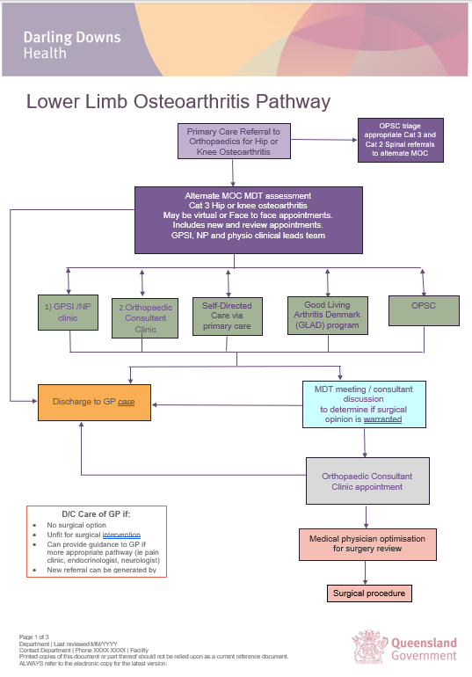
Notes:
Team – PT, Ortho, Diet, NPC, GpwSI
No new funding (recruited a GPwSI – previously unfunded)
Building scope of practice in physio and other disciplines (feels uncomfortable)
Lots of meetings and tweakings

Slide 12
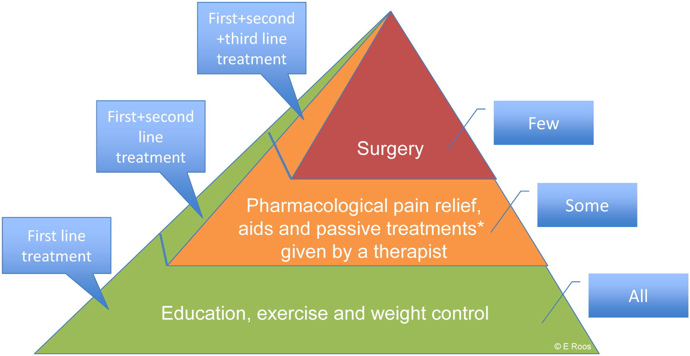
Treatment recommendations
A combined early intervention of education, exercise and weight control is recommended both nationally and internationally as first line treatment
Brand et al. 2014
Hunter 2011; Carr et al. 2012; Fernandes et al. 2013; Zhang et al. 2008; SST 2012
12%
23-28%
3%
Lots of barriers
Notes:
Despite agreement across all these lead organisations, and the vast amount of evidence, people with OA still aren’t receiving the support, advice and interventions they need.
The percentages in this infographic reflect the current referral rates to first, second and third line treatments.
It is clear that evidence-based first line treatment of education and exercise therapy are not currently recommended as first line => there is a great opportunity to improve patients treatment choices based on the evidence.

Slide 13
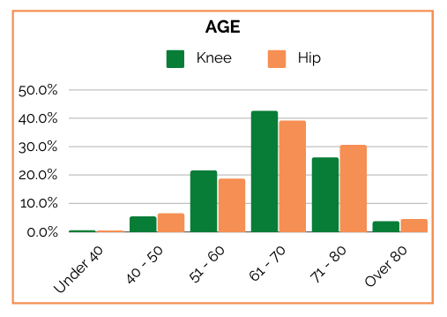
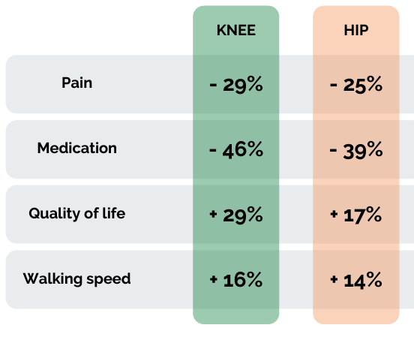
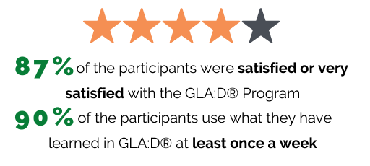
Australian Outcomes: 2023
From: GLA:D® Australia Hip and Knee
Annual Report 2023

Slide 14
GLA:D® changes surgery intentions
“Do you have so much trouble and pain from your knee that you want to have surgery?”
294/1159 said yes at baseline – 25.4% (changed to 50/336 = 14.9% at 3 months)

Slide 15
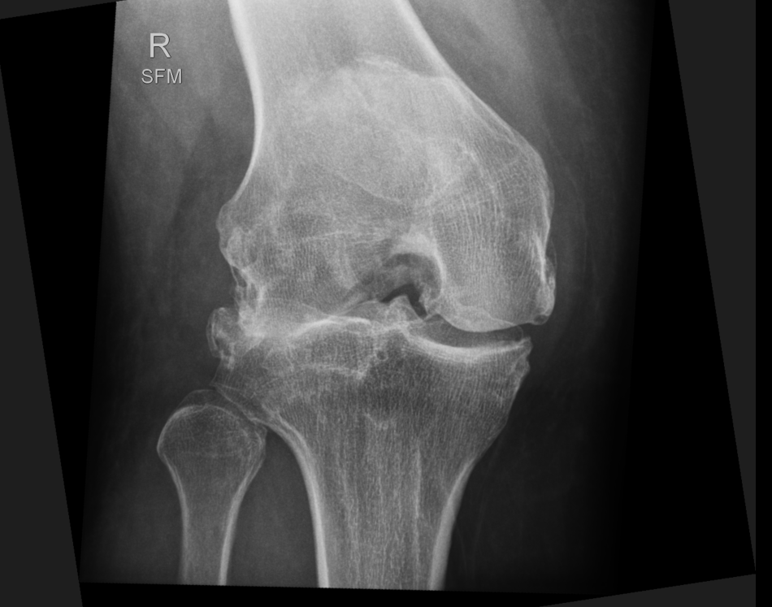
Improving Patient Flow and optimising engagement outcomes surgically and non-surgically
52M
BMI48
Primary carer for son with disability
Rugby injury in teens
Lives in South Burnett
Left work in 2022
Advised to delay surgery in 2019 secondary to age and weight. Had steroid injections (short term relief). Seen physio in Kingaroy x 1, simple exercises – not much benefit
Re-referred in 2024
VLCD + Telehealth Physio: WL >20kgs, walking >3kms days, low pain
Nb: May still have arthroplasty secondary to valgus

Slide 16
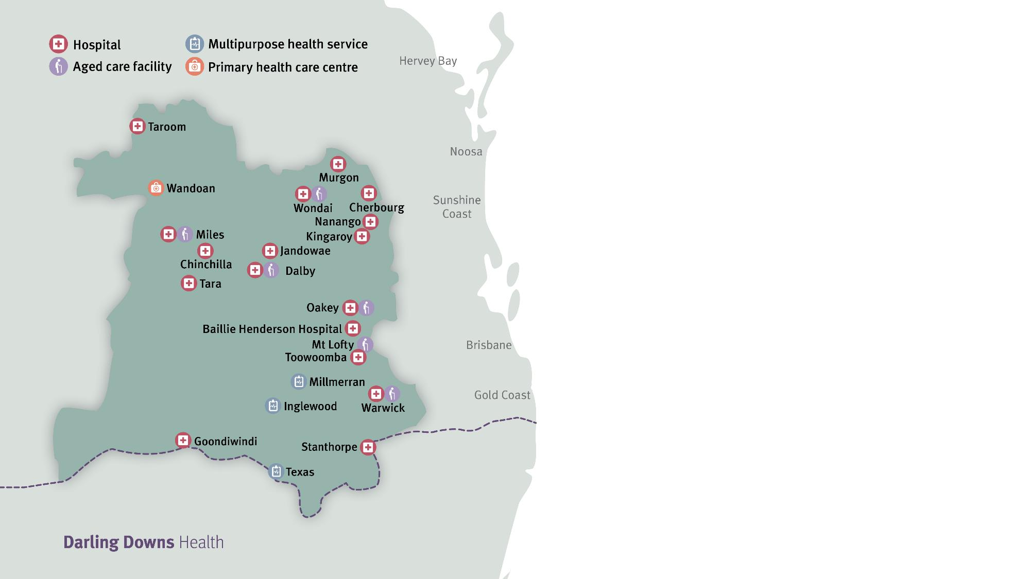

Slide 17
What the GPSI clinic looks like
Initial assessment 100% virtual
  VC or phone
  Designed to avoid unnecessary patient travel and increase access
  15 minute chart review with 30 minute phone consultation
    Physical chart review
    Images reviewed
    Referrals reviewed
    Viewer used for pharmacy history, hospital presentations, pathology, etc.

Slide 18
What the GPSI clinic looks like
Purpose of the program is explained to patient;
  Holistic approach to care
  Does not replace, but works with regular GP
Open ended questions to patients;
  “What is happening with your joint in your words, and what would you like to see happen”
  All kinds of answers to this question

Slide 19
What the GPSI clinic looks like
History of illness
Medical history and screening
Discussion of conservative mgmt.
Plan developed with the patient moving forward
Essentially, going through the PHN pathway with the patient

Slide 20
First 7 months of Data
Initial Pathway | # | %
Deceased | 4 | 1.23%
FTA - removed | 8 | 2.46%
GPSI | 207 | 63.69%
OPSC | 59 | 18.15%
Surgical | 26 | 8.00%
Pt declined review | 21 | 6.46%
Grand Total | 325

Slide 21
First 7 months of Data
GPSI | 207
Discharged | 17
GPSI | 38
OPSC | 66
Surgical opinion | 86
OPSC | 59
Discharged | 6
GPSI | 2
OPSC | 31
Surgical opinion | 20
ORSC | 26
Discharged | 4
OPSC | 1
Surgical opinion | 21

Slide 22
First 7 months of Data
Outcomes from Surgical Review | # | %
Discharged | 13 | 9.70%
ESWL | 84 | 62.69%
FTA - discharged | 2 | 1.49%
GPSI for optimisation | 18 | 13.43%
Not OA - further investigations | 9 | 6.72%
OPSC | 8 | 5.97%
Grand Total | 134

Slide 23
First 7 months of Data
Barriers Identified | # | %
Weight loss | 36 | 11.11%
HBA1c | 12 | 3.70%
Smoking | 20 | 6.17%
Skin condition | 7 | 2.16%
Other medical condition | 22 | 6.79%
Needs conservative management trial | 116 | 35.80%
Illicit substance use | 2 | 0.62%
Dental | 3 | 0.93%
No barriers | 106 | 32.72%
Total | 324

Slide 24
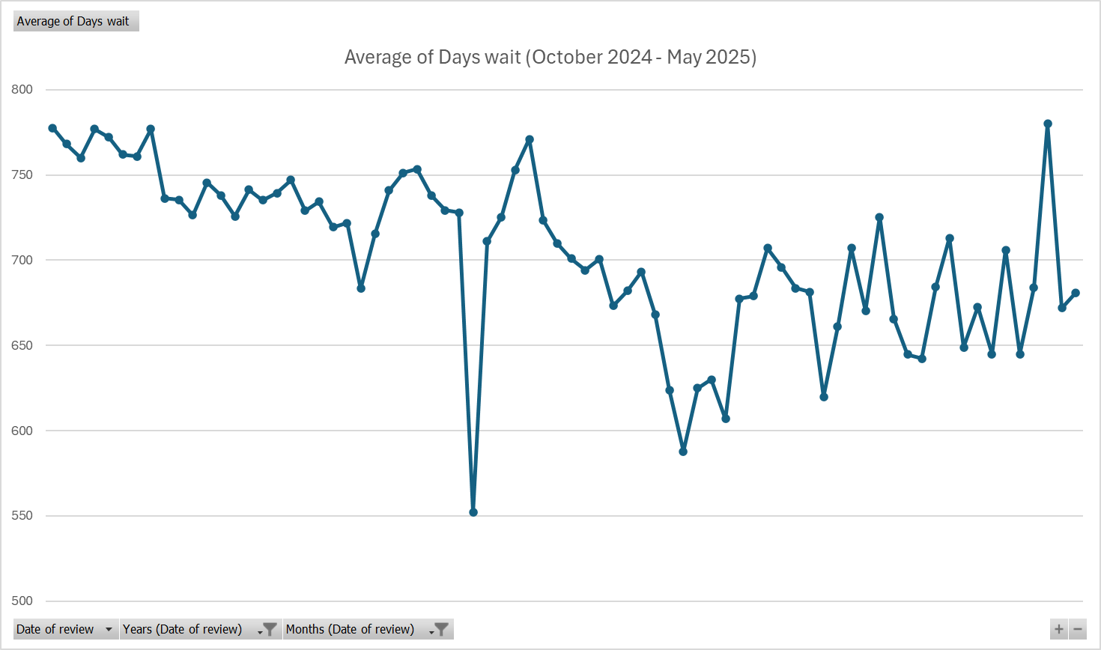

Slide 25
Pathways and discharge
Pathways are not mutually exclusive
  Many patients will be seeing OPSC, while still under GPSI for other medical conditions, while being discussed with ORSC
  Patients are discharged only as part of joint decision making
  Those requiring coaching and frequent input are reviewed monthly, occasionally more frequently

Slide 26
What doesn’t happen as part of the clinic
Medicare item numbers are not billed, including CCMPs, etc
Medications which require frequent follow up with usual GP are not commenced in the clinic
Medical conditions outside of the scope of the clinic are not managed in this space

Slide 27
Clinical Guidelines
Developed through the PHN in discussion with Director Orthopaedics, Physiotherapy and key stakeholders working in this space
  Knee Osteoarthritis (OA)
  Hip and Knee Joint Replacement
    https://darlingdownsdraft.communityhealthpathways.org/14146.htm
    https://darlingdownsdraft.communityhealthpathways.org/16195.htm

Slide 28
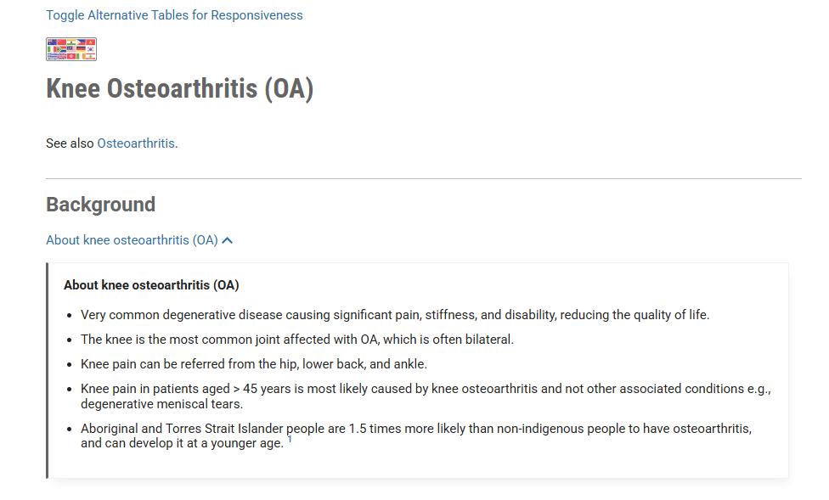

Slide 29
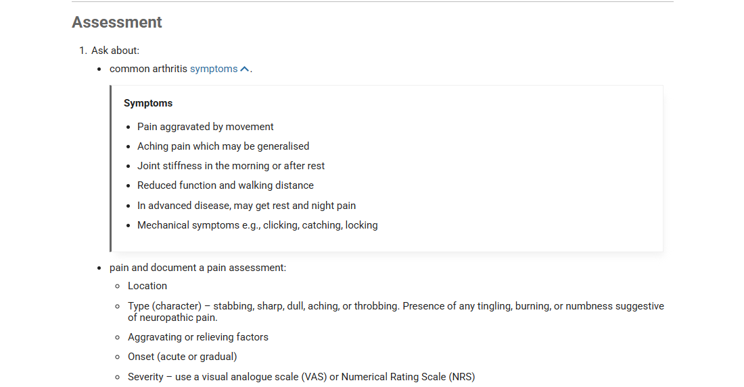

Slide 30
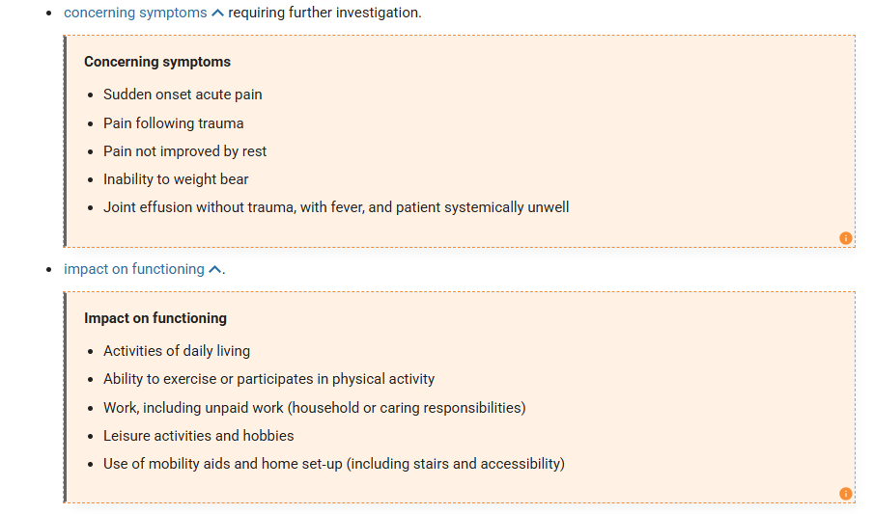

Slide 31
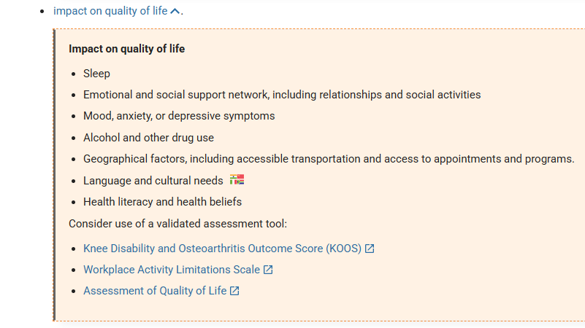

Slide 32
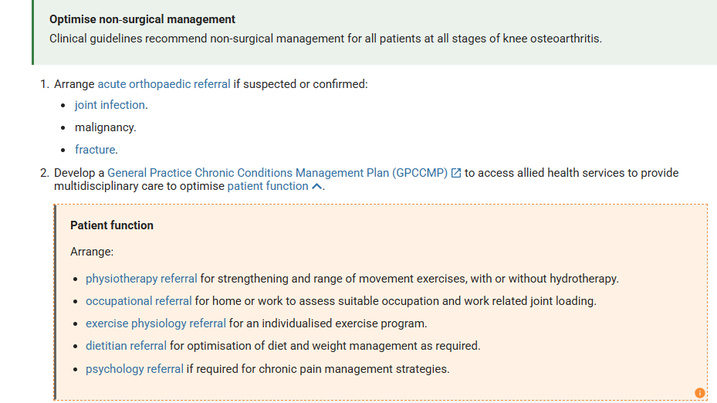

Slide 34
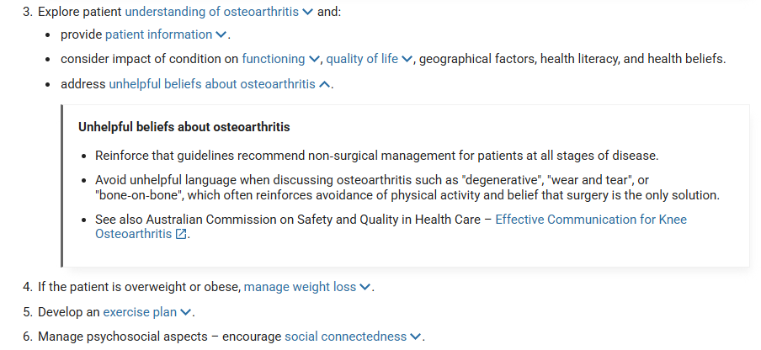

Slide 35
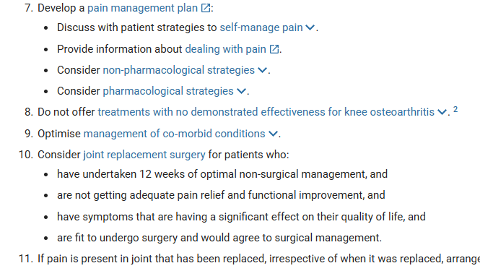

Slide 36
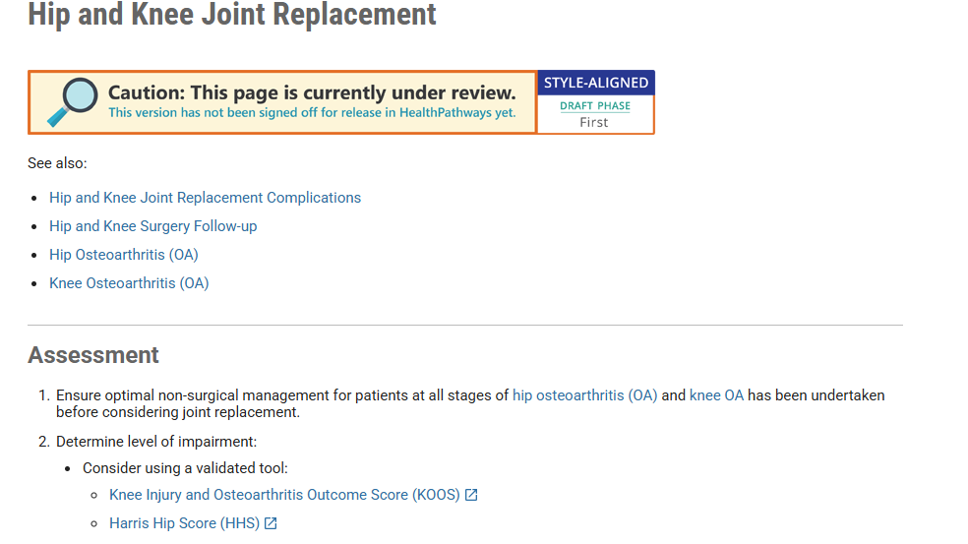

Slide 37
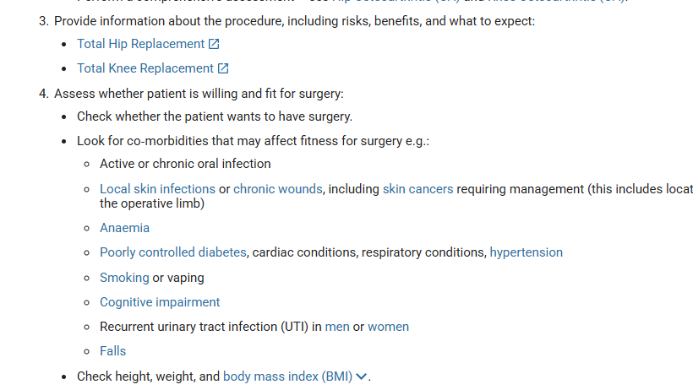

Slide 38
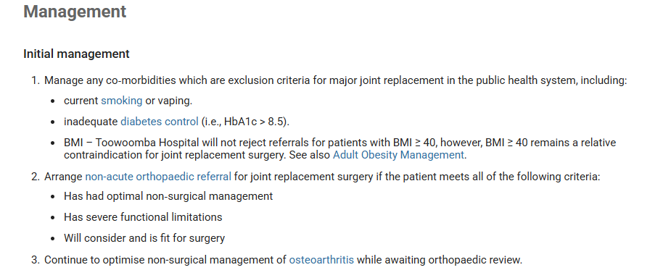

Slide 39
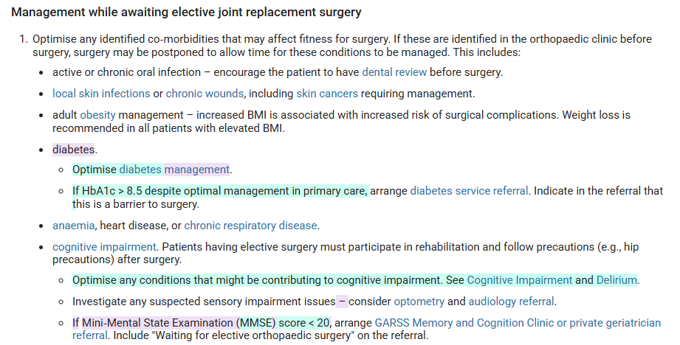

Slide 40
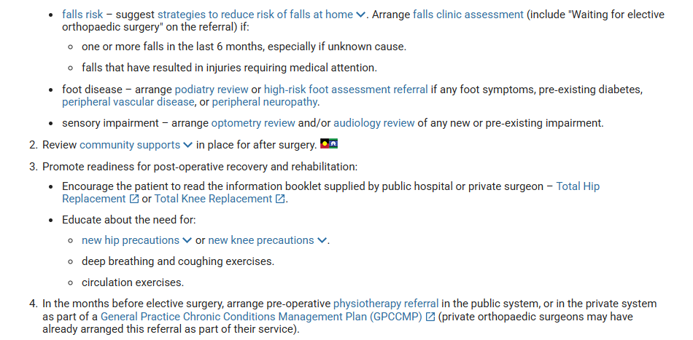

Slide 41
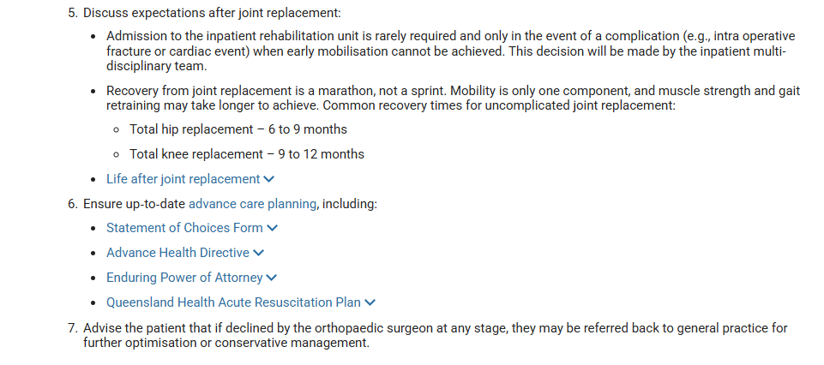

Slide 42
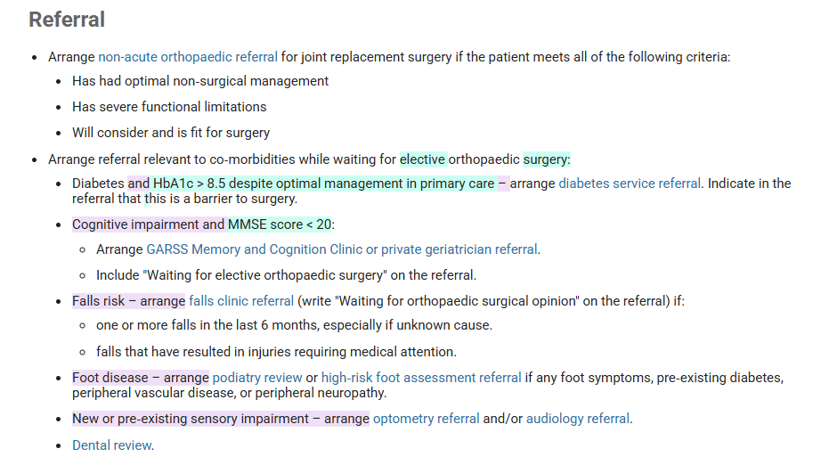

Slide 43
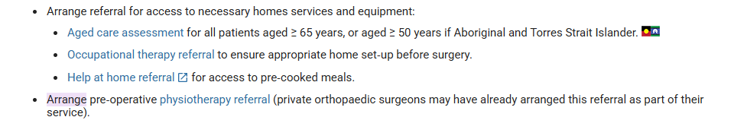

Slide 44
Patient experience
Vast majority of patients are just happy to have contact and information
Very rarely there is the patient who refuses to engage; will talk to a surgeon only
Full spectrum of patient health knowledge. Some will be “fixed” with self-initiated conservative management, some their health will have massively declined

Slide 45
Patient comments
Deny any knowledge of smoking cessation
  “When I had my last knee done, the nurse used to wheel me down and we had a smoke together”
Expectation that a hip or knee replacement is a 100% cure
  Reflected by the significant number of patients who go on to decline surgery
That it is the only possible path
  Bone on bone
  Completely worn out
  Needs replacing the same as a worn out part in a car

Slide 46
Where to
To keep up with increasing service demand and to improve waiting times for review, intent is to at least double FTE
Methods to improve information to the patient early in the journey
Research into patient centred outcomes and clinical outcomes
Work with General Practitioners and Allied Health services both public and private to achieve best conservative management

Slide 47
Clinical resources ~ 2-3 hours
Aus Clinical Care Standards Knee OA – 2024 : Great patient resources as well
RACGP guidelines hip and knee OA – 2018
UQ Masters Presentations – Gwen Jull Oration – Professor Rana Hinman 2024 – 14min onwards : highlight obesity contextual factors and difficulties with OA Mx
Lancet Seminar on OA – Published January 2025

