Slide 1
Queensland Voluntary Assisted Dying
What GPs need to know
Darling Downs GP Symposium
July 26th 2025
Karen MacKellar, DDHHS VAD CNC

Slide 2

I would like to show my respect by acknowledging the traditional owners of the land on which we meet and pay my respects to elders past, present and emerging
I would like to extend that respect to all Aboriginal and Torres Strait Islander people in attendance today
This Photo by Unknown Author is licensed under CC BY-NC

Slide 3

End of life, especially an expected end of life, is complex involving social, psychological, cultural, existential, spiritual and medical and other treatments issues
​
People hold deeply personal views about end of life for reasons that are important to them​
End-of-life care can also be complex – optimally it is proactive, interdisciplinary and always patient-centred. Carers and clinicians also hold deeply personal views about end of life​
VAD is now part of proactive, patient-centred end-of-life care.
END OF LIFE CARE AND VAD

Slide 4
What is Voluntary Assisted Dying?
An additional end-of-life choice that gives eligible people who are suffering and dying the option of asking for medical assistance to end their lives.
An eligible condition:​
is advanced, progressive and will cause death, and ​
is expected to cause death within 12 months, and ​
is causing suffering that the person considers to be intolerable​
​
Have decision-making capacity​
Be acting voluntarily and without coercion​
Be at least 18 years of age​
Fulfil residency and citizenship requirements​

Slide 5
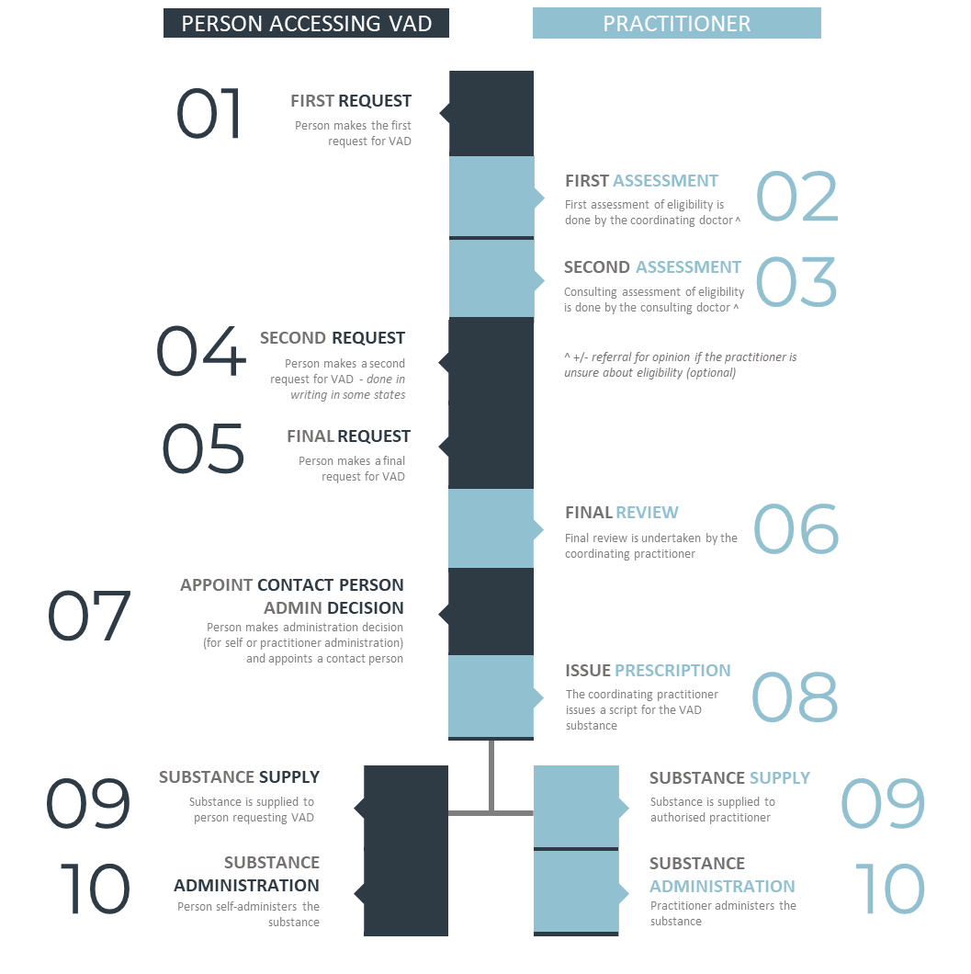
VAD PROCESS
depends on State legislation
self or practitioner administration
three separate requests
can be halted or terminated at any time
underscores autonomy / patient choice

Slide 6
Why should I learn about Voluntary assisted dying as a GP?
Voluntary Assisted Dying (VAD) has high public acceptance
Over time you are likely to come across someone wanting VAD, an understanding of the process will assist you to provide high quality support to these patients and their loved ones.
The VAD Act 2021 requires all doctors to provide a minimum standard of care (including conscientious objectors)
General Practitioners are a trusted and accessible health information provider

Slide 7
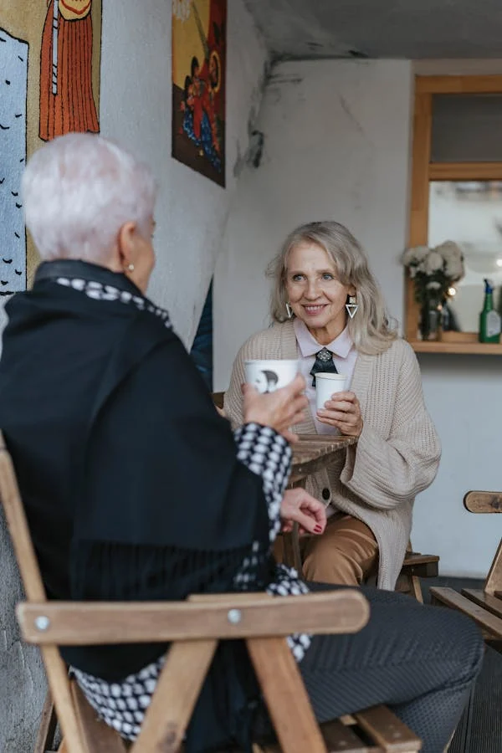
Any doctor can bring up VAD with a patient for the first time if at the same time, they inform the person about available:
treatment options and likely outcomes
palliative care treatment and support options and likely outcomes of this care.
Once this initial discussion has occurred the doctor can then bring up VAD with the person at any appropriate time without informing the person of those details again.
If a person raises voluntary assisted dying, all medical practitioners can provide information and answer questions if they feel comfortable and informed to do so.
A doctor who is a conscientious objector to VAD has requirements under the legislation to provide a minimum response to a person who raises the issue of VAD with them
INITIATING DISCUSSIONS

Slide 8
IDENTIFYING THE RIGHT TIME TO TALK ABOUT VAD
For many of your patients you will have an existing relationship and understanding of the person’s health issues, social circumstances and end of life preferences that will inform you about when the right time to mention VAD is.
If not then ask yourself - would I be surprised if this person where to die in the next 12 months? If the answer is yes then it might be appropriate to mention VAD in the context of discussing the person’s overall care.
Notes:
The cornerstone of access is the eligibility criteria.
A person must be an Australian citizen, a resident for the preceeding 3 years or a NZ citizen with a special category visa, AND have been a resident of Queensland for the preceeding 12 months.
There is an ability to seek an exemption from either the Austn or Qld residency requirements, from QH, if the person has substantial connection to Qld and on compassionate grounds.

Slide 9

The simplest way is to make a neutral statement such as:
‘For completeness I can talk to you about Voluntary Assisted Dying if you would like’
This allows the person to be aware that you have information on VAD and that you are willing to speak with them about it.
The person is then able to either take your lead or disregard it without feeling that you have made a judgement about the value of their life.
HOW TO TALK ABOUT VAD

Slide 10
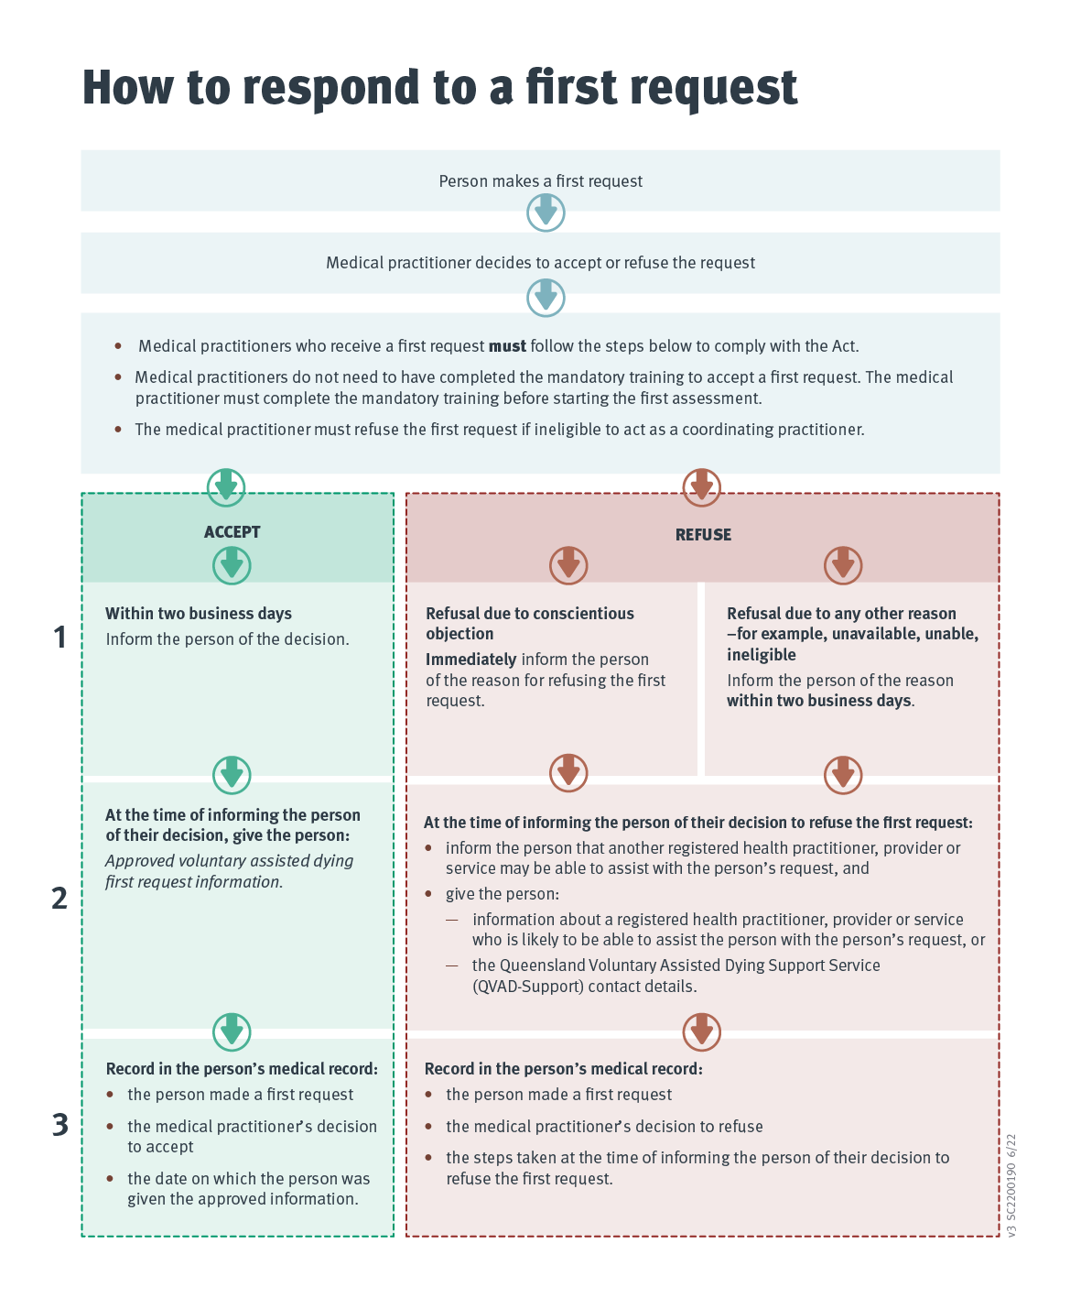
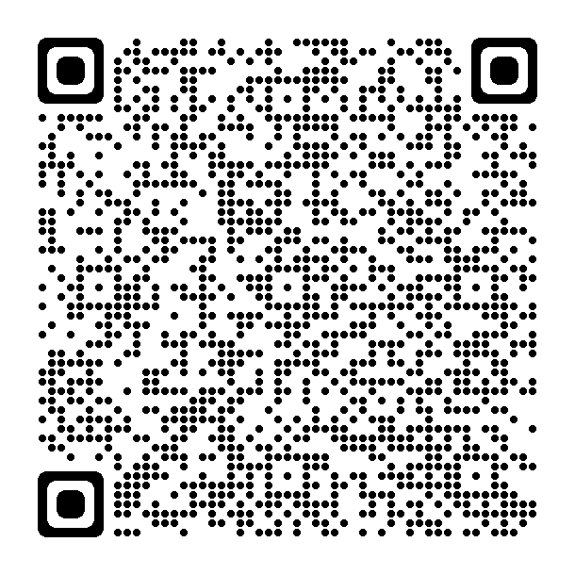
Responding to first requests: Process for medical practitioners
Notes:
Can either talk through the diagram or refer people to the QH website for more information

Slide 11
Registered health practitioner obligations
All registered health practitioners who refuse to participate in any part of the process due to conscientious objection must:
  inform the person that other healthcare workers, health service providers or services may be able to assist the person
  provide information about where the person can get further information or support, such as a colleague or the details of QVAD-Support
  respect their patient’s autonomy, beliefs, values, and the choices they make about end-of-life care, including voluntary assisted dying and treatment decisions
  continue to support a person and be involved in their care.
A person’s access to care and treatment must not change or be compromised due to their decision to ask questions about or access voluntary assisted dying
s84 Voluntary Assisted Dying Act 2021

Slide 12
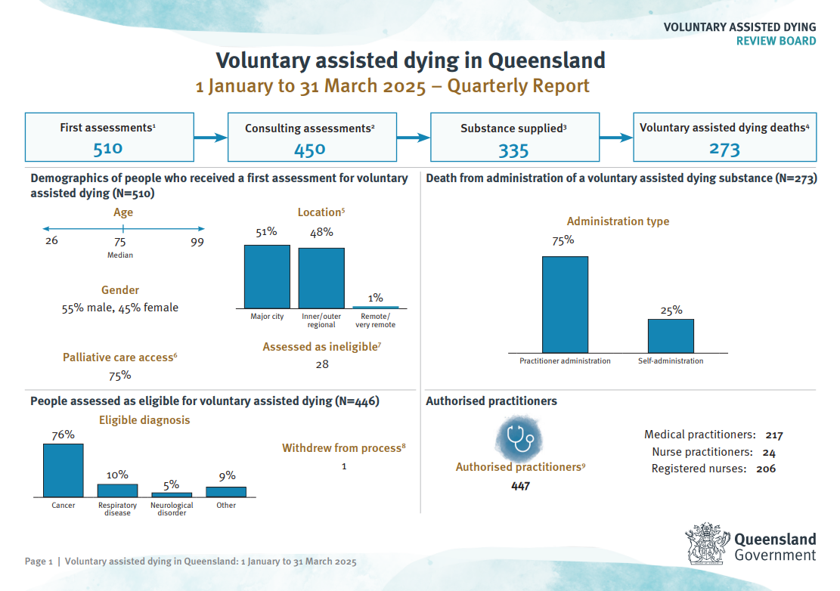

Slide 13
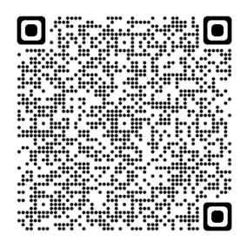

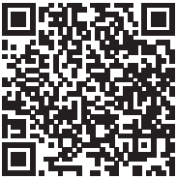
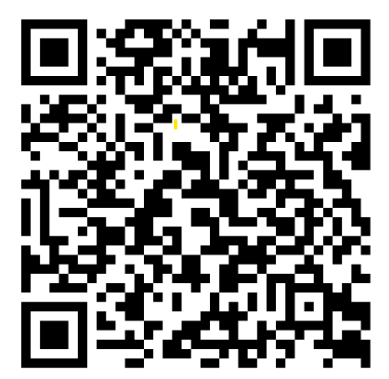
VAD TRAINING AND EDUCATION
Becoming an Authorised Practitioner
www.health.qld.gov.au/clinical-practice/guidelines-procedures/voluntary-assisted-dying/authorised-practitioners/becoming-vad-practitioner
GP module – Voluntary Assisted Dying in Queensland What GP’s need to know
www.rise.articulate.com/share/TkhUebnM0qiMwiCLCAKNaRI8KLkc2jfn#/
Healthcare worker module
www.ilearn.health.qld.gov.au/shared/Qvad/story.html
Notes:
The mandatory training consists of 11 self-paced modules with an open book test at the end – need to get 90% correct
Education module for non-authorised clinicians explaining the process and lawful requirements

Slide 14
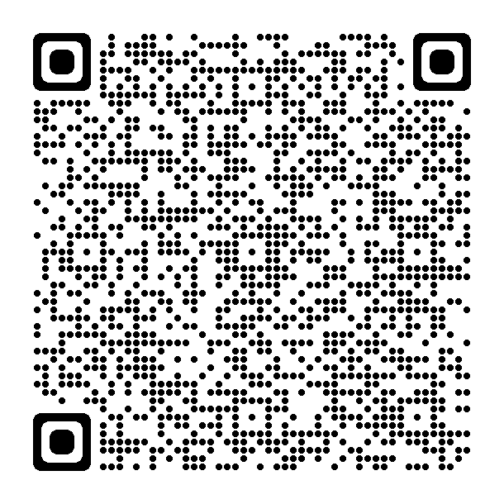
TO BECOME AN AUTHORISED PRACTITIONER
Step 1: submit an application form via QVAD Review
Board IMS
Step 2: all complete applications are reviewed by the
Queensland VAD Practitioner Eligibility Panel
Step 3: once verified, the practitioner is given access to
the mandatory training online modules – these take approximately 8 hours to complete. There is a MCQ exam at the end.
Step 4: after successful completion of the mandatory
training, the VAD Program Unit undertakes a final
review of the authorisation processes, and the
doctor will receive confirmation of the
authorisation from the QH Chief Medical Officer
Notes:
Explain

Slide 15
HOW TO REFER TO VAD
DDHHS VAD Service:
Operates Monday – Friday 07:00 -15:30 excluding PH
DDHHS-VAD@health.qld.gov.au
VAD CNC: 0499 797 056
Health Pathways, Medical, objects, phone, email, self-referral form patients
OR call or email QVAD support between 8.30am and 4pm
A person can also self refer through QVAD support
QVADsupport@health.qld.gov.au
1800 431 371

Slide 16
DDHHS VAD Service
DDHHS-VAD@health.qld.gov.au​
Ph: 0799 797 056
QVAD Support and Pharmacy and Service​
Qvadsupport@health.qld.gov.au​
Ph: 1800 431 371
Visit the Queensland Health website​
www.health.qld.gov.au/clinical-practice/guidelines-procedures/voluntary-assisted-dying
Want to know more?

