Slide 1

Sorting the trees from the woods
Neurodevelopmental assessment with focus on red flag identification

Slide 2
Normal development
Development pathway that is followed by the majority of children within a population group
Following the progress of the individual child’s development over time before diagnosing developmental delay with respect to achieving milestones

Slide 3
Factors that influence development
Intrinsic
  Genetic or hereditary
  Gender
  Prenatal factors
  Conditions that impact on development
Extrinsic
  Prenatal
  Postnatal
  Culture
Notes:
Genetics – as a result of progress in genetics and mapping of the human genome, there has been an increase in identification of regions that code for specific diseases affecting development
Gender – twin studies support clinical findings that some developmental conditions are more common in males (eg ADHD) and SLI
Pre-natal – babies born prematurely will appear to acquire milestone at a later stage compared with FT babies; The deficit in the premature infant’s milestone attainmanet needs correction to the degree of prematurity until 2 years of age
Low and VLBW babies and babies who are SGA are at greater risk for developmental problems such as learning, language, and cognitive difficulties
Extrinsic
prenatal
- there are sensitive and critical periods in brain development and that the effects of nutrition, social adversity and parental stress are all relevant
- maternal psychological health (stress, depression, anxiety) high cortisol with associated lower birth weight
Optimal nutrition as under nutrition affects placental transport capacity and vasculogenesis, consequently impacting on nutrient delivery to the fetus with implications for optimal development and long term adult health
The effect of alcohol in the developing infant is well known
Post natal
Social disadvantage, poverty, parenting issues, family dynamics, cognitive factors have impact on child’s development
Child’s emotional health and later behaviour can be influenced by the quality of attacments with parents and caregivers
Children thrive and progress in their development when they are in secure , safe environments where their needs for comfort, warmth, nutrition and nurturing are met

Slide 4
Extrinsic: Postnatal
The interactional process between the young child and their environment
  Where the environment is lacking in parental or carer response
  Where there is paucity of stimulation within the environment
  Where children are not encouraged to play or explore for a variety of reasons
  Poverty and social disadvantage
  The negative impact of civil unrest and war
Notes:
Children who have been forced to leave their homes because of war and conflict are often without alternative shelter and cannot go to school. This puts them at a higher risk of abuse and exploitation. Displaced girls and women, and unaccompanied children, are particularly at risk.
Exposure to violence, and constant fear and uncertainty caused by war and conflict, can have negative, long-term impacts on children. This includes a child’s psychological, emotional, and social development. Poor development in these areas can affect a child’s ability to learn and, in turn, their job prospects in the future. This means, for a child living in poverty, conflict will perpetuate the cycle of disadvantage in their family.

Slide 5

Screen time
Emotional development (media as a constant baby-sitter)
  Decreased emotional regulation
Cognitive development
Social development
  Inhibits young children to read faces and learn social skills
  Limited two-way interaction between children and adult caregivers

Slide 6

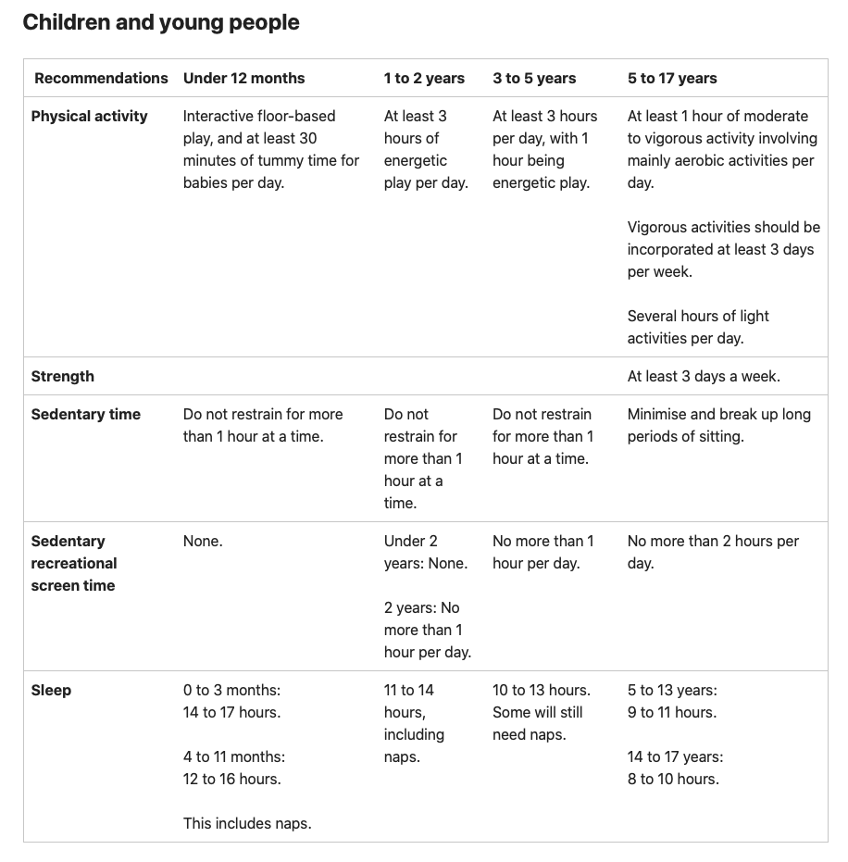
What are the national guidelines for screen time?
no screen time for children younger than two years
no more than one hour per day for children aged 2–5 years
no more than two hours of sedentary recreational screen time per day for children and young people aged 5–17 years (not including schoolwork).

Slide 7
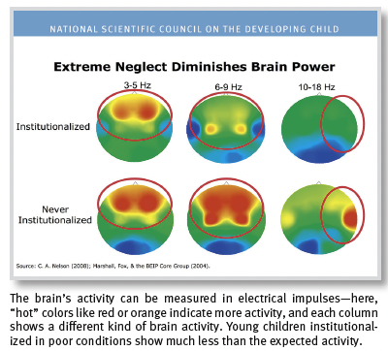

Impact of early experiences
Early experiences influence the developing brain
Chronic stress can be toxic to the developing brain
Significant early adversity can lead to lifelong problems
Early intervention can prevent the consequences of early adversity
Stable, caring relationships are essential for healthy development
Notes:
During early sensitive periods of development, the brain’s circuitry is most open to the influence of external experiences, for better or for worse. During these sensitive periods, healthy emotional and cognitive development is shaped by responsive, dependable interaction with adults, while chronic or extreme adversity can interrupt normal brain development
2. Learning how to cope with adversity is an important part of healthy child development
When strong, frequent, or prolonged adverse experiences such as extreme poverty or repeated abuse are experienced without adult support, stress becomes toxic, as excessive cortisol disrupts developing brain circuits.
3. Toxic stress experienced early in life and common precipitants of toxic stress—such as poverty, abuse or neglect, parental substance abuse or mental illness, and exposure to violence—can have a cumulative toll on an individual’s physical and mental health. The more adverse experiences in childhood, the greater the likelihood of developmental delays and other problems. Adults with more adverse experiences in early childhood are also more likely to have health problems, including alcoholism, depression, heart disease, and diabetes.
4. Early intervention can prevent the consequences of early adversity. Research shows that later interventions are likely to be less successful—and in some cases are ineffective. For example, when the same children who experienced extreme neglect were placed in responsive foster care families before age two, their IQs increased more substantially and their brain activity and attachment relationships were more likely to become normal than if they were placed after the age of two. While there is no “magic age” for intervention, it is clear that, in most cases, intervening as early as possible is significantly more effective than waiting
5. Stable, caring relationships are essential for healthy development. Children develop in an environment of relationships that begin in the home and include extended family members, early care and education providers, and members of the community. Studies show that toddlers who have secure, trusting relationships with parents or non-parent caregivers experience minimal stress hormone activation when frightened by a strange event, and those who have insecure relationships experience a significant activation of the stress response system. Numerous scientific studies support these conclusions: providing supportive, responsive relationships as early in life as possible can prevent or reverse the damaging effects of toxic stress.

Slide 8

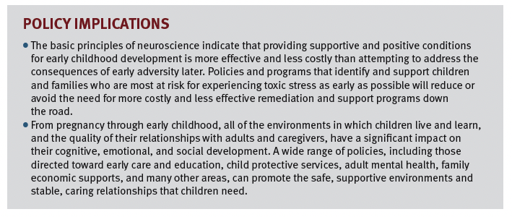

Slide 9
Delayed development
Child’s development is slower than that of other children of the same age
Skills are acquired at a later stage
Development not necessarily be permanently delayed or impaired
  Mild (functional age <33% below chronological age)
  Moderate (functional age 34% - 66% of chronological age)
  Severe (functional age <66% of chronological age)
Notes:
Developmental delay occurs when a child does not achieve developmental milestones in comparison to peers of the same age range.
The term developmental delay should only be used in retrospect when it becomes clear at follow up that milestone have been delayed but that “Catch-up” has occurred
Paediatrician should be cautious about using this term early in the assessment process as parents might infer from “delay” that “catch up” will occur and this can not be guaranteed

Slide 10
Developmental delay
Single domain VS GDD (global developmental delays)
  Isolated
  GDD – 2 or more developmental domains affecting children <5 years of age

Slide 11
Patterns of abnormal development
Developmental disorder
  Development does not follow the normal patterns
Developmental arrest and regression
Developmental disability
Notes:
In developmental disorders, development does not follow the normal pattern, such as in a child with autism who has language abilities but is unable to use it for social interaction and communication purposes.
Developmental arrest and regression refers to a normal developmental phase in a child that is followed by a failure to develop new skills or even loss of previously acquired skills.
Regression is an unequivocal red flag and warrants an urgent referral to a specialist for further assessment and management.
Developmental disability, which refers to severe, lifelong impairment in areas of development that affects learning, self-sufficiency and adaptive skills

Slide 12
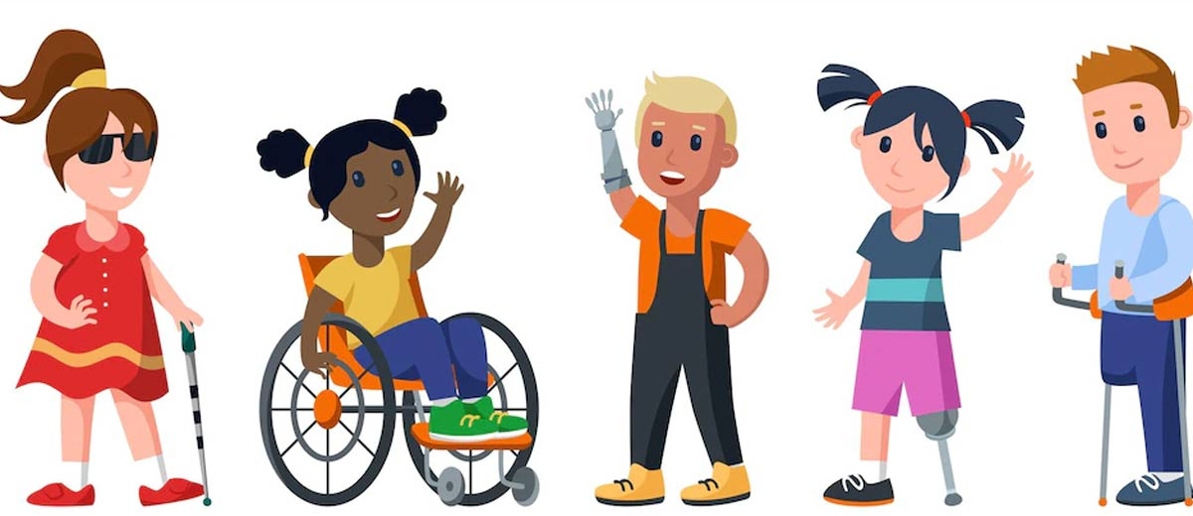
Developmental disability
Significant delay and impairment of acquired skills
Implies permanent condition with high morbidity with respect to the child’s social, language, sensory, motor, self-help and cognitive abilities
Children who have a disability are at increased risk of abuse and neglect.
Notes:
Children who have a disability are at increased risk of abuse and neglect. This risk can increase or decrease depending on the type and severity of a child’s disability, and the presence and absence of a range of risk and protective factors

Slide 13
Identifying developmental delays
Three major channels
  During routine developmental surveillance or screening
  Following parental concern
  After third parties such as preschool teachers or nursery care professionals raise concerns
Notes:
The child’s health booklet is a useful resource that should be wisely utilised by parents and clinicians to monitor a child’s development. An important step to improve the early identification of developmental delay is educating the parent to make use of the health booklet’s developmental checklist.

Slide 14
Later infancy to school age
Primary developmental domains
  GM
  FM
  Language
  Cognition
  Social and emotional behaviour

Slide 15
Identifying developmental Delays : a structured approach
History
Physical examination
Developmental assessment
Assessment for behavioral syndromes or phenotypes
Differential diagnosis
Targeted investigations

Slide 16
What’s in the History: one rule of thumb
Never ignore a parent’s concern
Parents’ concerns are particularly likely to be accurate in the areas of speech and language skills, cognitive performance and the FM skills
Any history of developmental regression or marked stagnation
History of seizures with developmental implications
Concerns with head circumference
Unusual skin and facial features
Notes:
Overall history taking is the cornerstone of all paediatric assessment

Slide 17
History taking : other key issues
Keep a broad view and open mind throughout and beware of rushing into conclusions
Substantiate parental reporting of neonatal or past history from previous discharge summaries where possible
Learn about parents, siblings and grandparents and any developmental or health issues that have affected them and to maintain broad powers of observation during consultation
Ask if any family went to special school
Ask about child’s play
Specific enquiries about a range of developmental domains

Slide 18
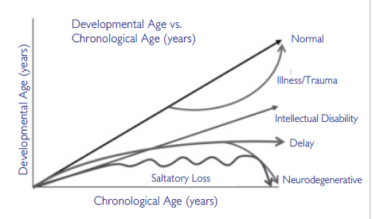
Developmental trajectories
Notes:
Most presentations of global developmental delay result from a previous injury or disease and remain stable over the years.
Static abilities are rarely normal and are therefore a red flag. If children’s abilities do not improve with time, those children might be regressing. It is important to recognize that developmental delay or regressing skills can be caused by raised intracranial pressure secondary to a tumor, hydrocephalus or other non-neurodegenerative entities.
If there is regression, clinicians must consider whether the case involves true regression or the evolution of signs in a static encephalopathy, such as autistic regression

Slide 19
Lost of developmental milestones
Unexplained change in mental status in school-age who fails to respond to psychostimulants for attention problems (ADL)
Rett syndrome

Slide 20
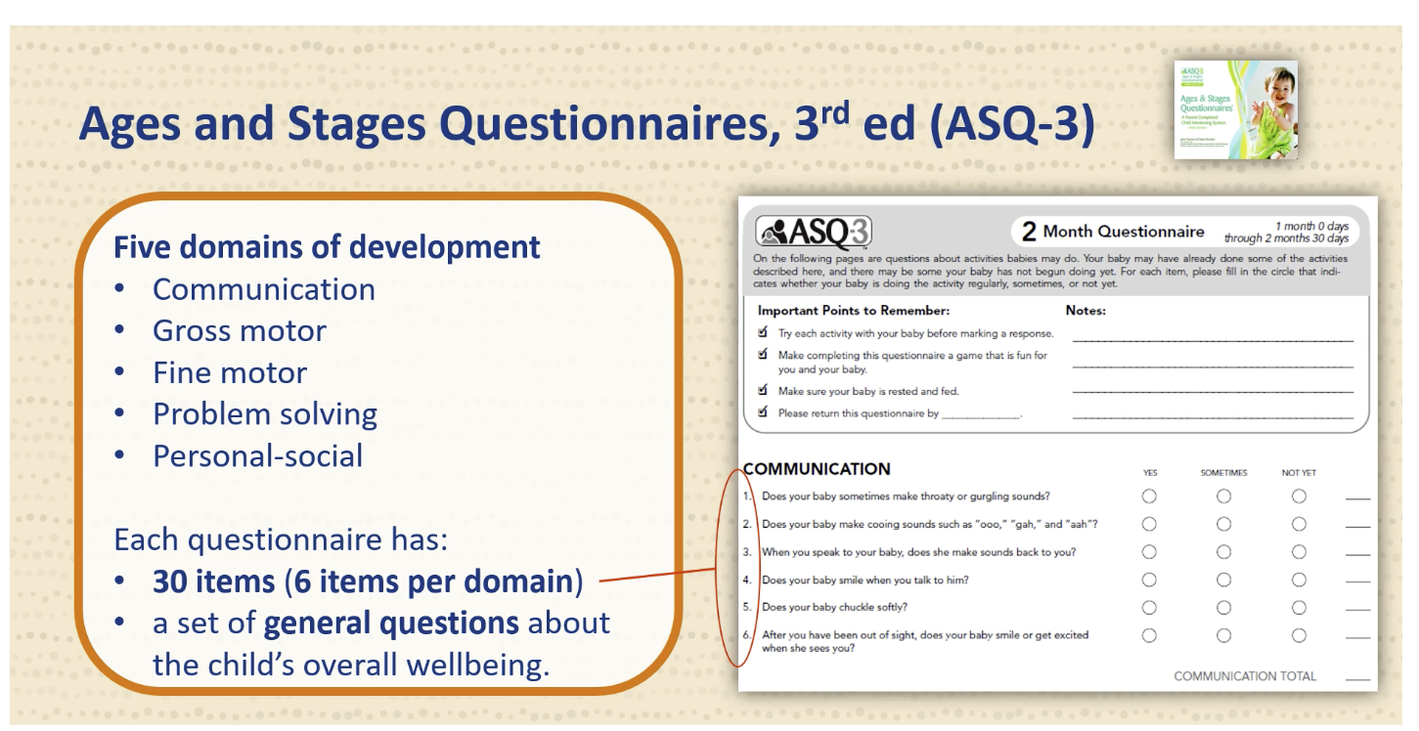
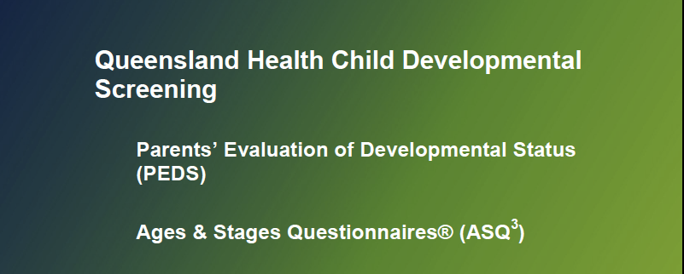
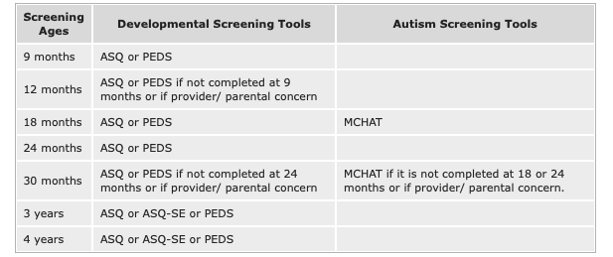
What tools we can use
Notes:
The ASQ is for children 1 month to 6 years of age and includes a review of communication, gross motor skills, fine motor skills, and problem solving skills. A second screen, the Ages and Stages Questionnaire: Social-Emotional (ASQ-SE) screens for personal-social issues (self-regulation, compliance, communication, adaptive functioning, autonomy, affect, and interaction with people). Parents/caregivers complete the questionnaires; professionals, paraprofessionals, or clerical staff score them. ASQ questionnaires are designed for specific age levels, and they are available in Spanish and English.
PEDS, both an evidence-based surveillance tool and a screening test, is designed for children birth to 8 years of age. It contains 10 short questions that elicit parents' perspectives on their child for each developmental domain. One parent response form is used for all age ranges, and it is available in several languages. Parents can complete the form in 5 minutes; providers can complete scoring and interpret the results in 2 minutes.

Slide 21
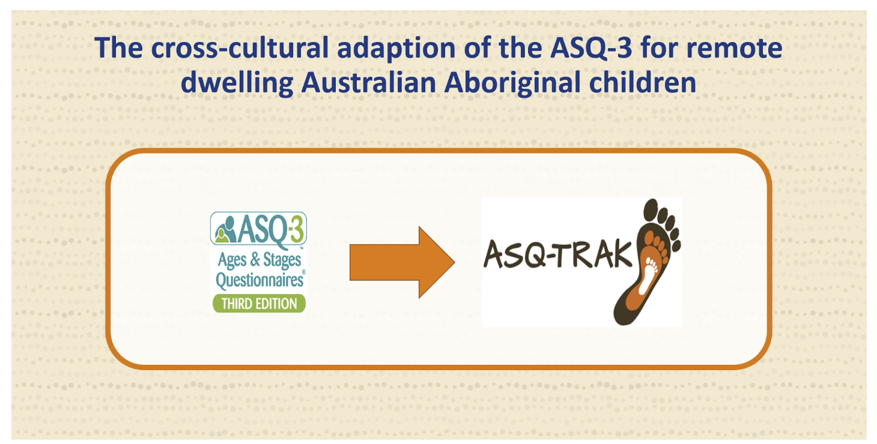
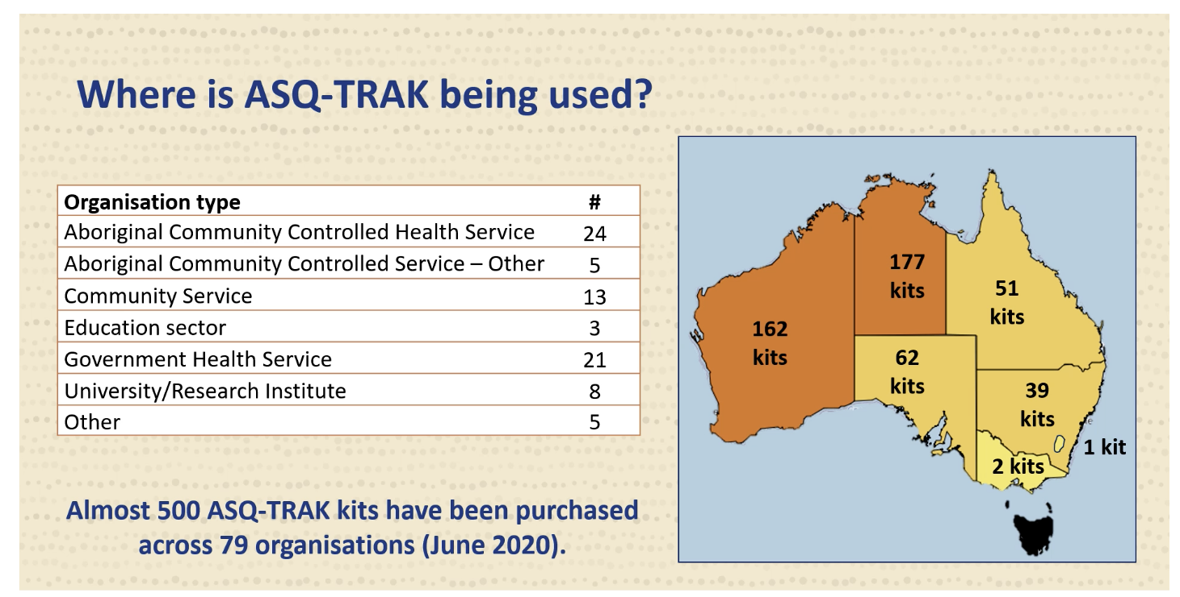
A developmental screening tool for observing and monitoring the developmental progress of Aboriginal and Torres Strait Islander
Developed in 2023 targeting children from 2 months up to 5 and ½ years

Slide 22
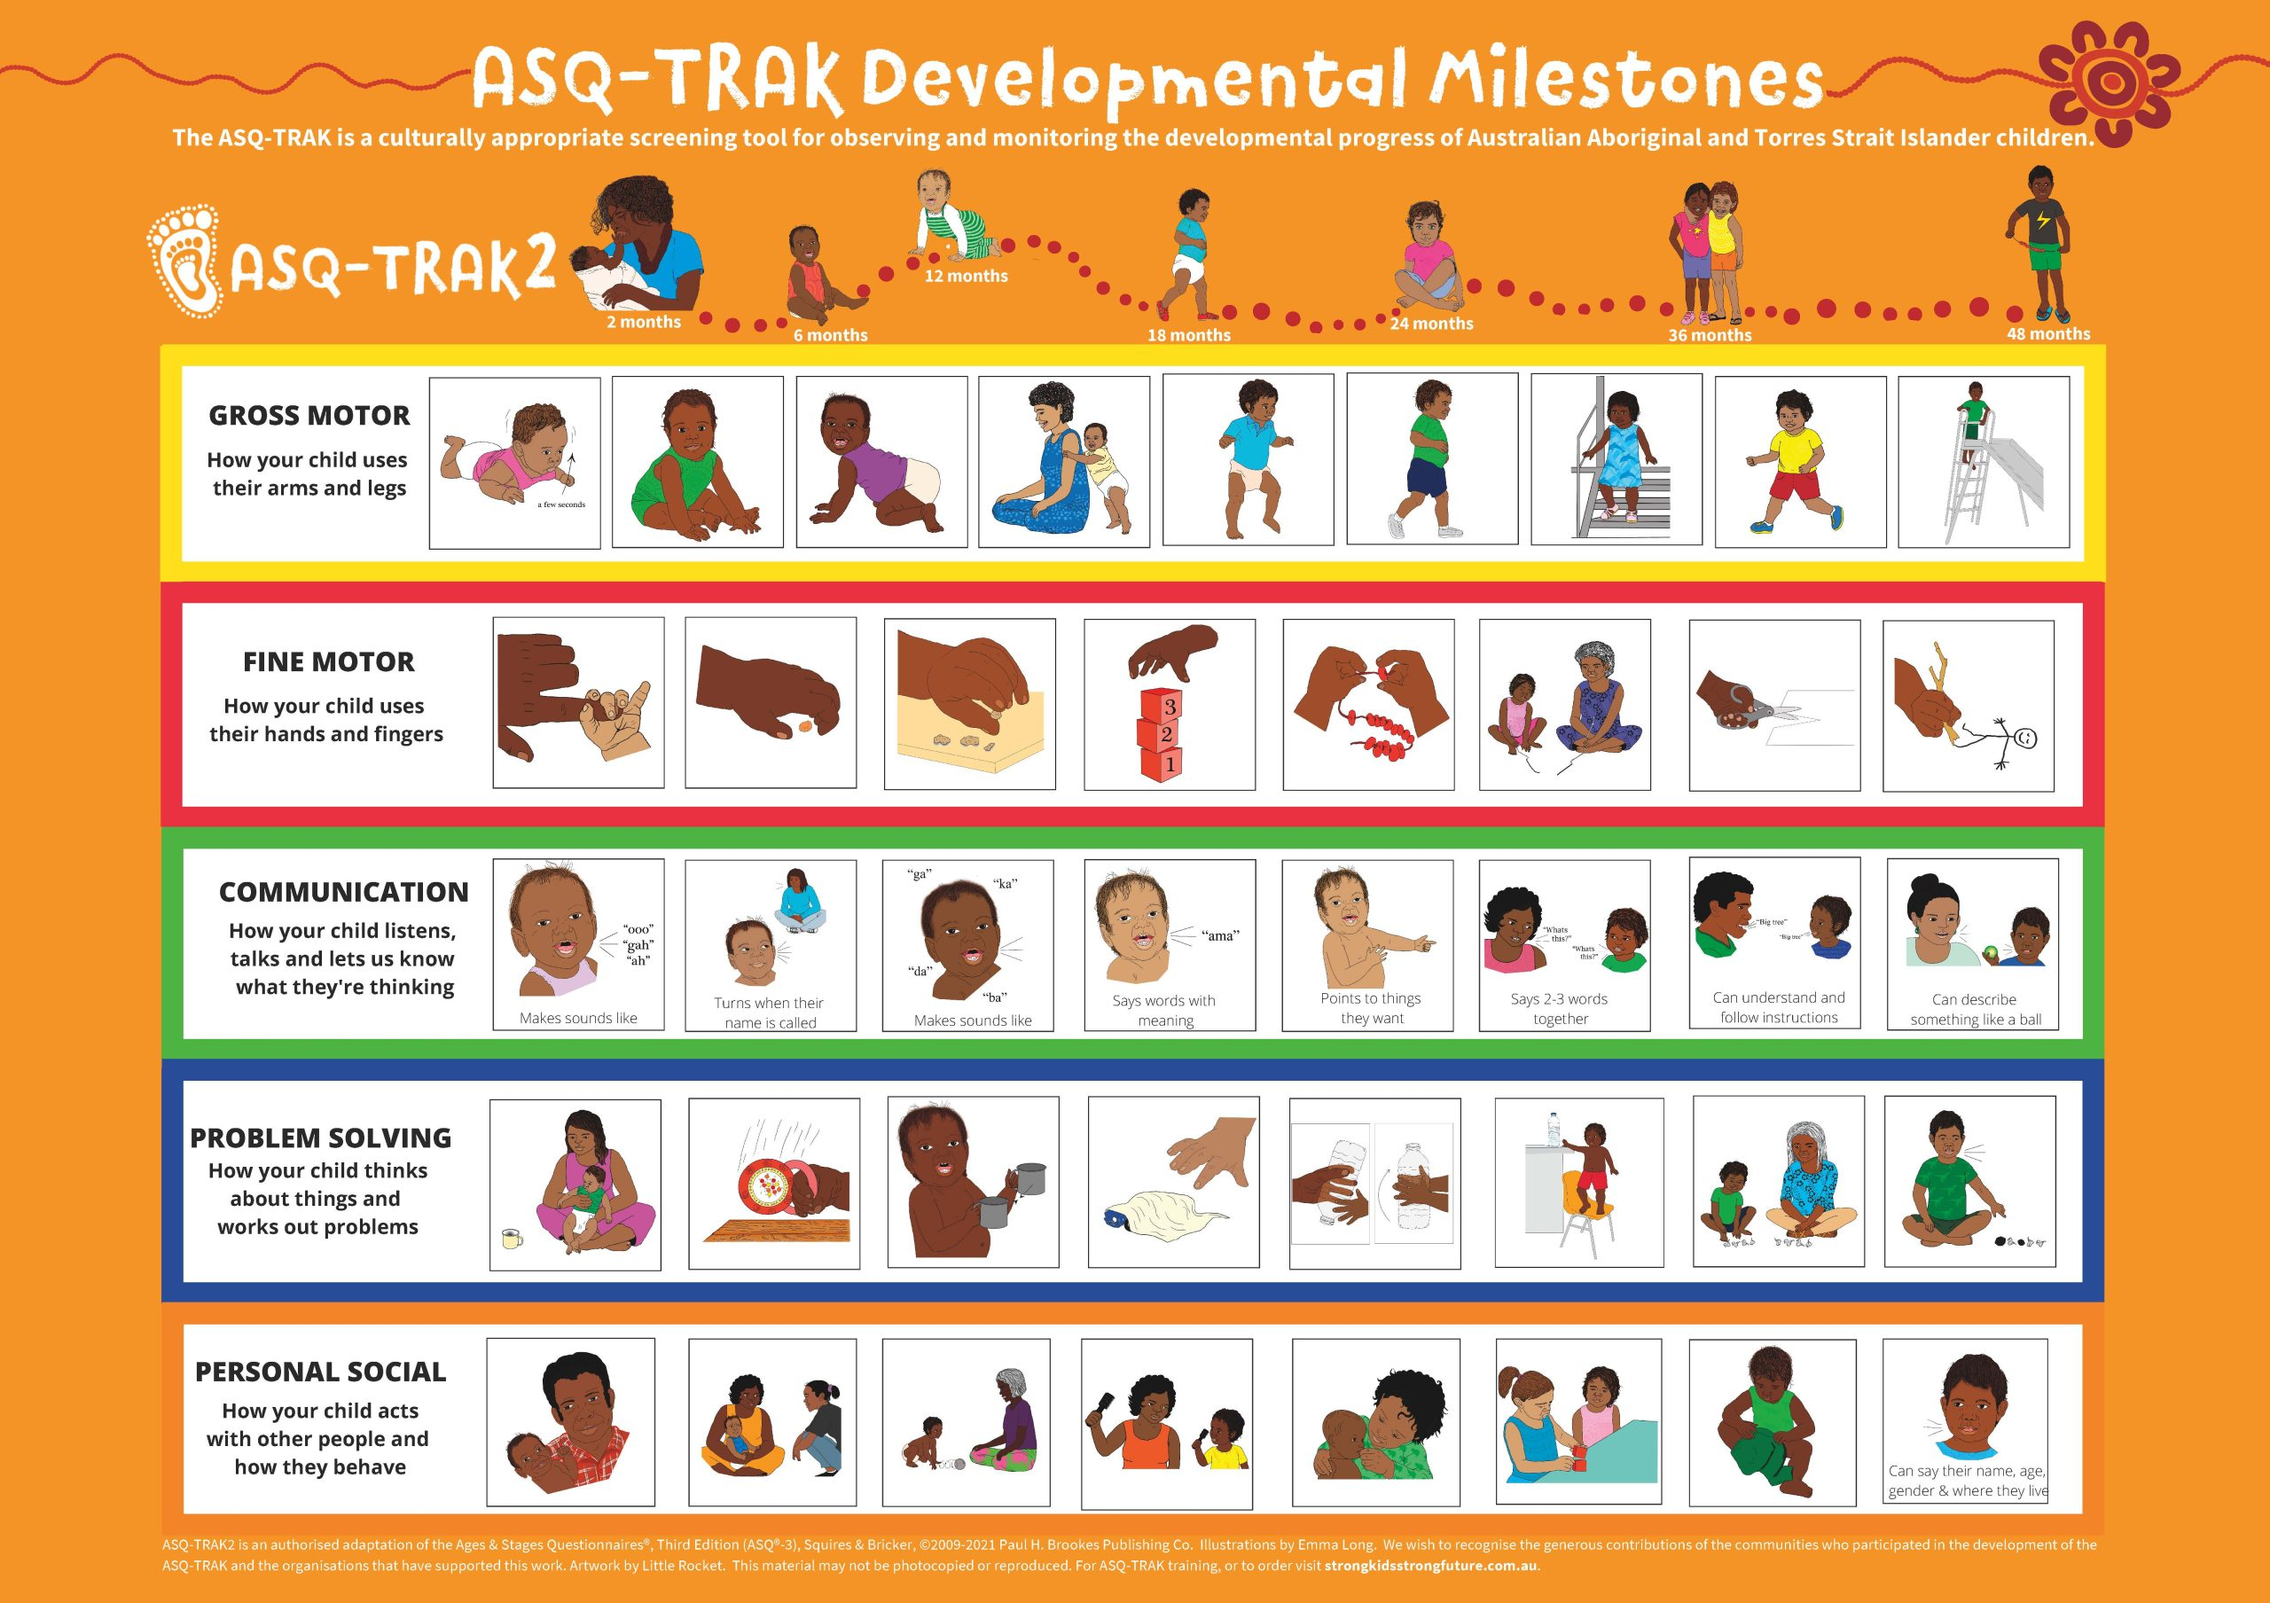

Slide 23
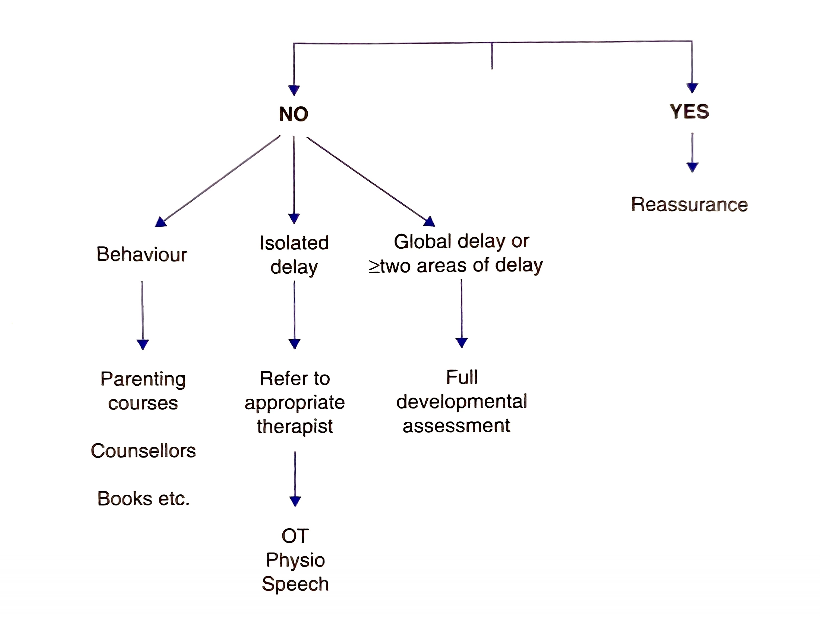
After the screening
If unsure, err on the side of caution and refer to Paediatrician
Notes:
After screening and office-based assessment, one should have an idea whether the young child’s development is within the broad range of average expected for age or whether there remains concerns regarding development in one or more areas
If the concern is regarding an isolated delay, referral to that specific allied health professional is indicated, that is, SP and language pathologist (and hearing test); Physiotherapist (motor and tone); occupational therapist (FM and GM coordination); clinical Psychologist (behaviour, parenting) and formal vision assessment
If there is concern regarding delay in 2 or more areas of development, referral to MDT /CDS is required for comprehensive diagnosis and assessment.

Slide 24
Investing in parental education
Most developmental delays are time –limited
Prevention of the delays themselves and shortening their duration may respond to environments that stimulate cognitive, motor, sensory, psychological, social and emotional development across setting (home, school, daycare)
Parent training can foster a proper understanding of the functional impact of the needs of children and the risks intrinsic to developmental delay
  Parent guidance should be a part of every pre-natal and well-child visit

Slide 25
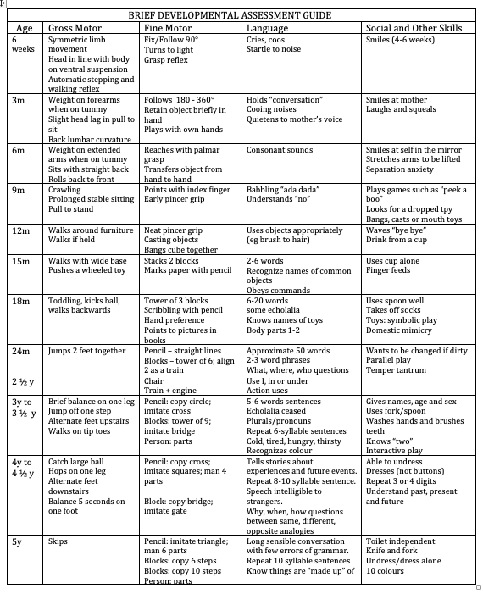
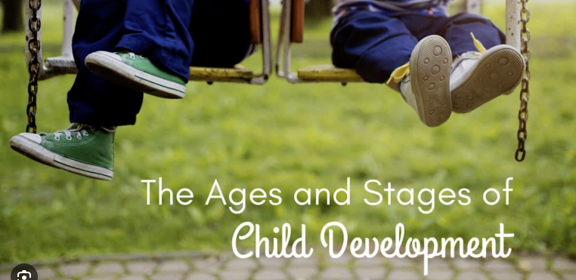




Slide 26
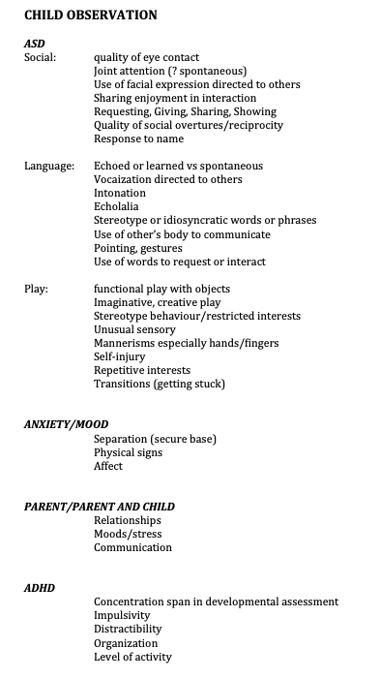
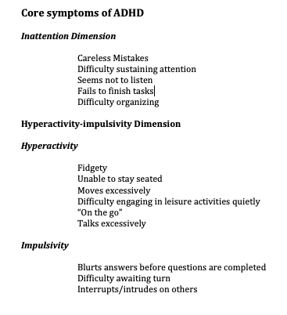

Slide 27
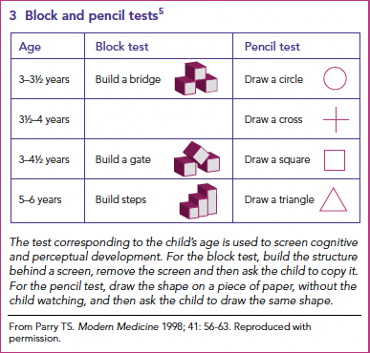
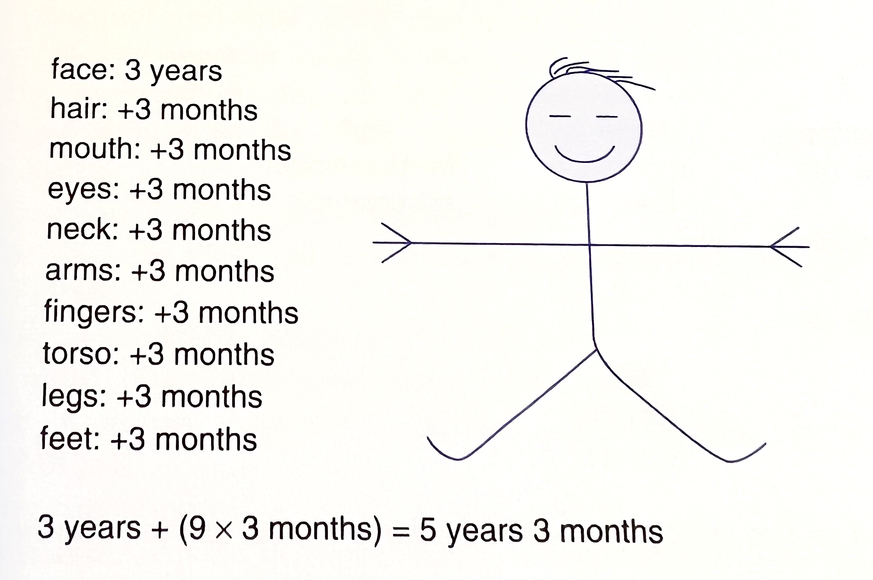
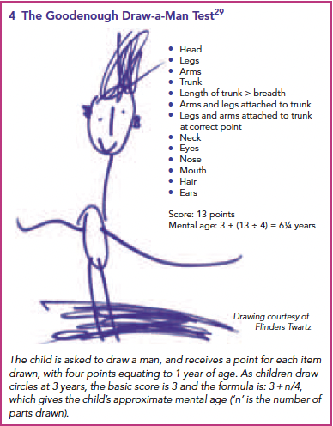
Goodenough-Harris drawing test
MJA • Volume 183 Number 1 • 4 July 2005
Notes:
Fine motor competency can be assessed by a child’s ability to
do up buttons and tie shoe laces, and in cutting, threading,
pegboard proficiency and drawing. At a screening level, some
useful information can be obtained by noting a child’s ability to
copy a range of geometric and block shapes (Box 3).
The
Goodenough Draw-a-Man Test is also helpful as an indicator of
cognitive development (Box 4)
Florence Goodenough in 1926 Draw-A-Man Test. Dale B Harris later revised and extended the test . The child is asked to draw the best person they can draw. The starting point is a circle for the face at 3 years of age. An
Additional point is then given for each item drawn, with each point being worth an extra 3 months.

Slide 28

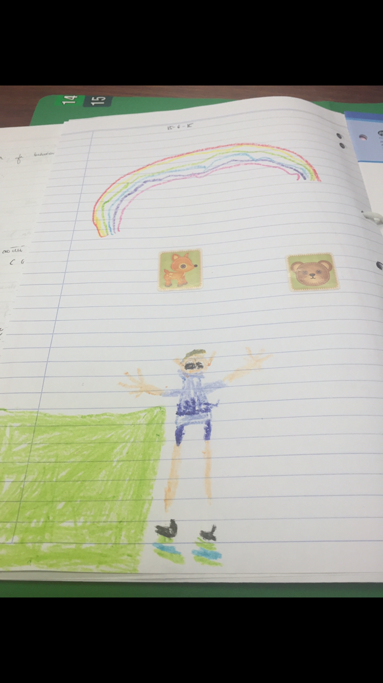

Slide 29
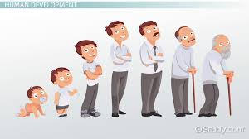
Because development is dynamic in nature and surveillance and screening have limits, periodic screening with a validated instrument should occur so a problem not detected by surveillance or a single screening can be detected by subsequent screening.

Slide 30
Red flags for important group of disorders

Slide 31
Metabolic disorders
Parental consanguinity
FHx of unexplained illness or death in childhood
Slowing of developmental skill acquisition
Loss of skills
Evidence of encephalopathy
Coarse facial features
Organomegaly

Slide 32
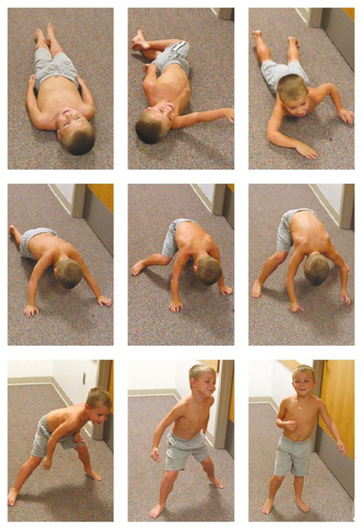
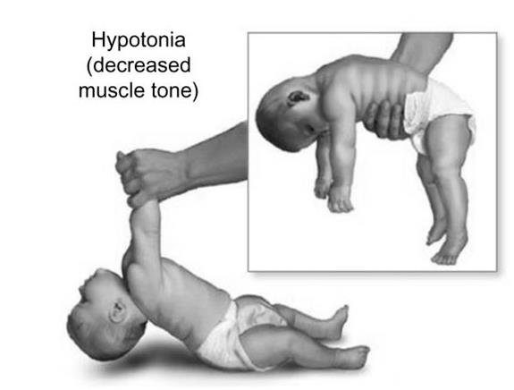
Neuromuscular disorders
Reduced foetal movements
Early feeding difficulties
Hypotonia/floppy infant
Late motor milestones (specially if male and not walking by 18 months)
“Slips through hands” when picked up
Head lag when pulled to sit
Depressed or absent deep tendon reflexes
Unable to jump by 3 years or hop by 5 years
Waddles when attempting to run

Slide 33
Helpful questions
Has your baby missed any developmental milestones, such as holding their head up or rolling over?
Does your child have trouble sitting or standing on their own?
Have you seen your child have trouble breathing?
When did you first notice the symptoms?
Has anyone in your family had similar symptoms?
Notes:
Helpful in SMA

Slide 34
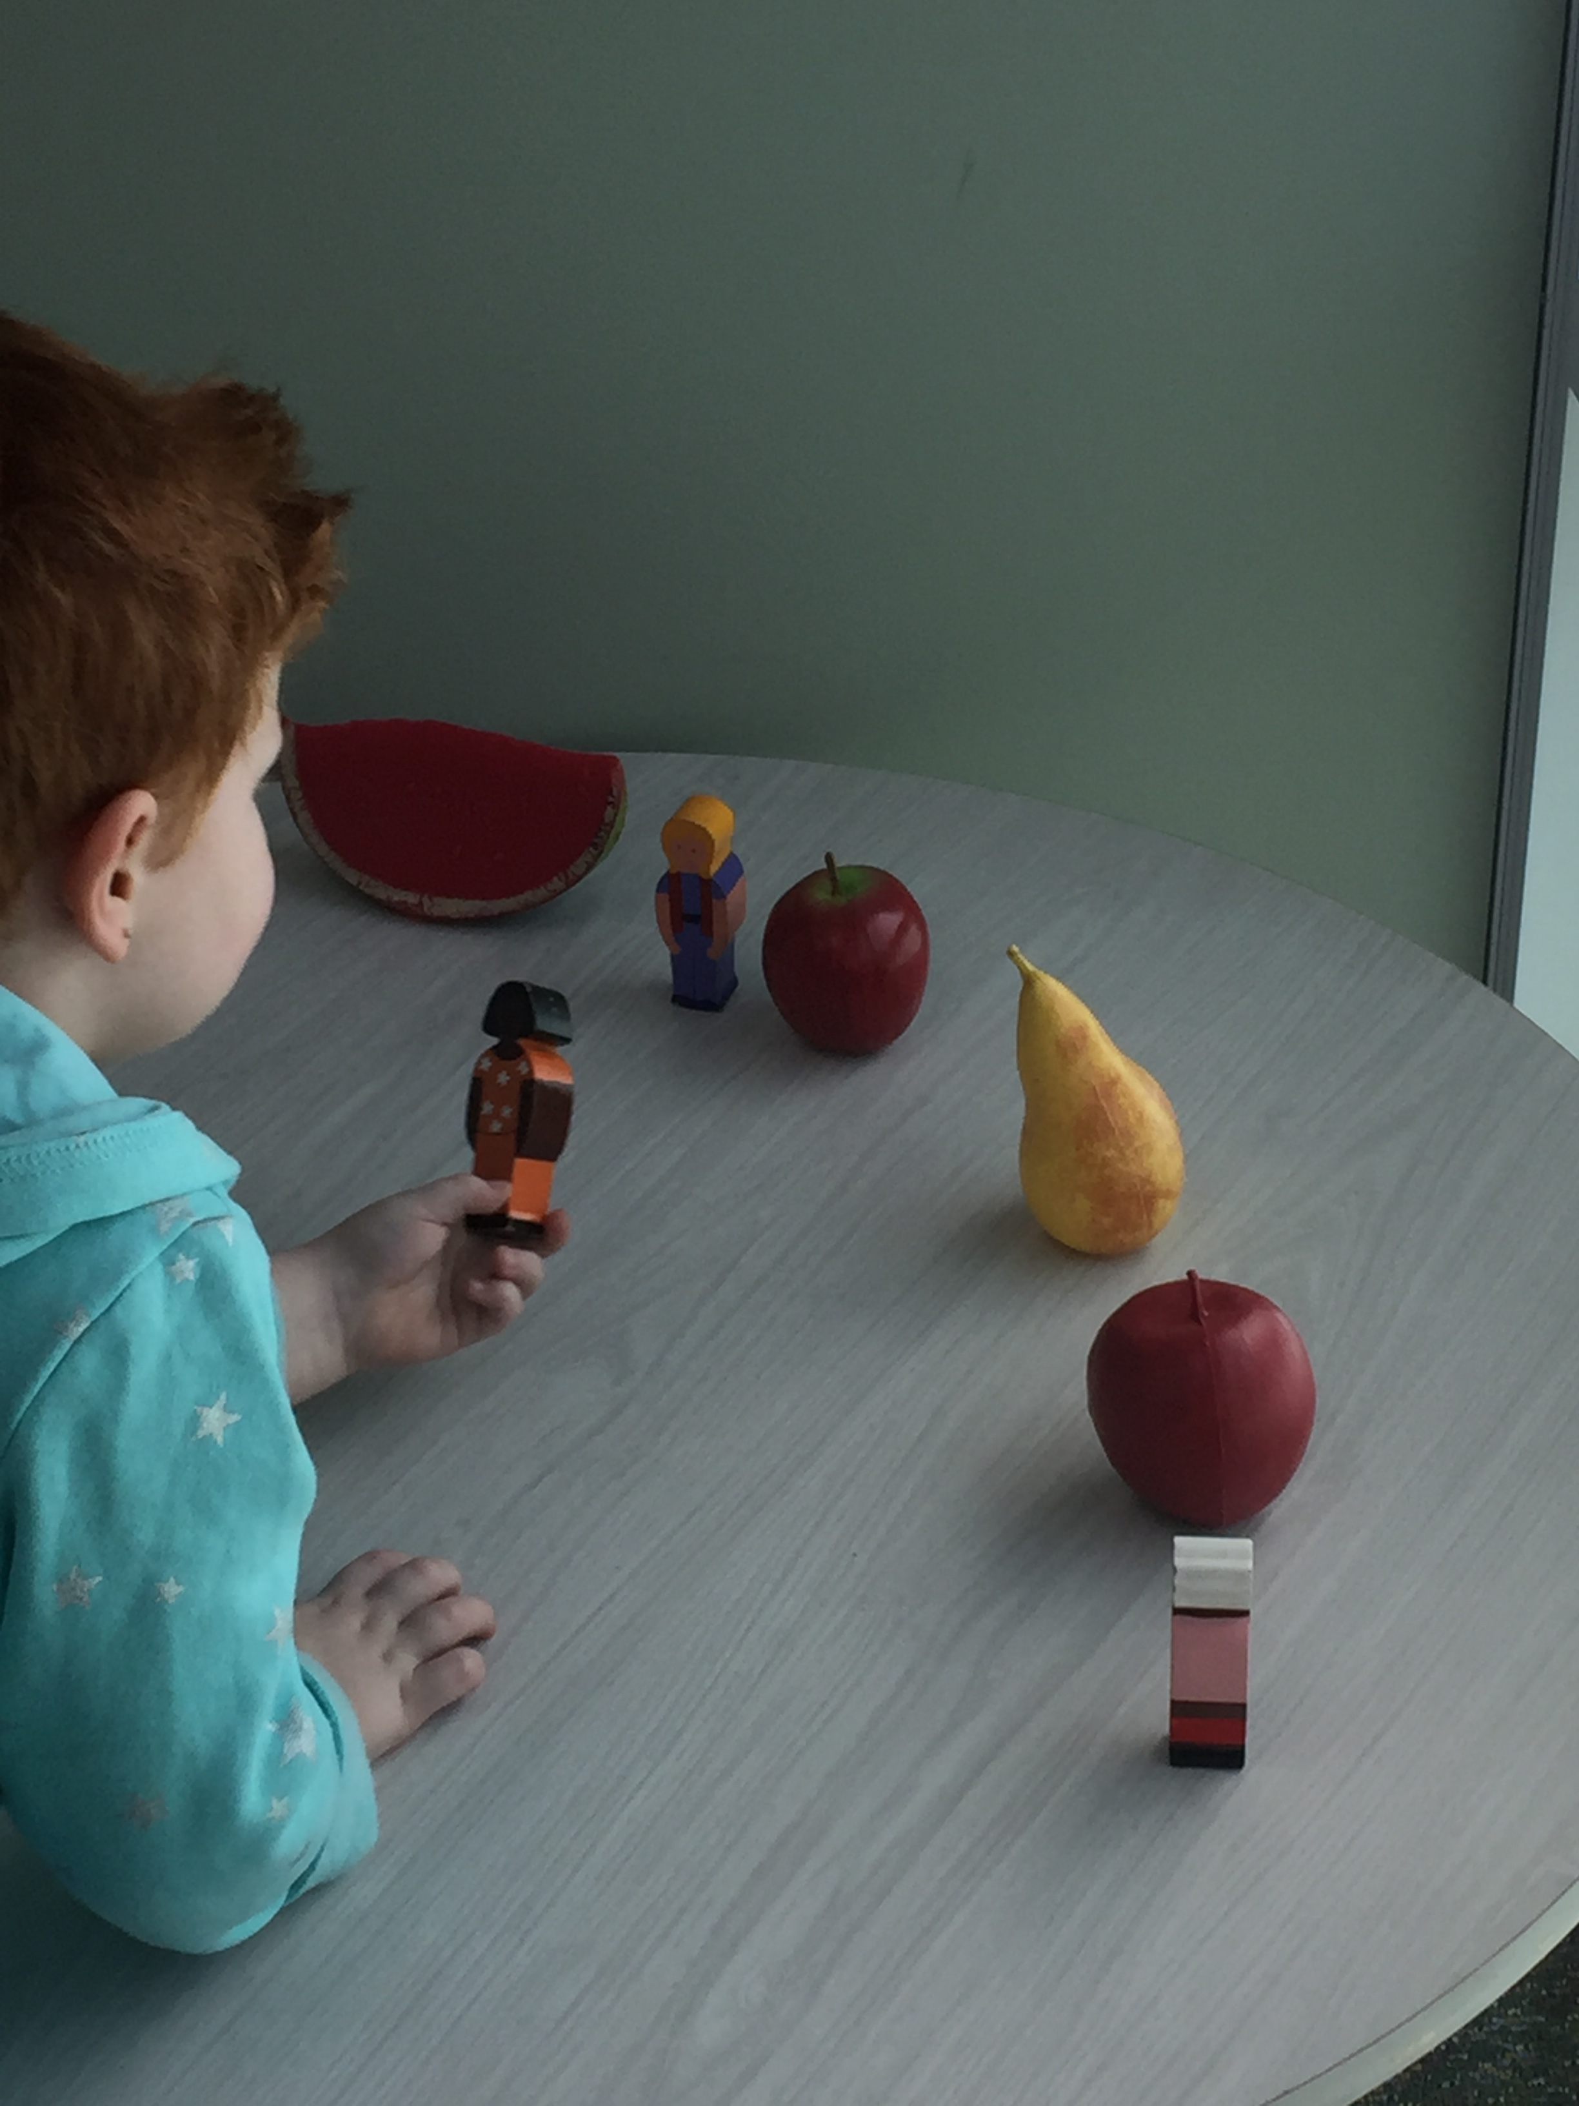
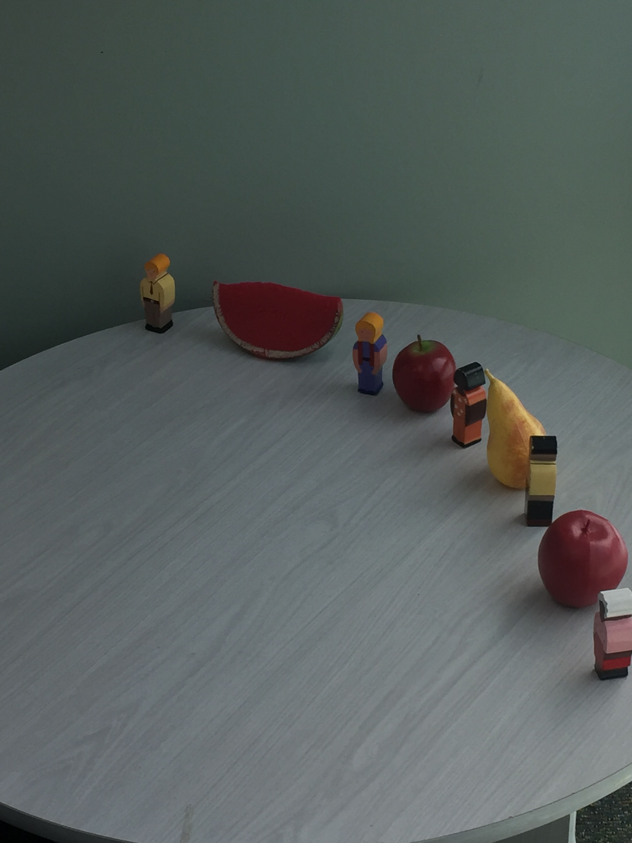
Autism spectrum disorder
Does not point to share interest or attention
Does not initiate interaction
Unusual eye contact and/or gesture
Does not show appropriate empathy
Marked insistence of sameness
Paucity of creative, spontaneous imaginative play
Restricted range of interest
Compulsive routines or rituals
Play with no purpose

Slide 35
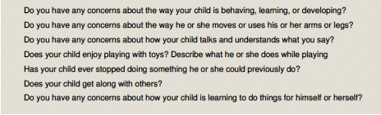
Opportunistic screening questions

Slide 36
What to look for during physical examination
Observe baby’s interaction and response to their mother or parent, temperament and general physical condition
Ascertainment of Ht, Wt and HC with reference to trends overtime
Overgrowth, short stature, faltering growth, early or delayed puberty
Macrocephaly or microcephaly
Presence of birthmarks
Dysmorphic features (enquire as to whom in the family the child’s look like)
Detailed systemic, musculoskeletal and neurological examination
Hearing

Slide 37
Head Circumference
Correlates with brain size and growth of the infant
Growth
  First 3 months : 2cm/year
  3 months to 1 year : 2cm every 3 months
  1-3 years: 1 cm every year
  3-5 years: 1 cm per year
  At 6 years old: approximate adult size
Macrocephaly
Microcephaly
Notes:
Macrocephaly: above 98th centile

Slide 38
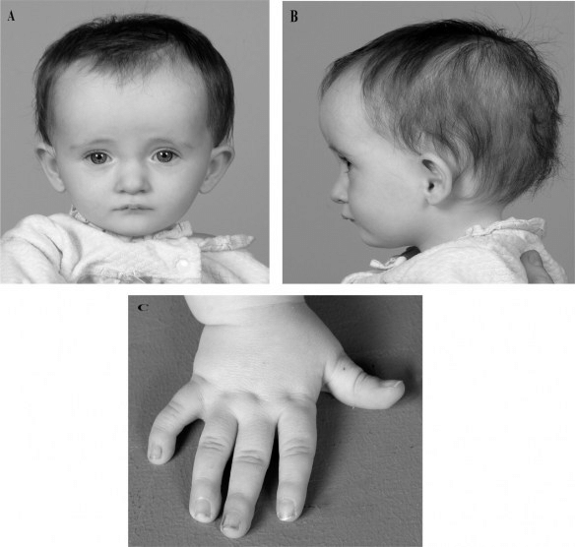
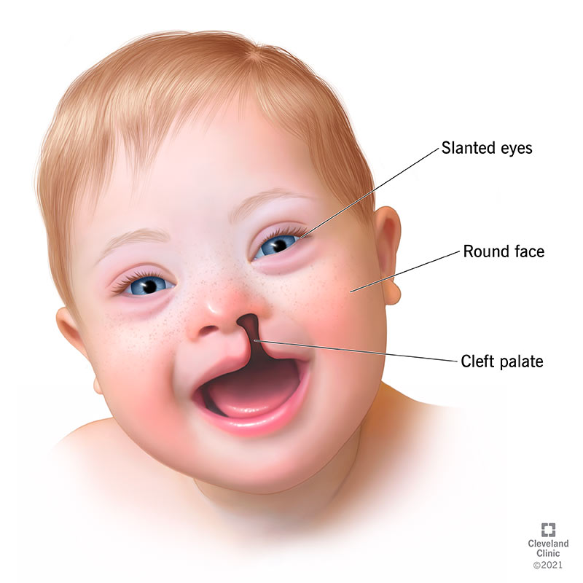
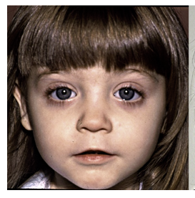
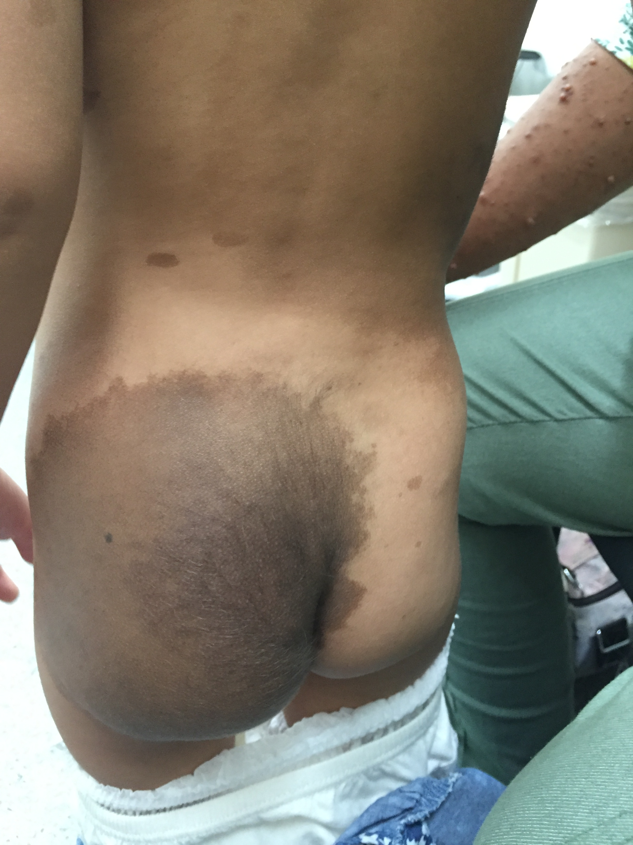

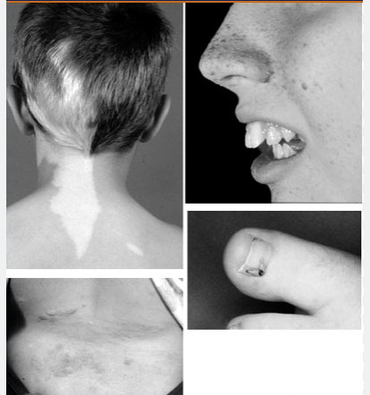

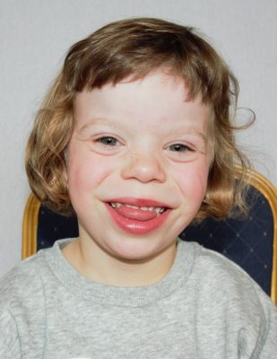
Skin and facial features

Slide 39
Primitive reflexes in the infant
Moro reflex: should be complete and symmetrical by 34 weeks gestation.
  Absence is abnormal
  Asymmetrical (hemiplegia, brachial plexus injury, clavicular fracture
  Should not be present by 3-4 months of age
Grasp reflex
Stepping reflex
ATNR
Parachute reflex
  Emerges by 7-8 months
  Well developed by 10-12 months
  Asymmetrical can be an early sign of hemiplegia

Slide 40
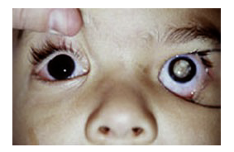
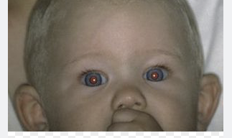
vision
Absence of a fixing and following response at 4-5 weeks
Presence of abnormal eye movements
Absence of red reflex
Squint
Notes:
Absence of fixing and following at 4-5 weeks is a significant sign and may be due to vision impairment or brain damage/dysfunction
Eye movements ( might indicate severe vision, developmental or neurological problems
Red reflex none- cataract or retinoblastoma

Slide 41
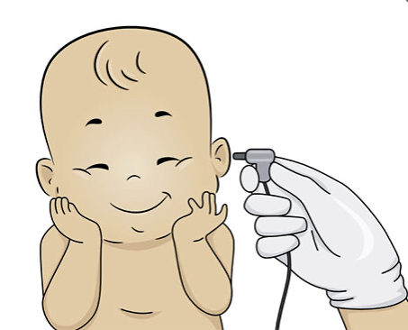
Hearing
Parental report that infant seems unresponsive to loud sounds
Practice points: infants who are born deaf do not respond to their mother’s voice or environmental sounds BUT are very alert to visual cues , such as their mother’s face or gesture.
Deaf infants will babble at the same time as normal hearing infants, BUT babbling fails to develop further or become richer in expression
Hearing impairment: congenital, infection, drugs, toxins
Notes:
Doctors sometimes wrongly reassure parents that a baby who babbles cannot be deaf

Slide 42

Signs of childhood hearing loss
Birth to 4 months
  Does not waken or stir to loud noises
  Does not startle to loud noises
  Does not calm at the sound of familiar voice
  Does not respond to mother’s voiceby smiling or cooing
4-9 months
  Does not turn towards source of familiar sounds
  Does not smile when spoken to
  Appears not to notice rattles or other sound-making toys
  No variation in cry for different needs
9-15 months
  Little variation in babbled sounds
  Does not respond to their own name
  Does not respond to changes in tone of caregiver’s voice
  No single words
  Does not use their voice to attract attention

Slide 43

Signs of childhood hearing loss
15-24 months
  Does not point to familiar objects when named
  Does not listen to stories, songs or rhymes
  Does not follow simple commands
  Does not use several different words
  Does not point to body parts when asked
  Does not name common objects
  Does not put two or more words together
Preschool and older children
  Turns up volume of TV excessively high
  Respond inappropriately to questions
  Does not reply when called by name
  Watches others to imitate what they are doing
  Has articulation problems or SP / language delays
  Has academic problems
  Complains of earache, ear pain or head noises
  Has difficulty understanding what people aresaying
  Speaks differently from other children of their own age
Children who have known risk factors for hearing loss needs close audiologic supervision
Even if the NB hearing screen passed.
Any child with recurrent or persistent OME for at least 3 months must be referred for audiologic
evaluation

Slide 44
Speech and language: when to be concerned
Infant that does not vocalize : typically starts around 6 weeks; concern if none by 4 months
No babble (two or more word-like sounds): usually starts around 7 months; concern if none by 8-10 months
No single words by age 18 months: usually starts at 10-12 months
No word combinations or two-word phrases by the age of 2 years: usually starts by 18 months
The child under 2 years of age who do not respond to simple requests
No simple sentences or phrases at 3 years
Persistent dysfluency at 4 years (persistent stutter)
Speech sounds errors at 7 years
Causes: deafness, developmental disability,
Specific language disorders, severe deprivation
And neglect. Others ASD, orofacial abnormalities
That impede speech development
Notes:
Leaving off sounds from words (example: saying “coo” instead of “school”) Adding sounds to words (example: saying “puhlay” instead of “play”) Distorting sounds in words (example: saying “thith” instead of “this”) Swapping sounds in words (example: saying “wadio” instead of “radio”)

Slide 45

Social interaction
No smile at 6-8 weeks
Little or no eye contact with mother when being nursed
No interactive vocalization
No reaching for objects or interest in surroundings
No pointing to objects at around 12 months
No interest in play or interaction with other children at 2 years
No turn taking behaviour in play at 3 years
Older child that seems to be in own world and showing little desire to interact with others
Social Relationship
At 2, children enjoy being with other children. They begin to offer toys to other children. They start to imitate other children’s actions and words. They start holding the book the right way up. They start to read to stuffed animals
At 2 ½, the child starts to have turn taking, either by using toys or having little conversation. They start showing concern when another child is hurt or sad. They start combining several actions in pretend play. They remember and understands familiar stories
Notes:
Pointing is an important gesture of the index finger used to request an object (called protoimperative pointing) or to draw attention to an object to comment on it or share interest in it (called protodeclarative pointing). The ability to make pointing gestures typically develops by the age of 12 months

Slide 46
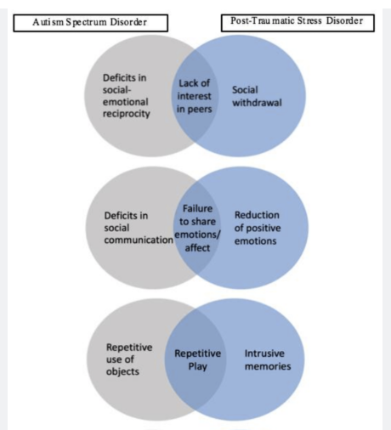
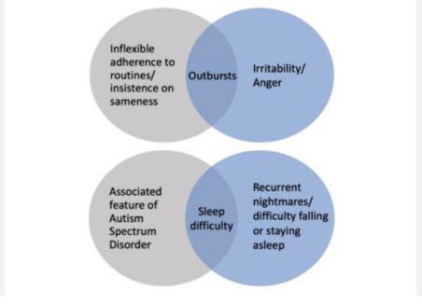
ASD vs PTSD ?
Stavropoulos, K.K.M., Bolourian, Y., & Blacher, J. (2018). Differential Diagnosis of Autism Spectrum Disorder and Post Traumatic Stress Disorder: Two Clinical Cases. J. Clin. Med, 7, 71.

Slide 47
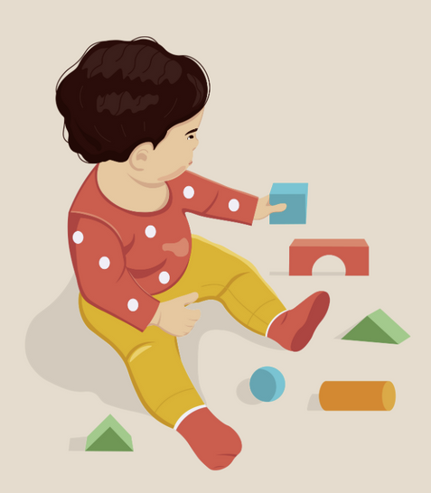

motor skills
Fine motor
  Early development of hand dominance might indicate weakness on the opposite side (eg hemiplegia)
  Handedness should not develop before 12 months of age and consistent hand dominance typically occurs at around 2 years of age
Gross motor
  Delay in sitting alone at 6-8 months
  Not crawling by 10-12 months
  No cruising at 12-15 months
  Not walking at 18 months often associated with bottom shuffling and (+) Fhx of late walkers

Slide 48
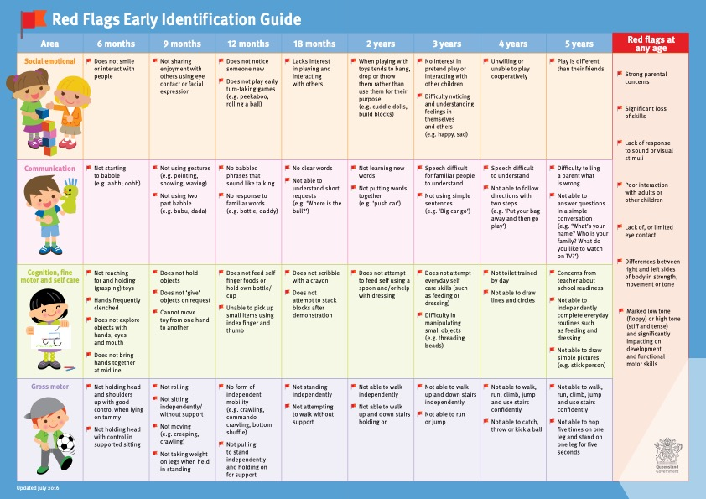

Slide 50
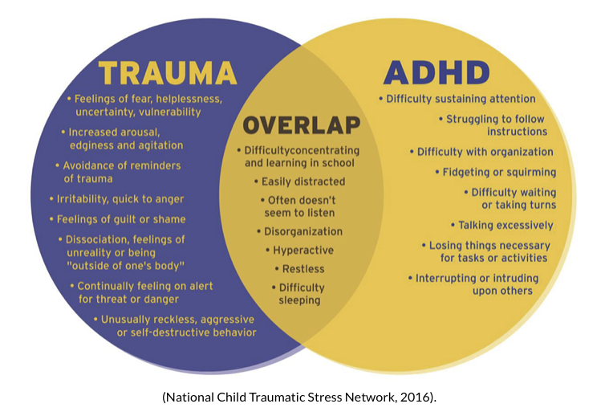
Traumatic Stress and Disability
Notes:
Many children who have experienced stress and trauma due to abuse, neglect, and other adverse life experiences present with symptoms that can overlap with other neurodisabilities like ADHD.. Not every child who experiences abuse or neglect will experience a traumatic stress reaction, but many will. When a child has traumatic stress, they may exhibit signs such as:
An inability to concentrate
Behavioural regression (for example, wetting themselves when previously toilet trained)
Separation issues, appearing fearful and anxious
Somatic complaints (complaining of a stomach ache with no medical explanation)
Aggression
Impulse control issues
What would the outcomes for a child be if you only pursued therapeutic intervention for the child in response to his traumatic stress due to the domestic violence?
What would the outcomes be for the child be if you only pursued an ADHD diagnosis?
Everyone’s disability affects them in a different way. Never assume to know how a person’s disability affects them without asking them and understanding first.
Children who have a disability are at increased risk of abuse and neglect. This risk can increase or decrease depending on the type and severity of a child’s disability, and the presence and absence of a range of risk and protective factors

Slide 51
How relevant is this to my practice

Slide 52
As a primary care physician
Significant role in early identification of developmental delays both through developmental screening and routine developmental surveillance
Evidence of effective early identification of developmental delays and timely intervention can positively alter a child’s long-term trajectory

Slide 53
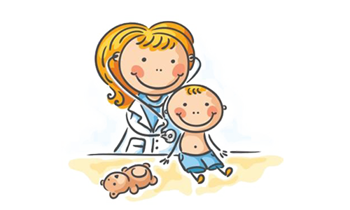
GPs perspectives on their role in well-child health care
GPs play a central role in the early detection of developmental and behavioral problems in children
GPs had a predominantly preventative focus approach “to catch things early”
Main well-child care was opportunistic rather than proactive
Nurse Practitioner
Notes:
a proactive approach to health promotion, wanting to “catch things early” (GP6). delivering preventative services to well-children and their families, including immunisations, assessing growth and development, discussing
behavioural issues and providing information to parents regarding their concerns.
They achieved this through organising routine health checks to identify problems with development, as well as applying recall systems for immunisation to “. . .make sure you get them back if they don’t come in time
Opportunistic approach to preventative health care, providing child health surveillance focused on growth, hearing, vision and speech when a child was brought in for a scheduled immunisation visit, an episodic illness or when brought in by a “motivated mother”. Arguably this is the most common approach in general practice
When asked about their role in health care for children, they immediately reflected on the sick child rather than the well-child
Some practices usually the Nurse practitioner do the routine health checks
with, “We normally see unwell children” (GP6) and “With well-children, they hardly come to the surgery. They normally come with a problem”
Fragmented Care: Here the family chooses the GP whenever they want, whoever they want. So they can move from GP to GP. So there can be a problem in the continuity of care
The Royal Australian College of General Practitioners (RACGP) states that children should be screened opportunistically, to assess hearing, vision, language and social skills, as well as growth and development

Slide 54
Fragmented care
Difficulty in maintaining continuity of care
  Switching GP
  GP not knowing what’s around
  Affordability in non-bulk billing practice
  Revolution of knowledge through the internet “Dr Google”
Nurse Practitioner
  GPs not having involvement citing the redundancy of these services in well-child-care
Notes:
Here the family chooses the GP whenever they want, whoever they want. So they can move from GP to GP. So there can be a problem in the continuity of care
Dr Google – recommendation not followed needing for families to research it first
GPs defer the healthy kids check and other child health activities to practice nurses

Slide 55

Key limiting factor for a GP
LACK OF TIME
  Difficulty allocating adequate time to properly assess the well-child as well promote key health messages to parents
  “Crowding out” of non acute and preventive care visits by ageing population
Lack of resources and training

Slide 56


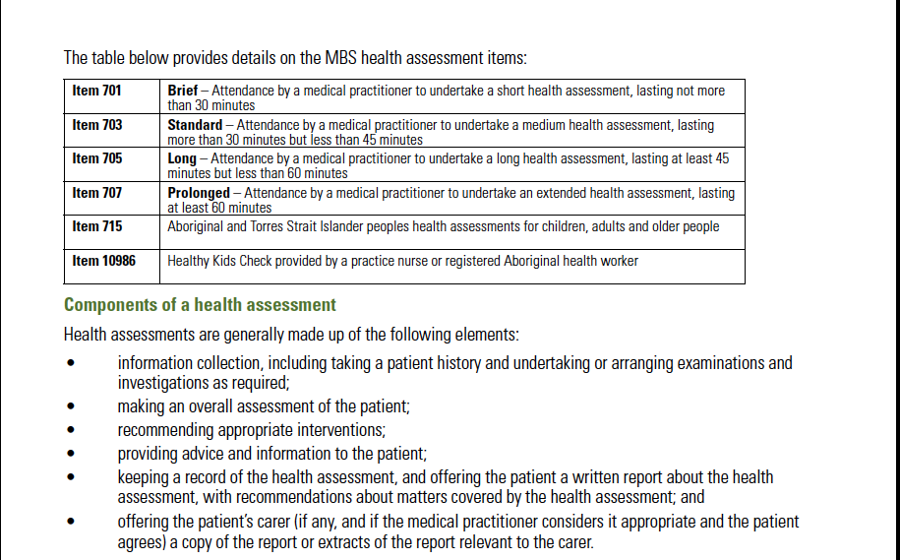
Notes:
a checklist of assessments to gather health information, identify health problems and promote healthy lifestyles at four years of age
The Medire item number (national health insurance) for this check, intended to identify children in need of additional services prior to school entry, does not appear to have been well utilised by GPs.
Since its introduction in July 2008,not well utilized

Slide 57
Every paediatrician, generalist or specialist, at every level and in every setting will come across a child or young person with disordered development.
We have a duty of care to ensure that appropriate assessment and investigations are undertaken.
Each individual is to be given the best possible opportunities to achieve the highest possible level of participation and enjoy the best possible quality of life.
Karen A Horridge Arch Dis Child Educ Pract Ed 2011;96:9–20

