Slide 1
What GPs can do for Early Intervention
An approach to developmental concerns in the first 2000 days
DR KK CHEUNG
GP with Special Interest Developmental Paediatrics
Gold Coast University Hospital
LEILA ELLIOTT
Occupational Therapist,
Child Development Service
West Moreton

Slide 2
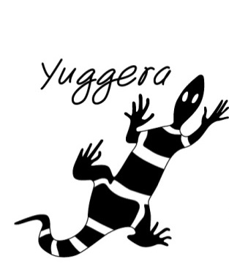

Acknowledgement of Traditional Owners
I would like to acknowledge and pay my respects to the Jagera (jag-er-a), Yuggera (yug-er-a) and Ugarapul (U-ga-ra-pul) Peoples, the Traditional Owners and Custodians of the land on which we are meeting today and recognise their continuing connection to land, waters and community.
I would like to pay my respects to elders’ past, present and emerging.
Mental Health Acknowledgement
I would also like to take this opportunity to acknowledge those here today who are living with a mental illness, and those providing care to people with a mental illness.

Slide 3

Jackson: 4yo boy check & immunisations
Approach to consult
Parental concerns – “He’s very active and doesn’t listen”
Developmental domains
Physical health check (don’t forget to graph the growth)
Practical Tips

Slide 4
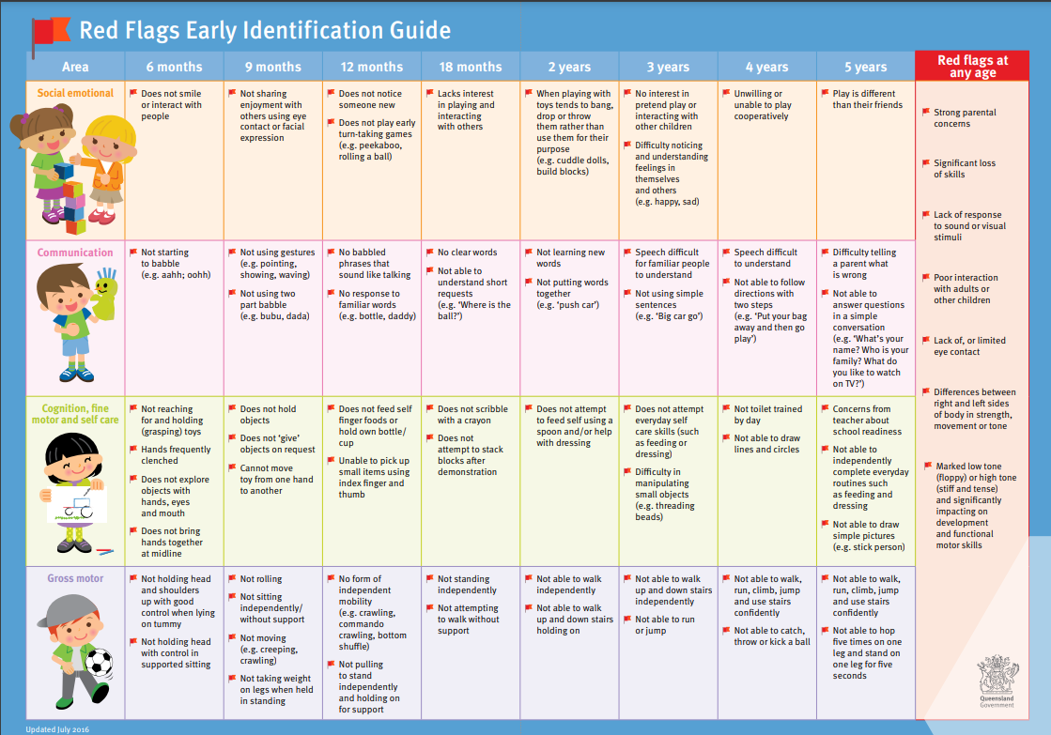
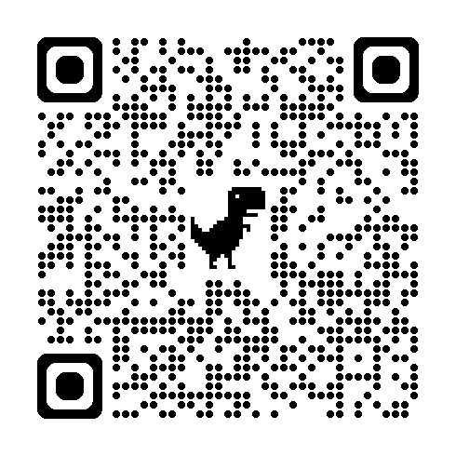
OR
Health Pathways
“Expected Development Milestones”

Slide 5
Practical Tips
SHORT CUTS
History
Gross motor skills
Fine motor skills
Eating/appetite
Toilet training: dry day and night?
Able to tell long stories?
Knows colours/shapes well?
Social concerns daycare/kindy?
TIMING OF CONSULTS
TELEHEALTH: Video
Pre-made handouts (email)
Examination
Growth: Ht and Wt
PEARL
Light reflex
Visual acuity on "E" testing
Cover/uncover test
Teeth oral health
ENT
HS
Chest
Abdo

Slide 6
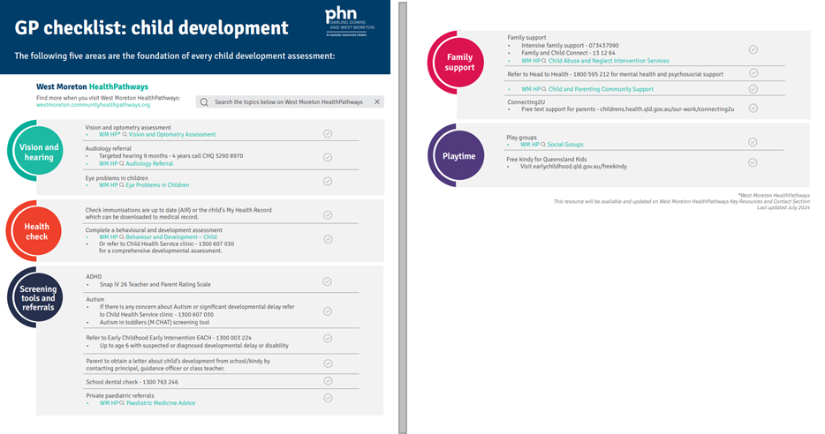

Slide 7
“Homework” for Parents
Hearing and vision screening
  QCH Aligned Optometrists
Community Child Health (Ages and Stages, hearing, development check etc)
Alternate carer feedback (e.g. daycare or kindy teacher observations)
Parenting resources
  Health Pathways: “Child and Parenting Community Support”
  Play Groups
  Triple P online
  Circle of security

Slide 8
Health Services
Team | What is provided: | How to refer
Child Health | Weight and measure for growth, Child hearing screen by appointment; screening available for children from 4 years, Toileting training support, Developmental screening, including ASQ3 School Based Vision Screening for Preps | GP Smart Referral (07) 3817 2340 – Child Health Service 1800 607 030 – Central Intake Parent and Child Health | West Moreton Health parents can self-refer More information on HealthPathways
Audiology Clinic | Can provide hearing assessment for Children with delayed speech and language milestones from 9 months. May be referred on from the Child Health Clinic for assessment. Ipswich Hospital Ripley site- dedicated hearing screening clinic | GP Smart Referral 1800 607 030 – Central Intake Provide information of nature of the speech and language concern Additional behavioural issues Social modifiers i.e. effect on home schooling, out of home residence Otological history More information on HealthPathways.
Notes:
Ages and stages, red book, 4 y/o check.
ENT issues as well, if screening difficult then CH will refer up to hearing.
parents can attend drop-ins without an appt.
ASQ- could be used as evidence to support an NDIS referral.
hearing screening clinic for non-complex children.
More complex children (such as ASD GDD may not be appropriate and will go on waitlist to be seen at Ipswich for diagnostic audiology assessment.

Slide 9
Follow up appointment(s)
  Jackson’s kindy teacher reports the following concerns:
  Trouble sitting still to complete any tasks e.g. colouring or story time
  Needs a lot of one-on-one adult support
  Has hit another child when frustrated
  Often complains he is hungry when dropped off as he hasn’t had breakfast

Slide 10
What Next?
Enlist the help of Allied Health clinician
  Emotional lability, behaviour support and parent-child interaction therapy: OT/psychologist
  Social communication: Speech Pathologists
    GP Management Plan
    Mental Health Plan
    University Allied Health Clinics – assessment and/or therapy
    NDIS Early Intervention: Children <6 with a developmental delay may be eligible
Consider referral to Paediatrics
Consider referral to family support services

Slide 11
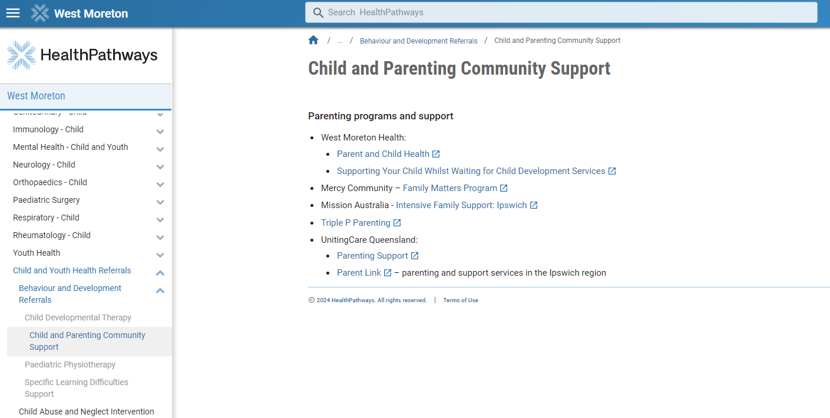
HealthPathways
Search: “Child and Parenting Community Support”

Slide 12
Family and Child Connect (FACC)
Family and Child Connect helps vulnerable families connect with services they need to safely care for their children at home. The service helps families access the help they need before problems escalate.
Parents can seek support through the service to:
  Develop parenting skills and managing child behaviour
  build better relationships between family members, including help with any violence at home
  improve budgeting and managing money
  manage alcohol, drug or gambling problems
  access housing, healthcare or other community or government services.
  The service can also link families to more intensive support services that help families stay together.
Team | How to refer:
Family and Child Connect (Kummara). | 13 FAMILY (13 32 64) Referral Form - Home - familyandchild connect (familysupportreferral.org.au) Information available: Family and Child Connect (familychildconnect.org.au)

Slide 13
Intensive Family supports (IFS)
IFS works with families experiencing multiple and/or complex challenges to help make positive changes to their circumstances and prevent the need for Child Safety to intervene.
They can provide a range of flexible, tailored support services that may include counselling, health interventions and in home supports.
Families must have children between 0 and 18 residing with the parents/carer and must have complex needs, benefitting from access to intensive and specialist support services; they must not currently be involved in statutory child protection.
Team | How to refer:
Mission Australia | - familysupportreferral.org.au - 07 3437 0900
Mercy Community Ipswich | - familysupportreferral.org.au - 07 3280 8000

Slide 14

Early Childhood Early Intervention
(ECEI)
The Early Childhood Approach service helps families with children aged 0 - 8 with assistance, advice and access to support in the local community.
Team | How to refer
EACH | NDIS Early Childhood Approach – EACH Children aged under 6 with developmental concerns/delays or a child with a diagnosed disability up to 9 years of age. Can be completed by a family member or by a professional working with the family. Needs to have impaired functional capacity and require specialist services from more than one professional for longer than 12 months.
Notes:
Multidomain delays
How to refer.
When we decide if a child has developmental delay, we use the definition in the law for the NDIS.
We need to know the delay:
is due to mental or physical impairments
substantially reduces the child’s functional capacity compared with other children the same age.
means the child needs specialist services from more than one professional working as a team to support the child and for longer than 12 months.
substantially reduces the child’s functional capacity compared with other children the same age.
means the child needs specialist services from more than one professional working as a team to support the child and for longer than 12 months.

Slide 15
Health Services
Team | What is provided: | How to refer
Child Health | weigh and measure for growth healthy feeding (breast and bottle) and eating sleep and behaviour information parent support immunisation information Parent Education groups | GP Smart Referral (07) 3817 2340 – Child Health Service 1800 607 030 – Central Intake Parent and Child Health | West Moreton Health parents can self-refer More information on HealthPathways
EIPS (Early Intervention Parenting Support) | For Parents of children under 8 Strengthen family relationships and build positive connections with your children. Help parents understand and support their child’s emotions and behaviours. Develop strategies to cope when struggling with postnatal mood and adjustment. Group programs such as circle of security or individual counselling. | GP Smart Referral 1800 607 030 – Central Intake Need to include the name and DOB of parent and child.
Notes:
CentralIntakeUnit.WMCHS@health.qld.org.au

Slide 16
Health Services Cont.
Health Services
Team | What is provided: | How to refer
Nurse Navigators | Support for young people (0-18 years) with medical and or disability complexity. Create links and supports between the family, acute and community services. Support families to advocate for their children. Help improve communication between families, healthcare providers and services. | GP Smart Referral 1800 607 030 – Central Intake
Notes:
CentralIntakeUnit.WMCHS@health.qld.org.au
GPS have referred from adult world.
Have had a referral from GPs in special schools. = Certain schools that have GPs sitting in school Goodna Dr Shilet.
Need to be on the waitlist of paeds.
Bimonthly meeting with Sarah Townsend. Run through past her at the meeting.
Complex kids
Consultive services to special schools- meet quarterly.
Linkage between acute and community.
Advocate for these patients.
Linkage for kids who are neurodiverse with behavioural difficulties- help with GA- make sure bloods done at the same time.
MRI and got dentist up to look in mouth.
Cassie, General paed,
Fay – NDIS and disability- younger cohort.
0- 18yrs and support young people with medical and or disability complexity.

Slide 17
University Clinics
University | Clinics | How to refer
University of Southern Queensland | Psychology and Counselling Clinics (Toowoomba and Ipswich) Exercise Physiology (Ipswich campus) Speech Pathology Services (currently being set up) | Toowoomba: 07 4631 1763/psychclinic@unisq.edu.au Ipswich 07 3812 6163 / pcclinic@unisq.edu.au Exercise Physiology Clinic Phone: 07 3812 6104 Fax: 07 3812 6256 Email: ExercisePhysiologyClinic@unisq.edu.au
University of Queensland (St Lucia) Offers Telerehab | Audiology Occupational Therapy Physiotherapy Speech Pathology | Phone: 07 3365 2232 Website: health-clinics.uq.edu.au Email: healthclinics@uq.edu.au
QUT (Kelvin Grove) | Psychology and Counselling. | Phone: 07 3138 0999 Website: healthclinics.qut.edu.au

Slide 18
University Clinics cont.
University | Clinics | How to refer
ACU (Banyo) | Speech Pathology Clinic Social Work Service Occupational Therapy Clinic Physiotherapy Clinic Exercise Physiology Clinic. | Email: Admin.HealthBris@acu.edu.au Phone: (07) 3623 7740 Fax: (07) 3267 0152
Griffith University (Gold Coast campus, Southport) | Speech Pathology Social work Physiotherapy Psychology Nutrition and dietetics Exercise physiology | P 1800 188 295 E ahreceptionteam@griffith.edu.au

Slide 19
Ipswich Paediatric Team
Referrals addressed to Ipswich General Hospital Paediatric Outpatient Department.
Clear evidence of multiple domain developmental delay (e.g., across 2 developmental domains)
Consider using tools such as Children’s Health- Red Flags Early Identification Guide red-flags.pdf (health.qld.gov.au) or seek additional information through Child Health Screening such as ages and stages.
If child is school aged- a letter from school with supporting evidence is very helpful. This helps provide the clear evidence of concerns.
At triage they may also be directed to the Child Development Service for an MDT allied health assessment, Child Health for further developmental screening and Early Intervention Parenting Specialists (EIPS).
Notes:
at this stage refer a lot to refer onto the child development team- this is based off other services where the developmental paeds are embedded in the CDS- however, in west moreton the Ipswich paed and AH CDS teams are two separate services- we aim to work together
The more information the better- clearer evidence will assist with categorisation and ensure they are categorised appropriately.
Often not a single domain delay- link back to Child health for further developmental screening to help get supporting evidence.
Only note- Physiotherapy- still refer to paed but can accept a single domain motor referral.
Sarah Townsend.

Slide 20
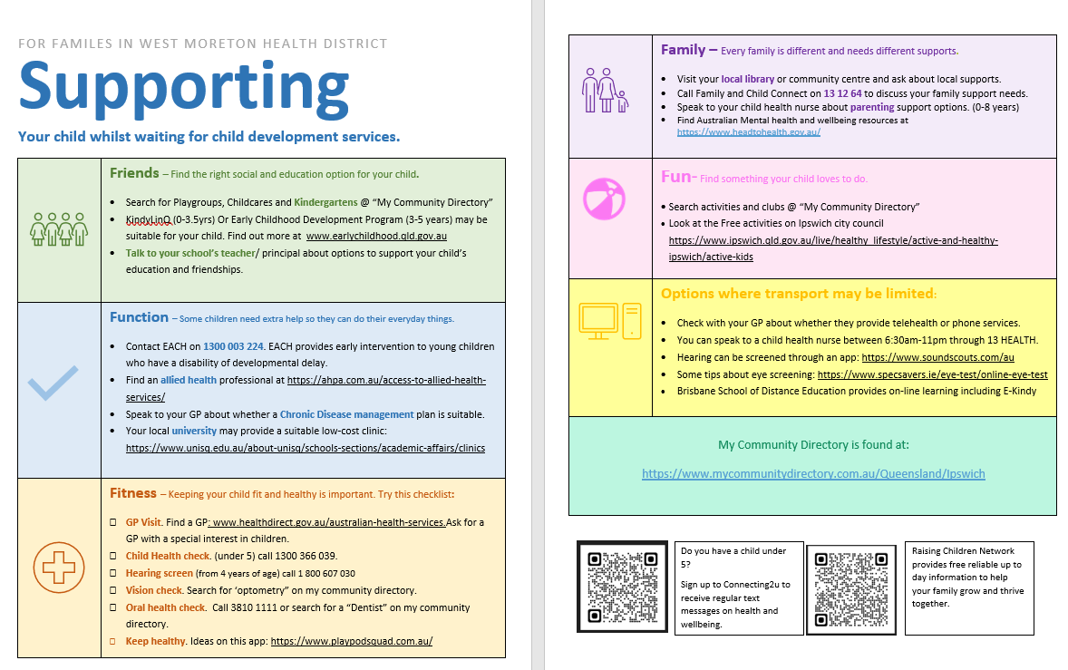

Slide 21
HealthPathways - helpful pages
Behaviour and Development – Child
Behavioural Concerns in Children Under 6 Years
Developmental Concerns in Children Under 6 Years
Child and Parenting Community Support

