Slide 1
A brief introduction to cardiomyopathy
Focus on postpartum cardiomyopathy
Dr Arup Ghoshal
Staff Cardiologist Ipswich General Hospital

Slide 2
Topics
Definition of cardiomyopathy
A case presentation of peripartum cardiomyopathy
Discussion on management & implication in primary care set up

Slide 3
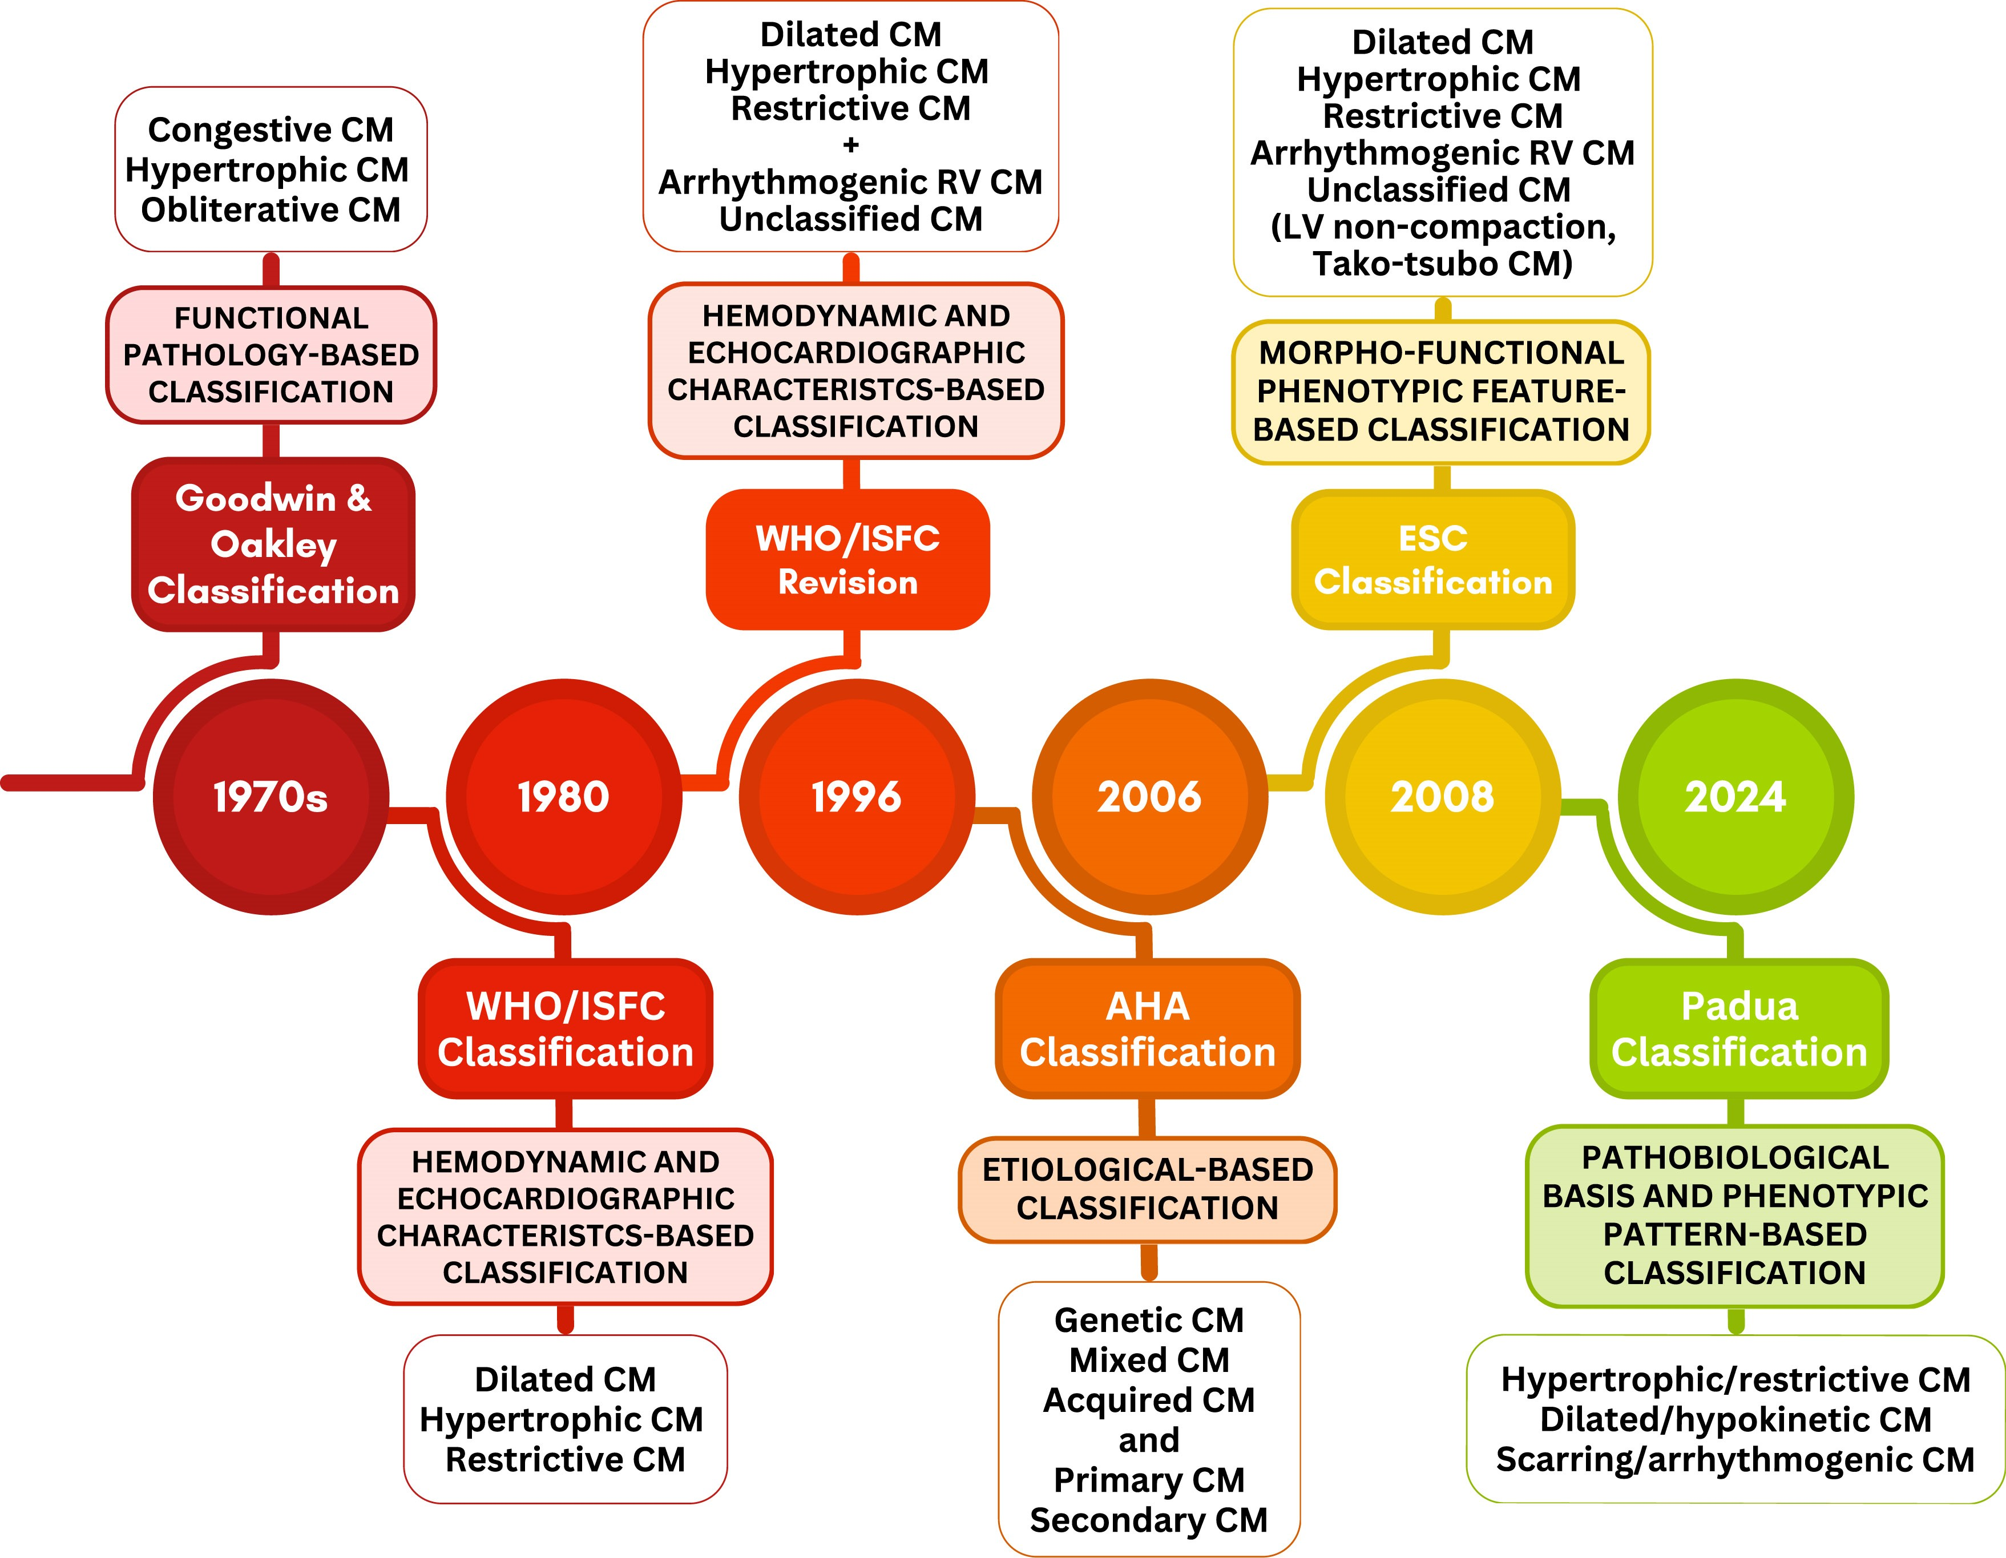
Notes:
The Padua classification, by its very nature, is an integrated approach that inherently addresses the concept of phenocopies. A "phenocopy" in medicine refers to a condition with a clinical presentation (phenotype) that is identical or very similar to a genetically-driven disease, but is caused by a different, non-genetic factor.
The strength of the Padua classification lies in its focus on both pathobiology and phenotype, which is precisely what's needed to differentiate true genetic cardiomyopathies from their phenocopies. Here's how the classification handles this:
How Phenocopies Fit into the Padua Classification
The Padua classification groups cardiomyopathies into three main categories—hypertrophic/restrictive (H/RC), dilated/hypokinetic (D/HC), and scarring/arrhythmogenic (S/AC)—each of which can have either a genetic or a non-genetic (acquired) origin. This is the core of how it addresses phenocopies.
Instead of lumping all conditions with a similar appearance together, it explicitly separates them based on the underlying cause.
1. Hypertrophic/Restrictive Cardiomyopathy (H/RC) and its Phenocopies
* Genetic H/RC: This includes classic hypertrophic cardiomyopathy (HCM) caused by sarcomeric gene mutations (e.g., in MYH7 or MYBPC3). The pathobiology is a primary defect in the heart muscle's contractile machinery.
* H/RC Phenocopies: These are conditions that look like HCM but are not caused by sarcomeric mutations. They have a different pathobiology. Examples include:
* Cardiac Amyloidosis: The phenotype is a thickened, stiff heart, but the pathobiology is the infiltration of the heart muscle with abnormal protein deposits (amyloid fibrils), not a genetic defect in sarcomeres.
* Fabry Disease: This is a genetic metabolic disorder where a faulty enzyme leads to a buildup of a fatty substance (globotriaosylceramide) in the heart muscle, mimicking the appearance of HCM.
* "Athlete's Heart": The physiological hypertrophy seen in athletes can be a "benign" phenocopy of HCM, and differentiating the two is a critical clinical challenge.
* Hypertensive Heart Disease: Chronic hypertension can cause the heart to thicken, creating a phenotype that is a phenocopy of HCM, but the pathobiology is a response to pressure overload, not a primary genetic defect.
The Padua classification would place all of these conditions under the H/RC umbrella but would use the pathobiological information (e.g., genetic test results, advanced imaging for amyloid, or clinical history for hypertension) to correctly classify them as "genetic" or "non-genetic" variants of H/RC.
2. Dilated/Hypokinetic Cardiomyopathy (D/HC) and its Phenocopies
* Genetic D/HC: This includes familial dilated cardiomyopathy (DCM) caused by mutations in genes like TTN or FLNC. The pathobiology is a primary weakness in the heart muscle's structure.
* D/HC Phenocopies: These are conditions that lead to a dilated and poorly contracting heart, but are not caused by a primary genetic defect. Examples include:
* Viral Myocarditis: The heart muscle is damaged by an inflammatory response to a viral infection, leading to a phenotype indistinguishable from DCM.
* Peripartum Cardiomyopathy (PPCM): The pathobiology is related to hormonal and angiogenic factors unique to late pregnancy and postpartum, but the phenotype is D/HC.
* Toxic Cardiomyopathy: Heart muscle damage from substances like alcohol or chemotherapy drugs can lead to a D/HC phenotype.
The Padua classification handles these by recognizing that while the morpho-functional features (phenotype) are the same, the underlying pathobiology is different, leading to a separate classification within the D/HC group.
3. Scarring/Arrhythmogenic Cardiomyopathy (S/AC) and its Phenocopies
* Genetic S/AC: The classic example is arrhythmogenic right ventricular cardiomyopathy (ARVC) caused by mutations in desmosomal genes. The pathobiology is a defect in the cell-to-cell junctions, leading to replacement of heart muscle with scar and fat.
* S/AC Phenocopies: These are less common but are also recognized. For example, a sarcoidosis or viral infection could cause a similar scarring and arrhythmogenic phenotype. The Padua classification helps in this scenario by using CMR (Cardiac Magnetic Resonance) to precisely characterize the myocardial tissue, looking for the specific fibro-fatty replacement pattern seen in ARVC, and combining this with genetic testing and clinical history to confirm the diagnosis and distinguish it from phenocopies.
Conclusion
The Padua classification's integrated pathobiology-phenotype approach is a significant step forward in the field of cardiomyopathies. By explicitly acknowledging that similar clinical appearances can have different underlying causes (i.e., phenocopies), it encourages a more detailed diagnostic workup, including advanced imaging (like CMR) and genetic testing. This allows for more accurate diagnoses and the development of targeted, disease-specific therapeutic strategies, ultimately improving patient outcomes.

Slide 4
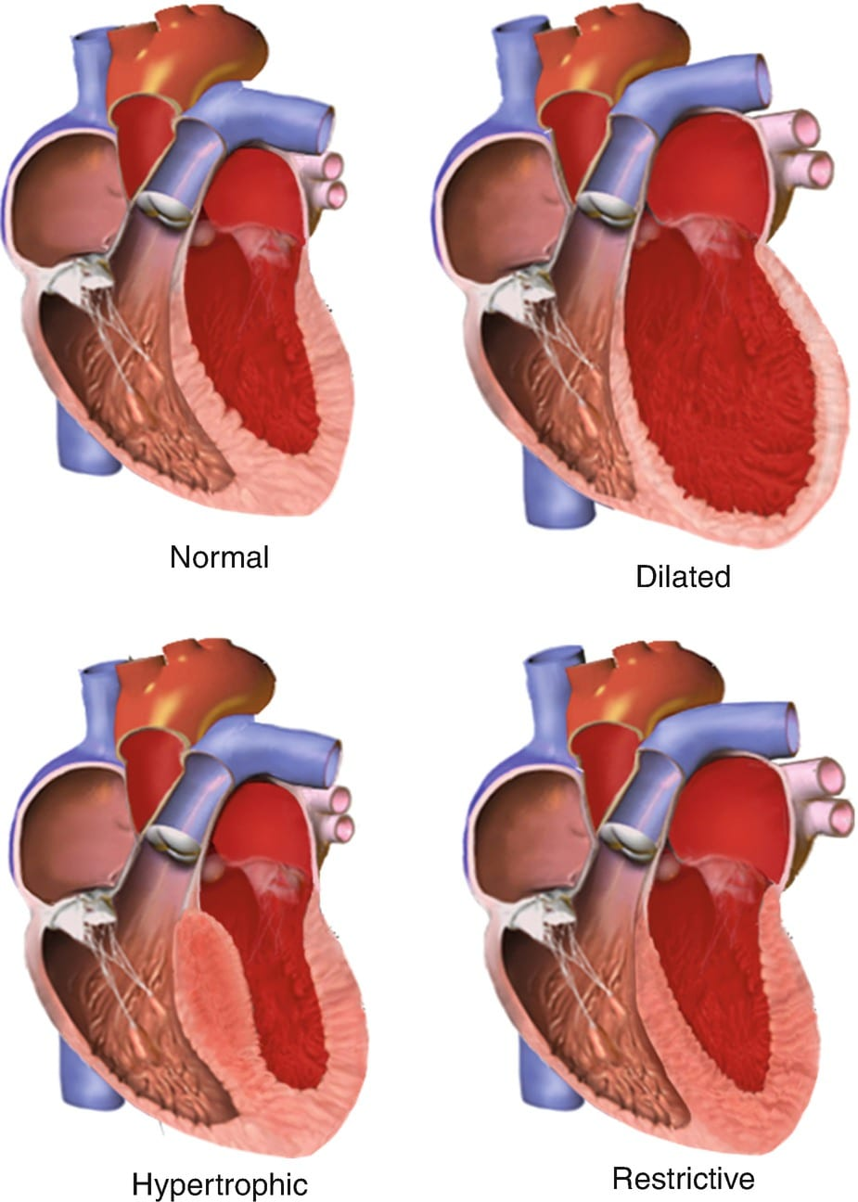
Notes:
Disproportionate LA enlargement in restrictive CMP

Slide 5
What is cardiomyopathy – Padua Classification2024
Diseases primarily affecting the myocardium which are characterized by permanent structural and functional heart abnormality.
Those conditions are excluded in which the myocardial disorder is not a primary event but occurs secondarily to coronary artery disease, hypertensive heart disease, valvular disease, or congenital heart disease.
Although the original (prototype) cardiomyopathy phenotype is genetically determined, a number of non-genetic diseases (‘phenocopies’) may exhibit phenotypic features, which closely resemble those of the inherited aetiologic variant.
In a significant number of cases, the cause of the disease may be not-identifiable (‘idiopathic’). Accordingly, each cardiomyopathy phenotype is sub-classified into genetic and non-genetic variants
Non-genetic cardiomyopathies are further sub-divided into variants with an identifiable cause and idiopathic forms.
The heart muscle involvement may occur in isolation or part of a generalized multi-organ disease.

Slide 6
3 distinctive categories of cardiomyopathies
What has changed?
Scientific advances in molecular biology and genetics
use of contrast-enhanced cardiac magnetic resonance (CMR) for morpho-functional imaging and structural myocardial tissue characterization.
cardiomyopathies that rely on the combination of the distinctive pathobiological basis (genetics, molecular biology, and pathology) and the phenotypic features (morpho-functional and structural ventricular remodeling)

Slide 7
3 different disease categories, each with a combined designation based on both ‘anatomic’ and ‘functional’ phenotypic features
Hypertrophic/restrictive cardiomyopathy (H/RC).
Dilated/hypokinetic cardiomyopathy (D/HC).
Scarring/arrhythmogenic (S/AC).

Slide 8
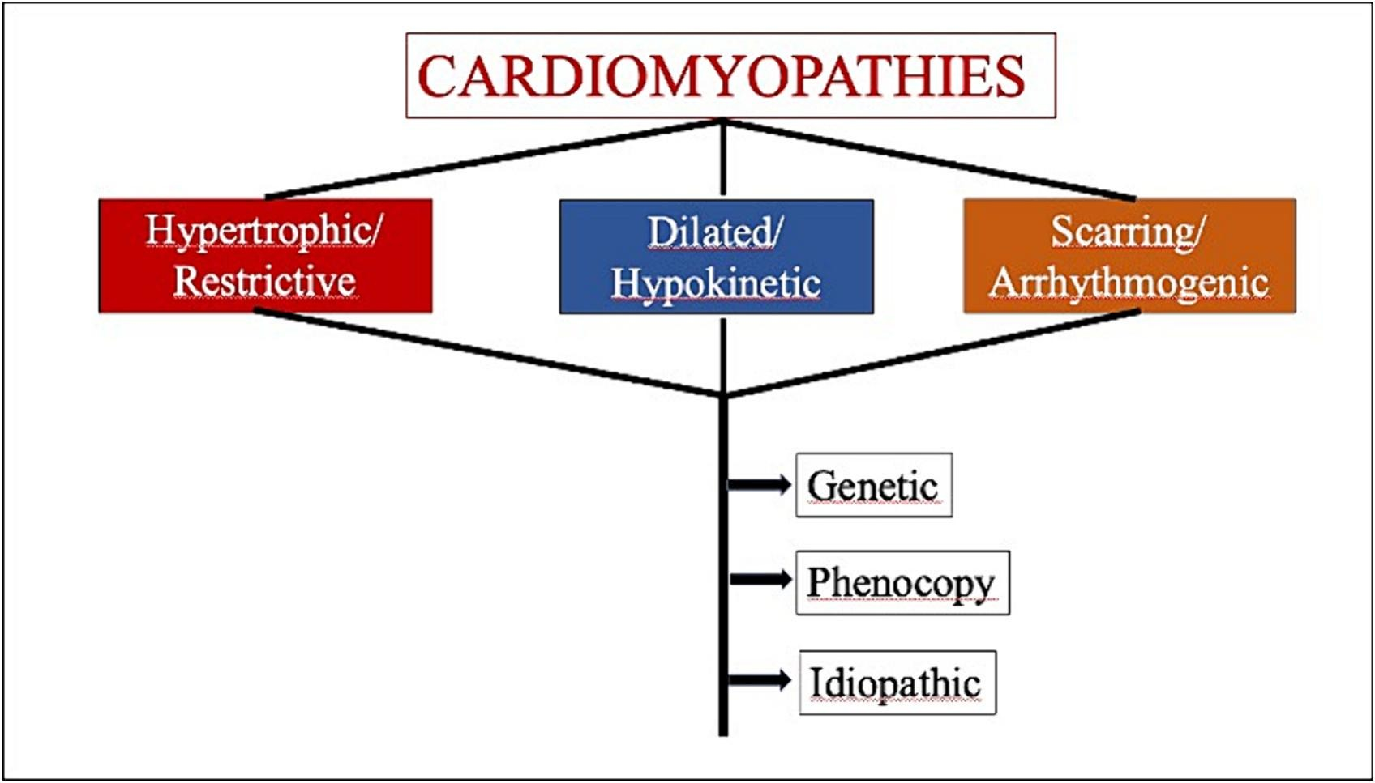

Slide 9
Hypertrophic/restrictive (H/RC) cardiomyopathies
Include genetic heart muscle disorders from genetically defective sarcomeric and non-sarcomeric proteins (storage and infiltrative diseases)
And
Non-genetic phenocopies, manifesting with the phenotypic pattern of LV diastolic dysfunction, with no or variable degree of ventricular hypertrophy.

Slide 10
Dilated/hypokinetic (D/HC) cardiomyopathies
Include genetic heart muscle disorders from a variety of defective genes encoding for proteins of cytoskeleton, sarcomere, nuclear envelope and intercalated discs.
And
Non-genetic phenocopies, manifesting with the phenotypic pattern of LV dilatation and/or systolic dysfunction

Slide 11
Scarring/arrhythmogenic (S/AC) cardiomyopathies
Include genetic heart muscle disorders from genetically defective intercalated discs/desmosomal proteins.
And
Non-genetic phenocopies, with the phenotypic pattern of non-ischaemic myocardial scarring of the LV, RV, or both, resulting scar-related ventricular arrhythmias and may lead to impairment of systolic function caused by myocyte death.

Slide 12
Not Included....
Acute myocarditis
Takotsubo syndrome, and left ventricular non-compaction.
Ventricular remodelling caused by electrical dyssynchrony and tachycardiomyopathies.
Primarily electrical abnormalities such as cardiac ion channel diseases are excluded from this definition.

Slide 13
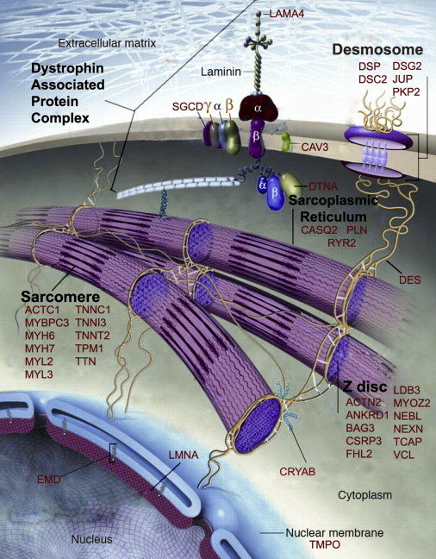

Slide 14
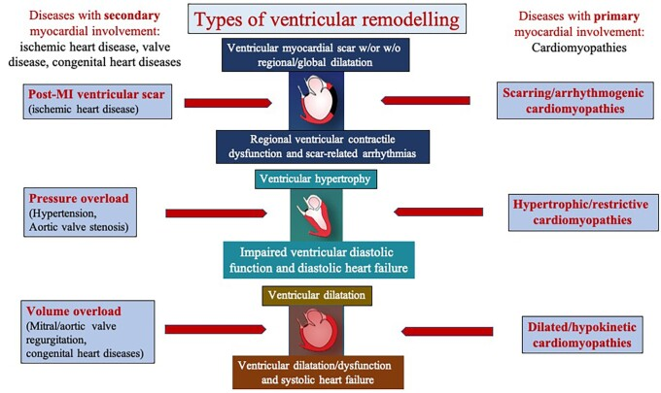

Slide 15
Post-partum Cardiomyopathy
Ms SL

Slide 16
Ms SL
35 yo F
Delivered 5th child on 28/10/24 at IGH
Uncomplicated Spontaneous Vaginal delivery, however represented 2/11/24 requiring hysteroscopy & removal of retained placental products
BMI 44.5, T2DM (poorly controlled – was on Metformin + insulin throughout pregnancy).
Tachycardic, with mitral murmur throughout both admissions
Significant social stressors: partner not working
Family history: Mother DCM – deceased age 60, Brother cardiac condition – unsure of nature
Represented to IGH ED 22/1/25: SOB + chest pain > ?CAP
Anxiety, depression, GORD, mild asthma, smoked 10-15/day, minimal ETOH, poor diet with high caffeine intake
Notes:
October 2024 prior to d/c noted to be tachycardic, BNP > 50
Came back in Jan 2025 with chest pain, tachycardia, normal CTPA. Late January was on Abx for LRTRI. 31
2025 ED SHO – felt that it could be PPCMP. BNP 267 then.
The Padua classification, by its very nature, is an integrated approach that inherently addresses the concept of phenocopies. A "phenocopy" in medicine refers to a condition with a clinical presentation (phenotype) that is identical or very similar to a genetically-driven disease, but is caused by a different, non-genetic factor.
The strength of the Padua classification lies in its focus on both pathobiology and phenotype, which is precisely what's needed to differentiate true genetic cardiomyopathies from their phenocopies. Here's how the classification handles this:
How Phenocopies Fit into the Padua Classification
The Padua classification groups cardiomyopathies into three main categories—hypertrophic/restrictive (H/RC), dilated/hypokinetic (D/HC), and scarring/arrhythmogenic (S/AC)—each of which can have either a genetic or a non-genetic (acquired) origin. This is the core of how it addresses phenocopies.
Instead of lumping all conditions with a similar appearance together, it explicitly separates them based on the underlying cause.
1. Hypertrophic/Restrictive Cardiomyopathy (H/RC) and its Phenocopies
* Genetic H/RC: This includes classic hypertrophic cardiomyopathy (HCM) caused by sarcomeric gene mutations (e.g., in MYH7 or MYBPC3). The pathobiology is a primary defect in the heart muscle's contractile machinery.
* H/RC Phenocopies: These are conditions that look like HCM but are not caused by sarcomeric mutations. They have a different pathobiology. Examples include:
* Cardiac Amyloidosis: The phenotype is a thickened, stiff heart, but the pathobiology is the infiltration of the heart muscle with abnormal protein deposits (amyloid fibrils), not a genetic defect in sarcomeres.
* Fabry Disease: This is a genetic metabolic disorder where a faulty enzyme leads to a buildup of a fatty substance (globotriaosylceramide) in the heart muscle, mimicking the appearance of HCM.
* "Athlete's Heart": The physiological hypertrophy seen in athletes can be a "benign" phenocopy of HCM, and differentiating the two is a critical clinical challenge.
* Hypertensive Heart Disease: Chronic hypertension can cause the heart to thicken, creating a phenotype that is a phenocopy of HCM, but the pathobiology is a response to pressure overload, not a primary genetic defect.
The Padua classification would place all of these conditions under the H/RC umbrella but would use the pathobiological information (e.g., genetic test results, advanced imaging for amyloid, or clinical history for hypertension) to correctly classify them as "genetic" or "non-genetic" variants of H/RC.
2. Dilated/Hypokinetic Cardiomyopathy (D/HC) and its Phenocopies
* Genetic D/HC: This includes familial dilated cardiomyopathy (DCM) caused by mutations in genes like TTN or FLNC. The pathobiology is a primary weakness in the heart muscle's structure.
* D/HC Phenocopies: These are conditions that lead to a dilated and poorly contracting heart, but are not caused by a primary genetic defect. Examples include:
* Viral Myocarditis: The heart muscle is damaged by an inflammatory response to a viral infection, leading to a phenotype indistinguishable from DCM.
* Peripartum Cardiomyopathy (PPCM): The pathobiology is related to hormonal and angiogenic factors unique to late pregnancy and postpartum, but the phenotype is D/HC.
* Toxic Cardiomyopathy: Heart muscle damage from substances like alcohol or chemotherapy drugs can lead to a D/HC phenotype.
The Padua classification handles these by recognizing that while the morpho-functional features (phenotype) are the same, the underlying pathobiology is different, leading to a separate classification within the D/HC group.
3. Scarring/Arrhythmogenic Cardiomyopathy (S/AC) and its Phenocopies
* Genetic S/AC: The classic example is arrhythmogenic right ventricular cardiomyopathy (ARVC) caused by mutations in desmosomal genes. The pathobiology is a defect in the cell-to-cell junctions, leading to replacement of heart muscle with scar and fat.
* S/AC Phenocopies: These are less common but are also recognized. For example, a sarcoidosis or viral infection could cause a similar scarring and arrhythmogenic phenotype. The Padua classification helps in this scenario by using CMR (Cardiac Magnetic Resonance) to precisely characterize the myocardial tissue, looking for the specific fibro-fatty replacement pattern seen in ARVC, and combining this with genetic testing and clinical history to confirm the diagnosis and distinguish it from phenocopies.
Conclusion
The Padua classification's integrated pathobiology-phenotype approach is a significant step forward in the field of cardiomyopathies. By explicitly acknowledging that similar clinical appearances can have different underlying causes (i.e., phenocopies), it encourages a more detailed diagnostic workup, including advanced imaging (like CMR) and genetic testing. This allows for more accurate diagnoses and the development of targeted, disease-specific therapeutic strategies, ultimately improving patient outcomes.

Slide 17
Investigations
3/2/25: TTE
  Dilated cardiomyopathy with severe left ventricular impairment (LVEF 15-20%)
  Severe functional mitral & tricuspid regurgitation
    Severe peri-partum cardiomyopathy
    25/2/25 : CTPA – No PE
    Bloods – Lactate elevated at 470(N < 250), elevated transaminases, normal renal functions.

Slide 18
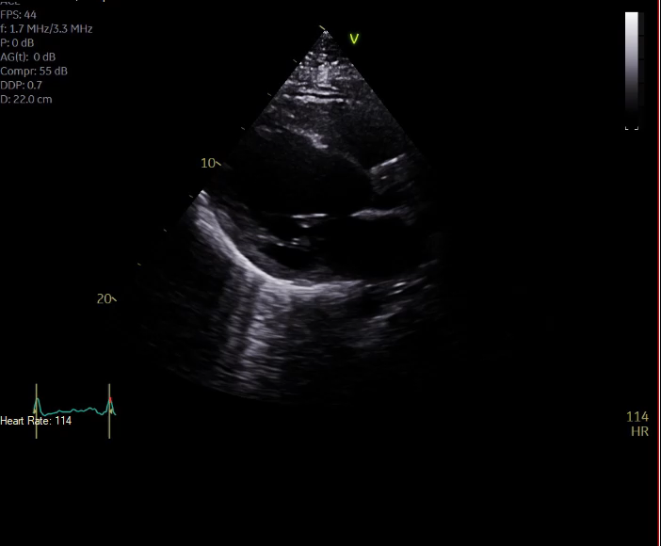
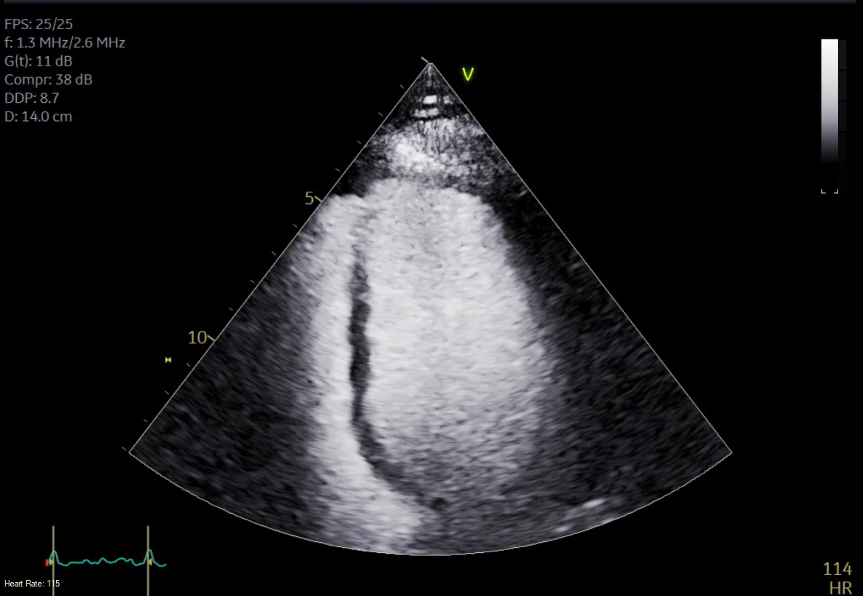
Echocardiogram

Slide 19
PPCM - Definition
NHLBI in the 1990s defined PPCM as heart failure that develops in the last month of pregnancy or up to five months postpartum with left ventricular systolic dysfunction (left ventricular ejection fraction (LVEF) <45% or fractional shortening <30%, or both).
However, a large proportion of patients who otherwise meet the criteria for PPCM present before 36 weeks’ gestation, raising concerns that the NHLBI definition may be overly restrictive and lead to the underdiagnosis of PPCM.
In 2010 the European Society of Cardiology (ESC) defined peripartum cardiomyopathy as heart failure that occurs “towards the end of pregnancy or in the months following delivery, where no other cause of heart failure is found.

Slide 20
Risk Factors and Epidemiology of PPCM
Global Incidence: PPCM is estimated to affect around 1 in 2,000 deliveries worldwide. However, its incidence varies significantly by region. It is most common in Nigeria, with an incidence of 1 in 100 births, while in Japan, it is much rarer at 1 in 20,000.
Western Countries and Ancestry: In Western nations, the reported incidence ranges from 1 in 1,000 to 1 in 5,000 deliveries. It is significantly more prevalent in women of African ancestry.
Pregnancy-Related Conditions: Certain pregnancy-related complications are strong risk factors:
1. Hypertensive Disorders: Gestational hypertension and pre-eclampsia are associated with a three-fold
increased risk of PPCM.
2. A meta-analysis found that pre-eclampsia was present in 22% of PPCM cases, and other hypertensive
disorders were present in 37%.
Multiple Gestations: Carrying multiple babies (twins, triplets, etc.) is another strong risk factor, reported in 7% to 14.5% of PPCM cases.
Other Risk Factors:
Advanced Maternal Age: The risk of PPCM increases with maternal age, particularly from 30 years and older.
Cocaine Use: Maternal use of cocaine is identified as a risk factor for the condition.

Slide 21
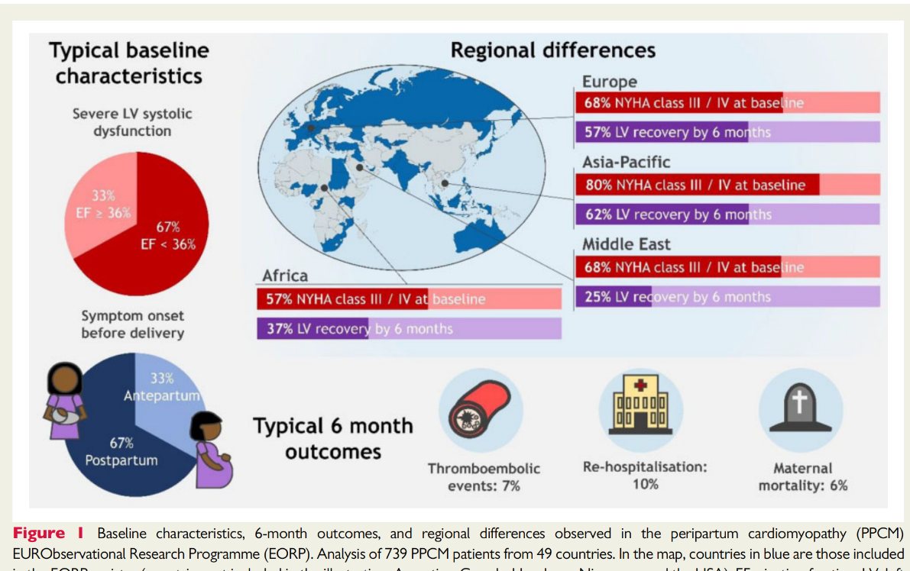
Wide Geographical Variation - EORP Registry data
Worse outcomes in Africa & middle east.
67% Diagnosed postpartum

Slide 22
Pathophysiology
Oxidative stress & possible prolactin(16 KDa fragment) induced vascular dysfunction.
Conversely, secretion of relaxin-2, a pregnancy-associated vasculoprotective hormone, is suppressed in PPCM.
The fact that all pregnant women undergo similar hemodynamic and hormonal changes but very few of them develop PPCM, suggests that genetic predisposition could be particularly important. Heterozygous loss-of-function genetic variants(Titin Gene mutation) in one of several genes associated with nonischaemic dilated cardiomyopathy have been encountered in almost 15 % of PPCM case.
This molecule is also elevated in preeclampsia and multiple gestations, thus partially explaining the association between these conditions and PPCM.
Increased levels of the soluble fms-like tyrosine kinase 1, an antagonist of the vascular endothelial growth factor, secreted by the placenta during the last months of pregnancy, it induced PPCM in mice.
Notes:
1.Angiogenic imbalance
2. 16 Kda fragment doesn't work through Prolactin receptor it induces Micro RNA 146a on the surface of endothelial cells & mediates antiangiogenic effect. It also impairs epidermal growth factor receptors in myocytes & subsequent metabolic activity & function. Pharmacological inhibition of the this micro RNA prevents onset of PPCMP in mice. Its elevated in PCMP & other DCMP & may be used in future for early detection

Slide 23
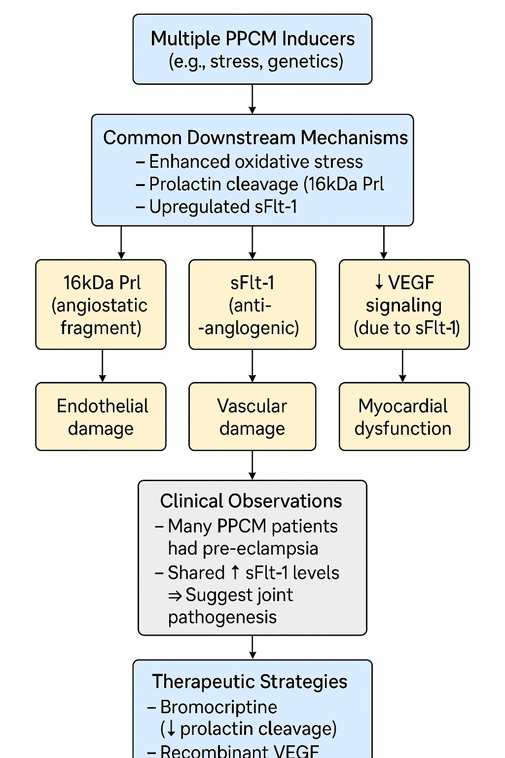

Slide 24
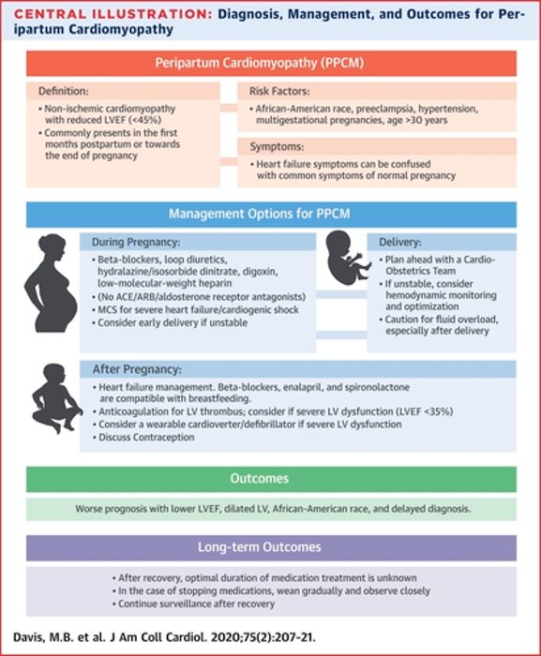

Slide 25
Genetics Testing
Significant genetic Overlap with Dilated Cardiomyopathy (DCM)
Role of TTN Mutations: Truncating mutations in the titin (TTN) gene, a well-known cause of DCM, are found in 10–15% of PPCM patients
Other Shared Genes: Other DCM-associated genes, including DSP, FLNC, and BAG3, are also present in PPCM patients
"Multiple Hit" Model: PPCM is likely triggered by a "multiple hit" model. A genetic predisposition, which may not cause disease on its own (low penetrance), is combined with environmental or physiological stressors, such as the hemodynamic and hormonal changes of pregnancy
Low Penetrance: The penetrance of TTN truncating mutations is very low (95% of carriers show no cardiac disease), suggesting that cardiac function is preserved in the absence of additional stressors.
Clinical Implications:
Genetic findings may impact prognosis and management (e.g., TTN mutations may suggest a worse prognosis; FLNC and DSP mutations may require aggressive anti-arrhythmic care).
Identifying a pathogenic variant in a patient allows for genetic testing and monitoring of family members.
Despite these findings, there are currently no formal recommendations for genetic testing in PPCM patients.
Yet, genetic testing may be considered in cases of PPCM, especially in cases of familial aggregation of cardiomyopathies, for prognosis and to facilitate family screening.
Notes:
Titin _ sarcomere
FLNC – Intercalated disc(cytosketon)
BAG 3 = autophagy
Desmosome – DSP - cytoskeleton

Slide 26
Diagnostic Evaluation
Initial Action: Urgent assessment by a specialist is required for any peripartum woman showing signs or symptoms of heart failure.
Electrocardiogram (ECG): Abnormalities are found in almost all PPCM patients. T wave inversion, BBB, varying AV block, ST depression, sinus tachy/ bradycardia. LAA(negative deflection of P wave at its terminal > 40 msecs is associated with poor recovery of LV function.
Chest X-ray: Can help rule out other causes of breathlessness (e.g.infection).Commonly shows an enlarged heart/ congestion/ normal.
Echocardiography:
Confirms cardiac dysfunction and quantifies its severity.
Excludes alternative causes of heart failure (e.g., congenital heart disease, valve disease).
Typically shows enlarged left ventricular volumes and a mean left ventricular ejection fraction (LVEF) around 30%.
A comprehensive assessment of the right heart is crucial, as reduced right ventricular function is a predictor of poor outcomes.
Useful for assessing the presence of LV thrombus
Cardiac Magnetic Resonance Imaging (MRI):
Useful for excluding other conditions like myocarditis, left ventricular non-compaction, or infiltrative diseases.
Routine Lab Tests:
Routine blood work can identify reversible factors like anemia and assess for end-organ damage.
Measuring natriuretic peptide levels is recommended.
Genetic Testing:
Not yet routine clinical practice but may be considered, especially if there is a family history of cardiomyopathies.
The identification of a disease-causing mutation has clinical relevance for both the patient and her family members, including offspring.
When a pathogenic mutation is found, cascade screening of relatives is recommended to identify other carriers who may need follow-up and routine cardiac screening.
Patients must receive counseling before and after genetic testing to understand the implications.

Slide 27
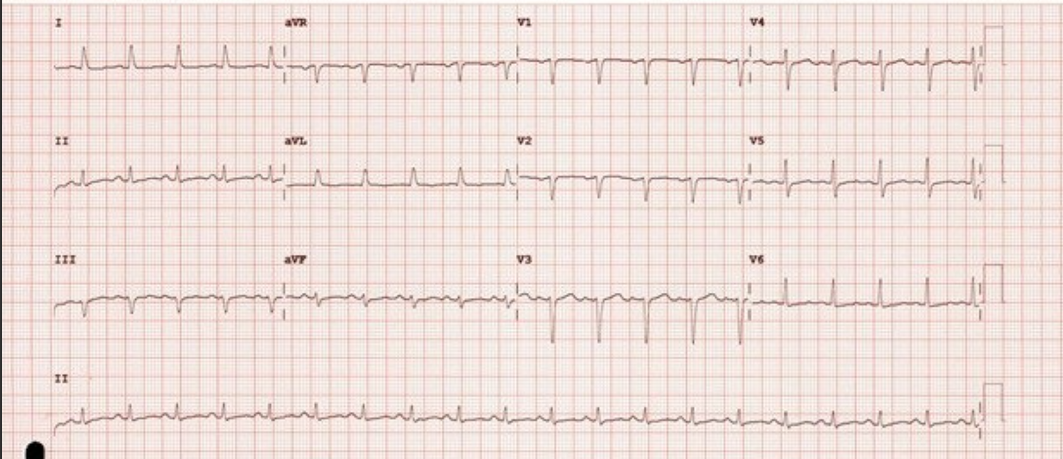

Slide 28
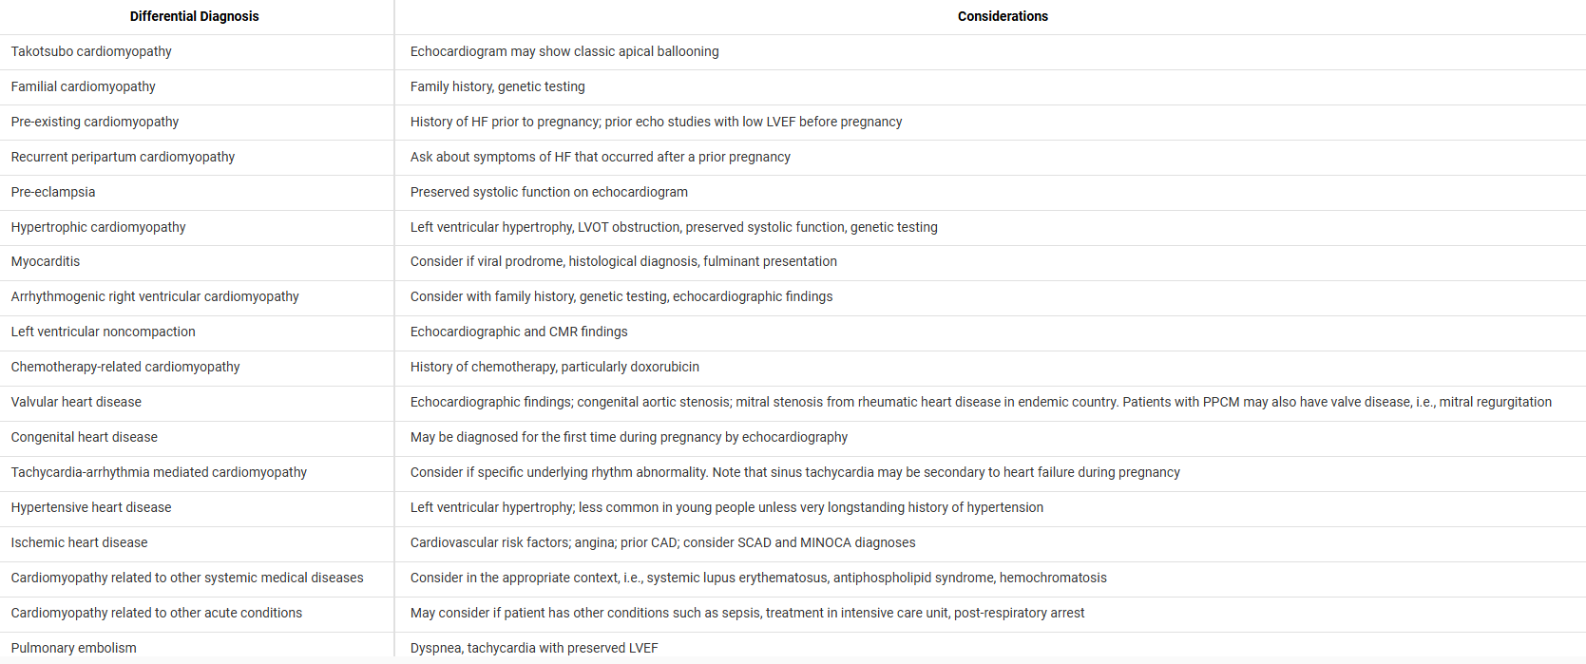
Diagnosis of Exclusions

Slide 29
IGH admission Feb
Targeted therapy commenced – limited by hypotension
FR 1.5L, daily weights
Diuresis
TPCH discussion 7/2/25 re: heart transplant/mechanical assist device: deemed not eligible due to BMI + smoking status
NSVT

Slide 30
Limitations to therapy and complications for Ms SL
Represented to IGH 25/2/25 – hypotension - Adrenaline infusion
Withheld Bisoprolol, Frusemide, Spironolactone > re-referred to PICS
Restarted Bisoprolol 3/3/25, increased 17/3/25
Restarted MRA on alternate days 12/3/25, with plan to increase to daily in 3 weeks
Slow titration

Slide 31
Lifestyle, social + medication management
Social work: financial hardship
- Inability to afford medications resulting in anxiety
- At risk of significant health deterioration if non-compliant
Community funding: $1298.51 (pharmacy, gas, electricity)
Obtained approval to waive IGH pharmacy invoice
Weight loss: would benefit from GLP-1 however unable to afford privately. Has T2DM however not on other therapies, therefore does not meet PBS criteria. HbA1C 5.6%
Contraception – rx for Levonorgestrel IUD
Smoking cessation
Medication compliance – dosette box

Slide 32
Readmission June 2025
Eminent cardiogenic shock
ICU admission – commenced on inotropes.
Rediscussed with The Prince Charles & accepted for further assessment regarding transplant/advance heart failure therapy.
Deemed unsuitable & returned to IGH early July 2025
Profoundly hypotensive, inotrope dependent.
Genetic testing organised
Palliative care input - currently at a hospice

Slide 33
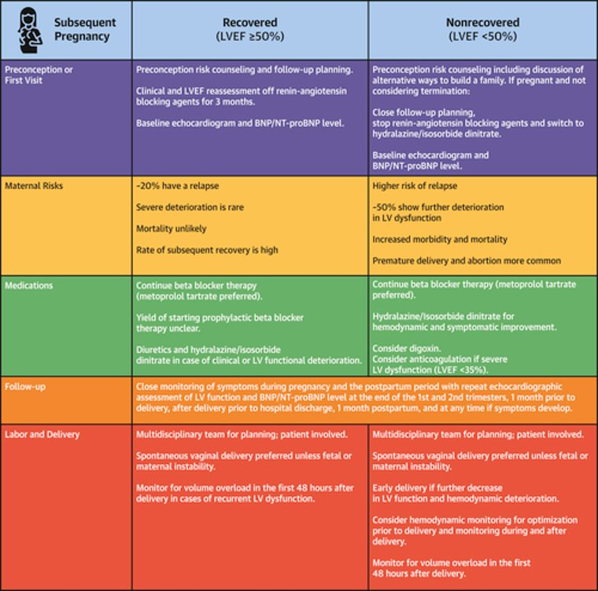

Subsequent pregnancy
Melinda B. Davis et al. JACC 2020; 75:207-221.

Slide 34
Proposed Echo follow up

Slide 35
Prognosis
Recovery of LV function >50% after 6 months in 44%( 13-25% middle east, 37% Africa, 57% Europe). At 12 months ~ 58%.
Mortality 1.4 -3.4% within 30 days. 8% at 6 months( 11.5% Asia-pacific, 10.9% Africa, 0.7% Europe). At 12 months 9.8%(15.2% Africa), At 2 years 10%.

Slide 36
Adverse Prognostic Markers & Specific therapy
Worse NYHA class
LVEF<25%, LVEDD > 60 mm
Being from African ancestry
Multiparity
Age> 30-35 years or < 20 years
Bromocriptine is showing some promise( ESC recommendation Class 2B,level of evidence B) - 2.5 mg BD for 8 weeks + GDMT. Ongoing trial REBIRTH – results awaited ~2029. Associated with increased risk in PPCM scenario.
QT Prolongation
Known PPCMP with persistent LV dysfunction.
Diagnosis during pregnancy
RV involvement
Low systolic BP

Slide 37
Discussion – key points, Treatment & management
Multidisciplinary Approach: Treatment for PPCM requires a team including cardiologists, obstetricians, and other specialists to manage all aspects of a patient's care.
Initial Treatment: PPCM is treated similarly to other forms of systolic heart failure, with an emphasis on pregnancy-safe therapies such as dietary sodium restriction, diuretics, and beta-blockers.
Medication During Pregnancy:
  Diuretics (furosemide and hydrochlorothiazide) can be used at low doses with careful monitoring to avoid harm to the fetus.
  Beta-blockers (beta-1 selective) can be used cautiously. Carvedilol is effective as it also helps decrease afterload.
  Hydralazine is a safe vasodilator.
  Digoxin is safe for pregnancy and can be used for its inotropic and chronotropic effects.
  Contraindicated Medications: ACE inhibitors, MRAs, ARBs, and nitroprusside are unsafe during pregnancy. Beta-blockers are contraindicated during breastfeeding.
Anticoagulation: Anticoagulation is generally not recommended unless the left ventricular ejection fraction is below 30-35% or atrial fibrillation is present due to the high risk of blood clots.
Delivery and Postpartum Care:
  The timing and method of delivery are decided based on the mother's clinical stability.
  Breastfeeding is often recommended as many PPCM medications are safe for lactation.
  Family Planning: Women must be counseled on the high risk of recurrence in future pregnancies. Contraceptive options like IUDs and subcutaneous implants are recommended, while combination oral contraceptives should be avoided in women with severe left ventricular dysfunction.
Genetic Counseling: Genetic counseling and testing are recommended to identify genetic variants that may increase arrhythmia risk (e.g., in genes like FLNC and DSP) and to guide family screening.
Advanced Therapies: In severe cases, treatments may include inotropic drugs, mechanical support like a left ventricular assist device (LVAD), or an implantable cardioverter-defibrillator (ICD).
Investigational Treatments: Experimental therapies, such as bromocriptine (a prolactin inhibitor), are being studied based on the theory that PPCM is triggered by a harmful form of the prolactin hormone.

Slide 38
Prognosis and Outcomes
Recovery: While over half of patients recover cardiac function, PPCM carries significant morbidity and mortality. Recovery typically happens within 3 to 6 months postpartum but can take up to 48 months.
Morbidity and Mortality: PPCM is a leading cause of maternal mortality. Mortality rates can be as high as 20% globally, with higher rates among Black women in the United States and women in less developed regions.
Racial Disparities: In the United States, Black women are twice as likely as White women to experience prolonged cardiac dysfunction. When recovery does occur, it takes them twice as long.
Prognostic Factors:
  Favorable: A good prognosis is associated with a smaller left ventricular size (diastolic dimension <5.5 cm), an ejection fraction above 30-35% at diagnosis, and non-African American ethnicity.
  Poor: Poor outcomes are linked to a larger left ventricular size (diastolic dimension ≥ 6 cm), an ejection fraction below 35%, a delayed diagnosis, and African descent.
Future Pregnancies: The recurrence rate of PPCM in subsequent pregnancies is high, ranging from 10% to 50%. Women are advised against future pregnancies if their ejection fraction remains low. If a subsequent pregnancy is desired, patients should wait at least five years after their heart function has normalized. It is advisable to go off all medications 3 months before conception = have an echo & proceed.
Differential Diagnosis
PPCM is a diagnosis of exclusion. This means other conditions with similar symptoms must be ruled out.
Other possible diagnoses include pre-existing cardiac conditions that have worsened during pregnancy, Takotsubo cardiomyopathy, severe preeclampsia or eclampsia, pulmonary embolism, and amniotic fluid embolism syndrome.
Notes:
Over-representation of TTN truncating variants have likewise been identified in cohorts of cardiotoxicity associated with chemotherapy (53) and alcohol use (54), suggesting that pregnancy may similarly represent a “second hit” for patients predisposed by genetic variance. Importantly, however, >90% of individuals with TTN truncating variants do not develop DCM or PPCM (55), indicating that additional environmental, genetic, or epigenetic factors are at play. The fact that most women with PPCM do not have a family history of cardiomyopathy and that PPCM does not always recur with a subsequent pregnancy indicates that any genetic origin is incompletely penetrant and that additional factors contribute to disease incidence. Further research in diverse populations is needed to study the interaction of genetic variants with comorbidities as well as vascular, hormonal, and hemodynamic insults.

Slide 39
Thank You

