Slide 1


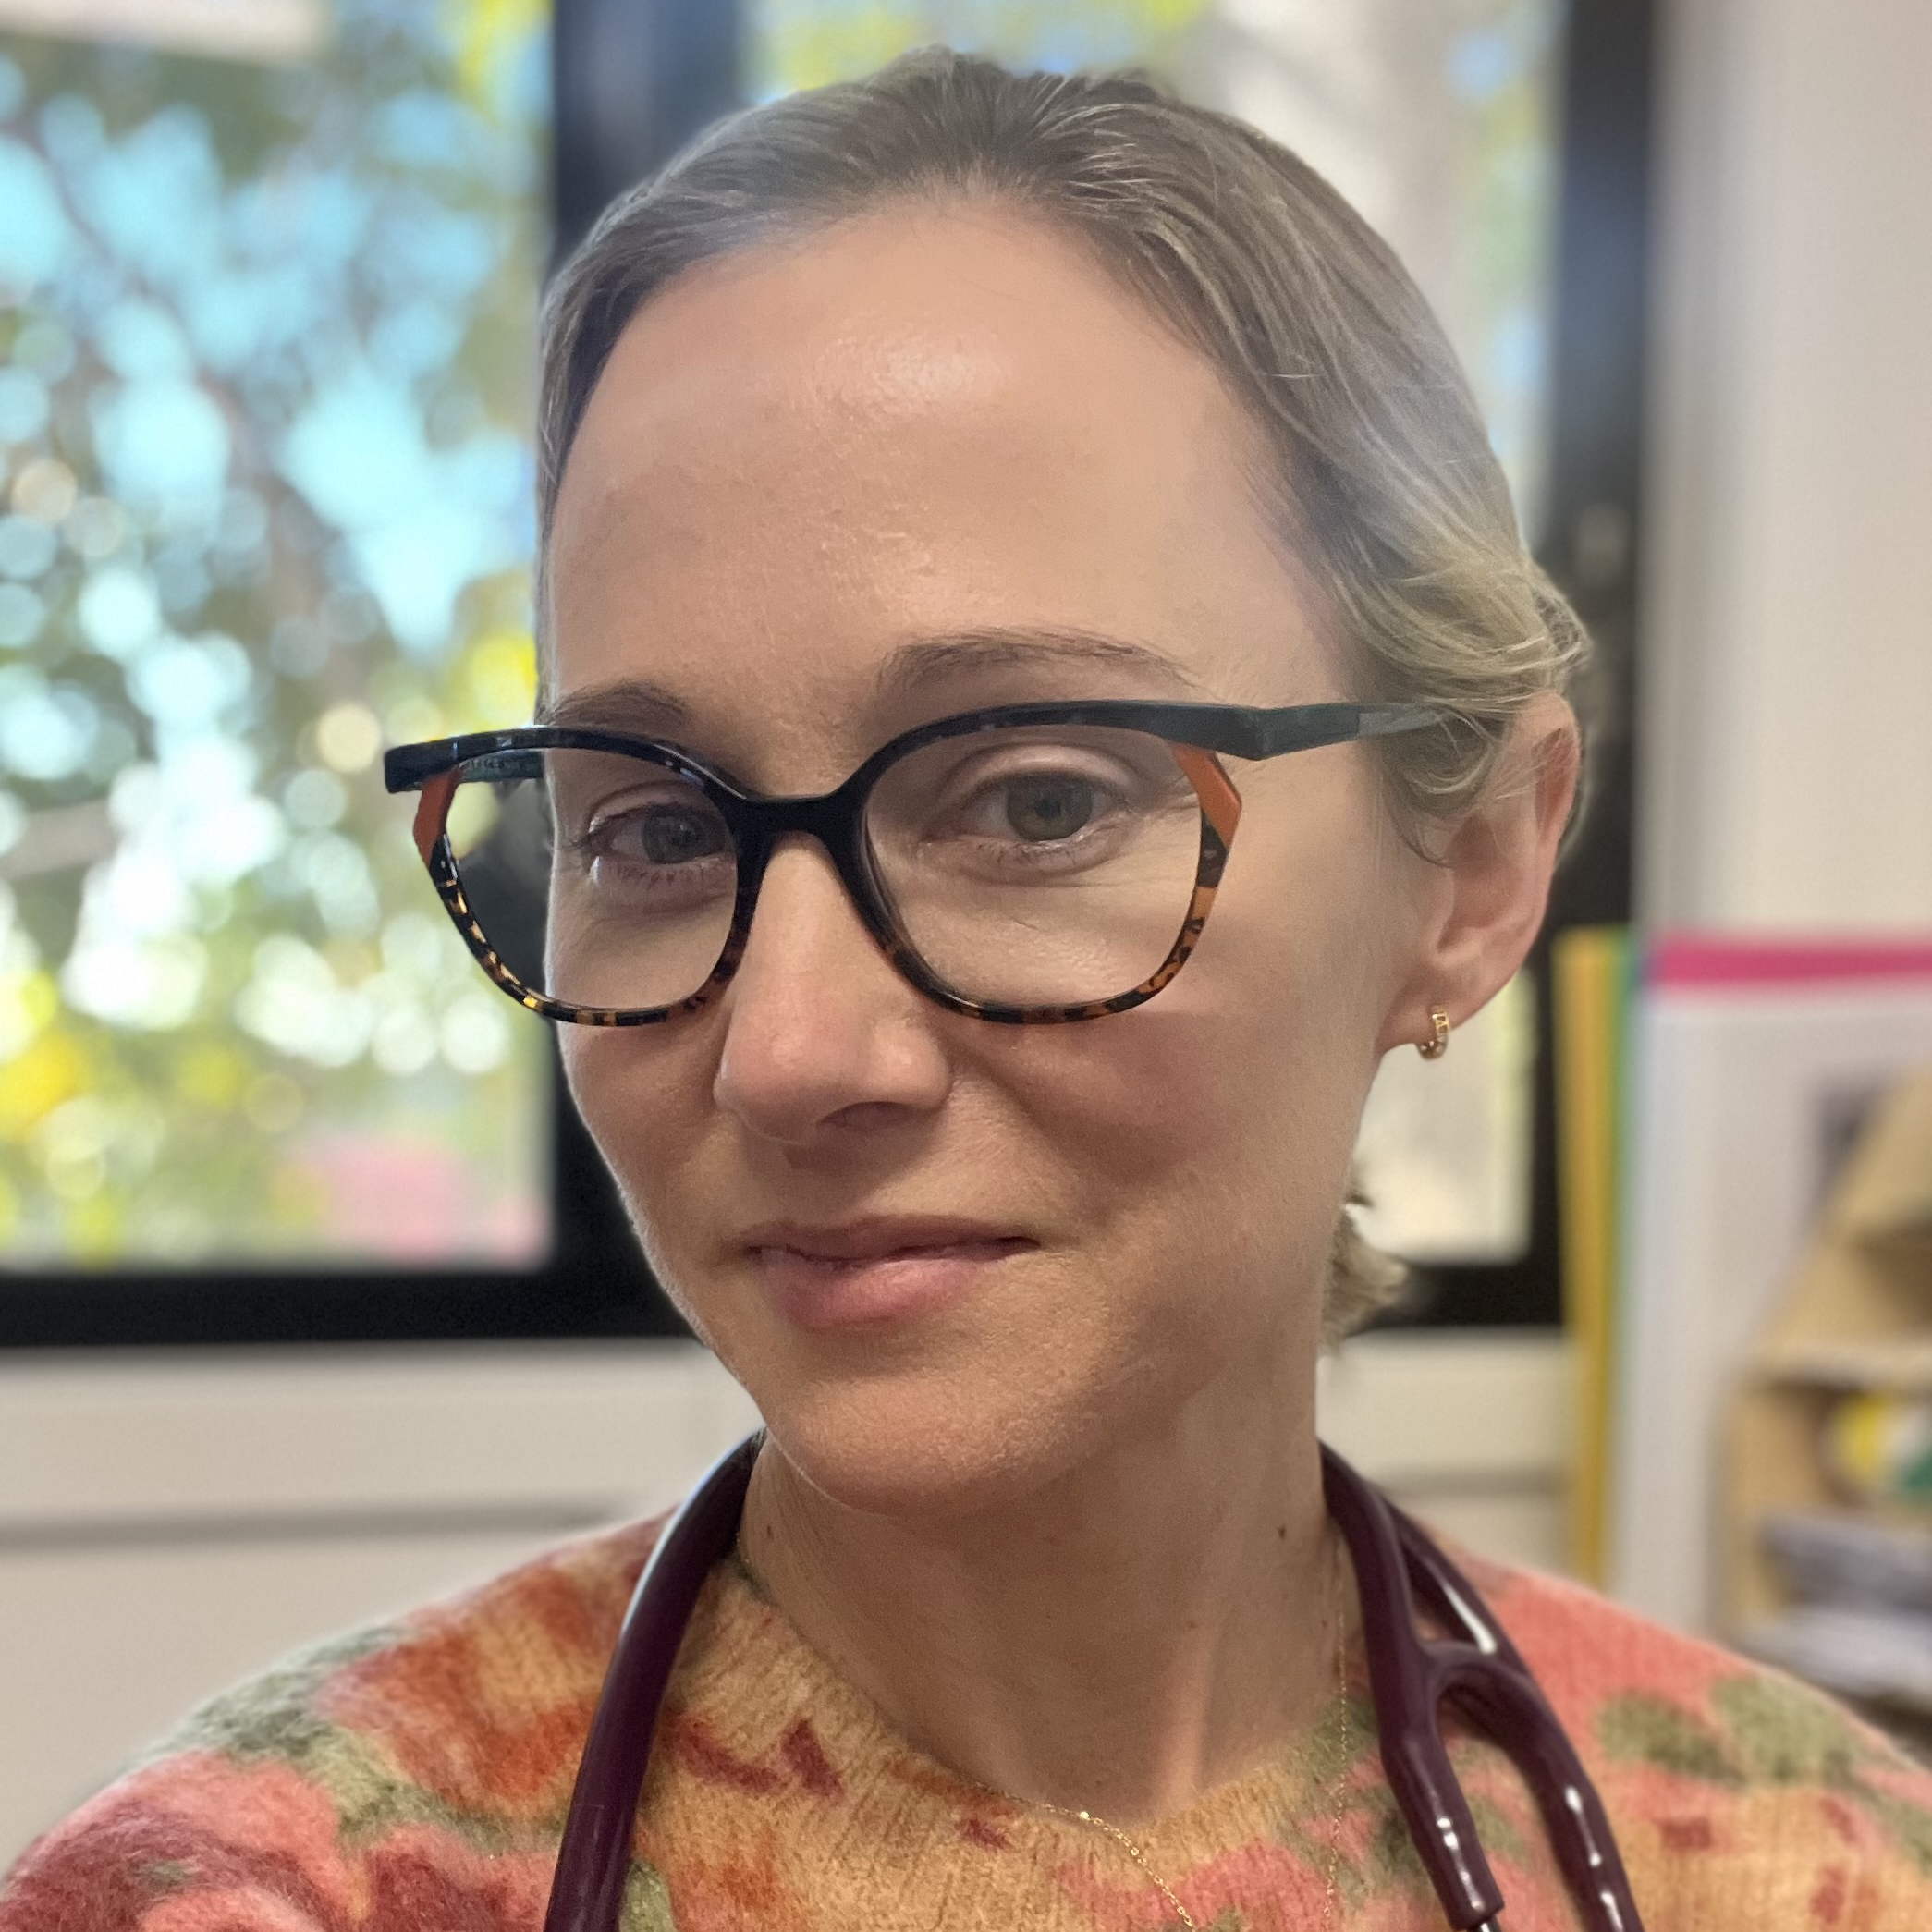
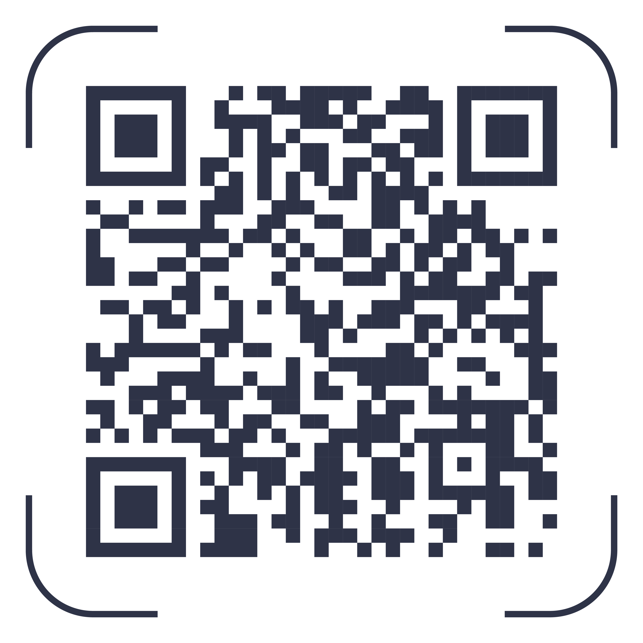
10:35am – 11:05am
Paediatric and ADHD Update
Dr Lauren Rolley
Got a question?
LOG IT HERE:

Slide 2
ADHD and Behaviour
Dr Lauren Rolley
Paediatrician, Ipswich Hospital
Lauren.rolley@health.qld.gov.au

Slide 3



Do not edit
How to change the design
Join at slido.com
#2245702
The Slido app must be installed on every computer you’re presenting from

Slide 4
Overview
Common behavioural concerns
Medical considerations
Red flags
ADHD
ASD
Other
What to do in the meantime?
ADHD Medications
West Moreton Service: Audit, Shared Care Pathway, Requests for Advice
Resources
Summary
Questions

Slide 5

Do not edit
How to change the design
What are some common behaviour concerns you are asked about?
The Slido app must be installed on every computer you’re presenting from

Slide 6

Do not edit
How to change the design
How comfortable are you with assessing and managing behaviour concerns for children?
The Slido app must be installed on every computer you’re presenting from

Slide 7
Medical Considerations
General medical
Sleep (Sleep-disordered breathing SDB – ask about snoring, screentime, sleep environment)
Hearing and vision
Bowels/bladder
Intake/diet
Activities
Allergies
Nutrition
Review growth
Other: hyperthyroid, absence seizures, lead poisoning, substance abuse
Notes:
A few other things on health pathways for consideration eg hyperthyroid, absence seizures, lead poisoning, substance abuse (particularly older children)

Slide 8
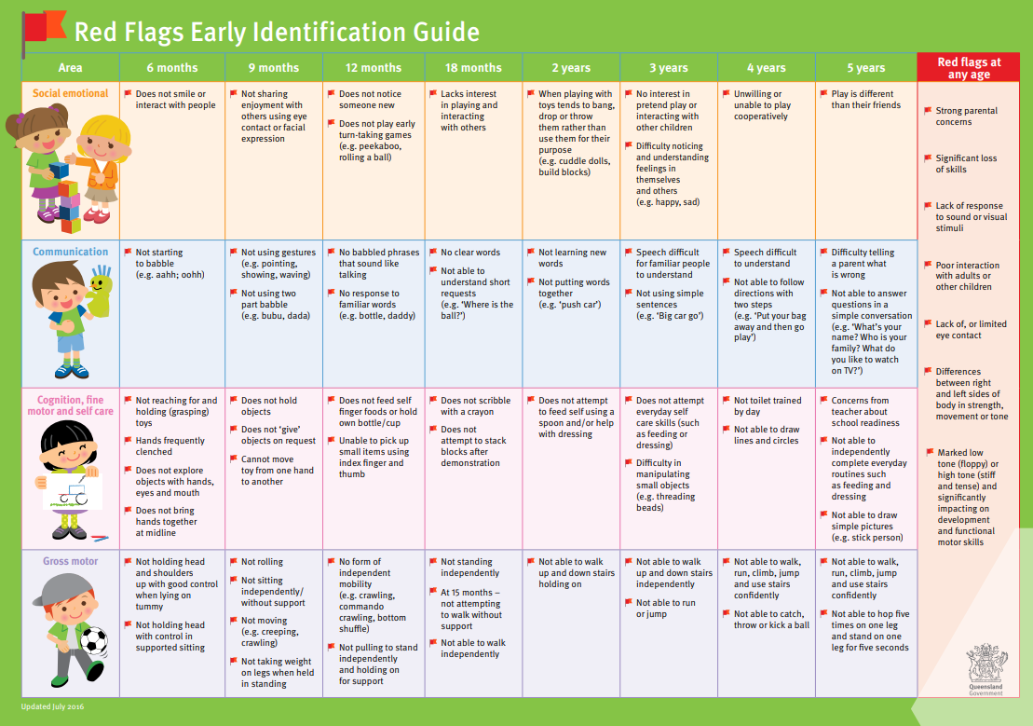

Slide 9
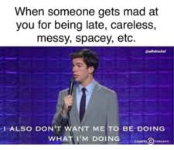
Attention Deficit Hyperactivity Disorder
ADHD
7% of children
Issues:
  Working memory
  Flexibility
  Impulse Control
DSM V criteria
  Inattentive symptoms
  Hyperactive symptoms
  Functional impairment
Behaviours: motor activity, difficulty engaging in activities, disorganised, reckless behaviours, easily distracted, talkative
Notes:
“That disinhibition also underpins creativity, because thoughts and ideas that are left to run a little while often get you to interesting places.” Being able to hyperfocus can also help people excel in the right environment. “You see that particularly in sports people,” “the biggest examples being Michael Phelps and Simone Biles – two of the most successful Olympic athletes of all time.”
Sometimes won’t see the symptoms in clinic setting (new environment, new toys,
Example – seeing a child for a medical issue, sibling tearing up the room, sliding books across computer screen as I was typing, put a ruler down my back

Slide 10
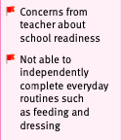
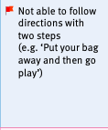
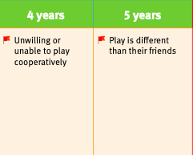

Slide 11
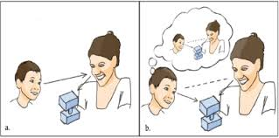
Autism Spectrum Disorder
Most recent estimate in Australian population is 1 in 40 (previously 1 in 70)
Social communication
Restricted repetitive patterns of behaviour, interests, or activities
Functional impairment
Early symptoms and signs: social skill deficits, language, frequent tantrums, intolerance to change, lack of orientation to name by 12 months, lack of protodeclarative pointing/joint attention by 14 months, lack of pretend play, avoiding eye contact or wanting to be alone, echolalia, giving unrelated answers to questions, idiosyncratic or stereotypical speech, getting upset by minor changes, obsessive interests, unusual movements, unusual reactions to sensory stimuli
Notes:
Early symptoms and signs – social skill deficits, language, behavior, frequent tantrums, intolerance to change, lack of orientation to name by 12 months, lack of protodeclarative pointing by 14 months, lack of pretend play e.g., feeding doll by 18months, avoiding eye contact or wanting to be alone, echolalia, giving unrelated answers to questions, getting upset by minor changes, obsessive interests, unusual movements e.g., flapping, rocking, spinning, unusual reactions to sensory stimuli
Examples
Baby at 3 months – no eye contact, response to voice. Appeared to respond to sound eg startle, had some vision eg hand regard
3yo boy who recited the entire number chart from the wall with an American accent
Seeing a 4yo patient in the playground area at the back of clinic due to chaos of him and 2 siblings with ADHD – jumping off equipment, throwing equipment, bit me on the bottom when I closed the door preventing him from absconding
Tantrums often prolonged, may be difficult to soothe
Joint attention JA is a spontaneously occurring behavior where the infant shows enjoyment in sharing an object or event with another person by looking back and forth between the two. Present by 14 months.
Pretend play – feeding a doll by 18mo
Echolalia – repeating words/phrases eg child who only says their name
Idiosyncratic speech – unique ways of speaking and using words or phrases eg calling trousers leg sleeves, calling a park “aunty kath” based on a personal connection, using a made-up word to describe something, eg saying toothfronts instead of front of teeth
Stereotyped speech – sounds as though it’s been borrowed from somewhere eg “everyone wears black in Melbourne”
May speak with an accent or unusual intonation, overly formal

Slide 12
Other – may be co-existing
Intellectual impairment
Specific learning disorder
Anxiety
Depression
Developmental language disorder
Developmental coordination disorder
Developmental trauma e.g., exposure to domestic violence

Slide 13
What to do in the meantime?
Identify the problems (not the diagnosis)
Investigate for any contributing factors e.g., medical (coeliac, iron deficiency!, TFTs, consider lead level), social, sleep, nutrition, constipation
Manage medical issues
Make sure the support people understand what the problems are
  School
  Therapists
  Consider assessments (Vanderbilt, M-CHAT)
If they have therapist already, suggest tackling one problem – make a plan and practice ++ when not in the actual situation
Regular physical and non-physical activities to build islands of competence
Build parenting capacity
Would psychology input be helpful?
Notes:
Islands of competence vs oceans of inadequacy

Slide 14
Assessments
To provide extra information and possibly reassurance
If you think ADHD – consider Vanderbilt questionnaires for parent and school
If you think ASD and aged 16-30 months, consider M-CHAT questionnaire – free, online 20 questions.

Slide 15
Reasonable Adjustments
Types of reasonable adjustments – Qld Education Website
Reasonable adjustments are different in each school and for each student according to their different strengths and needs. The reasonable adjustments will be made to support your child to attend, learn and participate in school activities. They may be required in the classroom, the playground, the school environment or during school excursions and camps.
Examples of adjustments could include:
teaching in a different way, for example, using diagrams and charts
providing extra learning to address areas of difficulty, for example, small group learning
using different resources and materials, for example, larger print, reference material, Braille
using different approaches to assessment
involving a teacher aide to support the classroom teacher at some times
using assistive technology, for example, speech to text tool, slope board
teaching a different year level in an age-appropriate way and developing an Individual Curriculum Plan
providing personal care supports, for example, to facilitate health or daily living needs
arranging the classroom or other learning environments so that all students can access what they need and move around the environment
making changes to areas of the school environment such as playgrounds or eating areas
providing a quiet area for students that responds to sensory issues or to support emotional regulation
using different strategies to ensure that all students are safe in emergency situations such as fire alarms
providing additional supports to students during school or out-of-school activities.
There are a range of podcasts on the NCCD website that outline the types of adjustments that could be made to respond to a range of conditions, disorders or disabilities, e.g., undiagnosed social/emotional disability
Notes:
School in our catchment has focus classes where students can be referred for focused attention on areas where they need extra support
Using different approaches to assessment eg a scribe, typing rather than handwriting, giving pause breaks during assessments
No one size fits all model for classroom arrangement eg students who have trouble focusing may be best served by sitting at the front of the classroom, where the teacher is very obvious to them and can help them stay focused. Other students with attention difficulties may find it easier to concentrate if they’re at the back of the classroom and can see everyone (don’t feel the need to turn around constantly)

Slide 16
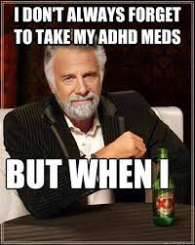
Medications for ADHD

Slide 17

Do not edit
How to change the design
How well do you understand what medications are available for ADHD?
The Slido app must be installed on every computer you’re presenting from

Slide 18
STIMULANTS
Ritalin
Dexamfetamine
Ritalin LA
Concerta
Vyvanse
NON- STIMULANTS
Atomoxetine (Strattera)
Guanfacine
(Intuniv)

Slide 19
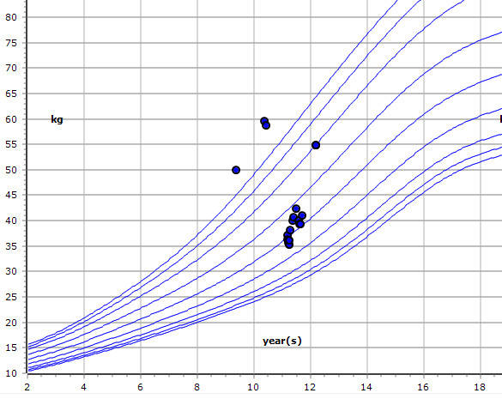
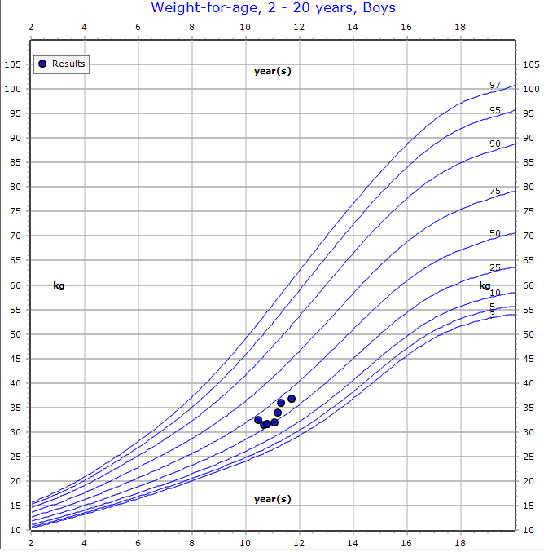
Stimulants
MOA: noradrenaline reuptake inhibitors and releasers
Considerations: cardiac risk factors eg congenital heart disease → ECG and cardiology advice
Start low and titrate up as tolerated/required
Do not require tapering to cease
Usually ~1mg/kg/day
Side effects:
Appetite suppression
Weight loss/stagnation
Sleep disturbance
Wearing off effects
Anxiety

Slide 20
Stimulant pitfalls
Modest improvement
Not all weight loss is due to stimulants
Not all inattention/hyperactivity is due to ADHD
Parents reporting no improvement
Diversion

Slide 21
Second-line agents
Guanfacine (Intuniv)
  Noradrenaline receptor antagonist, CNS alpha 2A agonist
  Side effects: sedation, hypotension, abdominal pain, nausea
  Wean up/down
  Not given with clonidine
Atomoxetine (Strattera)
  Noradrenaline reuptake inhibitor
  Takes 8-12 weeks for full effect
  Not commonly used
  Side effects: fatigue, headache, nausea, vomiting, abdominal pain, suicidal ideation

Slide 22
Follow up
Check BP and HR
Check growth
Tell them to eat breakfast
Check adherence
Monitor for side effects
Monitor efficacy (attention, hyperactivity, impulsivity, academic progress), consider repeating Vanderbilt on medication

Slide 23
West Moreton Paediatric Service
Audit

Slide 24
West Moreton Paediatric Service
Requests for advice

Slide 25
West Moreton Paediatric Service
Shared care pathway

Slide 26



Resources – 1
Books:
  No Drama Discipline
  Siblings Without Rivalry
  The explosive child

Slide 27

Resources – 2
Podcasts
  Popculture parenting
  Maggie Dent – Parental as Anything
  Hamish Blake - How other dads dad (less practical)

Slide 28



Resources – 3
Programs/courses:
  The Brave Program – free interactive online program for prevention and treatment of anxiety.
  Triple P (Positive Parenting Program)
  Circle of Security parenting program

Slide 29
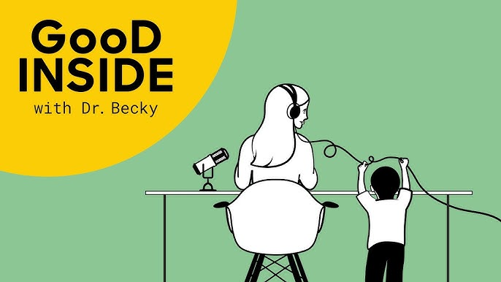
Resources – 4
Social Media:
  Dr Becky – Instagram (also has a podcast)

Slide 30





West Moreton Area
Mission Australia – Intensive family support
Early Intervention Parenting Service
Uniting care – free family case management program
Kummara – parenting support for Indigenous families
Play matters (play groups)
Anglicare

Slide 31
Any Questions?

