Slide 1


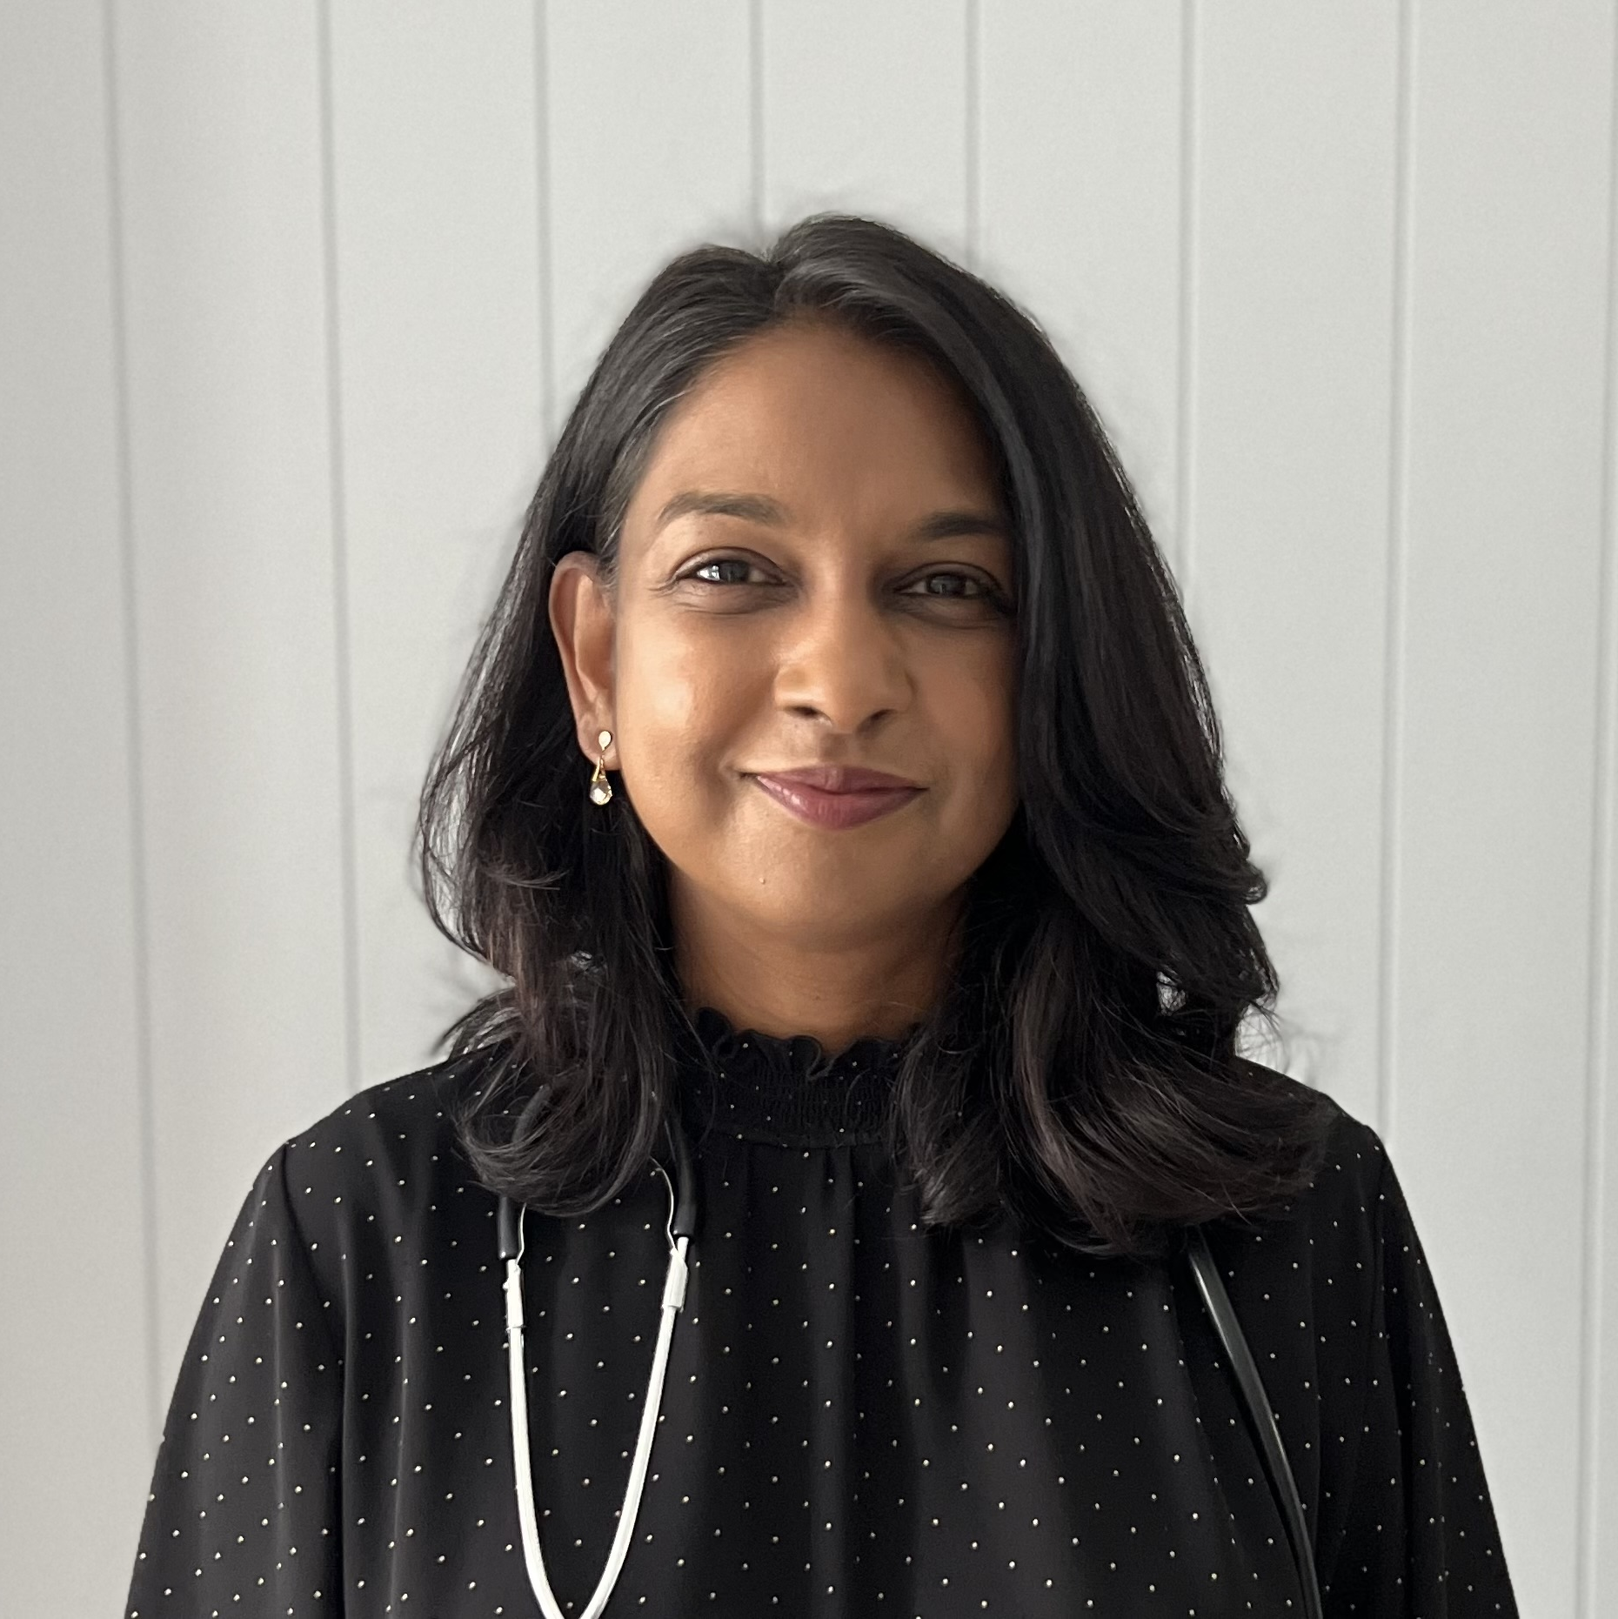

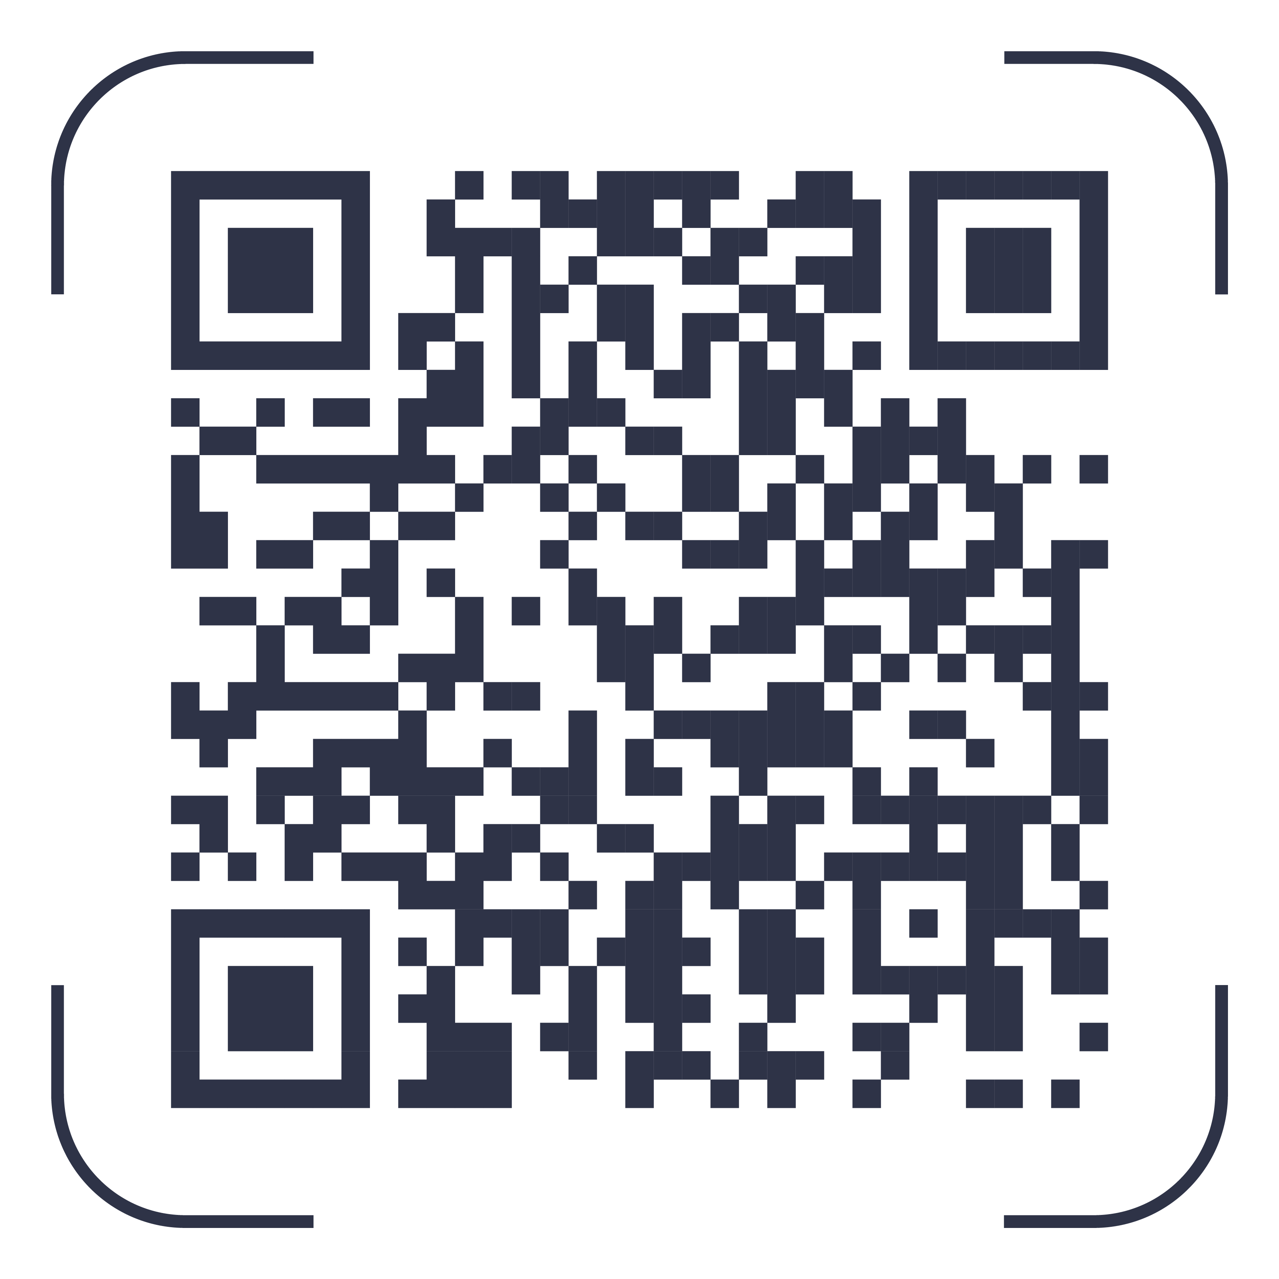
2:45pm – 3:00pm
New Service Update
Dr Tanusha Ramaloo
and Dr Mei Ching Freeman
Got a question?
LOG IT HERE:

Slide 2


Why is Clinical Handover/discharge summaries important?
Dr Tanusha Ramaloo

Slide 3


WM general practice snapshot
2.2 million consults in 2023
780 GP’s = 370 FTE
Approx. 9000 consults / day in General practice
LUMOS study - discharged patients who saw their GP’s:
within 2 days after discharge had 32% fewer readmissions
7% fewer readmissions in the first 4 weeks
13% fewer readmissions down the track (1-3 months)
GP’s time is valuable – Cheat Sheets
HealthPathways
Login: wmuser
Password: wmpassword
Grand Rounds
Last Tuesday of every month at 12-1pm via MS Teams

Slide 4
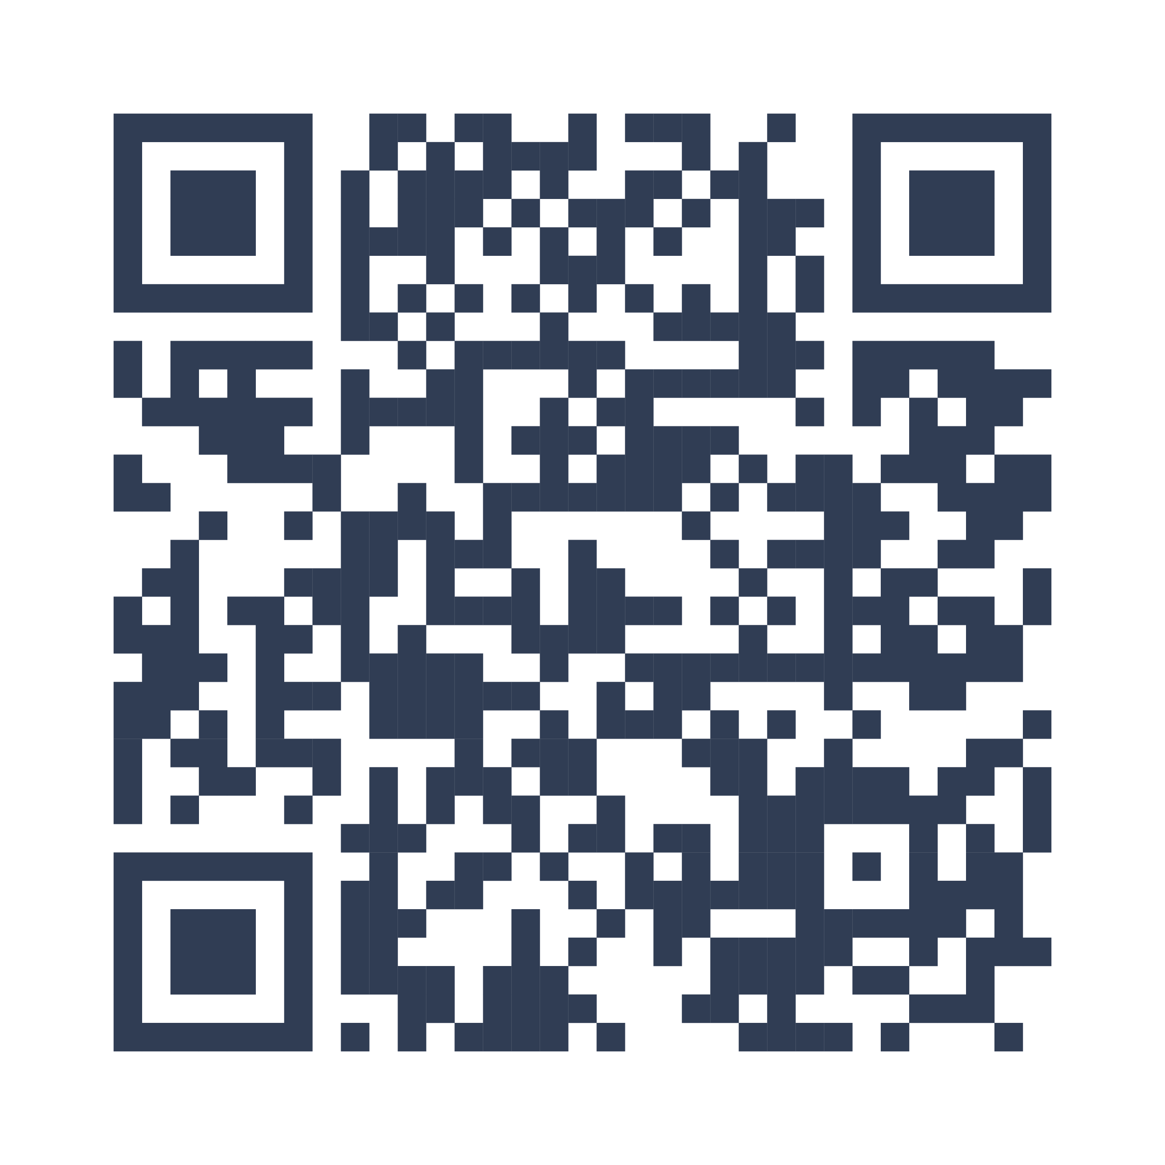
The Viewer and My Health record workflow
My Health Record – Queensland Pathology and Dr verified Radiology reports, ED event and Discharge summaries. Medication list, Immunisations. Can be incorporated into Practice software.
The Viewer- an option for patients without MHR. Additionally, appointments, Mental health notes, Oncology Care plans.
24/7 Helpcentre- 1300 478 439.
STS directory update for patients who see multiple GP’s in the practice. Need to contact medical objects (vendor) set up a generic practice inbox that is checked BD.

Slide 5
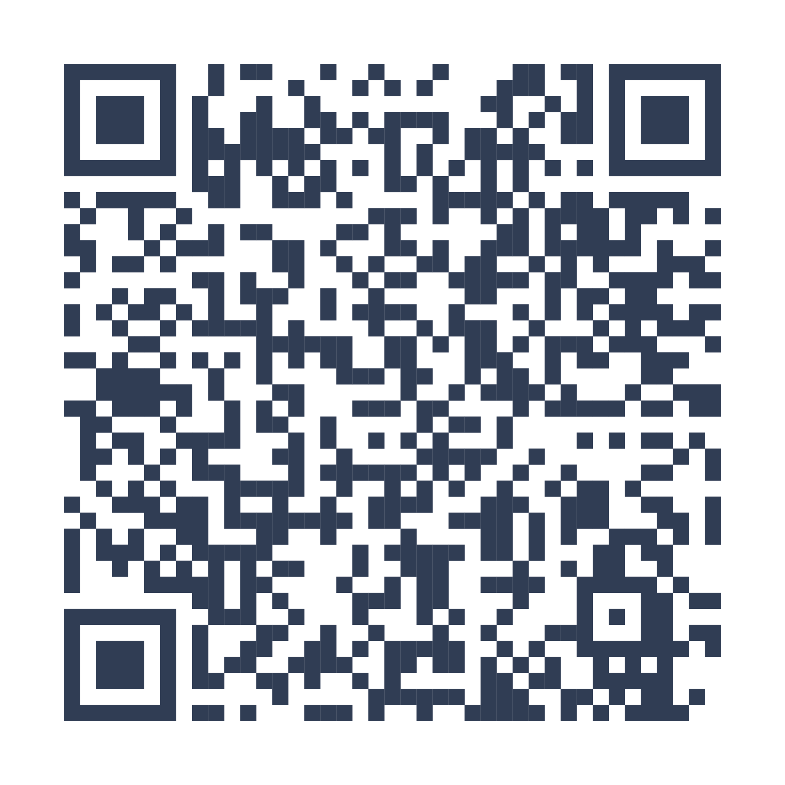
Alternatives to ED
- MRAC - VECS
- PICS - HiTH
Scan to download

Slide 6
Antenatal
Maternity and Maternity Shared Care

Slide 7
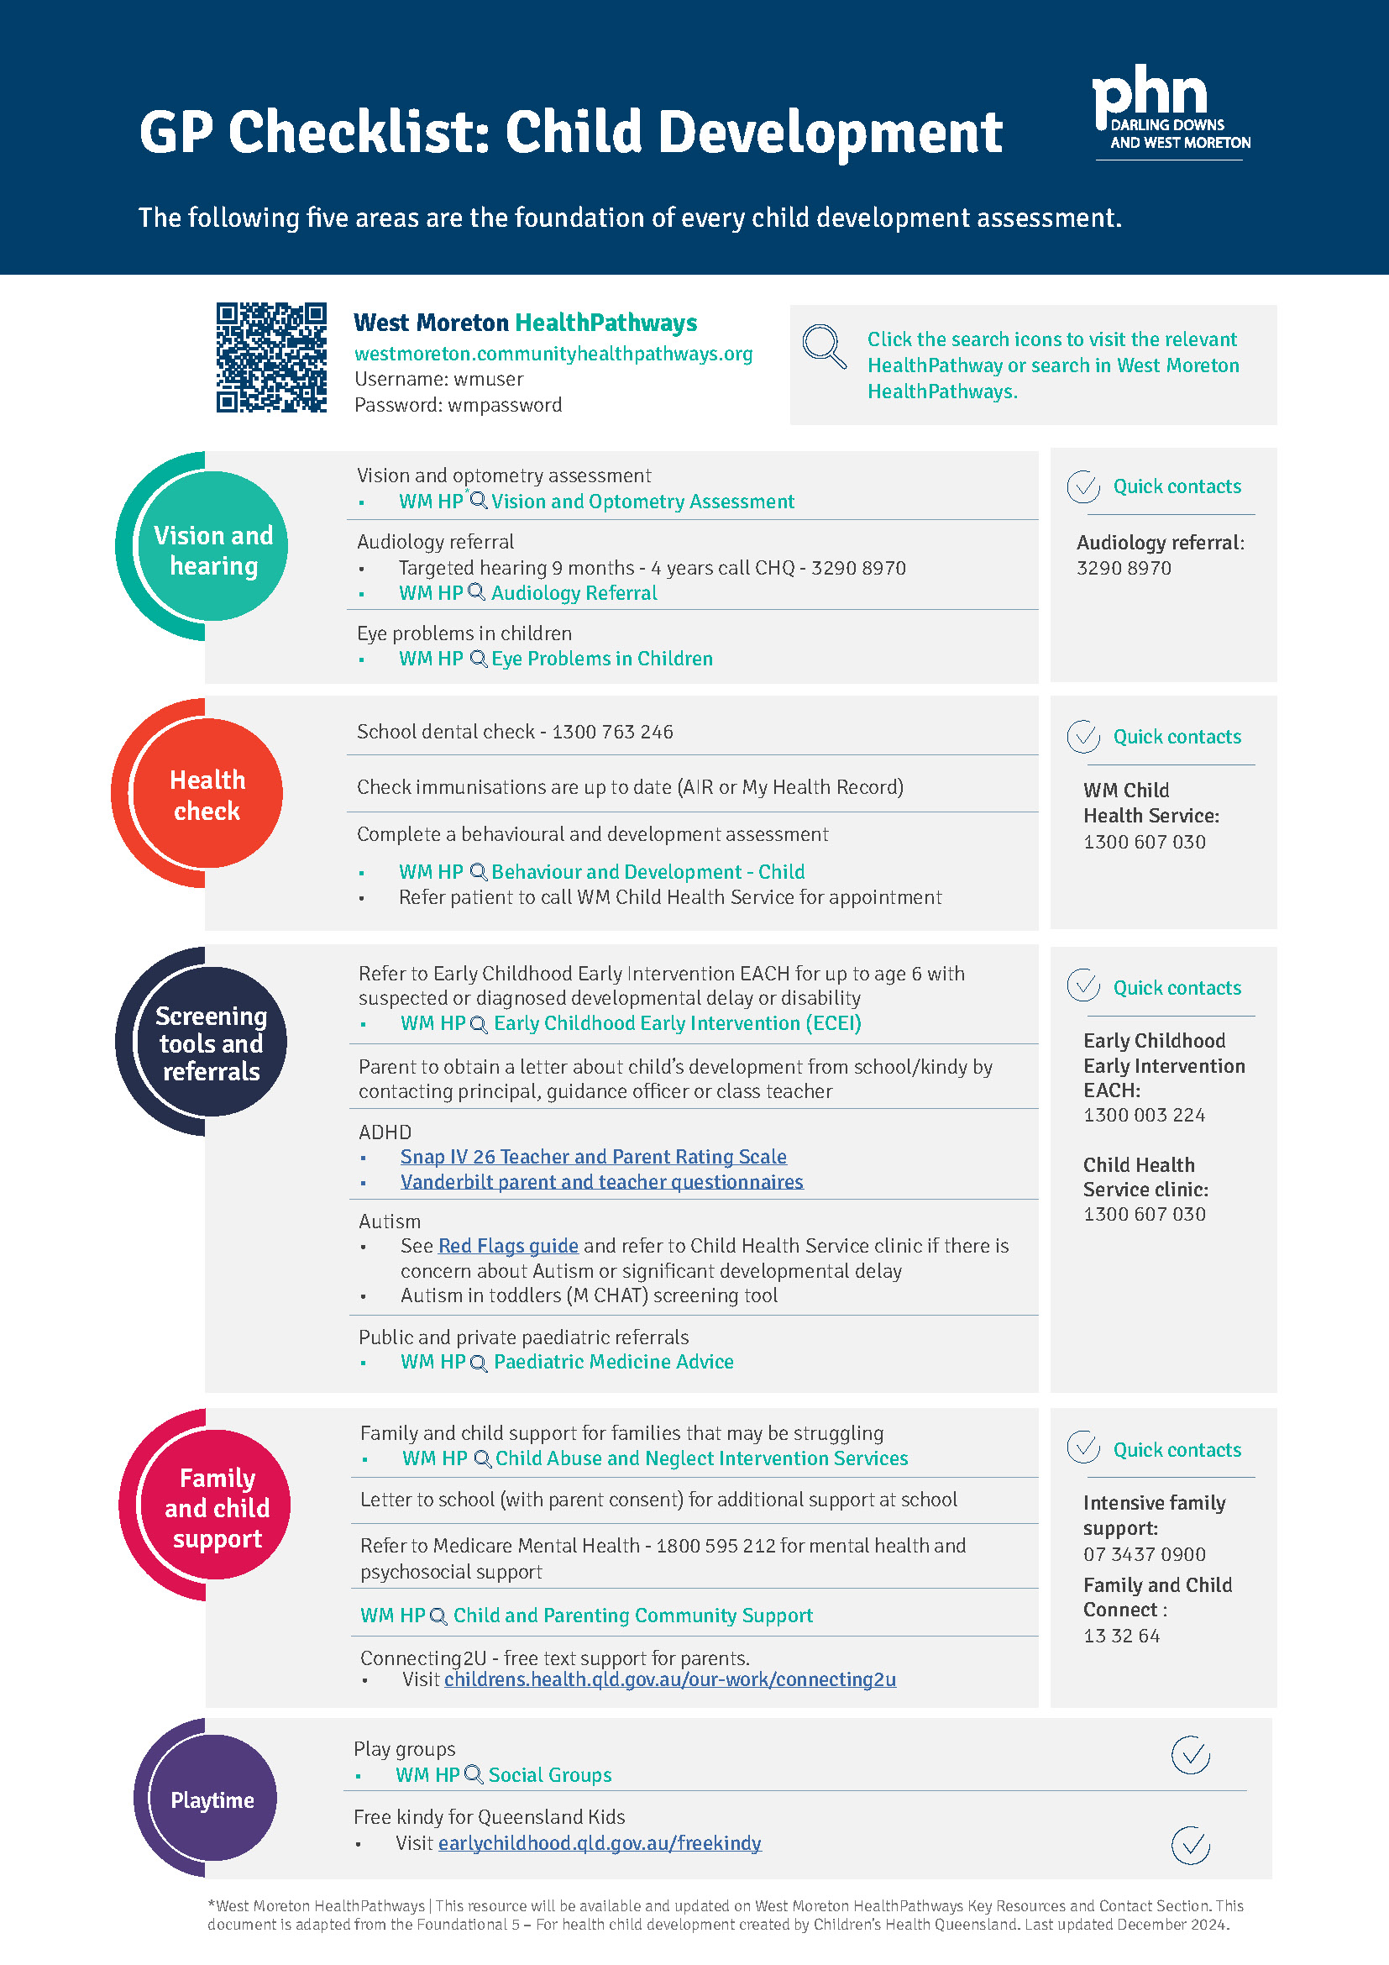
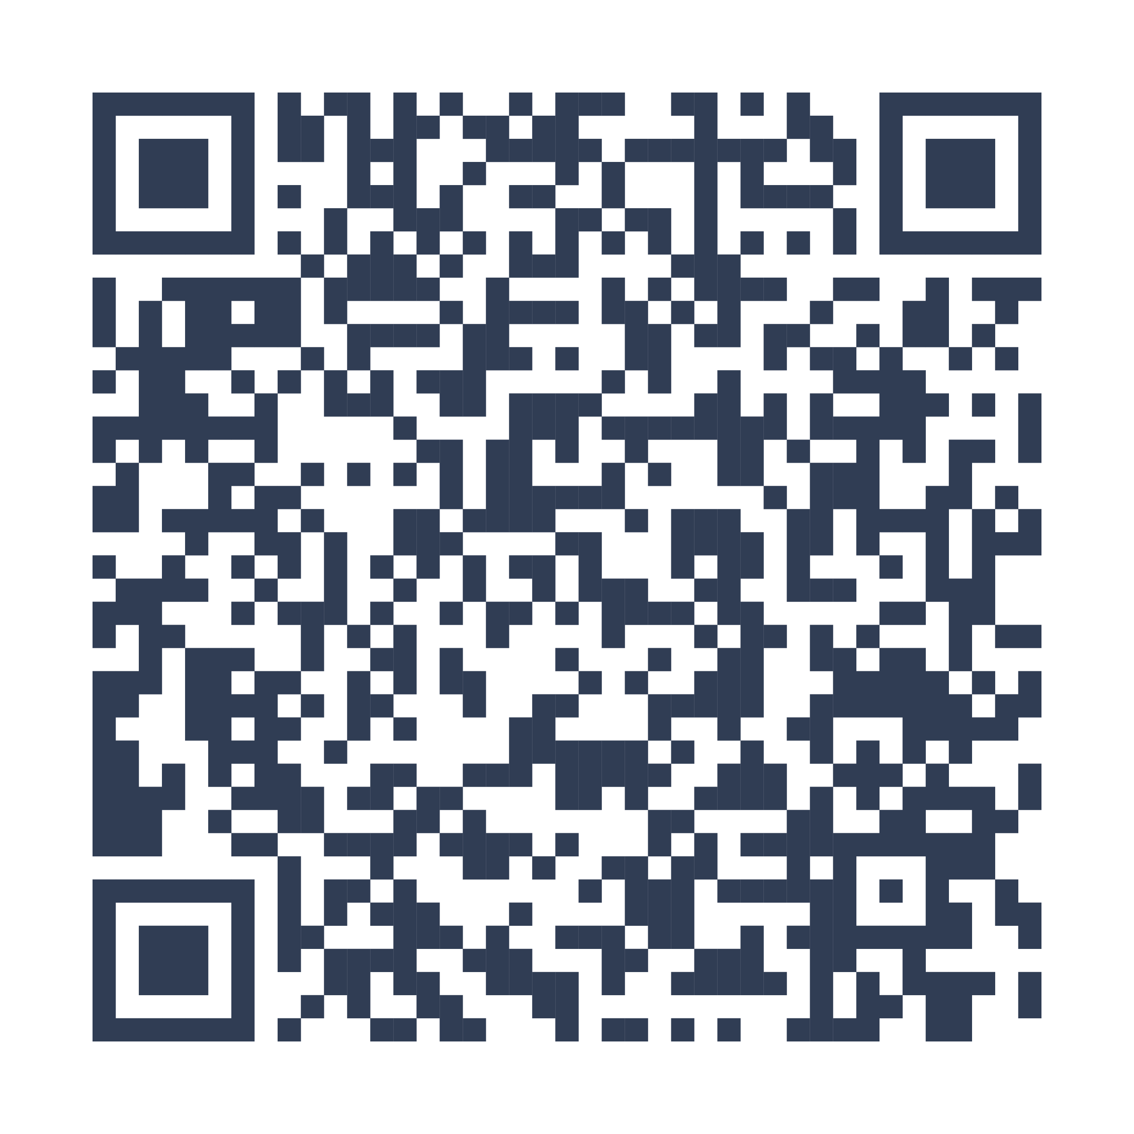
GP Checklist: Child Development
Scan to download

Slide 8
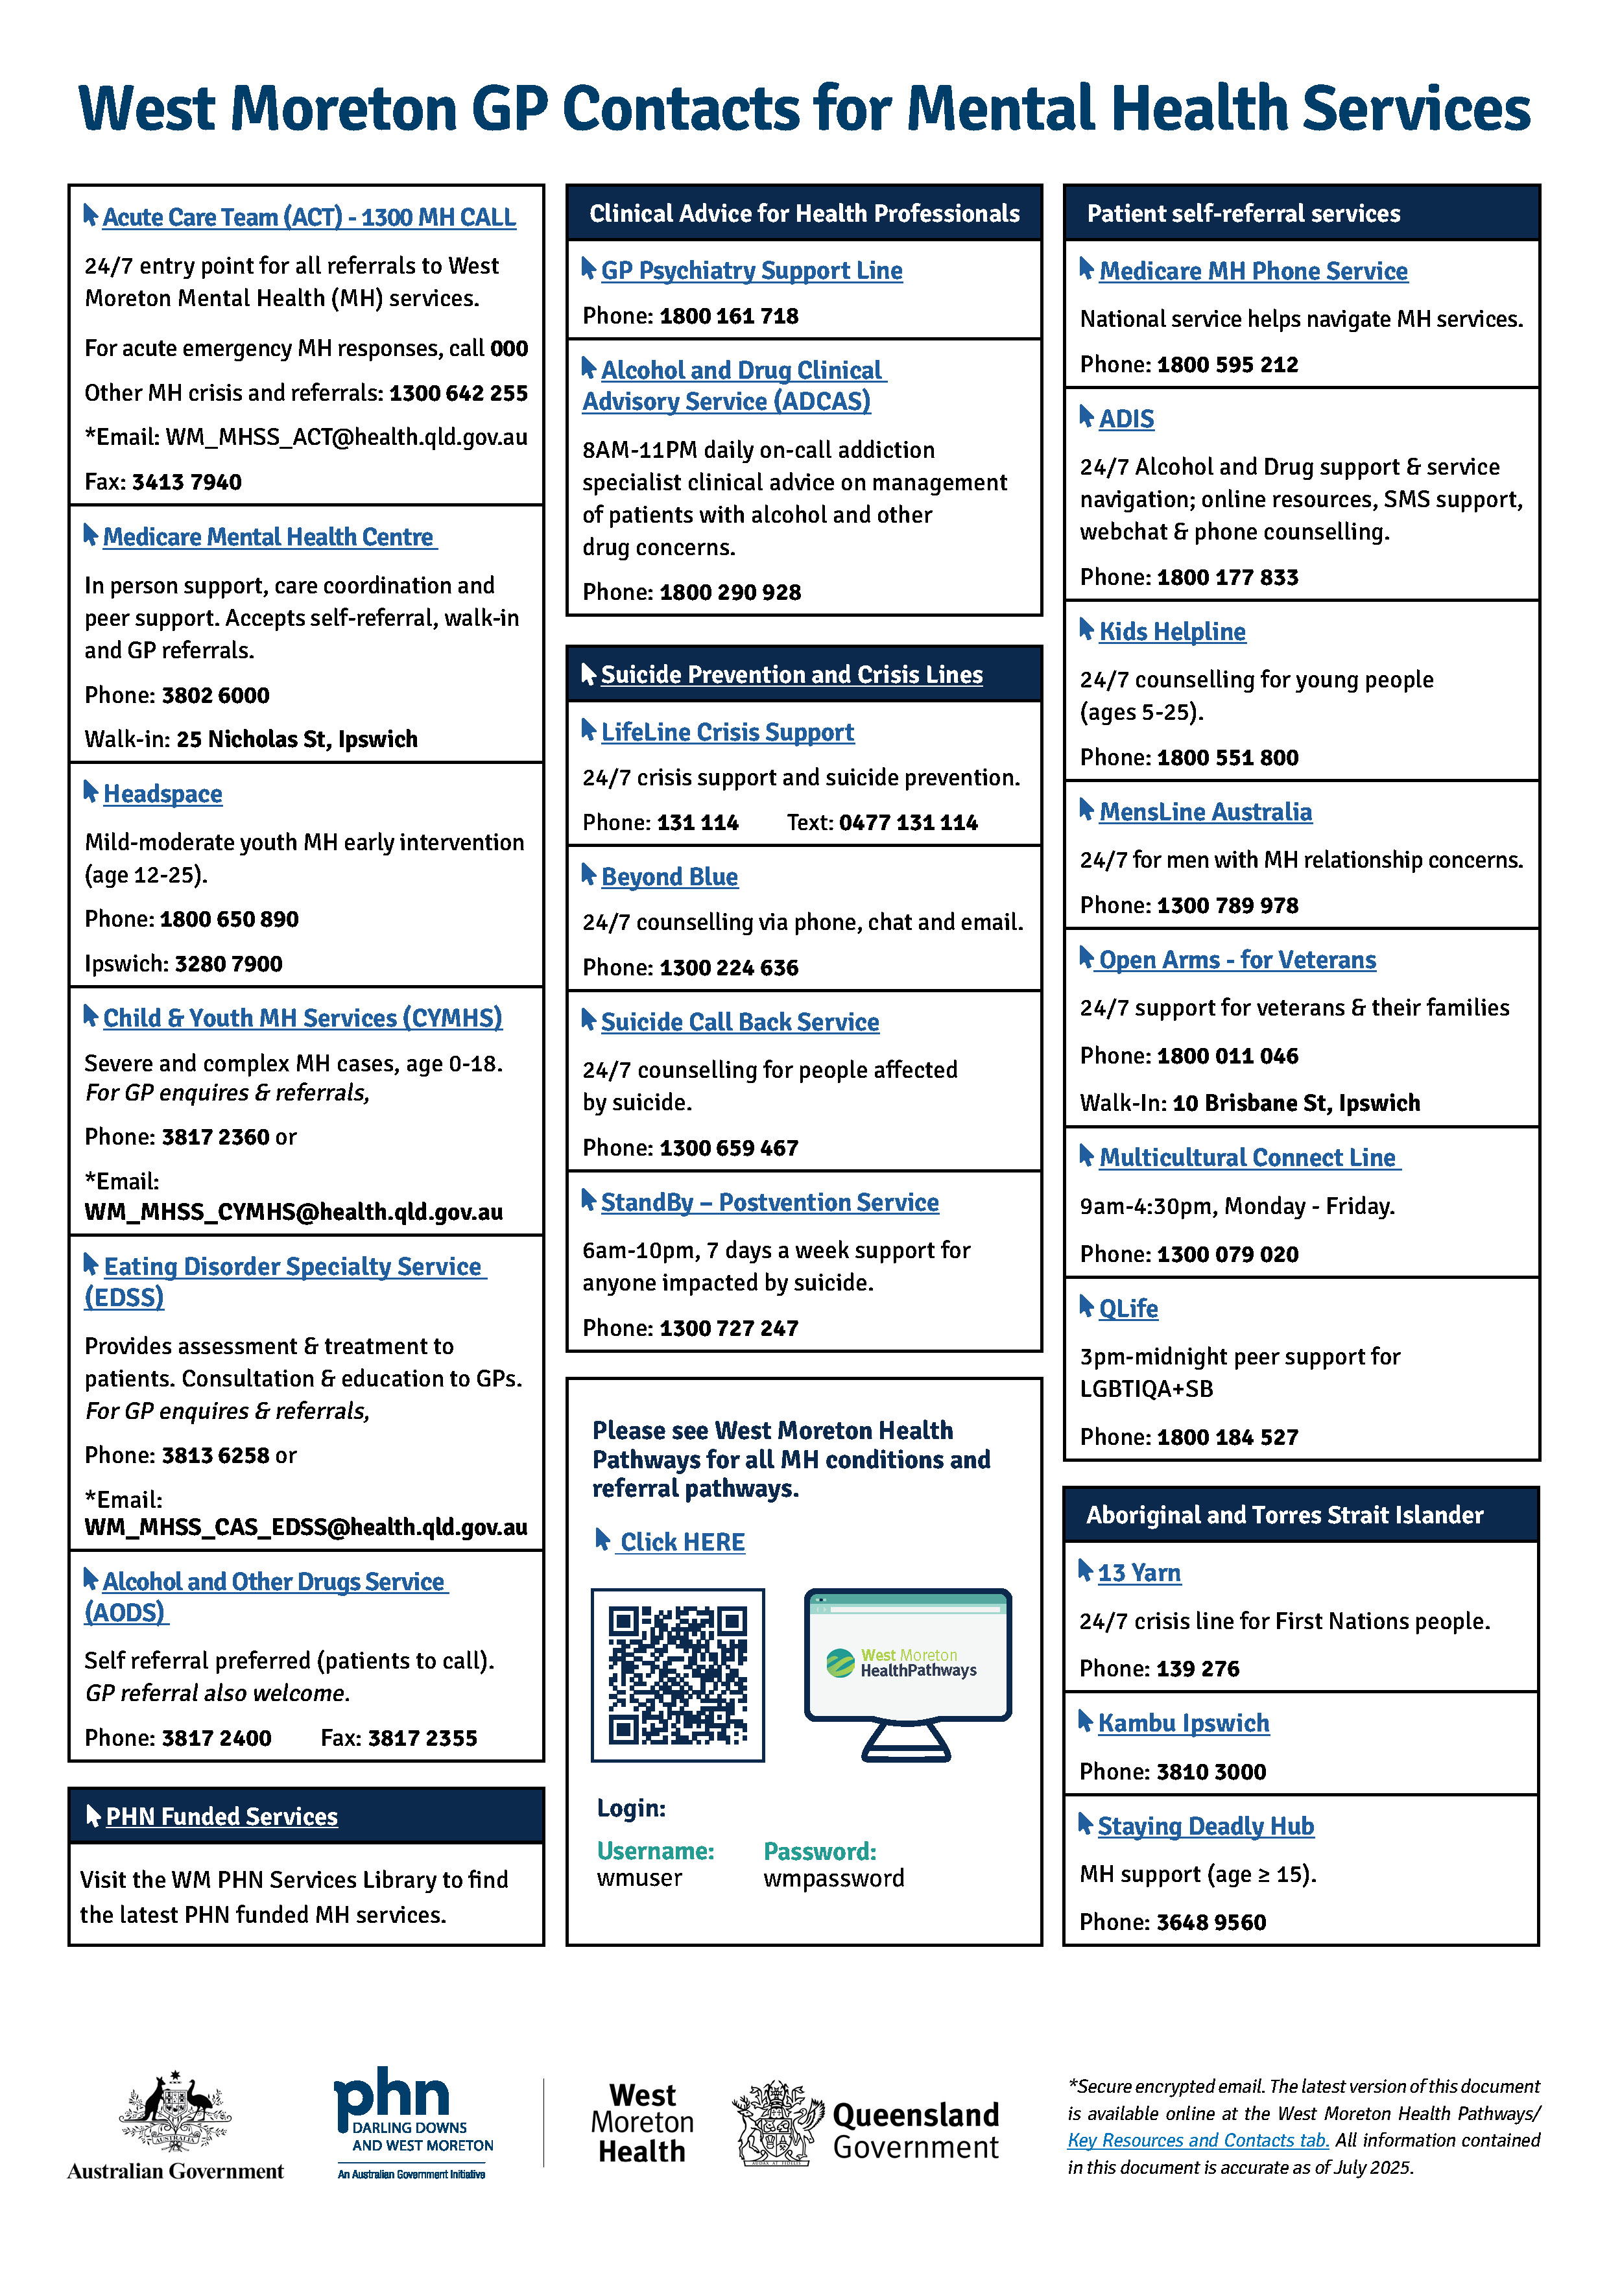
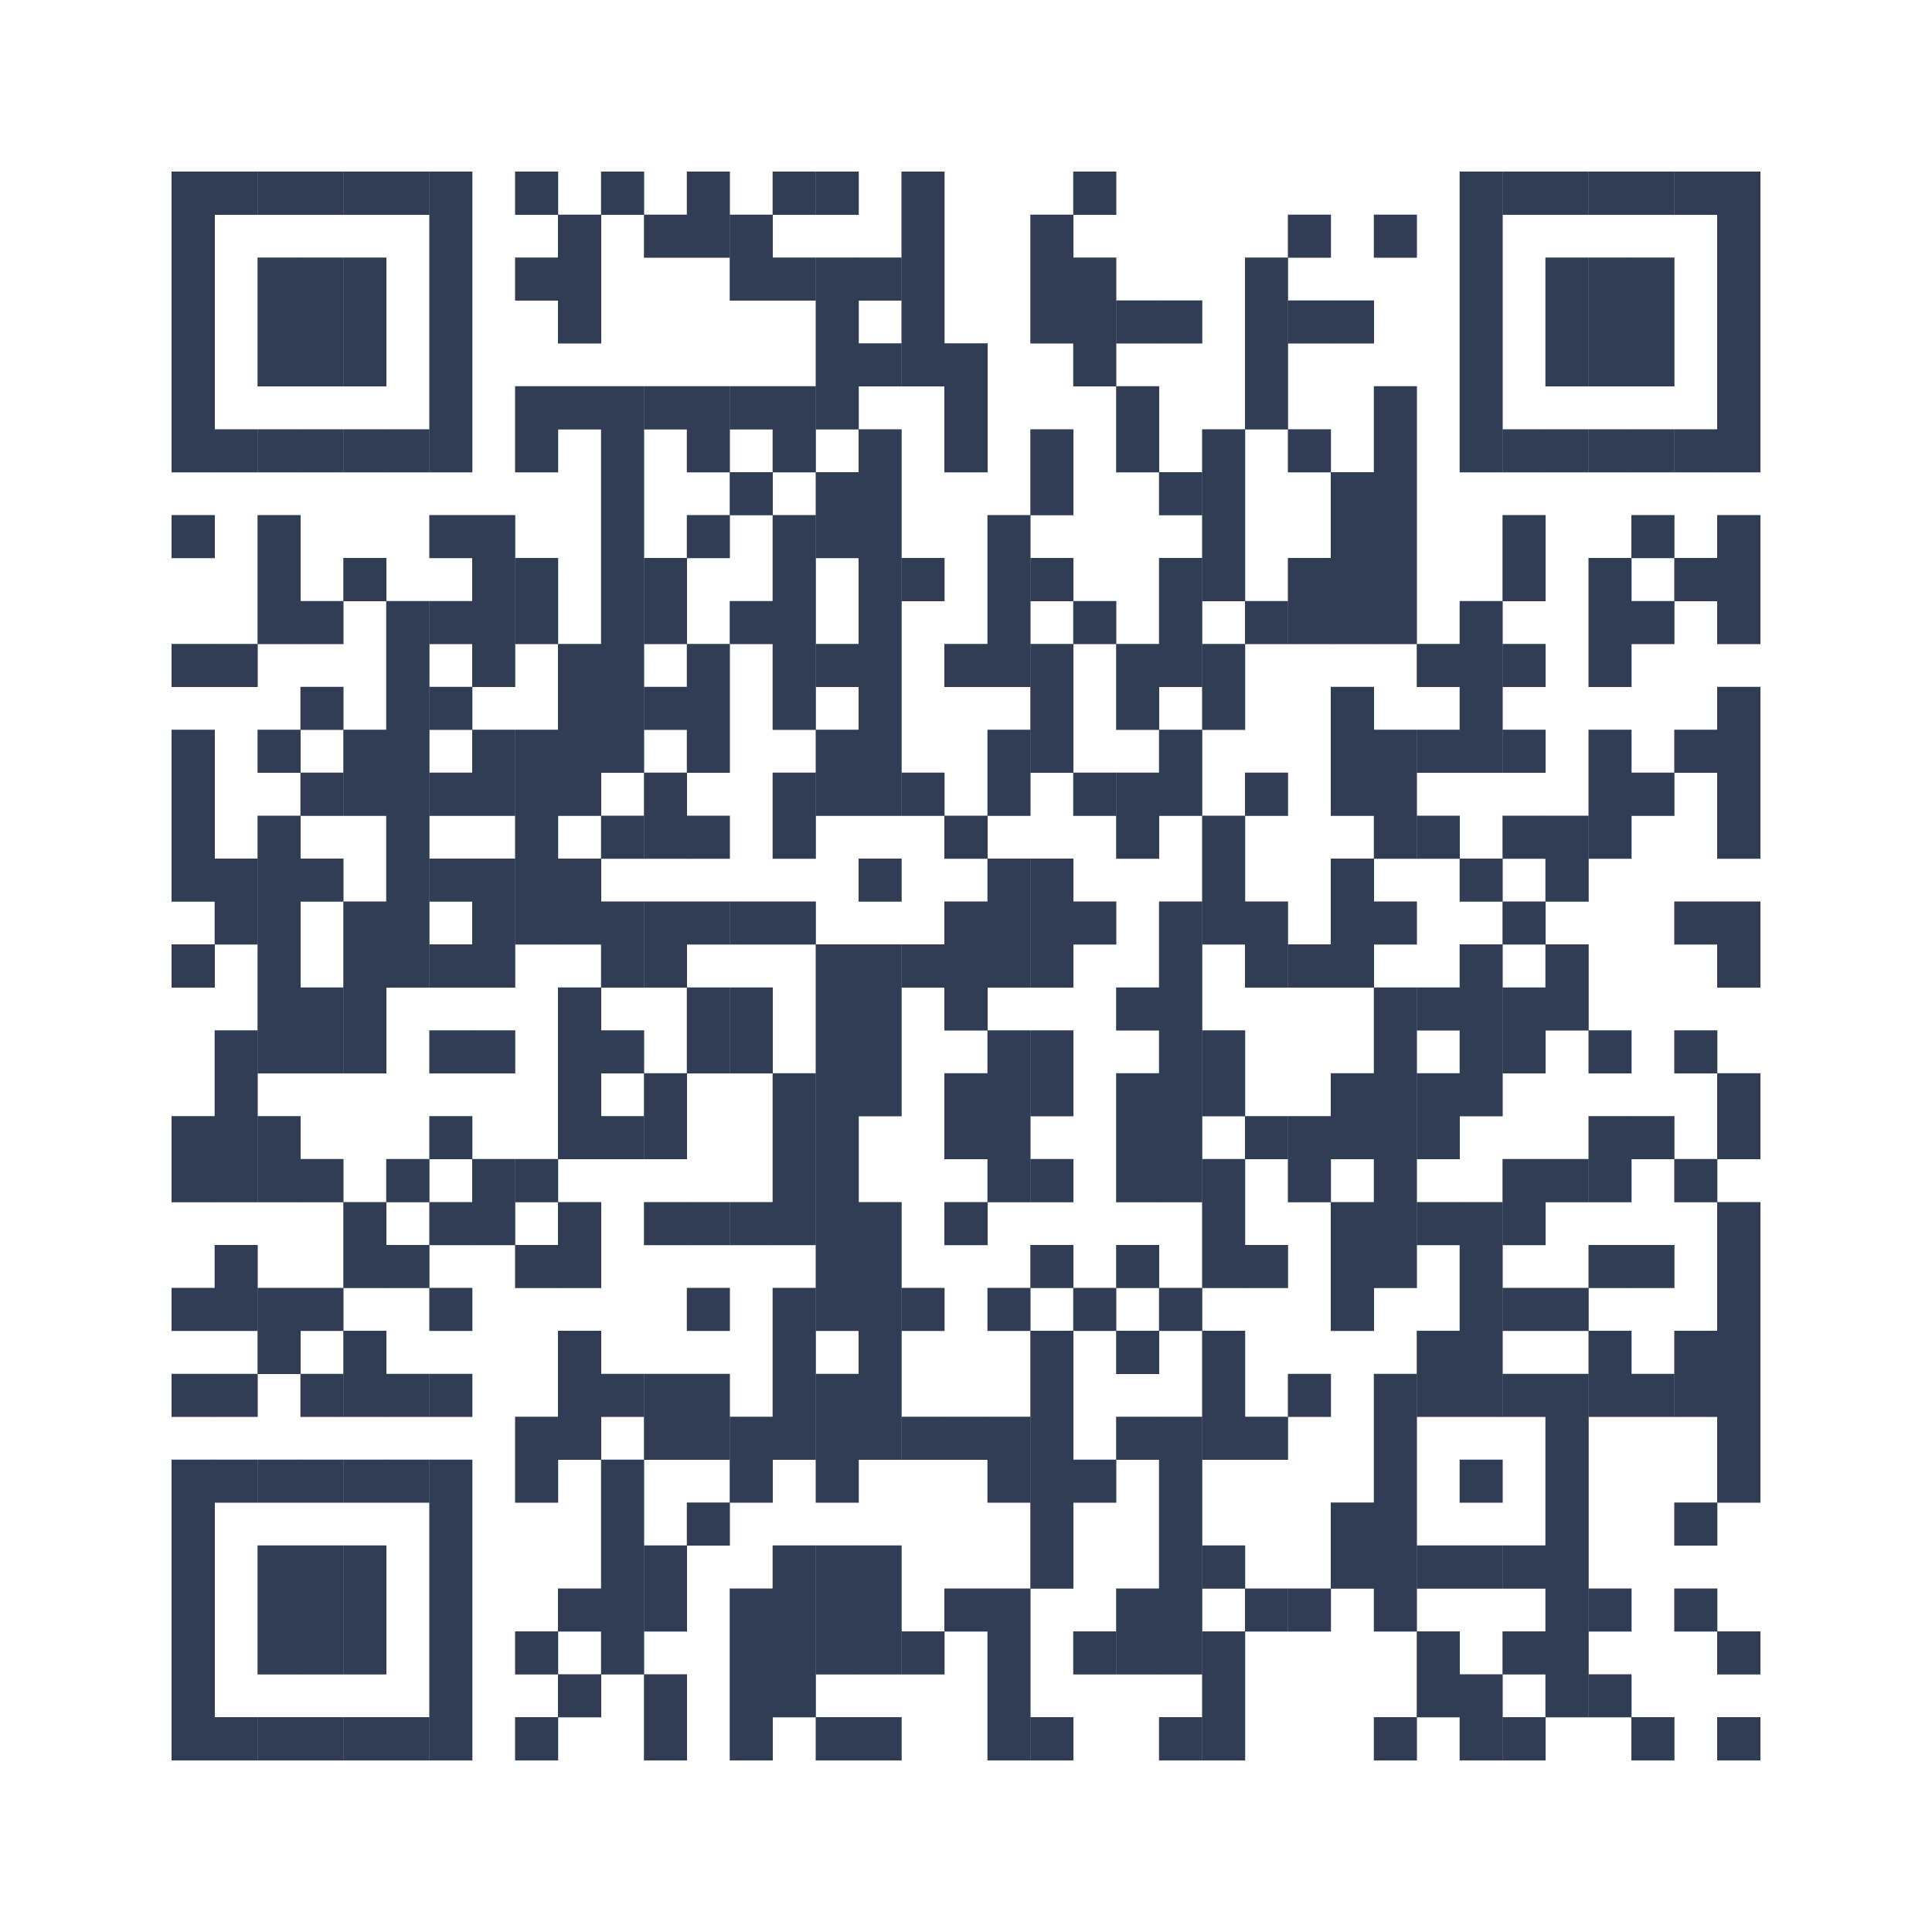
West Moreton GP Contacts for Mental Health Services
Scan to download

Slide 9
New services for West Moreton GP’s
Eating Disorder Speciality services SMO 3813 6258
WMH Request for Advice
- ONLY via Smart Referrals
  Older persons
  Respiratory
  Endocrinology
  Paediatrics as of 4 August 2025
  Cardiology
  Rheumatology
Post Operative Discharge Support Service PODSS
  Phone 0439‑032‑970
Infusions Service Update
  RMO 07 3413 5866
  Clinic Ph: 3413 7298
  2 options:
    Fax 38101762
    Smart Referrals to Day
    Infusion Service

Slide 10
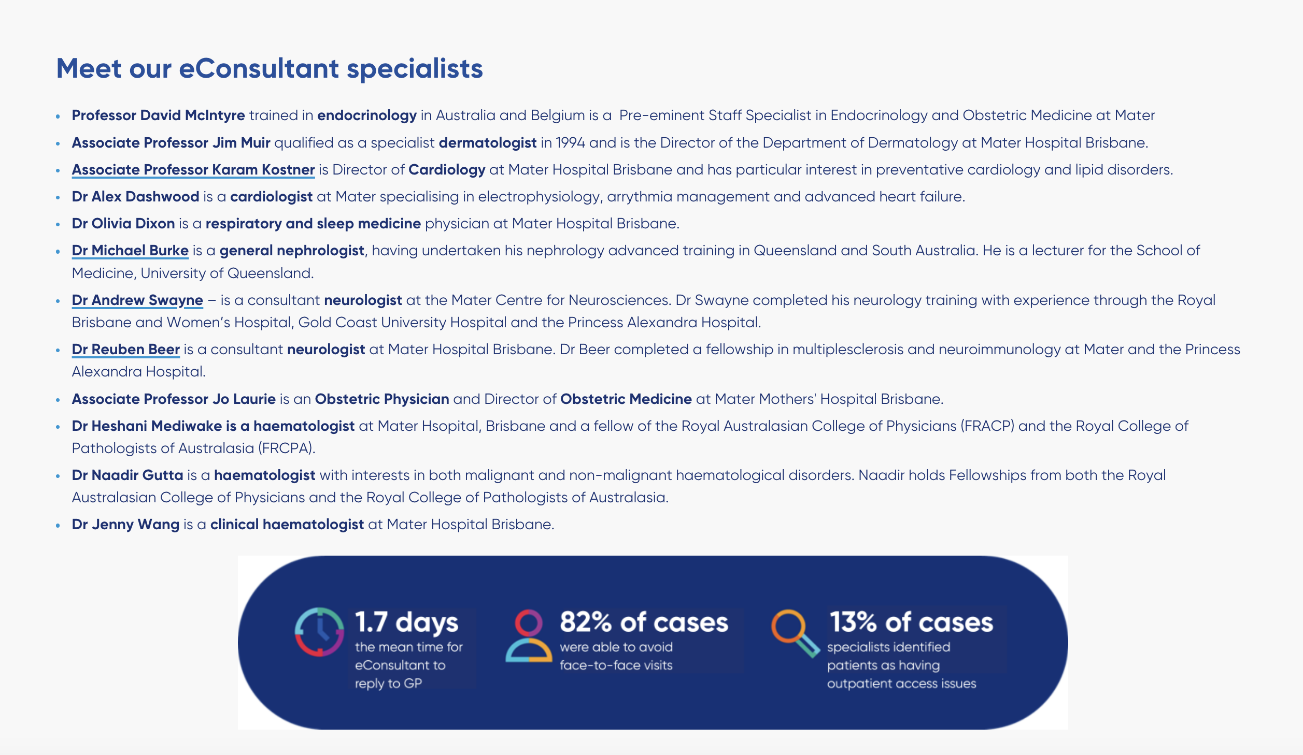
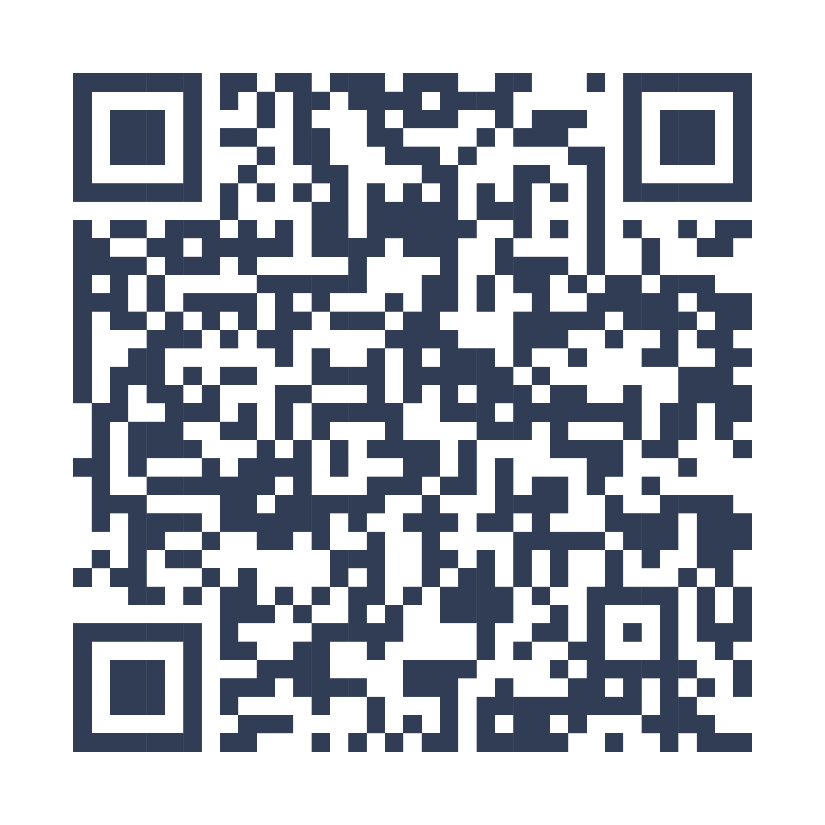
Mater South Brisbane – West Moreton catchment patients
Mater South Brisbane through Smart Referrals.
Adult referrals only.
Mater GPLO Contact
Scan to view

Slide 11
Ipswich Podiatry High Risk Foot Clinic
Weekly specialist multidisciplinary high-risk foot clinic at Ipswich Hospital that includes Podiatry, Endocrinology/diabetes, Infectious Diseases & Orthopaedics for acute high-risk foot complications (e.g., diabetic foot ulcers and infections, Charcot foot) requiring multidisciplinary care.
Referrals can be sent by GP's via
  Smart Referrals – high risk foot clinic as Urgent
  Priority Fax as Urgent
  Electronically via medical objects
  as Urgent
All high-risk foot referrals are reviewed by our high-risk foot co-ordinator and triaged to the appropriate service (Podiatry, PICS, High-risk foot MDT).
The service also provides a rapid pathway to PAH Vascular Surgery for acute outpatient review for patients with high-risk foot complications meeting their referral criteria. Patients can be referred to the Ipswich Hospital Podiatry Department where they will be assessed and referred for timely review if required.

Slide 12
Child health nurse referrals via smart referrals
Growth and development checks 0-5yrs including PEDS & ASQ3
Hearing screening 4-18yrs
Breastfeeding and early feeding support
Help with sleep and settling
Parenting support
Located at sub-centres across the West Moreton district including Ipswich, Goodna, Springfield, Whiterock, Ripley, Boonah, Riverview, Redbank Plains, Laidley, Gatton, Esk, Fernvale and Lowood
Notification of appointment will be sent via Smart Referrals to GP
Assessment Letter will be sent via medical objects to GP’s once they have seen the patient

Slide 13
The TeleOncology Service:
Patients see their Medical Oncologist via telehealth for consultations and treatment planning.
Treatment is administered locally at rural hospitals by upskilled RNs and CNs.
Only low-risk patients receiving low-risk treatments are managed at rural sites to ensure safety.
Currently operating from Ipswich Hospital to:
  Laidley and Esk Hospitals (12+ months)
  Gatton Hospital (6 months)
  Boonah Hospital to be onboarded in September

Slide 14
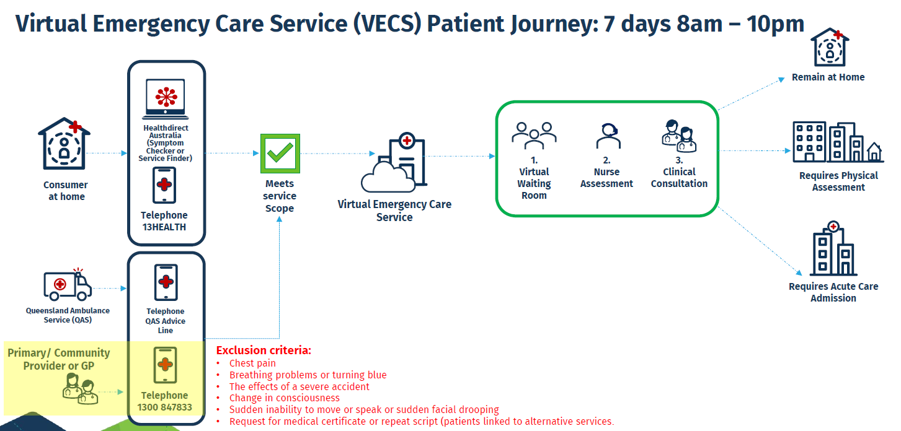

Slide 15
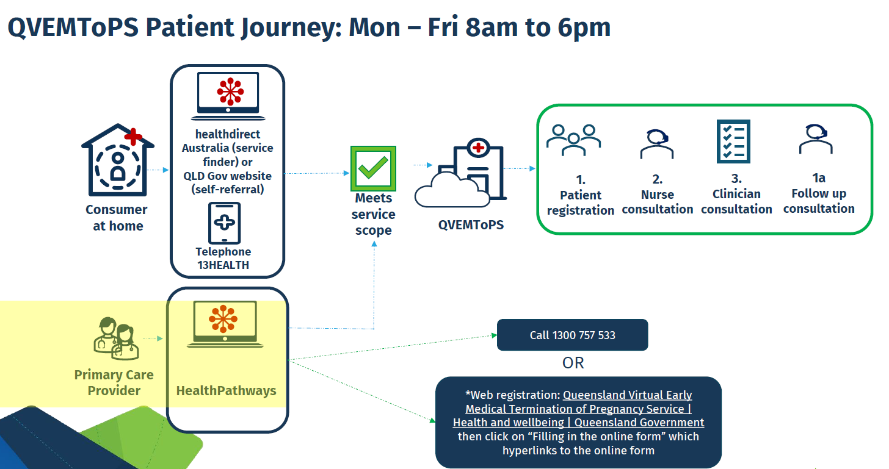

Slide 16
MTOP
Children by Choice 1800 177 725 for patients to call
Please Note: MSI – Will assist patient experiencing financial hardship. Patient must state they live in the WM catchment. GP can provide a letter of referral but patients should call Children by Choice to help navigate options.

Slide 17

Thank you for your time.
Questions ?

Slide 18
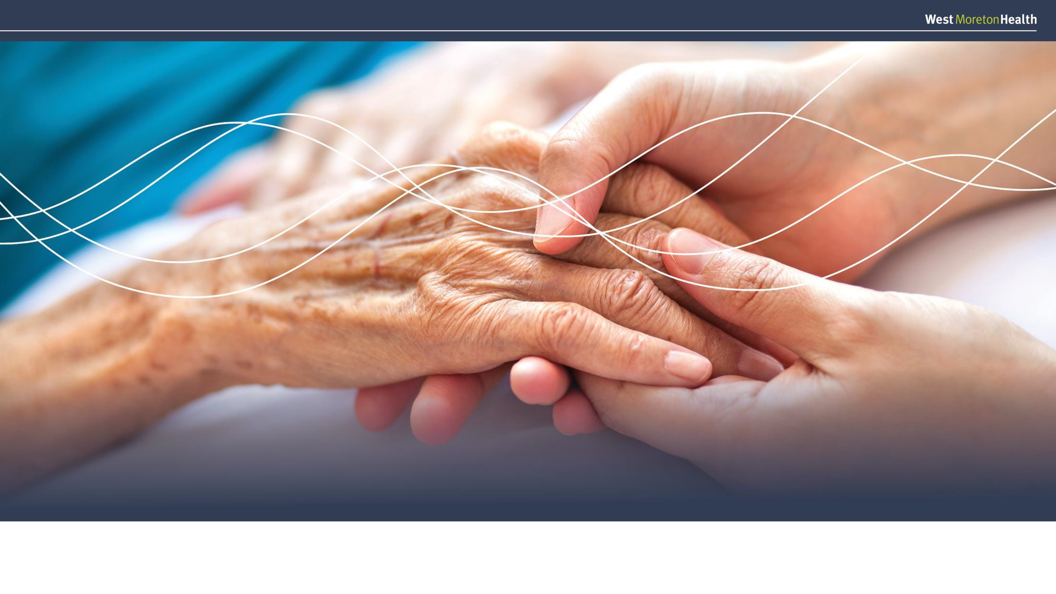

Preventative Integrated Care Service (PICS)
Meech Freeman, Clinical Director Prevention and Minor Injury & Illness Clinic

Slide 19
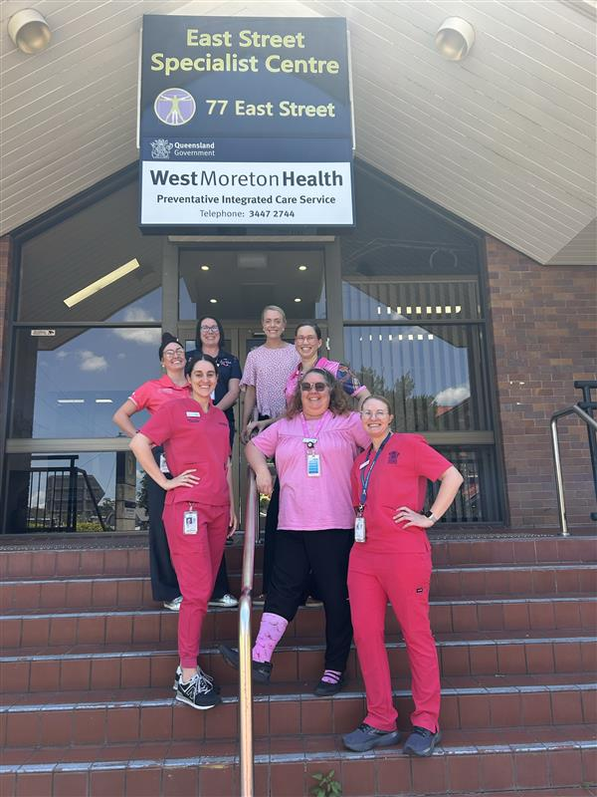
Preventative Integrated Care Service (PICS)
A community service that aims to reduce avoidable admissions and re-admissions in adult patients with chronic diseases, by:
Providing rapid access to sub-specialty assessment and management
Identifying and treating co-morbidities
Addressing psycho-social issues and optimising function
Notes:
PICS aims to improve patient health through timely access to care, care closer to home, and by supporting people to self-manage their condition. Additionally, PICS aims to:
Improve (patient) quality of life
Reduce (hospital) length of stay
Reduce unplanned presentations to the Emergency Department
Reduce Potentially Preventable Hospitalisations (PPHs)
Referral must be for medical/nursing follow up and can be supported by allied heath. Allied health input is assessed for each patient however the patients reason for referral can not be allied health follow up alone.

Slide 20







Cardiac
Diabetes
Respiratory
How does this work?
First 48 hours
Rapid triage and assessment
Streamed Medical & Nursing
Medical Officers
NP
CNCs
Streamed Medical & Nursing
Medical Officers
NP
CNCs
Streamed Medical & Nursing
Medical Officers
NP
CNCs
14 Days
Stabilisation & monitoring
Wrap-around MDT care
Multi-model contact
Remote patient monitoring
Multi-stream Allied Health
Pharmacists, Dietitian, Social Workers, Physiotherapist, Occupational Therapists, Podiatrist
Clinical Nurses & Registered Nurses
Rotate through each stream every 3-6 months
Discharge
Discharge back to community
Administrative team
Administration Officer Manager & supporting team
Multidisciplinary leadership team
Allied Health Team Leader,
Nurse Unit Manager, Clinical Director

Slide 21
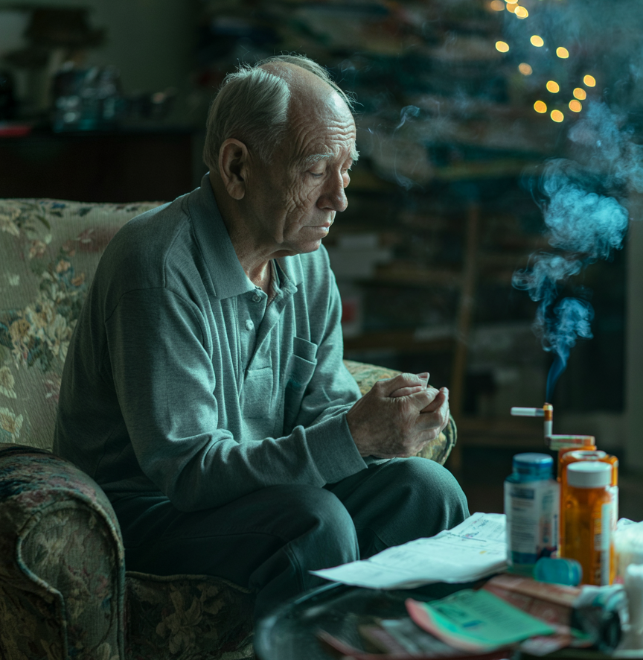
Patient example
66M with T2DM, COPD and new diagnosis HFrEF.
HbA1c 10.5% on metformin + empagliflozin.
Poor inhaler technique, still smoking.
Difficulty affording medication and petrol for car.
Lives alone, no community services.
Unsuccessful up titration of heart failure medications due to poor engagement.
Perfect patient for PICS

Slide 22
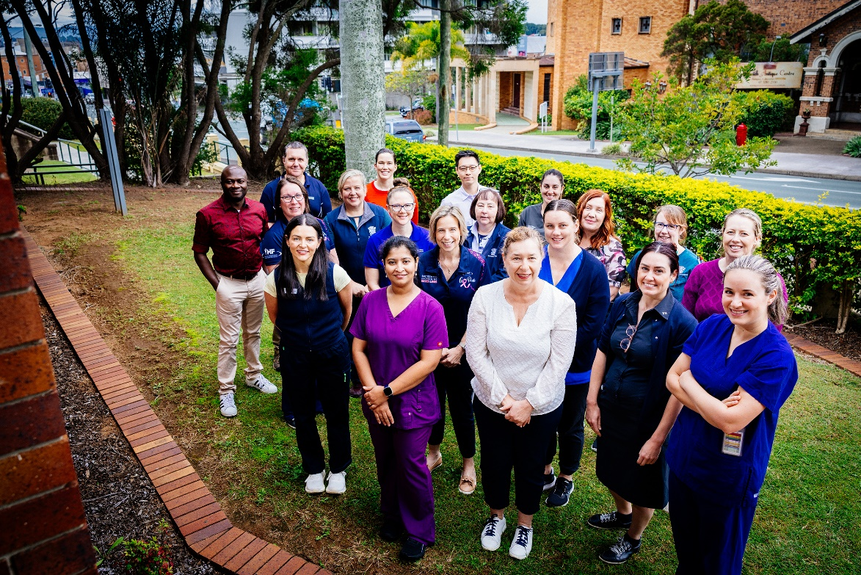
Referrals – phone us first
Find us on HealthPathways
Phone triage CNC to discuss:
0409 594 866
Available Mon-Sat, 8am-4pm
See flyer in your pack for
further information

Slide 23
Minor Injury & Illness Clinic
Ripley Satellite Health Centre
(formerly known as “Satellite Hospital”)

Slide 24
About us
We are a clinic, not an Emergency Department
We get lots of high acuity/complex patients requiring ambulance transfer to an ED
Some of these patients have been referred to us by external services, for example:
  Chest pain requiring cardiac workup
  Acute abdomen needing surgical opinion (e.g. appendicitis)
  Respiratory distress, including in young children
Please refer higher acuity/complex patients straight to an Emergency Department
Coming to our clinic does not guarantee faster service, and can delay access to definitive management
See flyer in your pack for further information

Slide 25
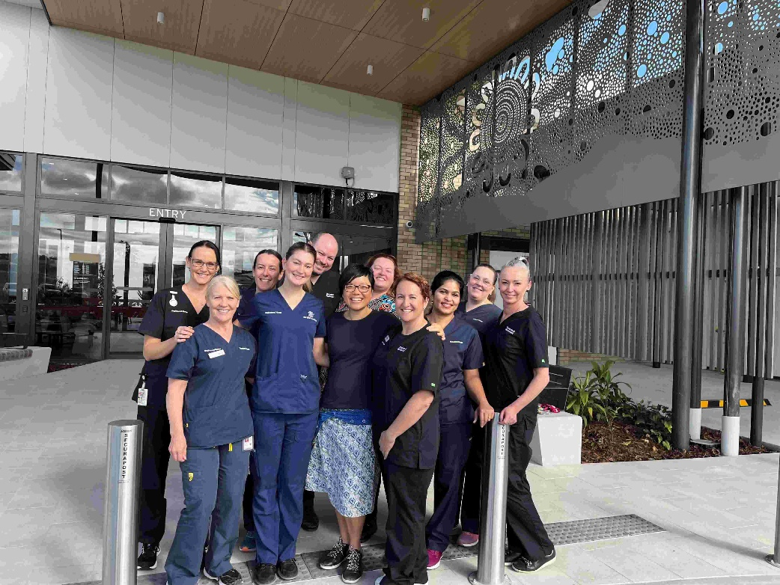
Referrals – phone us first
Find us on HealthPathways
Phone triage nurse:
3436 3765
Open 7 days 8am-10pm
When we reach our capacity limit, we will redirect patients to other services, including:
Virtual Emergency Care Service
Medicare Urgent Care Centres – Ipswich and Goodna

