Slide 1
Novel coronavirus

Slide 2
Background
31/12/19: China advised the WHO of a cluster of pneumonia in Wuhan city, Hubei province, China
Associated with a live animal market
7/1/20: confirmed novel coronavirus

Slide 3
As of 2nd February 2020
11,955 confirmed cases world-wide
259 deaths world-wide (all except one in mainland China)
12 cases in Australia
2 cases in Queensland
No confirmed cases in West Moreton HHS or Darling Downs Health regions

Slide 4
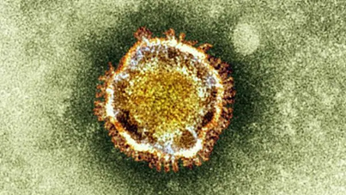
Respiratory viruses
Spread by coughing / sneezing / contact
Inert, don’t grow outside cells. Cannot jump!
Enveloped, RNA, fragile. Detergent kills them
Receptor targets in URT, LRT may differ
Dozens of coronaviruses, human & animal
Common cold – mostly very mild
Antibiotics don’t kill it, but..
Good infection control works
Notes:
Fomites and surfaces can be cleaned with ordinary products. nCoV lasts 1 – 2 days on surfaces
We actually know a great deal about coronaviruses
Empiric antibiotics are recommended for severe acute respiratory infection

Slide 5
Spread and outbreaks
Force of infection: How easily AND how quickly
R₀ –average transmits per case in non-immune population: varies by time and place. Non-immunes slow it down.
Incubation period 5 to 7 days (1 – 14 max).
Mild vs pre-symptomatic vs asymptomatic transmission? Many viruses 1 day prior. 2 days nCoV?
Most spread is from the sick
Duration of infectivity ?about a week, till afebrile
Widespread now in China and beyond. Underestimates…
We lack means to completely stop it, so
Expect a pandemic (may be slow), then persistence
Notes:
May be slow expansion because IP and serial interval longer than flu; initial control efforts will help
Emphasise brief pre-symptomatic transmission is a common feature of respiratory viruses.
But this as another reason why it will not be permanently contained

Slide 6
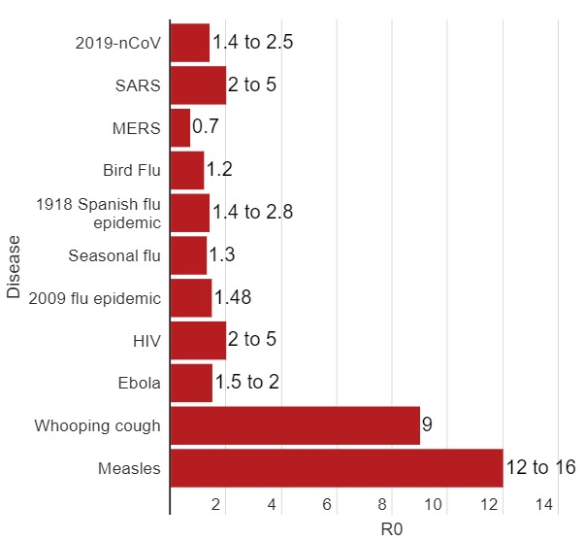
Reproductive ratios: nCoV etc
Uncertain & variable
Notes:
Note: Basic Reproductive Ratios (‘rates’) depend on the setting AND the virus

Slide 7
How will the pandemic behave?
HOST
AGENT
ENVIRONMENT
Notes:
Depends on several factors, not just the virus

Slide 8
Uncertainties suggest less severe
HOSTS Elderly and chronic diseases - many
No-one immune initially
Nutrition, education, wealth, smoking…
AGENT Only one strain, typical coronavirus
No current drugs or vaccines
ENVIRONMENT Australia v. different to Wuhan & China
Crowding, pollution, health services, access
Data: China vs outside numerators and denominators…
Deaths vs cases, proven vs unproven, incentives to hide?
Large early bias to severe / hospital cases

Slide 9
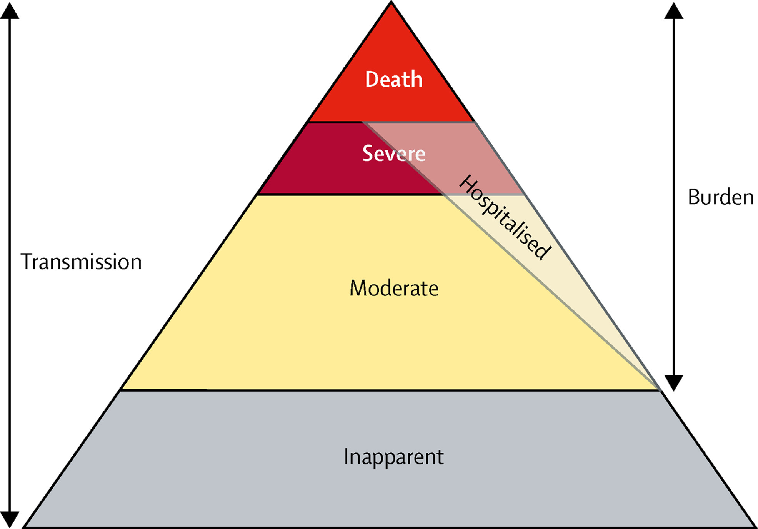
Tip of the iceberg?
Being tested
Being tested
NOT tested?
NOT tested? Not counted?
Thanks: Ian Mackay
Notes:
A large number of milder cases are likely omitted from early stats

Slide 10
Objectives
Containment: stamp it out? Unlikey
Slow it down
Spread it out over time
Get better info, tests, drugs, vaccine…
Reduce the burden, prepare H services
Reduce complications and deaths:
Bed and clinical capacity, supportive care
ICU, ventilators, etc
Notes:
Heroic containment measures can and will come to an end
Most of us will be exposed to this virus over coming months / years

Slide 11
What works in order…
Social distancing + hygiene + cough etiquette
Vaccine (will take months)
Supportive (clinical) care
Reduce other burden: flu, gastro…
Temporary benefits? Quarantine (well people), travel bans, restricting gatherings, testing all suspects..
Sustained benefit: isolation of cases (stay home)
May require special clinics @ hospital, community
Syndromic management of less severe at home
Notes:
Mathematical models (of flu) show social distancing and hygiene likely to make more difference than an even an effective vaccine.
We need to do much better at Health Promotion of social distancing as the primary strategy
Many of the quarantine / travel restrictions are not sustainable beyond initial stages

Slide 12
Case definition – suspect case
Epidemiological Criteria
Travel to (including transit through) mainland China in the 14 days before the onset of illness
OR
Close contact in 14 days before illness onset with a confirmed or suspected case of 2019-nCoV

Slide 13
Case definition
Clinical Criteria
Acute respiratory infection (respiratory infection with at least one of: shortness of breath, cough or sore throat) with or without fever or history of fever

Slide 14
Confirmed case
Test positive to a specific 2019-nCov PCR test or has the virus identified by electron microscopy or viral culture, at a reference laboratory
QHFSS able to test for 2019-nCoV

Slide 15
What to do with suspected case
Check they meet current criteria
Isolate, give a surgical mask (as filter + flag)
Single room (alt: neg pressure to outdoor..)
Call Public Health
Travel, movements, in-contact people, phone..
Notifiable: clinical, testing, confirmed
Specimens as required, with airborne PPE
Home isolation or admit on clinical grounds
Notes:
A mask is just a filter for coughed droplets; it also ‘flags’ the patient
Testing should be approved by PHP or IDP
Monitoring ‘contacts of suspects’ may be necessary

Slide 16
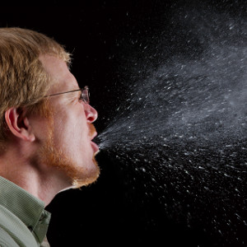
Infection control
Quarantine: people who are NOT yet sick
Isolation: people who are sick
Standard: hand hygiene, cleaning, sharps, disposal..
+Contact: hand hygiene, gown, (non sterile) gloves..
+Droplet: surgical mask, (+ eye protection)
+Airborne: N95/P2 mask, fit check, goggles, close door
Notes:
Hand hygiene means hand wash OR alcohol-based rub
Actions BEFORE and AFTER leaving room
This is not a complete infection control lecture. Talks about rationale, and how precautions likely to normalise in future

Slide 17
Clinical samples
When collecting specimens a PPE plus
Airborne precautions:
P2/N95 mask
Eye protection
Single room

Slide 18
Samples
Routine tests for acute pneumonia/ pneumonitis to be performed when indicated
Upper respiratory tract samples
Lower respiratory tract samples if lower tract is involved
Serum (to be stored pending serology availability)

Slide 19
URT samples
Nasopharyngeal swab and / or swab, Dacron or rayon, flock preferred.
nasopharyngeal: insert a swab into each nostril parallel to the palate, leave the swab in place for a few seconds to absorb secretions
• oropharyngeal: swab the tonsillar beds, avoiding the tongue
• place swabs back into the accompanying transport media

Slide 20
Nasal wash/ aspirates
collect 2-3 mL into a sterile, leak-proof, screw-top dry sterile container

Slide 21
Lower respiratory tract samples
Bronchoalveolar lavage, tracheal aspirate, pleural fluid
collect 2-3 mL into a sterile, leak-proof, screw-top sputum collection cup or dry sterile container
Sputum
patient should rinse his/her mouth with water before collection
expectorate deep cough sputum directly into a sterile, leak-proof, screw-top dry sterile container.

Slide 22
Serology
Serum should be collected during the acute phase of illness (preferably within the first 7 days of symptoms onset)
Convalescent serum to be collected 3 or more weeks after acute sample

Slide 23
Testing can be performed by the private labs
What to order
Swabs:
Multiplex PCR
2019-nCov PCR
Serum:
Serology

Slide 24
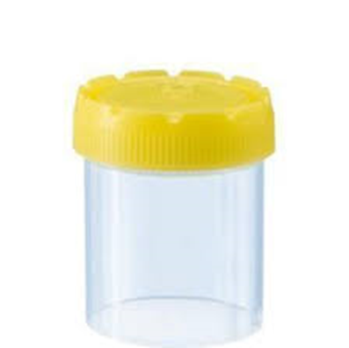
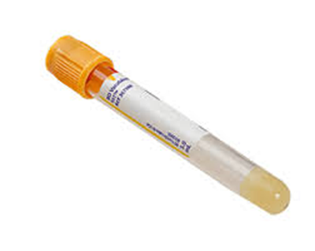
2 Nasopharyngeal swabs
1 for resp virus PCR
1 for nCoV PCR
Lower resp tract sample (sputum) if available – for nCoV PCR
Serum – ideally, store for Ab when available
Notes:
If the person has another respiratory virus, nCoV is unlikely
Soon nCoV will be added to the normal respiratory virus panel

Slide 25
Contacts - definition
Close Contact
> 15 minutes face-to-face contact with a symptomatic confirmed case in any setting
OR
Sharing of a closed space with symptomatic confirmed case for a prolonged period

Slide 26
Contact Criteria
Living in the same household or household like setting e.g. boarding house or hostel
Direct contact with body fluids or laboratory specimens without recommended PPE
A person who spent 2 hours or more in the same room
A person in the same hospital room when an aerosol generating procedure is undertake on a case W/O recommended PPE
Face-to-face contact for more than 15 minutes with the case in any other setting

Slide 27
What to do with contacts
Those people who meet the criteria for a contact will need to be placed in quarantine for 14 days from the last contact with a symptomatic confirmed case.
During this time to contact will be followed up daily to determine their condition.
Any contact who develops symptoms will need to be medically assessed and tested
If they test positive to 2019-nCoV they will then need to be isolated until they are no longer infectious which at this stage is 24 hours after the cessation of symptoms

Slide 28
If you have any questions or concerns
Please contact public health (NOT Emergency Department!)
Please be advised that it is now mandatory to report any suspect cases to the Public Health Unit
Contact for the Public Health Unit
Phone: 07 38184700
Email: Catherine.Quagliotto@health.qld.gov.au

Slide 29
PHU contacts
West Morton PHU
Phone: 07 38184700
Email: WM_PHN@health.qld.gov.au
Darling Downs PHU
Phone: 07 46998240
Email: Penny.Hutchinson@health.qld.gov.au

Slide 30
Websites
Commonwealth
https://www.health.gov.au/health-topics/novel-coronavirus-2019-ncov
Queensland Health
https://www.health.qld.gov.au/clinical-practice/guidelines-procedures/diseases-infection/diseases/coronavirus

Slide 31
QUESTIONS?

