Slide 1
Updates in Obstetrics part 2
Focus on Thyroid disease
Dr Ivana Rizzuto
MD CCT(UK) FRCOG FRANZCOG
Consultant Obstetrician and Gynecologist
Ipswich Hospital
Annual West Moreton Maternal Symposium 27th July 2024

Slide 2
Thyroid hormone plays a critical role in foetal development. In pregnancy, increased thyroid hormone synthesis is required to meet foetal needs, resulting in increased iodine requirements
Thyroid dysfunction affects 2–3% of pregnant women. In the Western world, Thyroid hormone deficiency is usually due to autoimmune thyroid disease or Hashimoto thyroiditis.
Iodine is abundant in milk, other dairy products and fish; however, diets in many countries do not provide adequate iodine without the fortification of salt with iodine.
The recommended iodine intake during pregnancy and lactation is 250 mcg daily.

Slide 4


Slide 5
Why to check for hypothyroidism?
Untreated hypothyroidism can lead to
Preeclampsia
Anemia
Low birth weight
Still birth

Slide 6
Why do we check for hyperthyroidism?
Premature birth
Low birthweight
Preeclampsia
Thyroid storm
Congestive heart failure

Slide 7
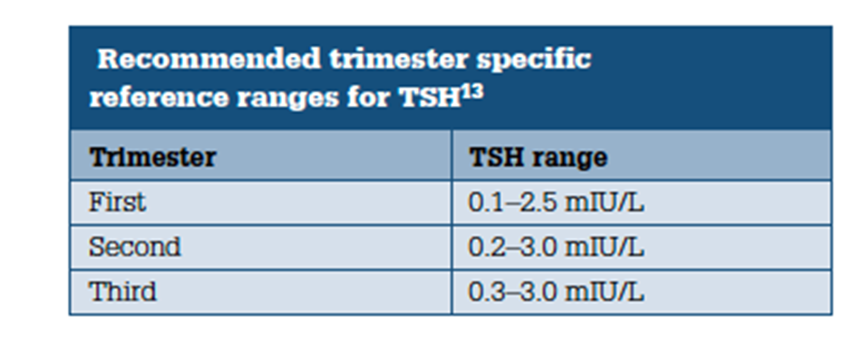
There is a wide variation in clinical practice with respect to testing thyroid function, with specific debate over the management of SCH and autoimmune thyroid disease (ATD). Especially in high risk women such as subfertility and women with recurrent miscarriage.
Diagnosis of SCH should be based on two separate tests for thyroid function taken 3 months a part (NICE Guidelines)

Slide 8
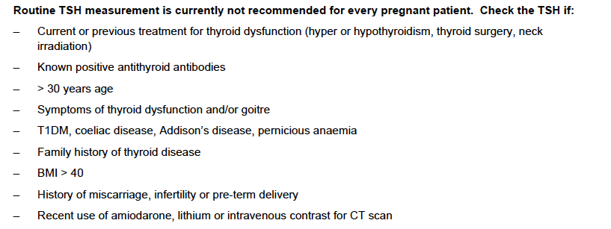

Slide 9
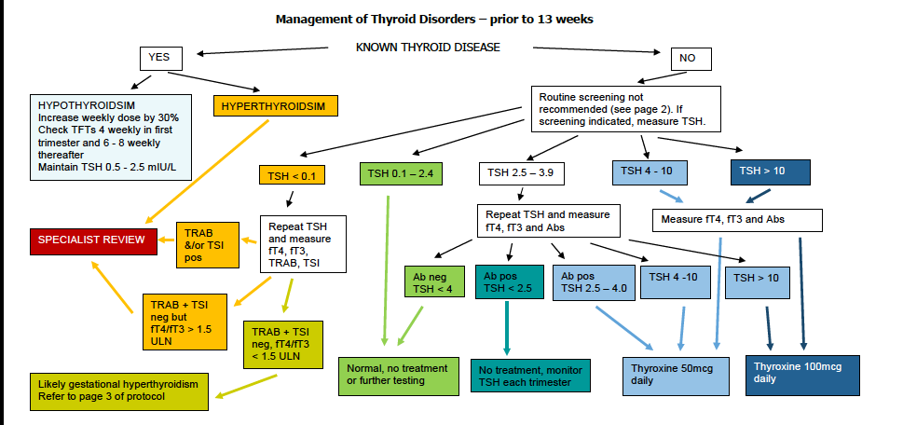

Slide 10
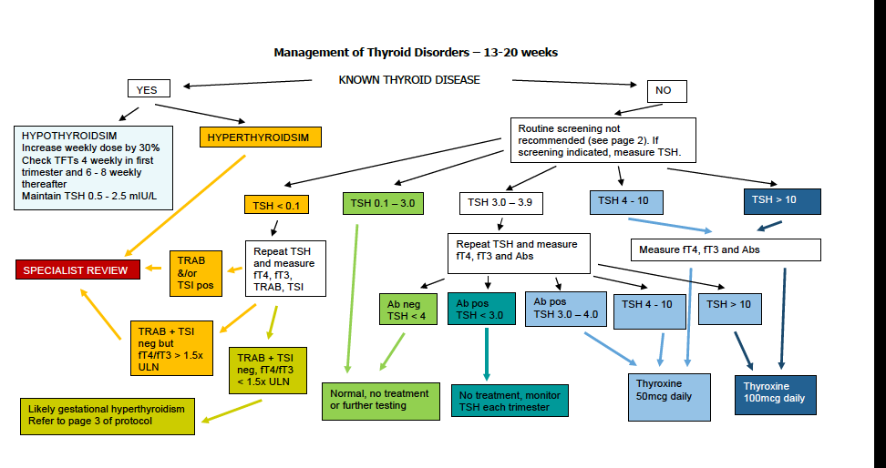

Slide 11
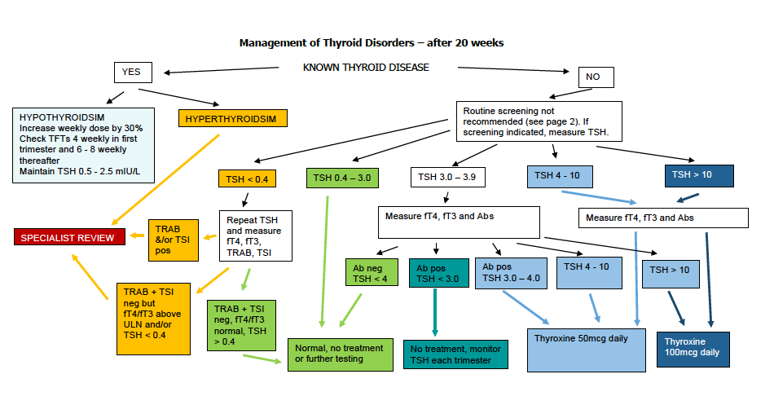

Slide 12
An alternative approach is an empirical dose increase of 25 μg daily for women taking 100 μg or less, and 50 μg daily for women on more than100 μg of levothyroxine. TSH measurements should be carried out at 7–9 weeks of gestation and monitored regularly until 34 weeks of gestation
RCOG Guidelines 2022

Slide 13
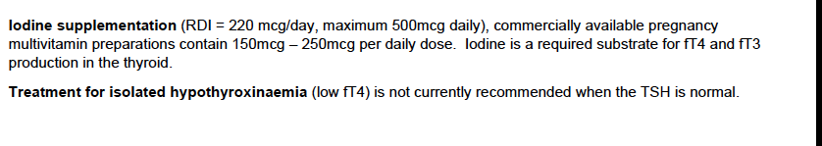

Slide 14
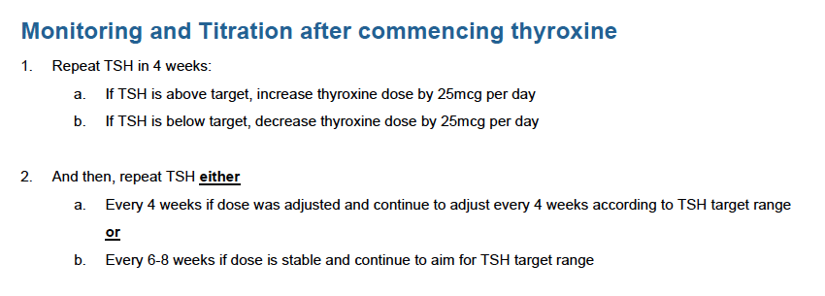

Slide 15
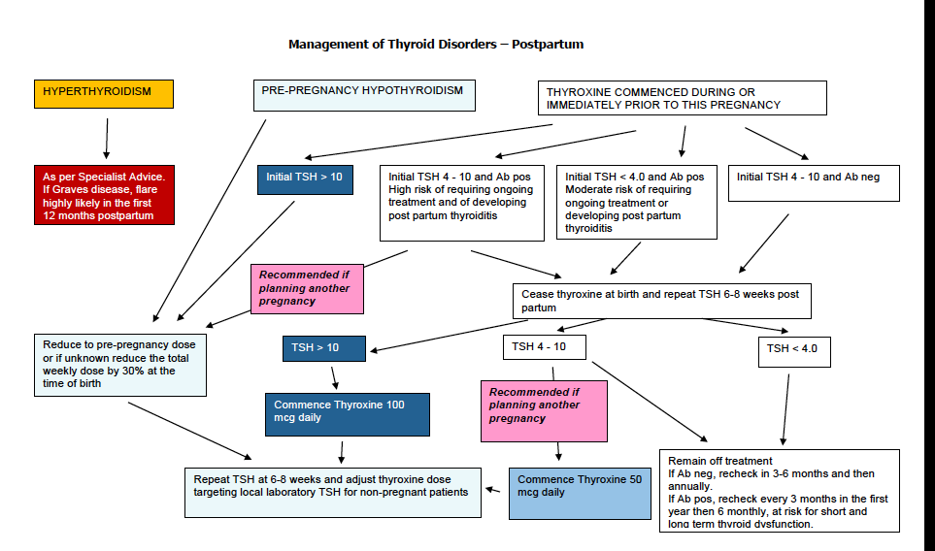

Slide 16
Case discussion 1
A 35 years old woman books an Antenatal appointment. She is with Type 1 DM and her BMI is 41. Not on thyroxine supplements. She is 10 weeks pregnant.
Do we request TSH?
YES
TSH = 3.5 mIU/L the next step?
Repeat TSH and FT4 and fT3 and antibodies antithyroid
TSH =3.6 mIU/L and positive antibodies
To start Thyroxine 50 mcg daily
TSH= >10 mIU/L
To start Thyroxine 100 mcg daily

Slide 17
Case discussion 2
A 25 years old woman books an Antenatal appointment. She is known to have hypothyroidism and she is on 50mcg thyroxine. She is now 20 weeks pregnant.
TSH= 5 mIU/L with positive antibodies. Do we increase the Thyroxine to 100 mcg?
Yes, 25mcg x day
How often we check TSH?
Every 4 weeks until TSH below the target .

Slide 18
Updates in Obstetrics part 2
Safer Baby bundle and postnatal check (well women)
Dr Ivana Rizzuto
Consultant Obstetrician and Gynecologist
Ipswich Hospital
Annual West Moreton Maternal Symposium

Slide 19
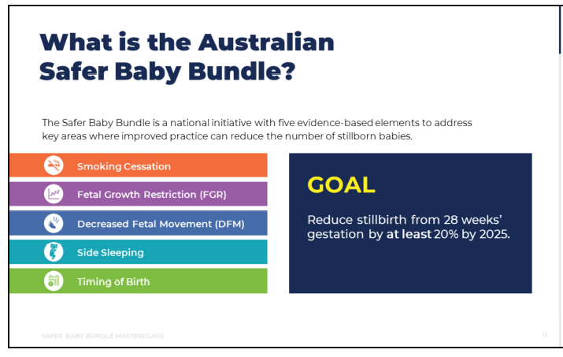

Slide 20
Safer Baby bundle
Development of the SBB has drawn from the expertise and experience of international advisors from the UK.
20% reduction in stillbirth rates has been seen in the UK and Scotland the bundle elements in the UK (launched early 2015)were: 1) reduce of smoking, risk assessment, prevention and surveillance of FGR; 2) raising awareness of reduced FM; 3) effective foetal monitoring during labour
22.5% reduction in stillbirth in Scotland from 2012-2015: 1) foetal growth, foetal movement and foetal monitoring.

Slide 21
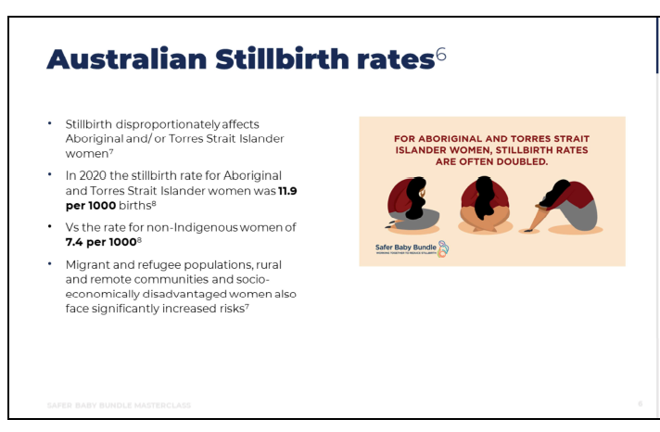

Slide 22
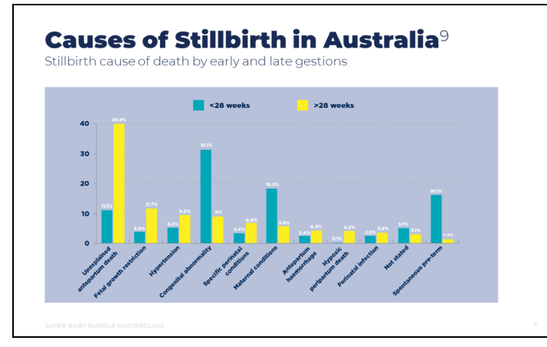

Slide 23
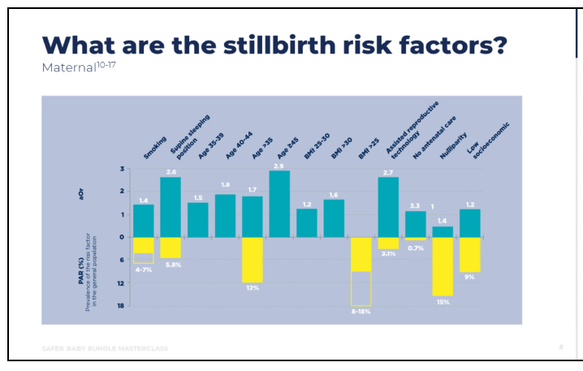

Slide 24
Smoking
1 in 10 pregnant women smoke, with disadvantaged women smoking at rates 3 times other women
Smoking affects placenta and reduces the nutrients crossing the placenta to the baby (Low birthweight and small for gestational age)

Slide 25
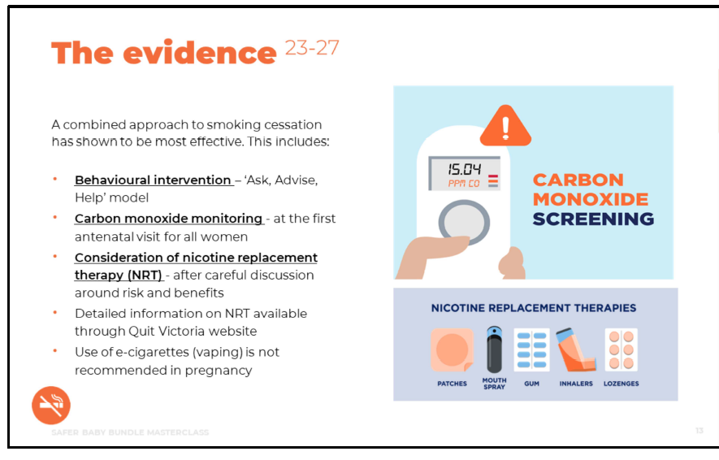

Slide 26
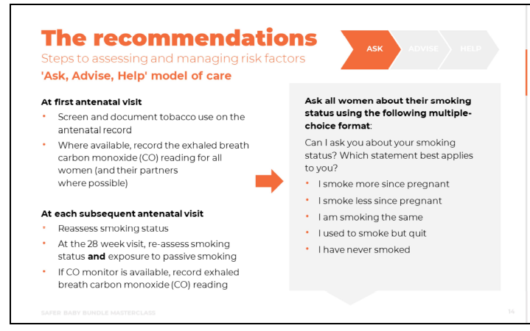

Slide 27
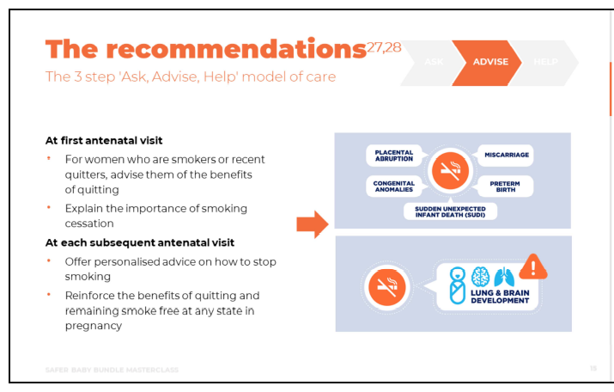

Slide 28
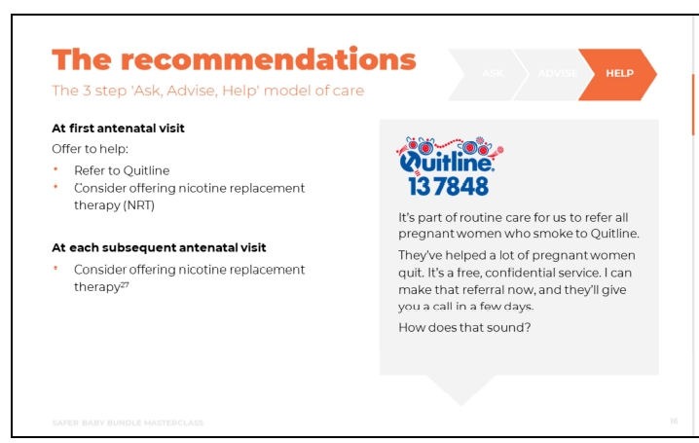

Slide 29

Parent resources can be found on Learn.stillbirthCRE.org.au for clinicians to
download and print, or alternatively saferbaby.org.au for patents.

Slide 30
Fetal Growth restriction
FGR is strongly associated with stillbirth and an increased risk of neonatal morbidity and mortality
It is also linked to long-term adverse outcomes such as impaired neurological/cognitive development, and cardiovascular/ metabolic diseases in adulthood
Risk Factors include:
- Age >35
- IVF
- Nulliparity
- BMI >30
- Prev SGA/FGR
- Low PAPPA

Slide 31
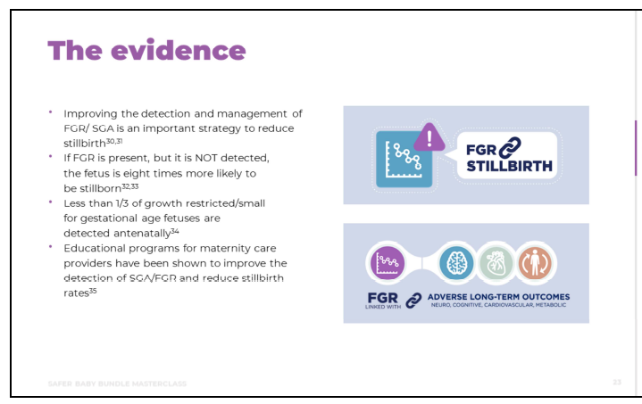

Slide 32
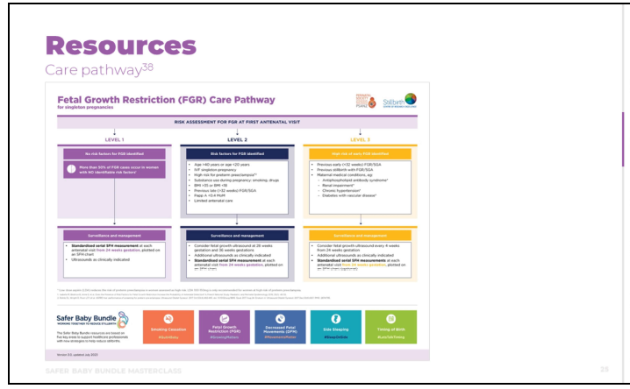

Slide 33
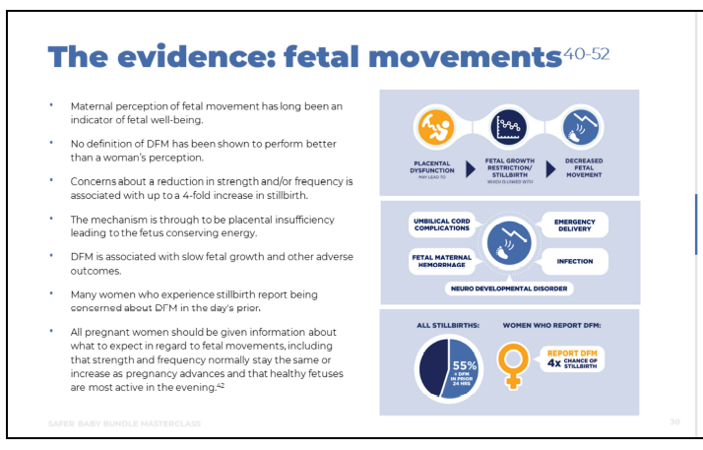

Slide 34
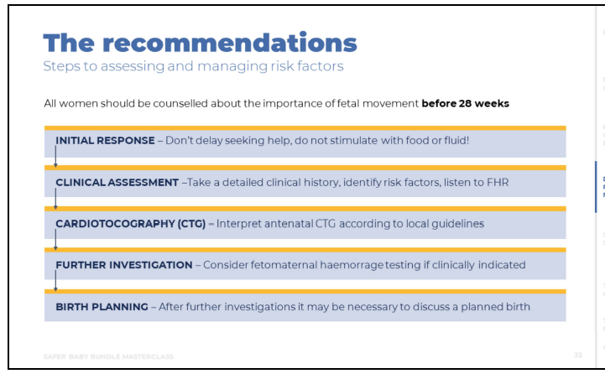

Slide 35
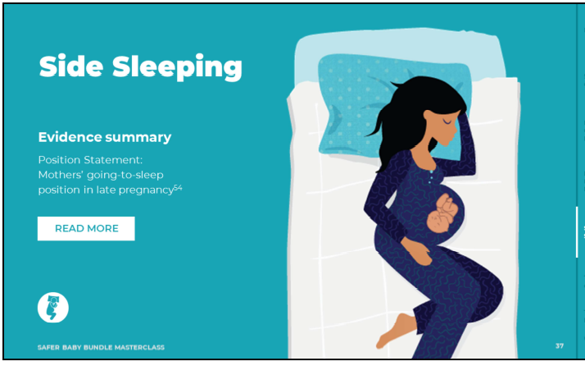

Slide 36
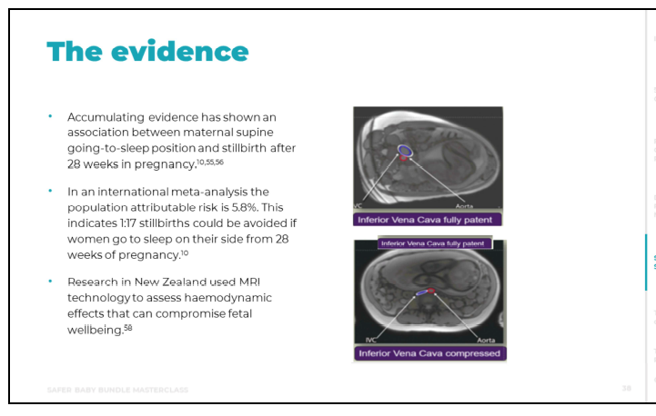

Slide 37
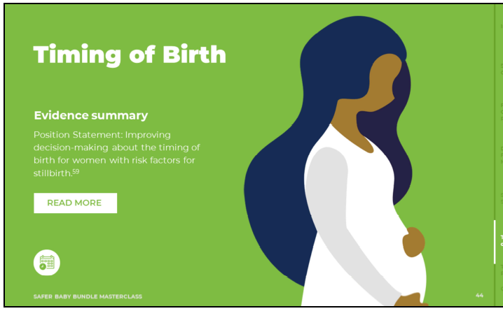
The prospective risk of stillbirth increases with gestational age at term, from 0.11per 1000 births at 37 weeks’ gestation to 3.18 per 1000 births at 42 weeks 'gestation.

Slide 38
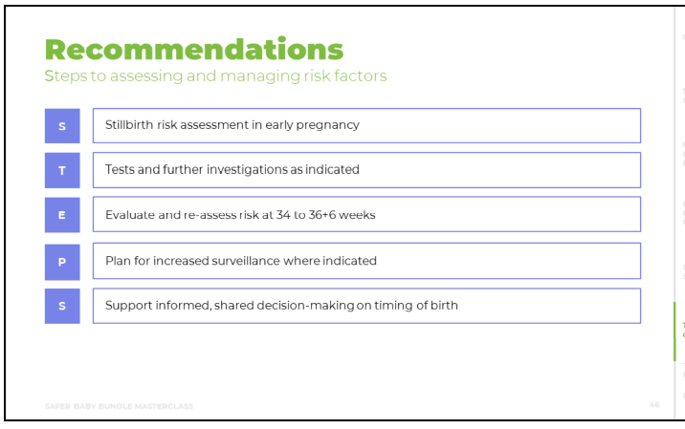

Slide 39
Updates in Obstetrics part 2
Postnatal check (well women)
Dr Ivana Rizzuto
Consultant Obstetrician and Gynecologist
Ipswich Hospital
Annual West Moreton Maternal Symposium

Slide 40
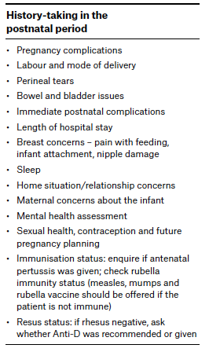
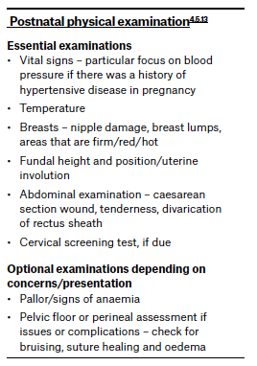

Slide 41
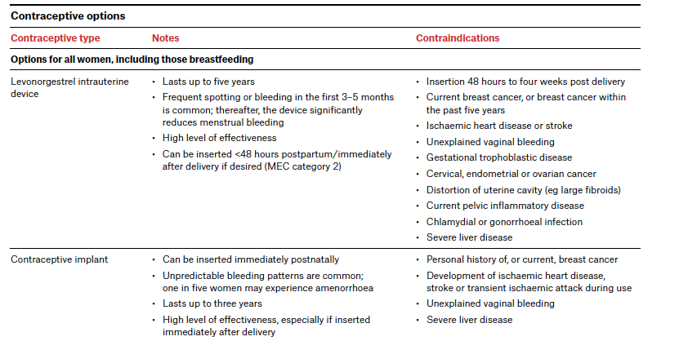

Slide 42
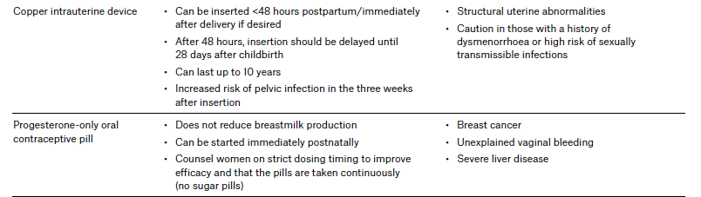

Slide 43
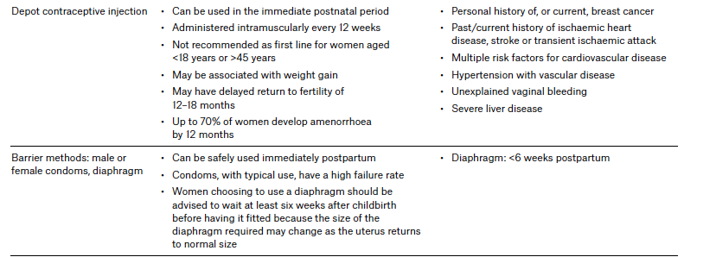

Slide 44
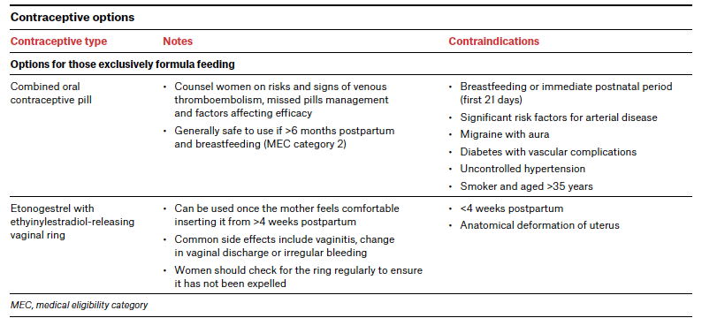

Slide 45
Thank you
dr_rizzuto@wagc.net.au

