Slide 1

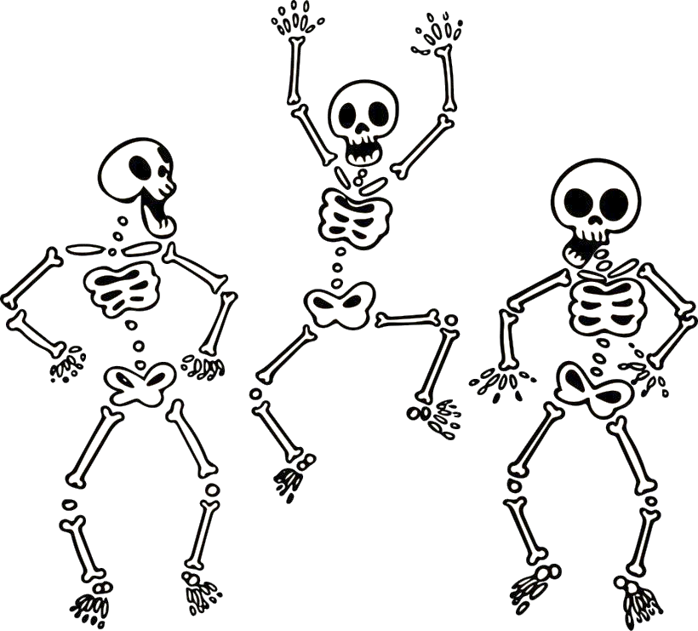
Osteoporosis Update
Dr Laura Careless
Endocrinologist
BHlthSc, MBBS, MMed (internal medicine), FRACP, MPhil (current)

Slide 2
Overview
Diagnosis
Australian prevalence data
Who gets a BMD before 70years?
What’s in a secondary screen?
Who gets treatment?
What treatment options are available?
  MHT vs bone specific therapy
  When should we consider anabolic agents?
  Who is appropriate for denosumab, how to switch from denosumab?
When to refer to Endocrinology?

Slide 3
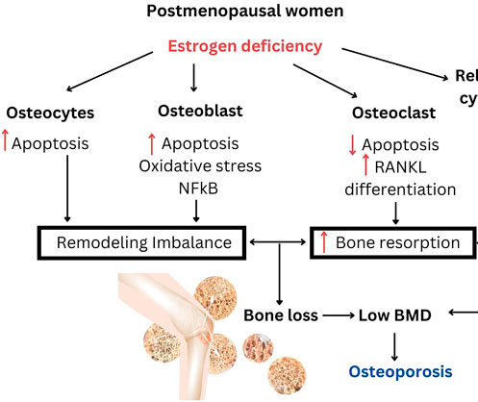
Osteoporosis
Post-menopausal women and men >50years
- T score ≤ -2.5 at hip or spine
- Minimal trauma fracture at OP site
  Hip, spine, forearm, humerus, pelvis
Osteopenia - T scores between -1 and -2.5
Oestrogen is integral to maintaining bone health
- Oestrogen deficiency → accelerated bone loss
- Avg. ↓ 10% of bone mass in first 5years post menopause
RACGP: Osteoporosis management and fracture prevention in postmenopausal women and men >50years of age

Slide 4
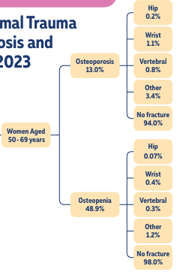
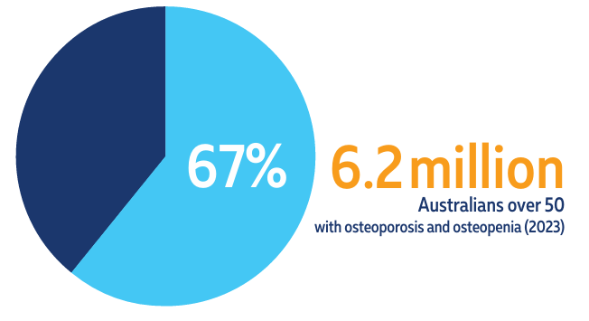
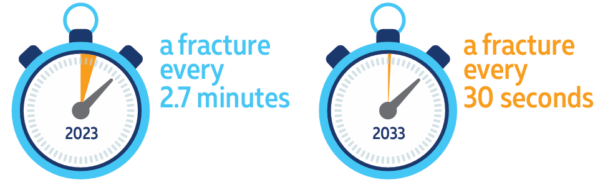
Osteoporosis/osteopenia Australian Data
In 2023 6.2mil Aus over 50 were living with OP
1/3 women >50years will experience a fracture in their lifetime
1 fracture every 2.7mins in Aus in 2023
Fractures → morbidity and ↓QOL
RACGP: Osteoporosis management and fracture prevention in postmenopausal women and men >50years of age

Slide 5
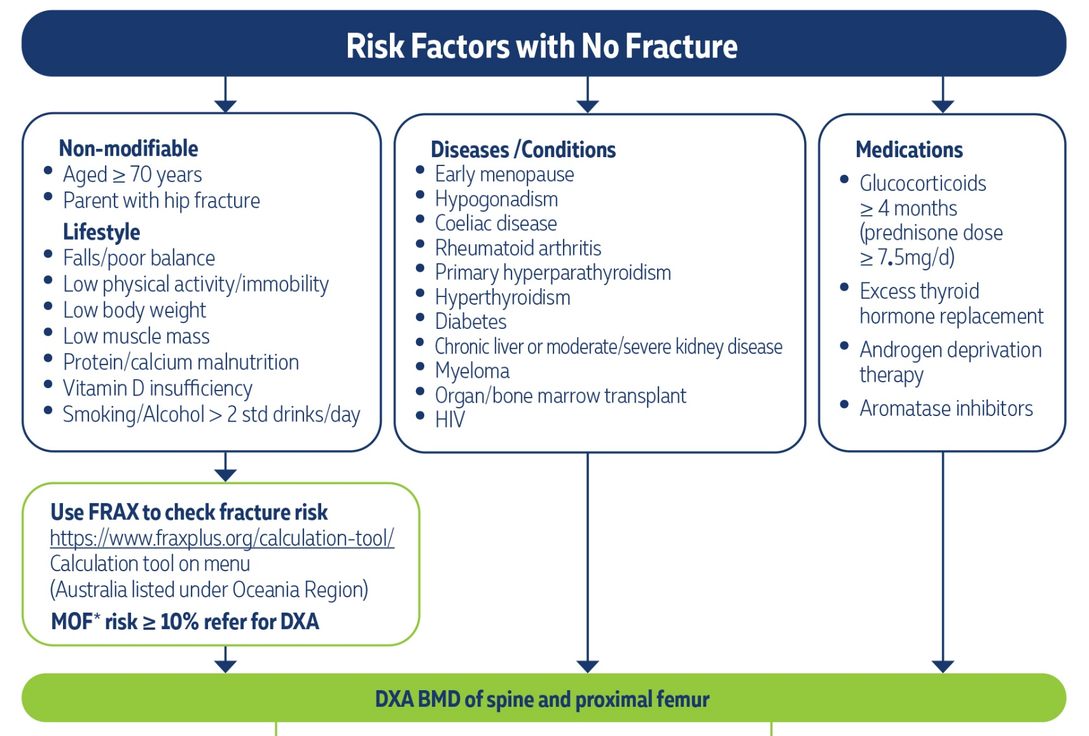
RACGP: Osteoporosis management and fracture prevention in postmenopausal women and men >50years of age

Slide 6
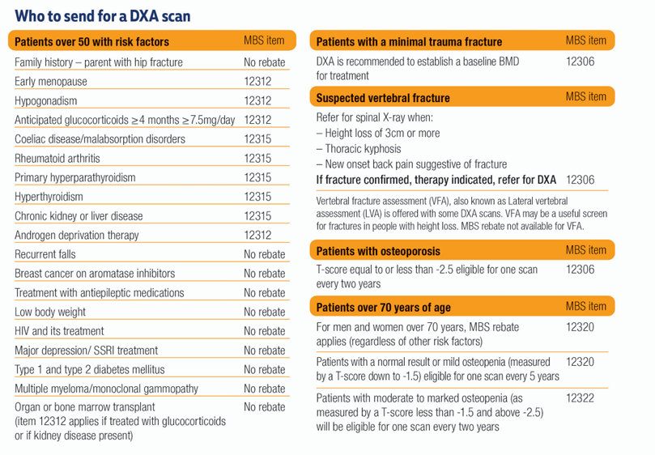
$120
out of pocket
RACGP: Osteoporosis management and fracture prevention in postmenopausal women and men >50years of age

Slide 7
Secondary screen in everyone with OP, pre-treatment
ALWAYS
E/LFTs – phos, calcium, ALP, protein, eGFR
Vitamin D
PTH
Coeliac serology
SEPP + SFLC
TFT
Testosterone, early morning/fasting (males)
X-ray thoracolumbar spine
SOMETIMES
CRP/ESR
1mg DST
Tryptase

Slide 8

RACGP: Osteoporosis management and fracture prevention in postmenopausal women and men >50years of age

Slide 9
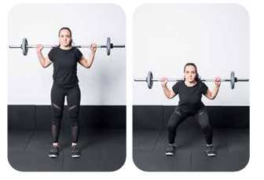
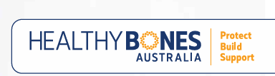
Basic Measures
Vitamin D target >50nmol/L, RDI calcium 1200-1300mg/day
Alcohol reduction <2 SD/day
Smoking cessation
Exercise mainly useful for reducing falls risk
  MAY reduce risk of OP fracture – particularly if it includes progressive resistance training
  Consider ET/PT referral
RACGP: Osteoporosis management and fracture prevention in postmenopausal women and men >50years of age

Slide 10
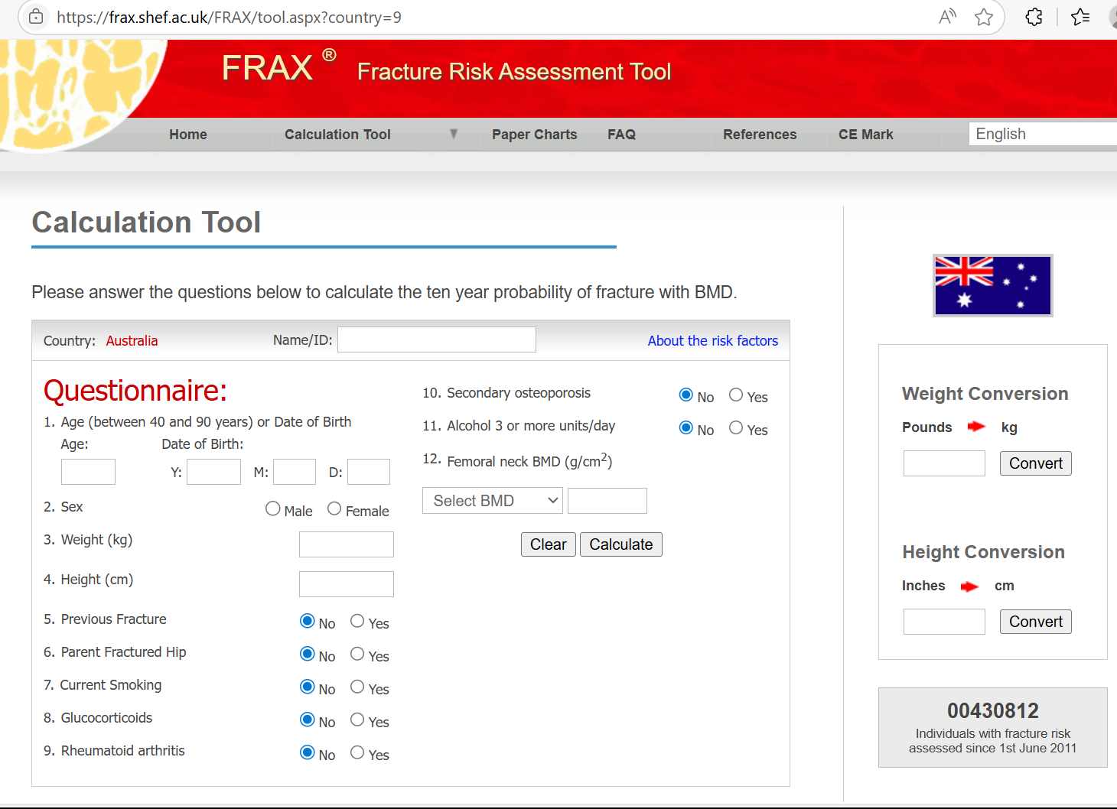
Treatment decisions based on # RISK
FRAX calculator is better at defining who will benefit from tx compared to isolated T-scores
Largest benefit
  T score ≤2.5 + >70years
  Low BMD + fragility fracture
  10-year risk MOF ≥20% or hip fracture ≥3%
Intermediate benefit
  T-score ≤2.5 + <70years
  10year risk MOF 15-19%
  Still suggest pharmacotherapy
RISK factors most strongly associated with #
  Increasing age, prior #, propensity to fall
CMAJ 2023, Clinical practice guidelines for Management of osteoporosis and fracture prevention Canada

Slide 11
Issues with FRAX
FRAX = better fracture risk assessment than BMD alone especially in those with osteopenia
FRAX widely validated in large international populations
Tendency to underestimate risk¹
Doesn’t include falls or some other important risk factors in calculation
Proposed treatment thresholds based on US health economics data >10years ago
Lumbar spine not incorporated
AJGP 2022, Kanis
RACGP: Osteoporosis management and fracture prevention in postmenopausal women and men >50years of age

Slide 12
Females < 65yrs + T-scores ≤-2.5
Very important to emphasise plan for DRUG HOLIDAYS
Patient led decision making
- Can use FRAX score as a decision aid -
Recommend treatment
MHT by itself
Bone specific therapy Bisphosphonates/anabolics
Combination
Therapy (if other indications for MHT)
Repeat BMD 2yrs and review decision based upon FRAX and trajectory of BMD
RACGP consensus

Slide 13
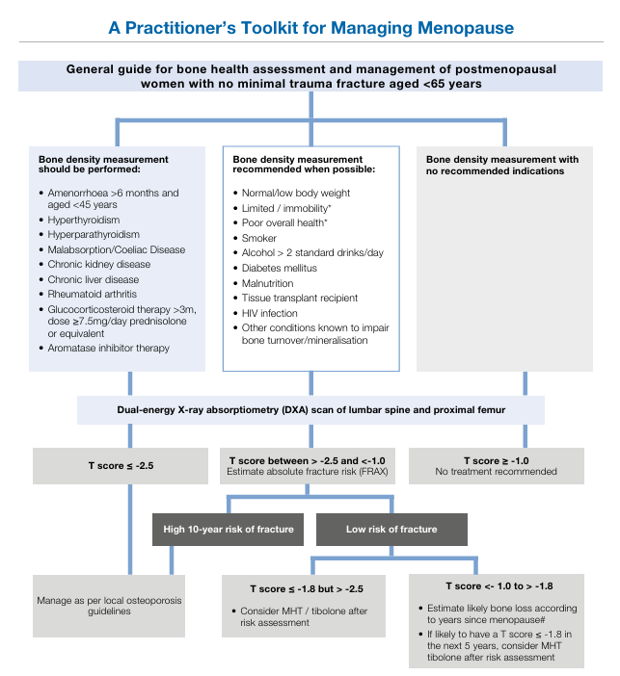
Monash: Practioner’s toolkit for the management of menopause

Slide 14
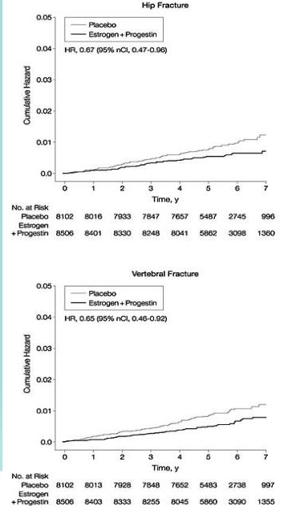
MHT on bone
Oestrogen → decreases bone resorption and promotes bone formation
Effectively prevents loss of BMD and reduces fractures when given post menopause
No minimum effective dose of E on bone loss is established
WHI clinical trials (n = ~16 000) ¹
  CEE + MDP for ~ average 5 year f/up
  HR 0.66 for both hip and vertebral fractures
  Limitation = BMD not a criterion for randomisation
Meta-analysis of 28studies including 33,426 participants ²
  HR 0.74 (CI 0.44-0.91) ALL FRACTURES (similar hip/vertebral)
1. JAMA 2002, Rossouw J
2. Menopause 2016, Zhu, L

Slide 15
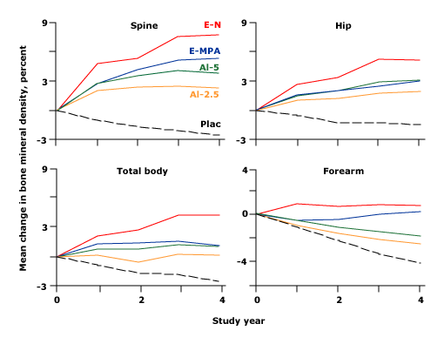
MHT vs Bisphosphonates
1609 post menopausal women 45-60years ¹
  Alendronate daily (low dose) 2 years followed by placebo vs E+P for 4 years
  BMD increase in both groups
  ? Fracture data, low dose alendronate only 2years
Varying consensus by different societies, Summary by RACGP
  Bone specific therapies more appropriate than MHT in post menopausal women at high risk of fracture
  Combination therapy more effective in raising BMD than either agent alone in some but not all studies ²
  No proven additional fracture benefit from using combination therapy²
1 Ann Intern Med 1999, Ravn
2. Uptodate 2025, Rosen

Slide 16
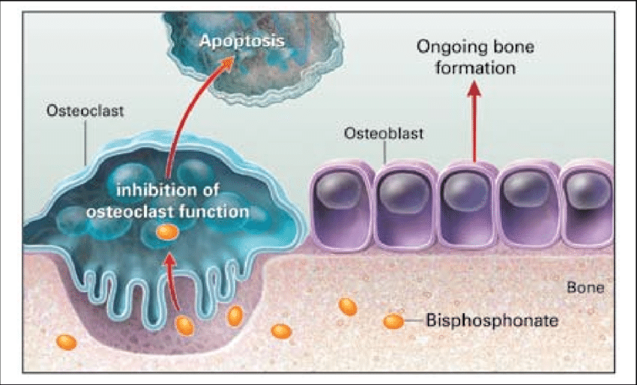
Bisphosphonates
  PO risedronate / PO alendronate / IV zoledronic acid
  Oral - GI SE (gastric irritation, oesophageal erosions, gastric ulcers)
    Needs to be taken properly for absorption
  IV zoledronic acid
    1/3 acute phase reaction ~50% with first infusion, PO 4mg dexamethasone pre and 2 days post infusion
  AFF 3.2-50 cases / 100,000 person-yrs
  MONJ risk 1-100 / 100,000 person-yrs
  AFF HR increases based upon tx duration
    3months vs 5years HR 8.86, 5years vs >8years HR 43.51, Asian race higher risk vs Caucasians
RACGP: Osteoporosis management and fracture prevention in postmenopausal women and men >50years of age
Bone Miner Res. 2023, Murdoch R

Slide 17
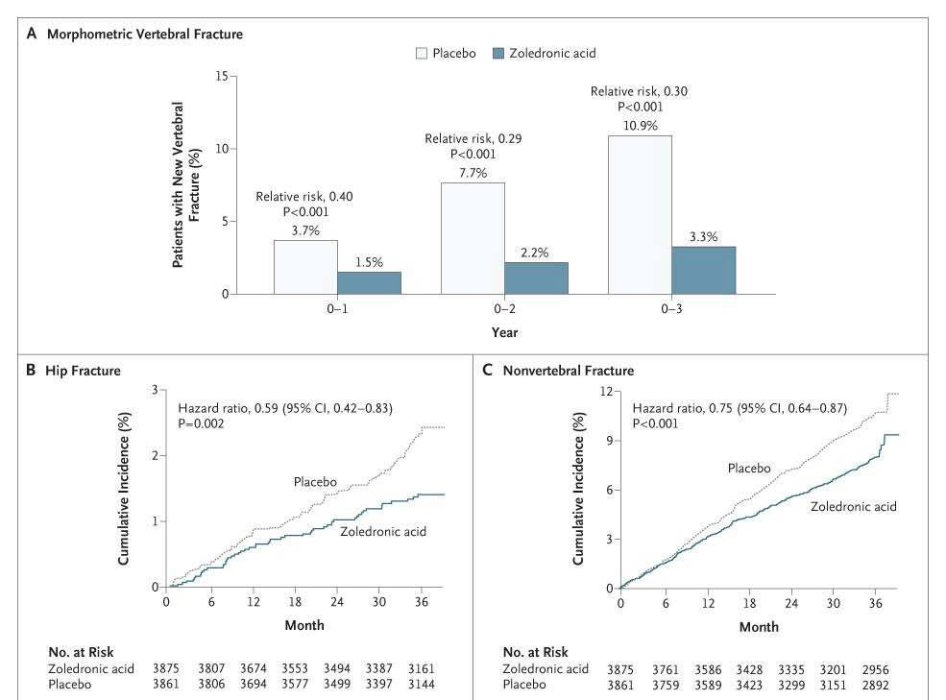
HORIZON trial
  Placebo-controlled trial ~4000 PM women
  5mg IV zol annually x 3 vs placebo
  Mean age 73years, followed for 36months
  30% <70years, 70% T <-2.5, 35% no prior #, ~13% on MHT
  70% reduction in vertebral #
  40% reduction in hip #
  BMD increase ~6% at both TH/LS
NEJM 2007, Black

Slide 18
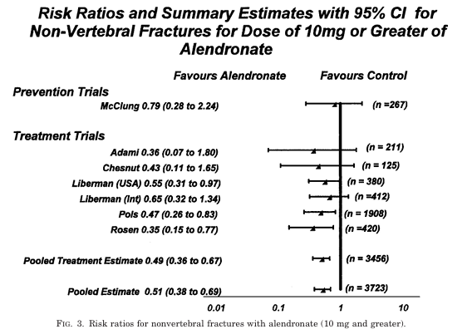
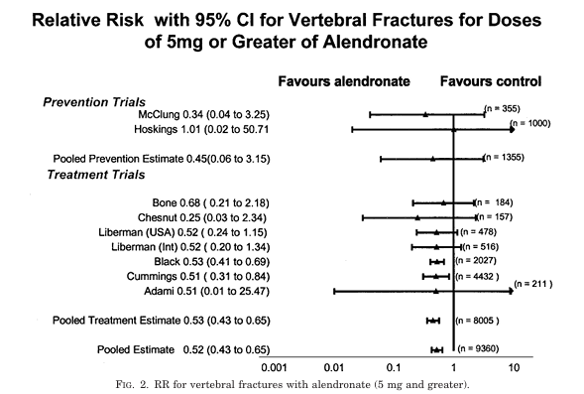
Meta-analysis of alendronate for the treatment of PM women
Mean age ~67.8years
Mean FN T-score -2.6
~30% prior vertebral fracture
~ 50% reduction in both vertebral and non vertebral fractures
Endocrine reviews 2002, Cranney

Slide 19
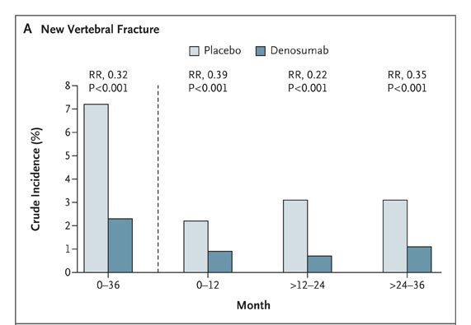
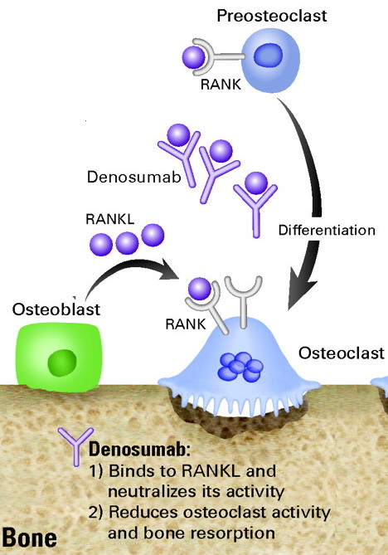
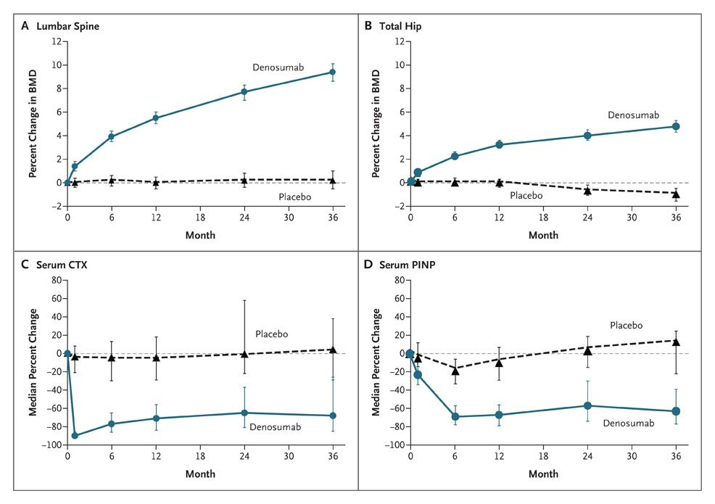
Denosumab
FREEDOM trial
8000 post menopausal women 60-90years
BMD <-2.5
Placebo vs 60mg denosumab 6monthly
Followed for 36months
9.2%
  68% reduction in vertebral #
  40% reduction in hip #
  BMD increase ~6% TH, 9.2% LS
6%
NEJM 2009, Cummings et al

Slide 20
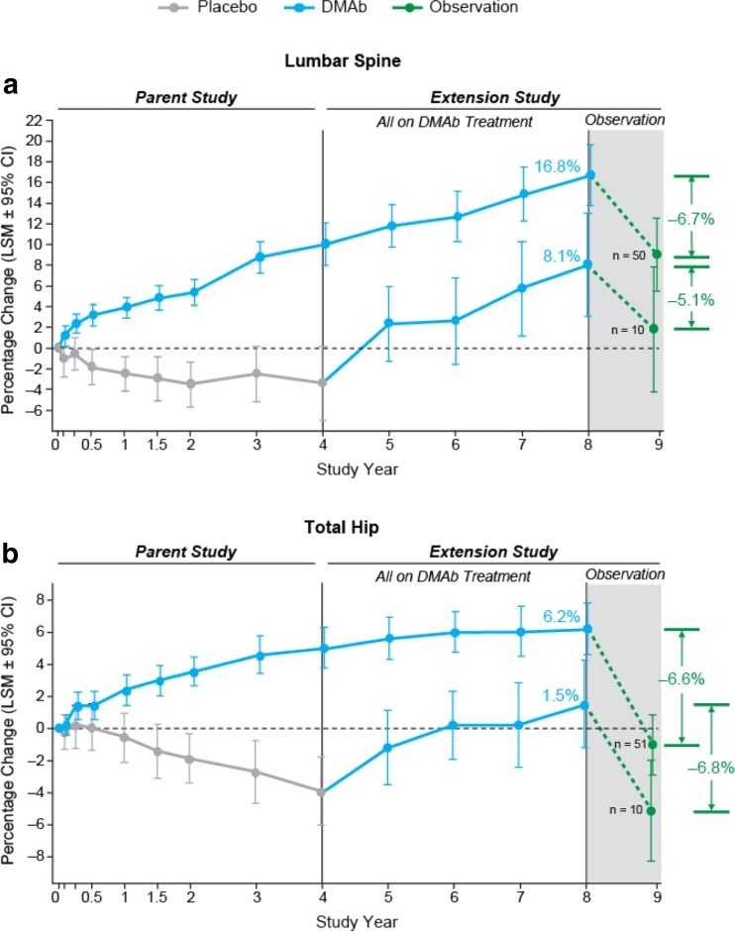
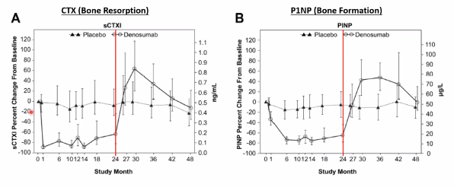
FREEDOM Extension
  10years of denosumab exposure
  AFF 1 per 10,000 person-years
  MRONJ 4.6 per 10,000 person-years
  Can we extrapolate this safety data long-term ??
  Reserved for those >70yrs in most cases
  DO NOT MISS OR DELAY A DOSE
  Rapid increase in BTM starting within weeks only returning to baseline by 12-24months
Lancet 2017, Bone et al
JCEM 2011, Bone

Slide 21
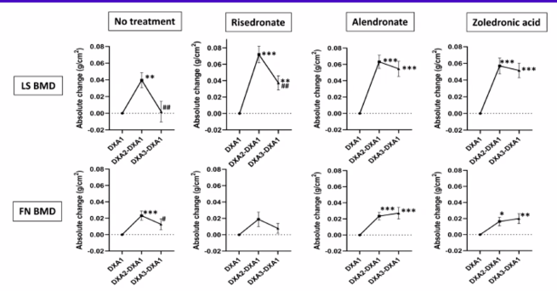
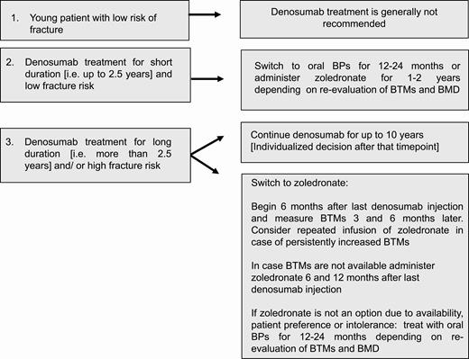
Stopping denosumab?
  Stopping → 3-5 fold higher risk for vertebral, major OP, hip #
  Longer duration of denosumab = more bone loss especially at lumbar spine
  If young → don’t start
JCEM 2021, Tsourdi E
Osteoporosis int 2023, Tutaworn

Slide 22
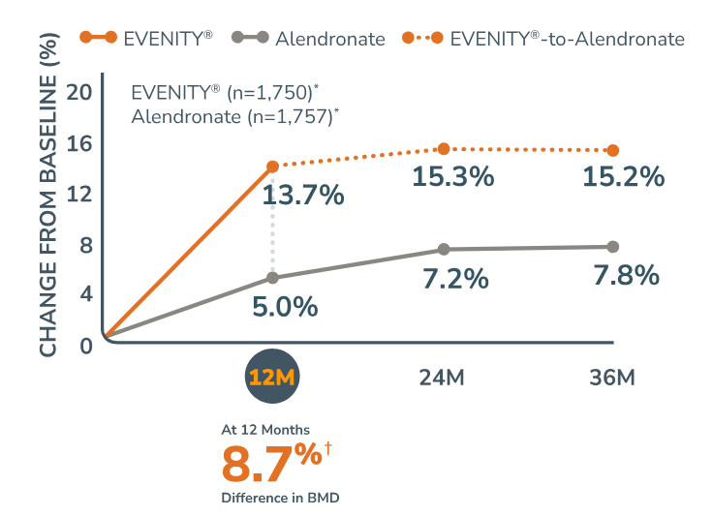
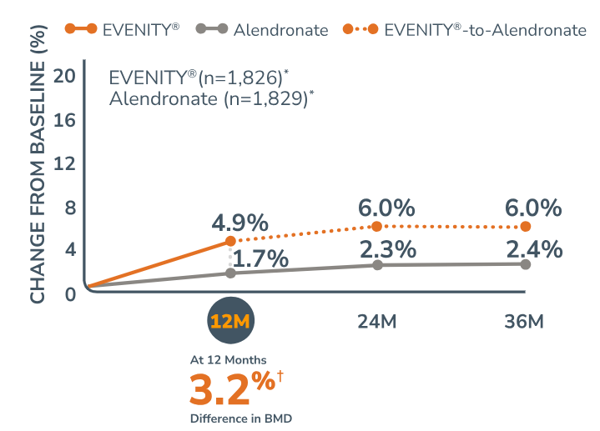
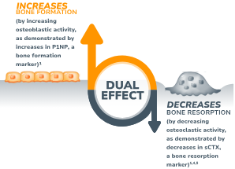
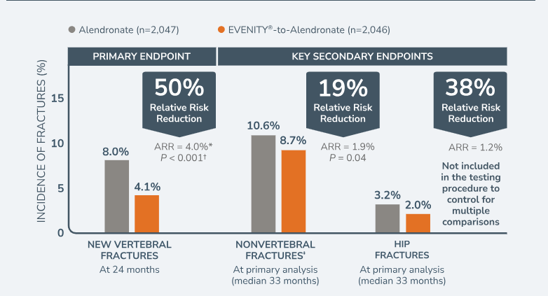
Romosozumab (Evenity)
Lumbar spine
Fem neck
Saag 2017, NEJM

Slide 23
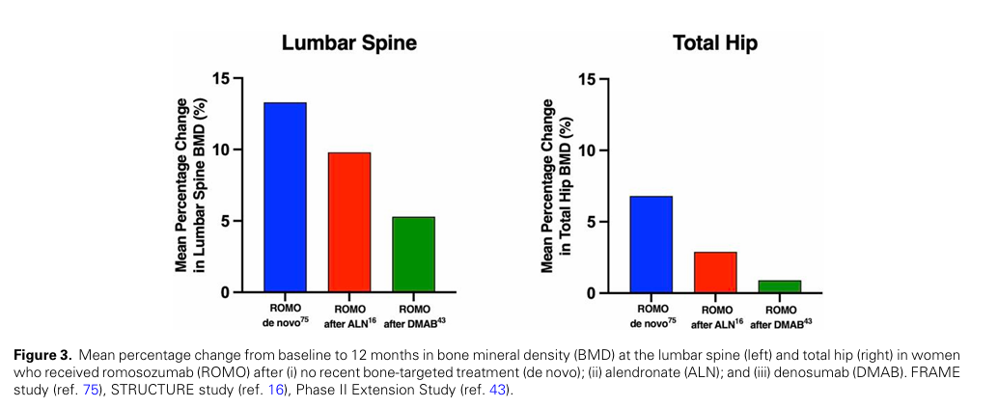
Romo is most effective when used as
1st line therapy

Slide 24
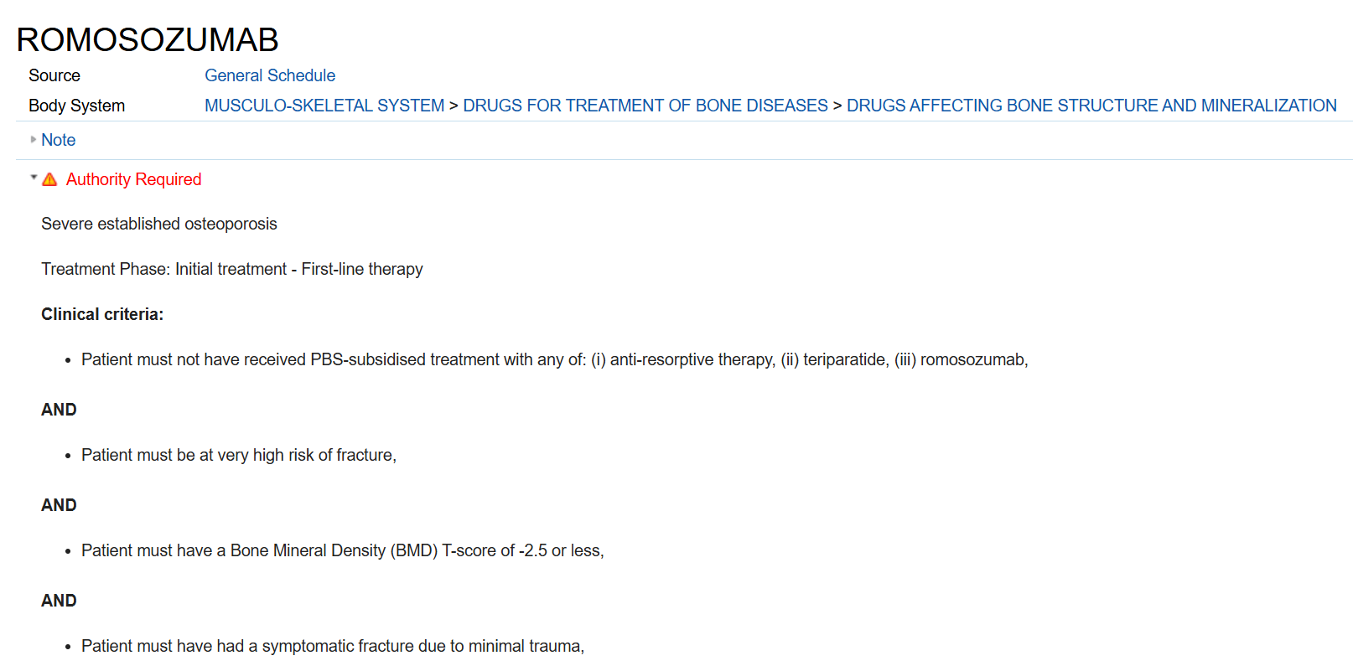
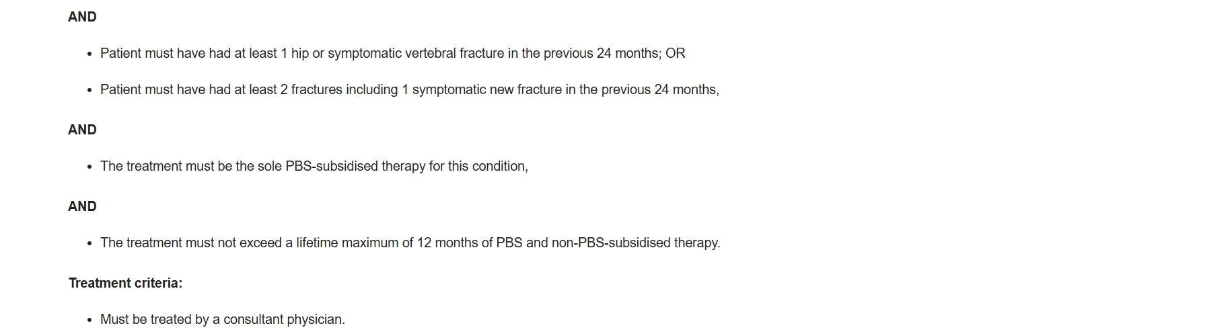
CI: prior history of MI or stroke

Slide 25
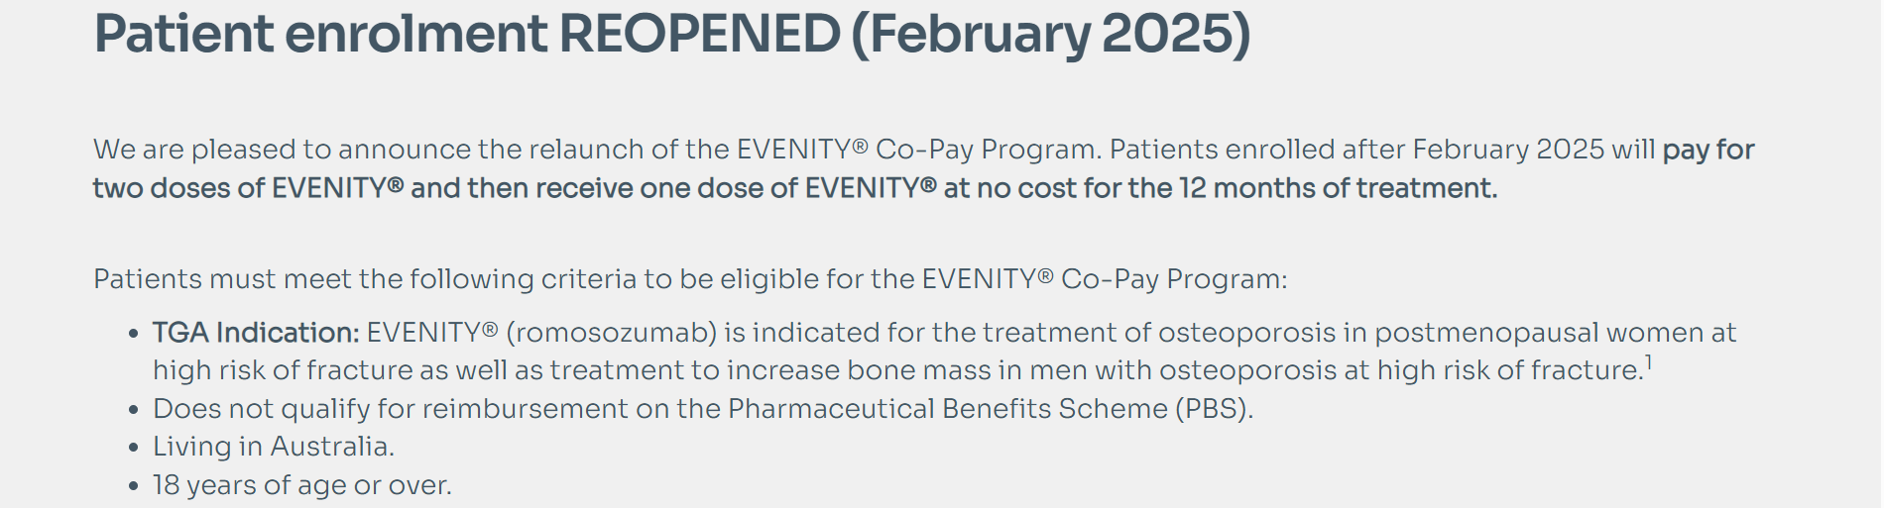
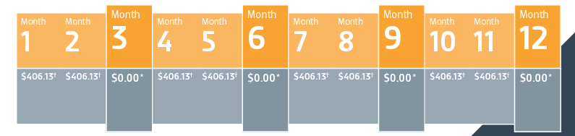
Evenity Co-Pay Program

Slide 26
How long to treat + monitoring?
Romosuzumab, monthly subcut for 12months + 12months of consolidation
Teriparatide, daily subcut for 18months + consolidation
PO bisphosphonates, 5-10years and then consider drug holiday if no further #, T score >-2.5
IV zoledronic acid, annual infusion 3yrs, then consider drug holiday
Denosumab only start if prepared to be lifelong
BMD every 2years, once post commencement of Dmab to ensure improvement
Use same machine wherever possible to improve comparability of results
Baseline BTM pre-PO bisphos, once 3-6months post start to assess compliance and efficacy
JBMR Plus 2022, Wang
RACGP: Osteoporosis management and fracture prevention in postmenopausal women and men >50years of age

Slide 27
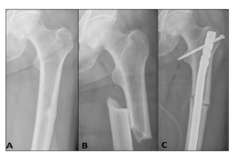
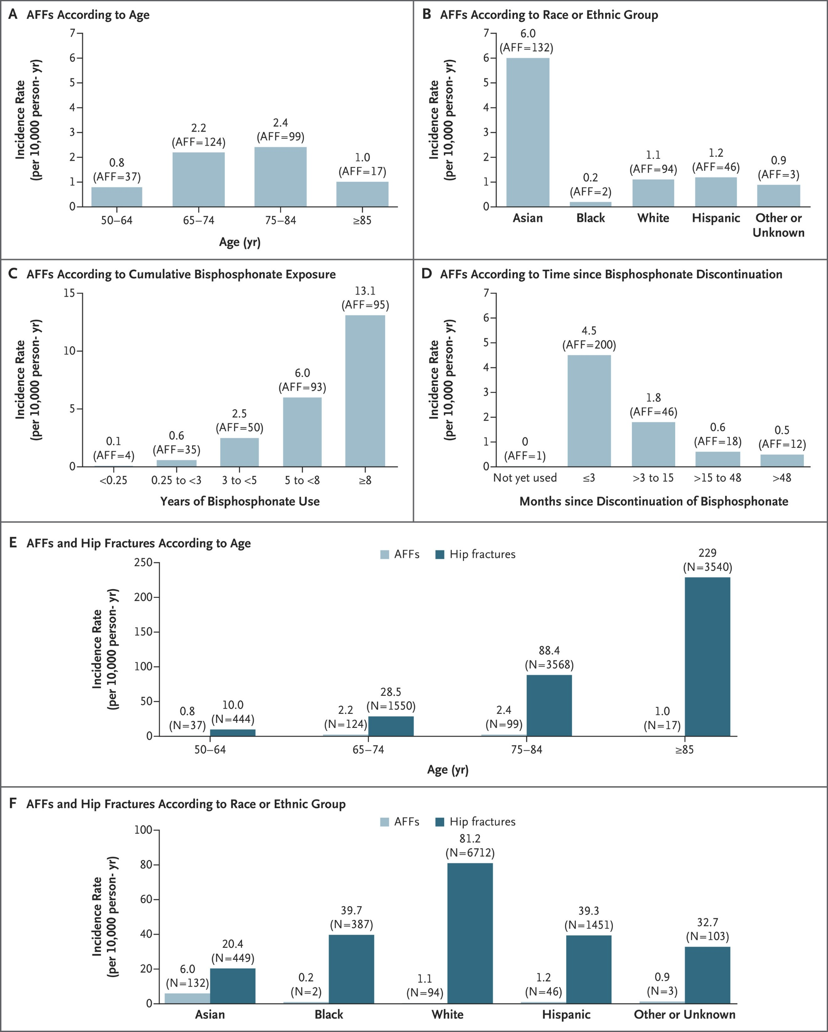
Why do we need to consider a drug holiday?
NEJM 2020, Black

Slide 28

Taking a drug holiday
When to restart treatment?
Reassess BMD 2yearly (1year off risedronate)
Restart treatment
      >5% decline in BMD
      T-score ≤ 2.5
      Further minimal trauma fracture

Slide 29
When to refer?
Anyone who qualifies for an anabolic agent under the PBS
  Even if they don’t qualify but prepared to pay $3600 for 12months of treatment
Minimal trauma fracture in patient with a normal BMD
Recurrent fractures or continued bone loss on therapy
Complications of therapy
Pre-menopausal osteoporosis or in men <50yrs
Condition that complicates management – CKD IV/V, hyperparathyroidism, malabsorption

Slide 30
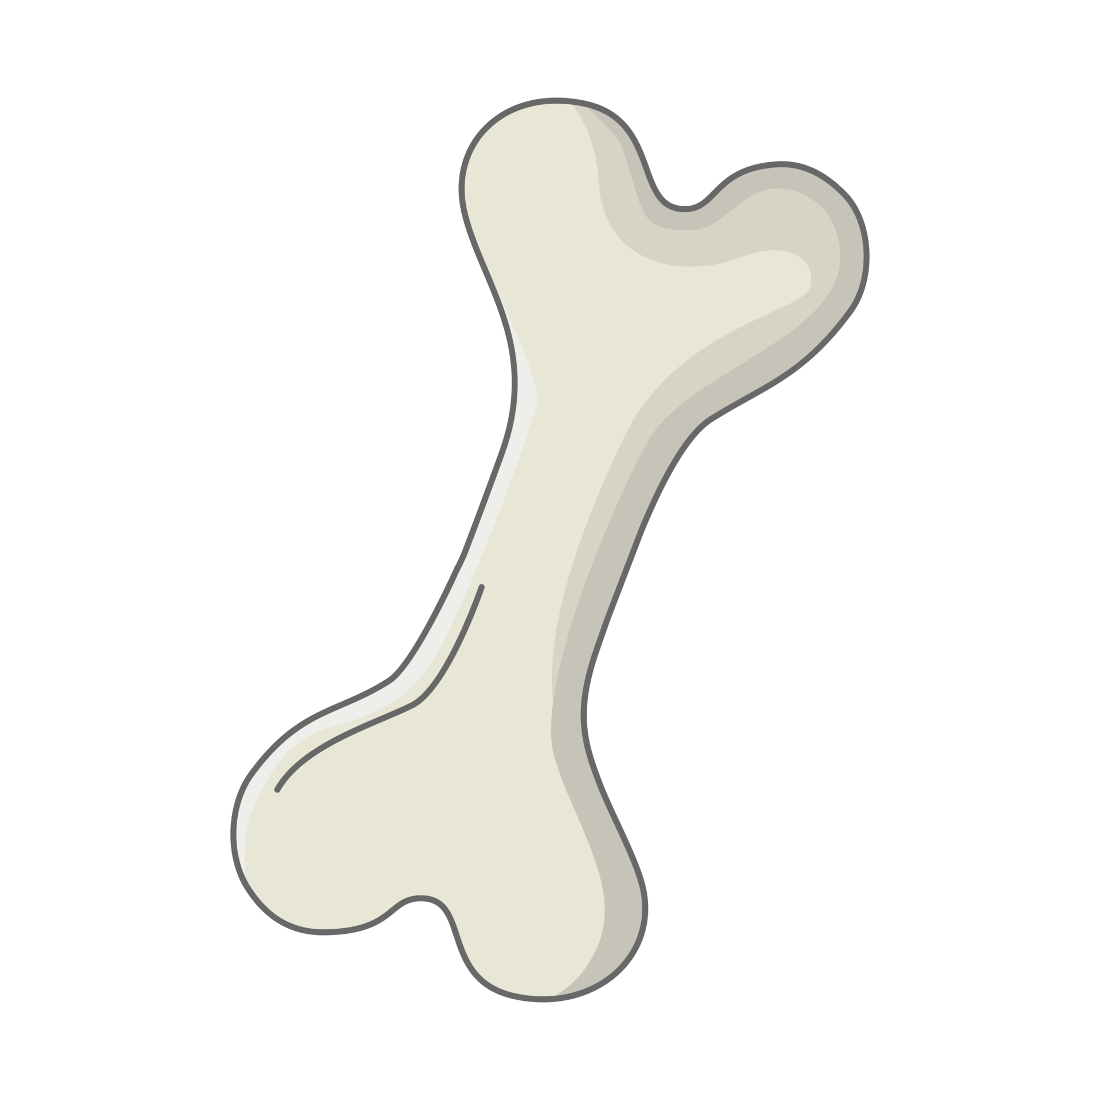
Summary
Osteoporosis is under-diagnosed, the best time to intervene is BEFORE fracture
Osteopenia in women within 10years of menopause should be offered MHT if no contraindications
Bone-specific therapy offered to those with diagnosis of OP or high fracture risk
Denosumab should be reserved for those >70years in most cases
Romosozumab should be considered as first line for osteoporosis especially if meeting PBS criteria

Slide 31
References
British Menopause Society - Tool for clinicians, Menopause: nutrition and weight gain, 2003.
RACGP - Osteoporosis management and fracture prevention in postmenopausal women and men >50years of age, 2024
Monash - Practioner’s toolkit for the management of menopause, 2025 update
Saag K et al. Romosozumab or Alendronate for Fracture Prevention in Women with Osteoporosis, NEJM. 2017
Cranney A et al, II. Meta-Analysis of Alendronate for the Treatment of Postmenopausal Women, Endocrine Reviews, Volume 23, Issue 4, 1 August 2002, Pages 508–516
McClung et al Observations following discontinuation of long-term denosumab therapy. Osteoporos Int. 2017 May;28(5):1723-1732.
Tsourdi et al, Fracture Risk and Management of Discontinuation of Denosumab Therapy: A Systematic Review and Position Statement by ECTS, The Journal of Clinical Endocrinology & Metabolism, Volume 106, Issue 1, January 2021, Pages 264–281
Wang M, et al Bisphosphonate Drug Holidays: Evidence From Clinical Trials and Real-World Studies. JBMR Plus. 2022 May 24;6(6)
Murdoch R, et al, Effect of a Three-Day Course of Dexamethasone on Acute Phase Response Following Treatment With Zoledronate: A Randomized Controlled Trial. J Bone Miner Res. 2023 May;38(5):631-638
Morin S et al Clinical practice guideline for management of osteoporosis and fracture prevention in Canada: 2023 update, CMAJ Oct 2023, 195 (39)
Rossouw JE et al, Group for the Women's Health Initiative Investigators. Risks and benefits of estrogen plus progestin in healthy postmenopausal women: principal results From the Women's Health Initiative randomized controlled trial. JAMA. 2002 Jul 17;288(3):321-33
Zhu L, et al. Effect of hormone therapy on the risk of bone fractures: a systematic review and meta-analysis of randomized controlled trials. Menopause. 2016 Apr;23(4):461-70.
Ravn P, Alendronate and estrogen-progestin in the long-term prevention of bone loss: four-year results from the early postmenopausal intervention cohort study. A randomized, controlled trial. Ann Intern Med. 1999 Dec 21;131(12):935-42
Zhu L, et al, Effect of hormone therapy on the risk of bone fractures: a systematic review and meta-analysis of randomized controlled trials. Menopause. 2016 Apr;23(4):461-70
Black D et al, Once-Yearly Zoledronic Acid for Treatment of Postmenopausal Osteoporosis for the HORIZON Pivotal Fracture Trial, N Engl J Med 2007;356:1809-1822
Cranney A et al IX: Summary of Meta-Analyses of Therapies for Postmenopausal Osteoporosis, Endocrine Reviews, Volume 23, Issue 4, 1 August 2002, Pages 570C
ummings S, et al, Denosumab for Prevention of Fractures in Postmenopausal Women with Osteoporosis for the FREEDOM Trial, 2009, NEJM
Bone H, et al, 10 years of denosumab treatment in postmenopausal women with osteoporosis: results from the phase 3 randomised FREEDOM trial and open-label extension, The Lancet Diabetes & Endocrinology, Volume 5, Issue 7, 513 – 523
McClung MR et al, Effects of 24 Months of Treatment With Romosozumab Followed by 12 Months of Denosumab or Placebo in Postmenopausal Women With Low Bone Mineral Density: A Randomized, Double-Blind, Phase 2, Parallel Group Study. J Bone Miner Res. 2018 Aug;33(8):1397-1406.
Cosman F et al, Romosozumab Treatment in Postmenopausal Women with Osteoporosis, N Engl J Med 2016;375:1532-1543

Slide 32
Dr Laura Careless
Liberty Women’s Wellness, Springfield
info@libertywomenswellness.com.au
Ph: 3472 6107
Questions ??

