Slide 1

West Moreton GP Symposium
Julie Eaton MUM ANC
This Photo by Unknown Author is licensed under CC BY-NC-ND

Slide 2

Models of care
GP Shared care
Low Risk Midwives Clinic
Ipswich Hospital Mondays, Tuesdays, Thursdays and Fridays
Ripley Satellite Hospital Tuesdays and Thursdays
Laidley Hospital Tuesdays
Redbank Community Centre Thursdays
Goodna Community Centre Fridays
Springfield High School YMCA Fridays
High Risk Midwives Clinic Wednesdays

Slide 3
Models of care continued:
Pasifika Liaison Midwife
Redbank Community Centre Tuesday
Goodna Community Clinic HR with consultant Wednesday
Goodna Community Centre Wed PM & Thursday
Friday Goodna Community Centre
Multicultural Liaison Midwife
Goodna Community Centre Mondays AM
Goodna Community Centre Tuesday PM
Goodna Community Clinic HR with consultant Wednesday
Ipswich Hospital Thursday AM
Redbank Community Centre Friday

Slide 4
Models of care continued:
Bereavement Liaison Midwife
All women who have experienced a loss in pregnancy are referred to this model of care and seen antenatally through the next pregnancy
If a loss is experienced in the current pregnancy the midwife connects with these women and offers follow up postnatally
Bereavement midwife will also support if a woman is being seen for a termination of pregnancy for various reasons
MCAL (midwifery care after loss) clinic Wednesdays at Ipswich

Slide 5
Models of care continued:
Midwifery Group Practice currently x 2 groups (10 midwives)
Each Midwife takes 37 women a year and gives all care throughout pregnancy, birth and up to 6 weeks postpartum and works an on call roster
South Ripley team runs clinics on Tuesdays at Ripley Satellite Hospital
Goodna Team runs clinics from Goodna Community Centre on Wednesdays

Slide 6
Other clinics at Ipswich:
Low Risk Doctors Clinic
Ipswich Hospital Mondays AM
High Risk Doctors Clinic
Ipswich Hospital Wednesday all day
GDM Doctors Clinic
Ipswich Hospital Thursday all day (Type 1 & 2 in PM)
GDM Midwife Clinic
Ipswich Hospital Thursday AM
Maternity Day Assessment Unit (MDAU) 3413 5788 BS Reg 3413 5789 Call reg for advice or to handover patients. 3413 7609 Consultant on call.

Slide 7
Midwifery Services offered
Midwifery Navigator service who looks after high risk and maternal diabetes in pregnancy. The navigator once referral is received will link in with the women and often has some contact in the postnatal period for a short time.
Early Pregnancy Service (EPS) now 7-day service 0800-1630. One of 2 midwives see women with concerns in their pregnancy up to 20 weeks' gestation i.e. bleeding and subsequent loss. There is the option to have the products of conception collected by the woman once they are returned by pathology or to have the products included in the memorial once a month that is attended by EPS and the hospital Chaplain on a Wednesday. Women are invited to this by EPS.
Termination of pregnancy – all TOP’s to be referred to Marie Stopes under 16 weeks – please follow pathway on referring patients

Slide 8
Booking in visit
Please refer early once dating scan/bloods shows viable pregnancY. include all relevant blood tests and ultrasound reports. Please also highlight any complex medical conditions or poor obstetric outcomes in previous pregnancy. If woman is requesting MGP please write this on referral as early referral is best as places book up quickly.
Women will be contacted by ANC for a booking in appointment which is done by Telehealth unless over 22 weeks then will be face to face. Gold standard is to book women into to the hospital by 12-14 weeks.
History is taken by the midwife and asks the woman her expectations of her care for the pregnancy. All women are then discussed with a consultant and a model of care agreed upon. If the woman would like GP shared care - further appointments are made at 36 weeks and 40 weeks for the woman and then back to GP care for all appointments as per the AN schedule. Any appointments made here are written on the back of the PHR.
Self referral for women - a statewide initiative not WMHHS – work in progress

Slide 9
Midwifery Postnatal Service (MPS)
Postnatal care is offered for up to 10 days postpartum
All women within 35 kms of the hospital are offered home visit, phone call or Telehealth appointment. Visit often includes the NNST if within timeframe 48-72 hrs.
Women outside of 35 kms are offered phone call or Telehealth appointment.
Women are advised to see GP at 7 days of age
Women generally offered 1 visit and then phone call or Telehealth follow up until discharge at approx. 10 days earlier if the woman declines any further contact.

Slide 10
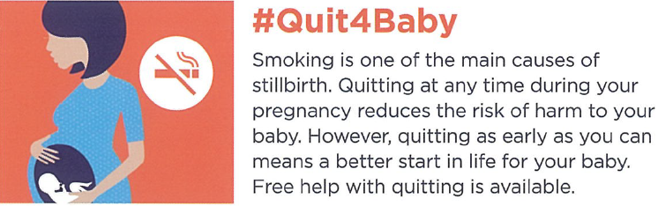
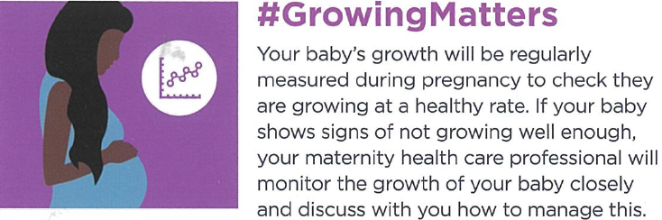
Safer Baby Bundle
5 elements were introduced to reduce stillbirth by 20% over the period of the project (2 years). Ipswich Hospital are an implementation site. We are also part of the PreTerm Birth alliance which is about timing of birth.

Slide 11
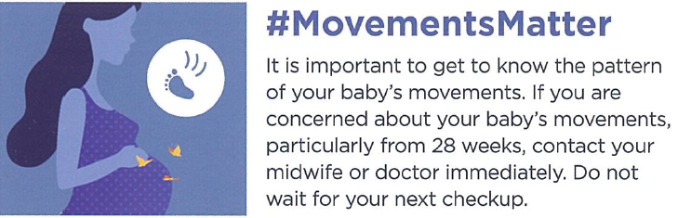
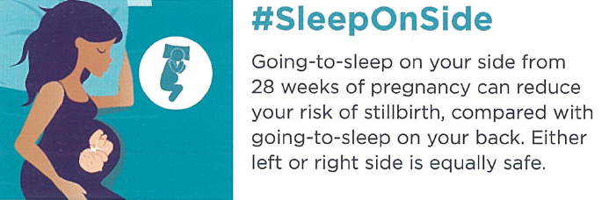
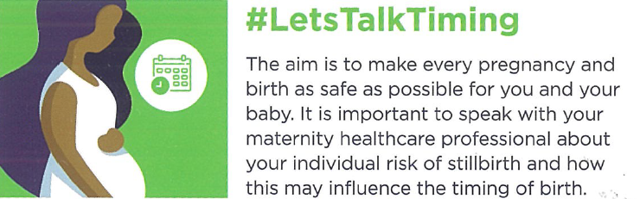

Slide 12

Pre term Birth alliance resource that is given to discuss timing of birth. Free to download from www.everyweekcounts.com.au Available in multiple languages

Slide 13
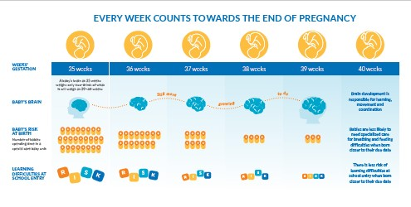

Slide 14
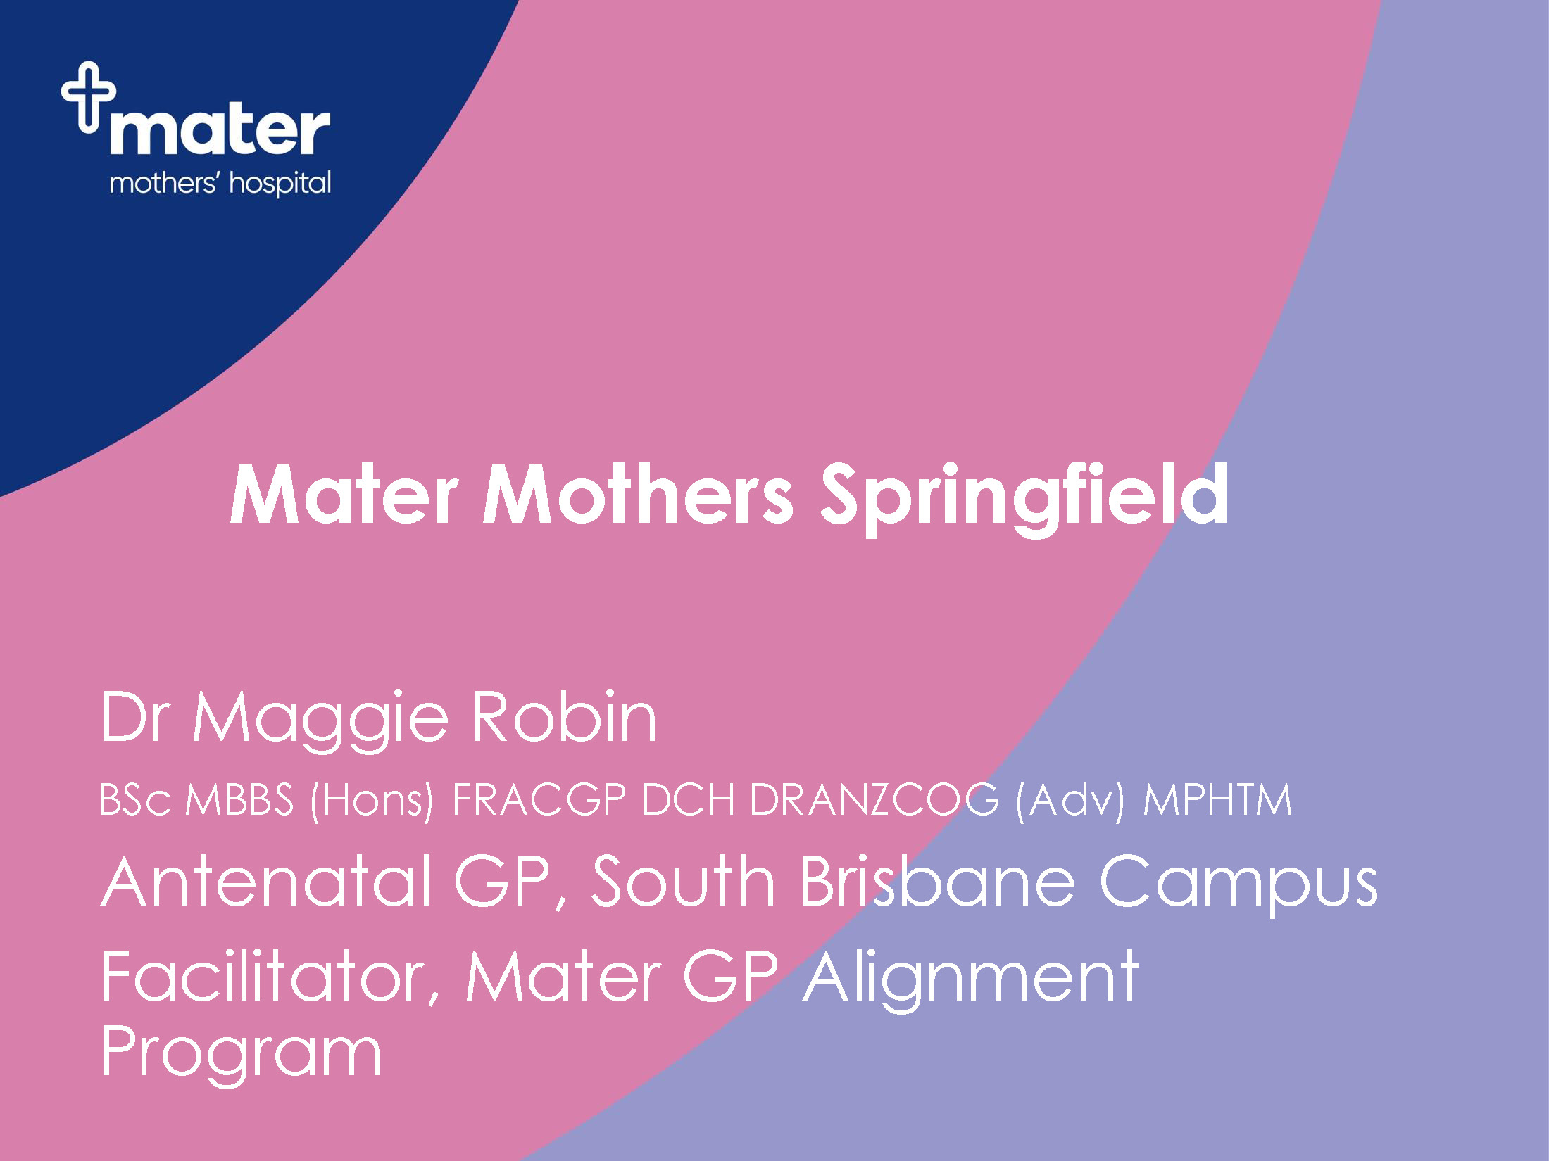

Slide 15




Maternity services at
Mater Mothers’ Springfield:
Opening 2026
Delivered through a hub and spoke model with Mater Mothers’ Hospital at South Brisbane serving as the central location for more complex care.
Models of care offered at Mater Mothers’
Springfield include:
GP Shared Care
Midwifery Group Practice (MGP)
Obstetric/Midwifery Care
16-bed inpatient ward
24/7 Pregnancy Assessment Centre
16-cot Neonatal Critical Care Unit
Antenatal clinic (opening December
at Mater Health Hub, Springfield)

Slide 16


Referrals open soon
Antenatal clinics open at Mater Health Hub, Springfield from December 2025.
Mater Mothers' Springfield to open from late April 2026.
Mater-aligned GPs will be eligible to provide shared antenatal care for patients birthing at Springfield.
            The immediate catchment area
            for Mater Mothers’ Springfield
            includes the SA3 areas of:
            Springfield-Redbank
            Forest Lake-Oxley
            Centenary
Find updates here:

Slide 17

Mater’s GP Shared Care Alignment Program
Eligibility requirement:
  ~ 2 hours pre-learning
  Completion of a free half day workshop (Alignment 1)
  Renewed every three years – multiple options for renewal
Alignment 1 content
Foundations of antenatal care across the 3 trimesters
Alignment 2 content
Preconception and fertility
Alignment 3 content
Perinatal mental health, medical complications of pregnancy
Alignment 4 content
  The fourth trimester: Pregnancy loss and bereavement, trauma, and the postpartum
Online re-alignment and bridging options also available
Alignment options & registrations here:

Slide 18


