Slide 1





9:40am – 10:20am
Medical Obstetric Update and Infections in Pregnancy Update
Dr Vishwas Raghunath and Dr Jill Parkes Smith
Got a question?
LOG IT HERE:

Slide 2



High Risk
Pregnancy
2nd August 2025
Dr Vishwas Raghunath
Nephrologist & Obstetric Physician
West Moreton HHS and Mater Mother’s Hospital

Slide 3
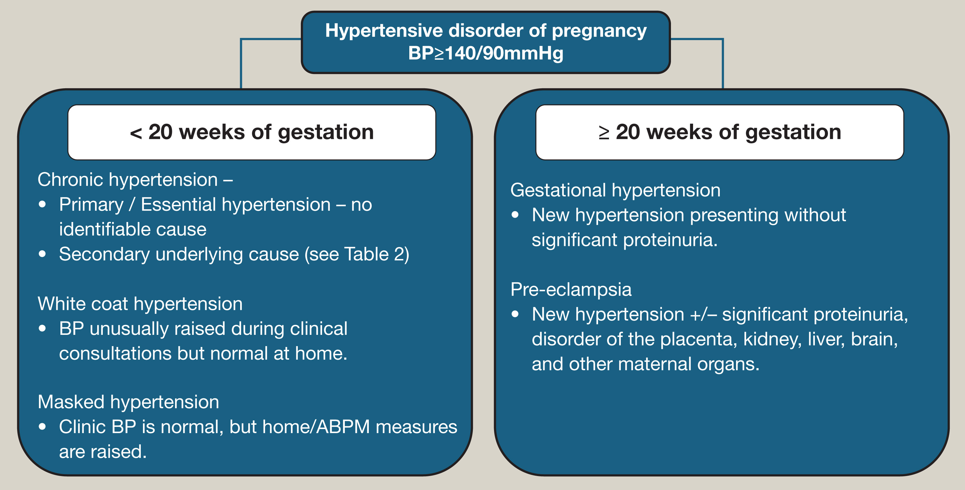
Preeclampsia
Preeclampsia is a multi-system disorder - new onset of hypertension (SBP≥140 mmHg and/or DBP≥90 mmHg) after 20 weeks' gestation accompanied by one or more signs of new onset organ involvement.
  Renal – proteinuria (uPCR>30mg/mmol) or serum creatinine > 90 umol/l.
  Liver – raised serum transaminases
  Hematological – thrombocytopenia, hemolysis or DIC.
  Neurological – seizures, cerebral irritability (hyperreflexia/clonus, PRES or persistent visual changes) or cerebrovascular accident.
  Pulmonary oedema
  Placental dysfunction – fetal growth restriction with abnormal umbilical artery dopplers or oligohydramnios.
  Biomarkers - sFLT1:PlGF ratio as a ‘rule out’ test.

Slide 4
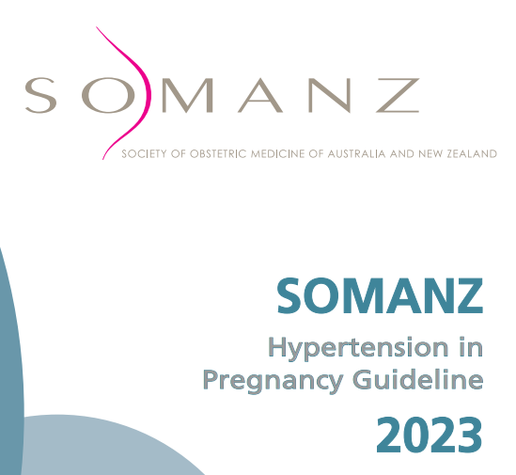
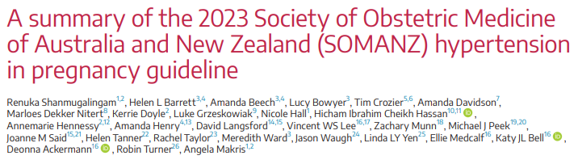
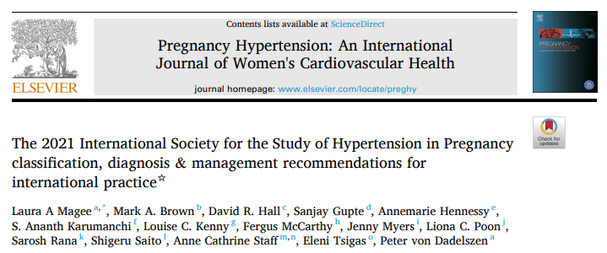
Risk stratification in preeclampsia
SOMANZ_Hypertension_in_Pregnancy_Guideline_2023.pdf
The 2021 International Society for the Study of Hypertension in Pregnancy classification, diagnosis & management recommendations for international practice

Slide 5
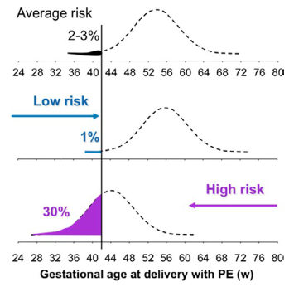
Screening for women at risk of preeclampsia
Women should be screened for their risk of preeclampsia early in the pregnancy. (1B)
At a minimum, risk stratification should be done based on maternal risk factors (maternal characteristics, medical and obstetric history).
Use of a combined first trimester screen (combined maternal features, biomarkers and sonography) to identify women at risk of developing preeclampsia is conditionally recommended (2B) based on local availability and access to the required resources.
  Combined screening for preeclampsia and aneuploidy at K12-K14 during nuchal translucency appointment.
Notes:
Competing risk model. Distribution of gestational age at delivery for PE. In pregnancies at low risk for PE the gestational agedistribution is shifted to the right and, in most pregnancies, delivery will occur before the development of PE. In pregnancies at high risk for PEthe distribution is shifted to the left.

Slide 6
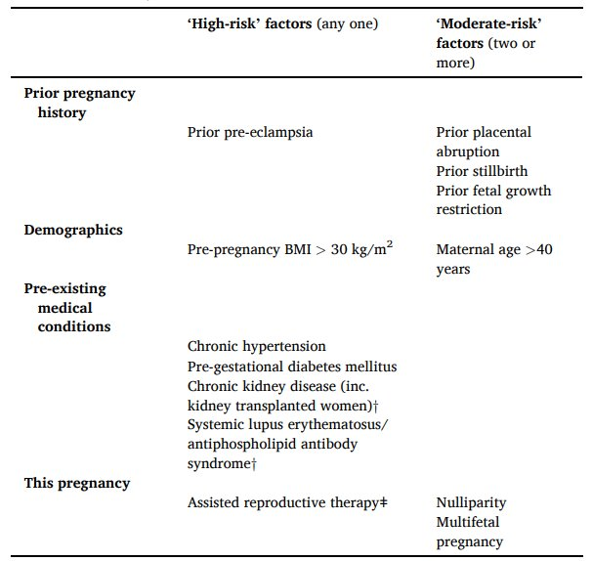
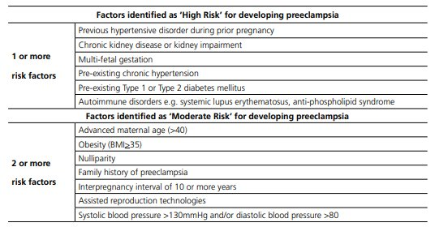

Slide 7
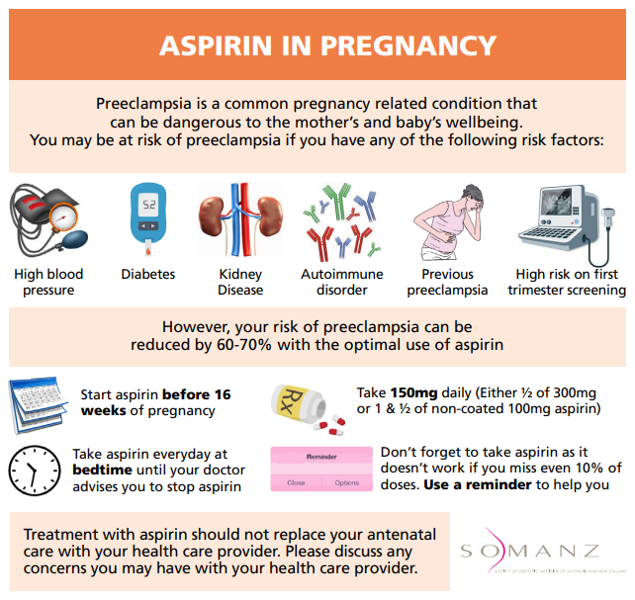
Preventative strategies - Aspirin
Initiation of aspirin in women at high risk of developing preeclampsia, prior to 16 weeks' gestation, is strongly recommended. (1B)
The dose of 150mg/day of aspirin is strongly recommended. (1B)
The use of bedtime aspirin is conditionally recommended. (2C)
Cessation of aspirin between 34 weeks' gestation and birth is conditionally recommended. (2B)
Universal aspirin in low-risk nulliparous women is conditionally recommended against. (2B)
Counselling on the use of aspirin in pregnancy is recommended to improve adherence to aspirin in pregnancy. (PP)

Slide 8
Preventative Strategies – other pharmaceuticals
Calcium
  The use of supplemental calcium is strongly recommended in pregnant women with low dietary calcium intake (<1g/day) for the prevention of preeclampsia, preterm birth, and gestational hypertension. (1C)
  Assess dietary calcium intake prior to recommending oral calcium supplementation (PP)
  Consider assessing serum corrected calcium in those taking calcium oral supplementation(to ensure the absence of hypercalcemia). (PP)
Others NOT recommended:
  Omega-3 lung chain polyunsaturated fatty acids
  Vitamins C, D & E, Garlic, Magnesium, Progesterone, Statins, Metformin.
  Clopidogrel, LMWH (if no thrombophilia or APLS)

Slide 9
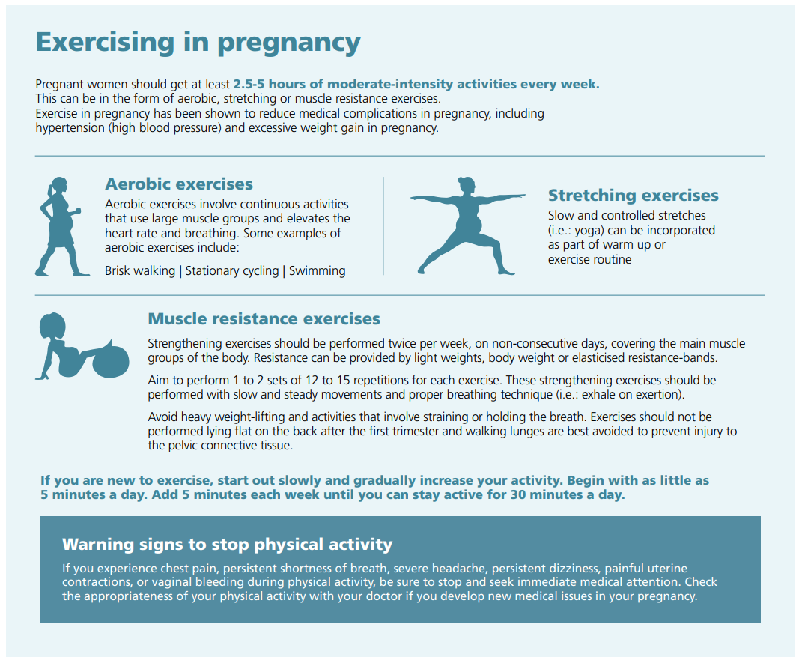
Exercise in pregnancy
Moderate intensity exercise, in the form of aerobic, stretching and/or muscle resistance exercises, for a total of 2.5-5 hours a week, as recommended as part of routine pregnancy wellbeing has the added benefit of reducing the risk of hypertensive disorders of pregnancy. (2D)
Exercise regimen should be commenced early in the pregnancy. (PP)

Slide 10
Longterm consequences of preeclampsia
Women should be informed of the long-term risks associated with preeclampsia, gestational hypertension and chronic hypertension and the importance of postpartum follow up prior to discharge from hospital (PP)
Women should be reviewed by a health care provider within 1 week of discharge from hospital to ensure stable blood pressure post discharge and titrate medications accordingly. (PP)
At 3-6 months postpartum, a follow up review of
  blood pressure (consider a 24-hour blood pressure monitor if not previously done),
  urine protein assessment (uACR and/or uPCR),
  BMI and metabolic profile (fasting blood glucose and fasting cholesterol assessment)
Interventions for any abnormalities (i.e. further investigations, specialist referral, weight management, lifestyle changes, smoking cessation) should be discussed. (PP)

Slide 11
A yearly follow up of blood pressure, urine protein assessment, BMI and metabolic profile should be considered in identifying early abnormalities in the first 5-10 years postpartum (PP)
At every review, women should be opportunistically screened for postpartum depression and anxiety. The Edinburgh Postnatal Depression Scale (EPDS) can be used as an initial screening tool . (PP)
At every review, women should be counselled on the risk of preeclampsia and gestational hypertension in subsequent pregnancies and the importance of pre-conception medical optimization, contraception (where indicated) and risk minimization strategies (i.e.: prophylactic aspirin). (PP)

Slide 12
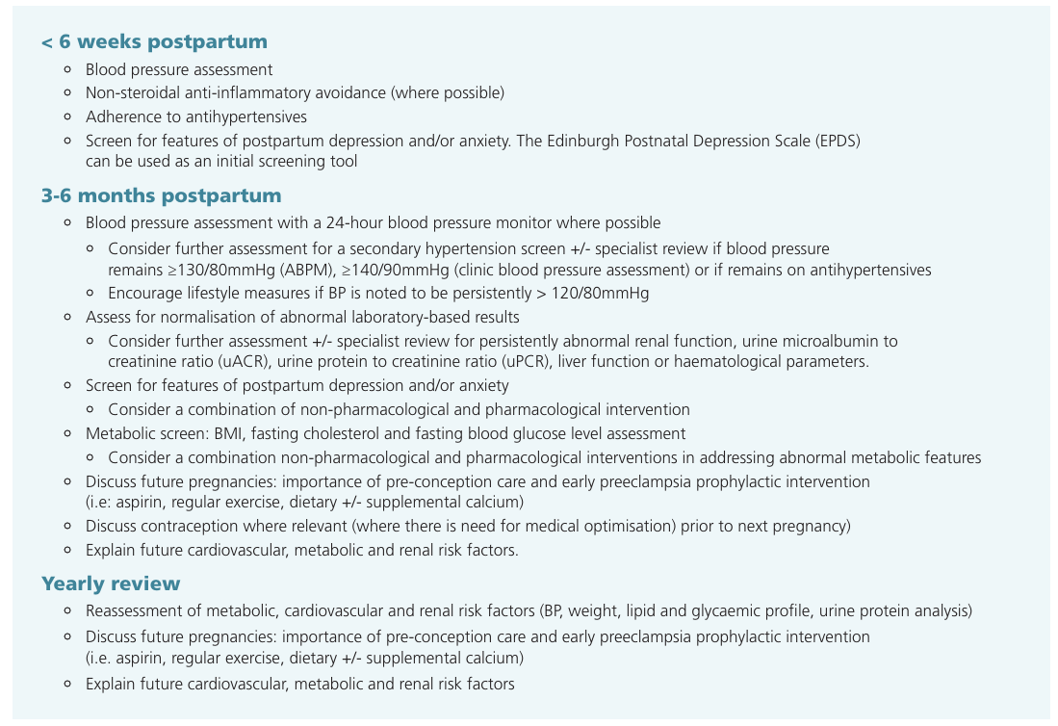

Slide 13
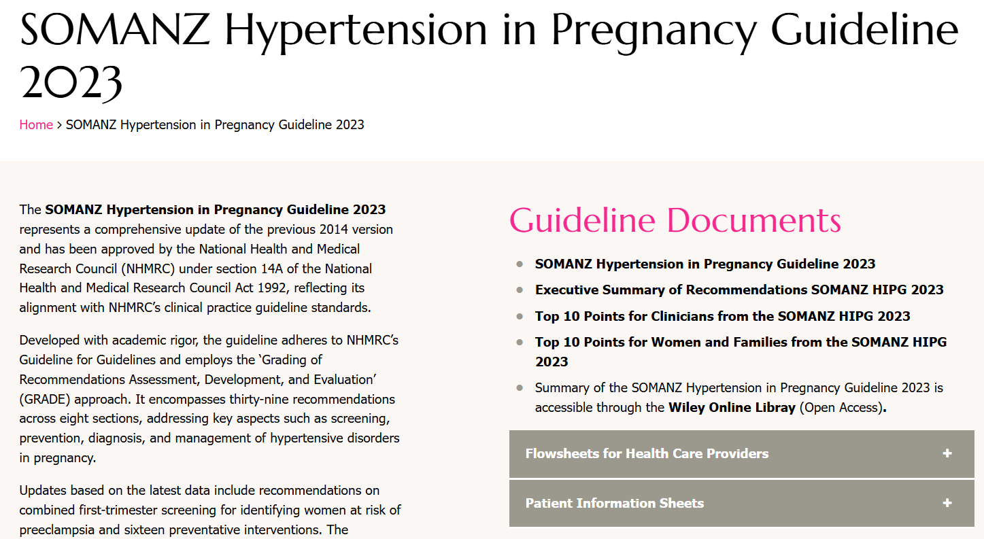

Slide 14
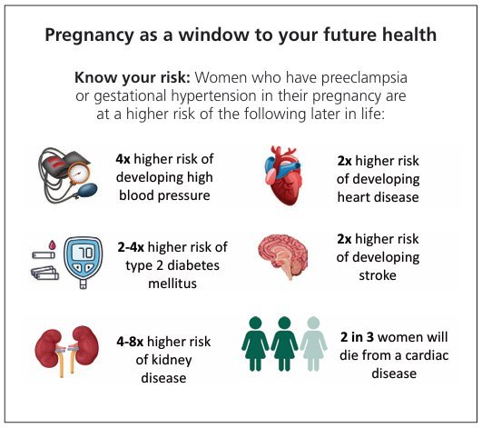
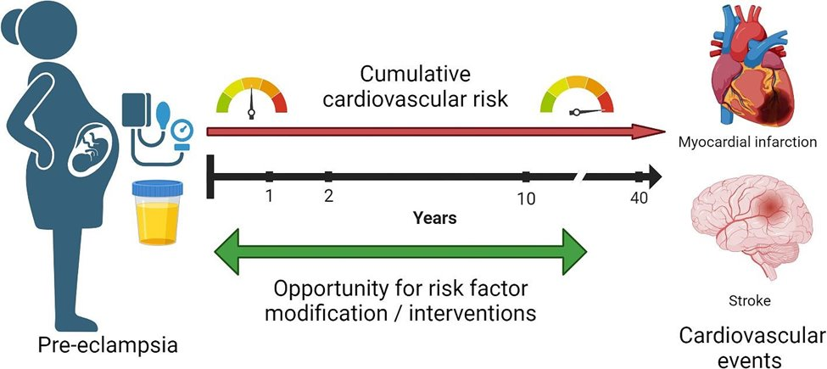
RISK

Slide 15
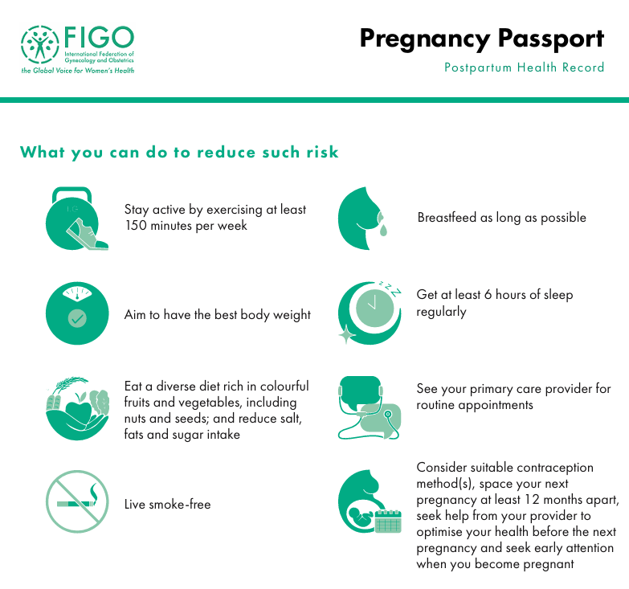
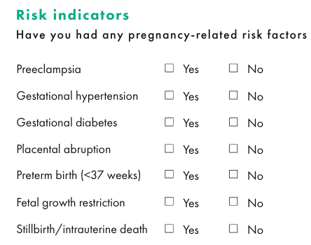

Slide 16
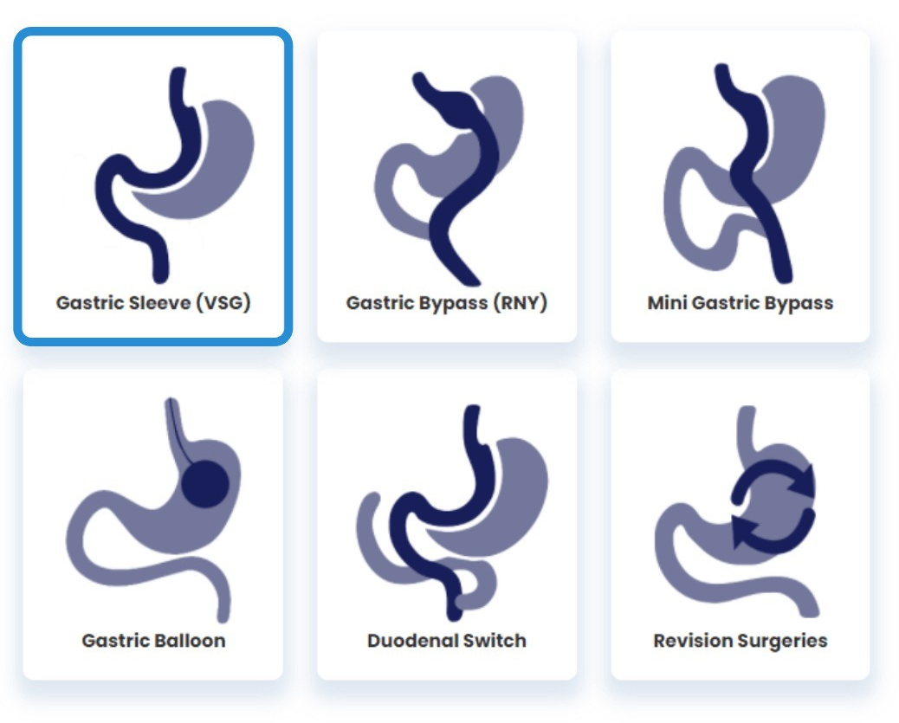
Pregnancy after Bariatric Surgery

Slide 17
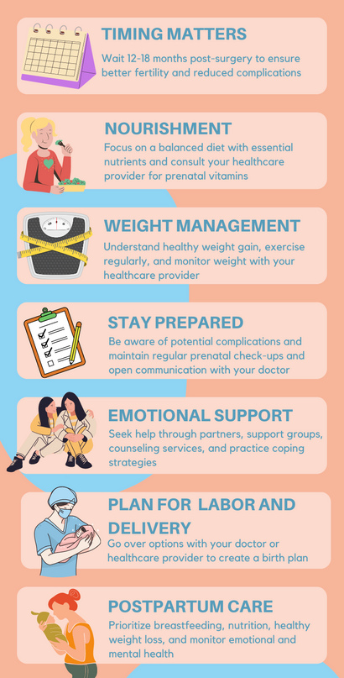
Introduction
Risks
Reward
Maternal obesity is linked to multiple complications in pregnancy.
~2/3 of patients undergoing Bariatric surgery are women of childbearing age - improves fertility.
Shekelle PG, Newberry S, Maglione M, Li Z, Yermilov I, Hilton L, Suttorp M, Maggard M, Carter J, Tringale C, Chen S. Bariatric surgery in women of reproductive age: special concerns for pregnancy. Evid Rep Technol Assess (Full Rep). 2008 Nov;(169):1-51.
Roux-en-Y gastric bypass was associated with more obstetric complications than Sleeve Gastrectomy.
Osiakwan SE, Jones KS, Reddy SB, Omotosho P, Skertich NJ, Torquati A. Pregnancy and birth complications among women undergoing bariatric surgery: sleeve gastrectomy versus Roux-en-Y gastric bypass. Surg Obes Relat Dis. 2025 Apr;21(4):509-515. doi: 10.1016/j.soard.2024.11.012.
Following bariatric surgery, pregnancy should be delayed by at least 12-18 months due to ongoing weight loss and a discussion about contraception had.
Pregnancy after bariatric surgery –
  Lower risk of GDM, HDP and LGA
  Higher risk of SGA and nutritional deficiencies
Harriet D Morgan, Amy E Morrison, Malak Hamza, Cathy Jones, Caroline Borg Cassar, Claire L Meek. The approach to a pregnancy after bariatric surgery, Clinical Medicine, Volume 25, Issue 1, 2025, 100275, ISSN 1470-2118.
Eccles-Smith J, Griffin A, McIntyre HD, Nitert MD, Barrett HL. Pregnancy and offspring outcomes after prepregnancy bariatric surgery. Am J Obstet Gynecol. 2025 May;232(5):485.e1-485.e9. doi: 10.1016/j.ajog.2024.08.044.
A multifaceted and multidisciplinary personalized approach in recommended.
Notes:
Consequences of maternal obesity span not only this pregnancy but also have implications for the woman’s long-term health, future pregnancies and the long-term health of the unborn child.

Slide 18
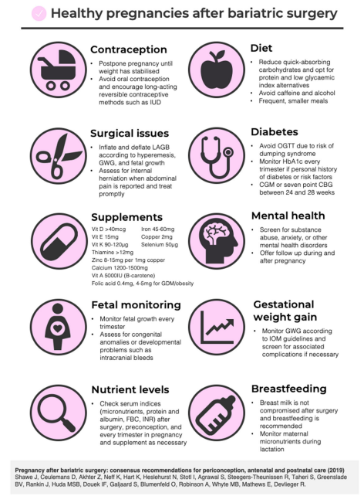
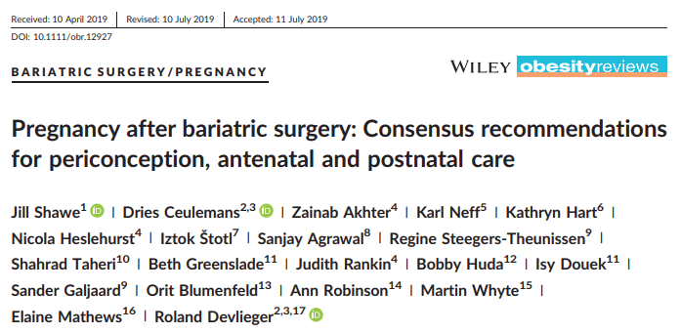
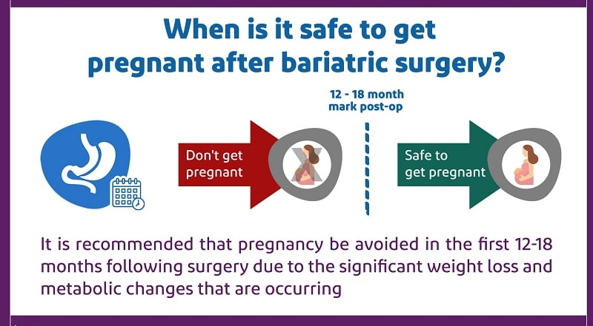

Slide 19
Pregnancy considerations
Nutrient testing – for ALL women as soon as possible, 1st trimester
  FBC, iron studies, active B12, folate, thiamine, vitamins A, D & E.
  Optional -
    Cu – if persisting iron deficiency or on Zn supplements
    Zn & Se – if deficiency suspected (eg. Gastric bypass).
    Vitamin K and INR (malabsorptive procedures)
  Repeat 'micronutrient screen' every trimester.
Gastrointestinal symptoms -
  Watch for things like postprandial hyperinsulinaemic hypoglycaemia (dumping syndrome), recurring vomiting, reflux disease, constipation or diarrhoea (esp. steatorrhoea) and upper abdominal pain.
  Constipation is common –
    Lifestyle intervention: ensure adequate hydration 6-8 glasses fluid/day), dietary fibre (25 35g/day) and physical activity.
    May recommend bulk-forming laxative: e.g. Benefibre/wheat dextrin, Metamucil/psyllium husk, Fybogel/ispaghula husk).
  Treat dumping syndrome with low GI carbohydrate (e.g. wholegrain crackers) with a source of protein and fat (e.g. peanut paste or cheese).

Slide 20
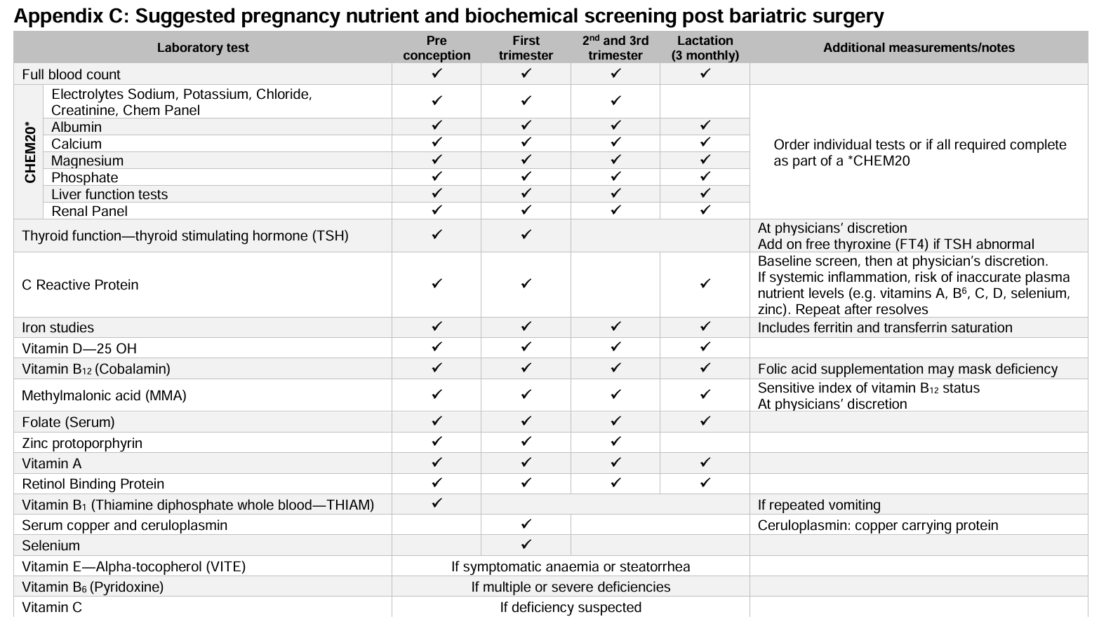

Slide 21
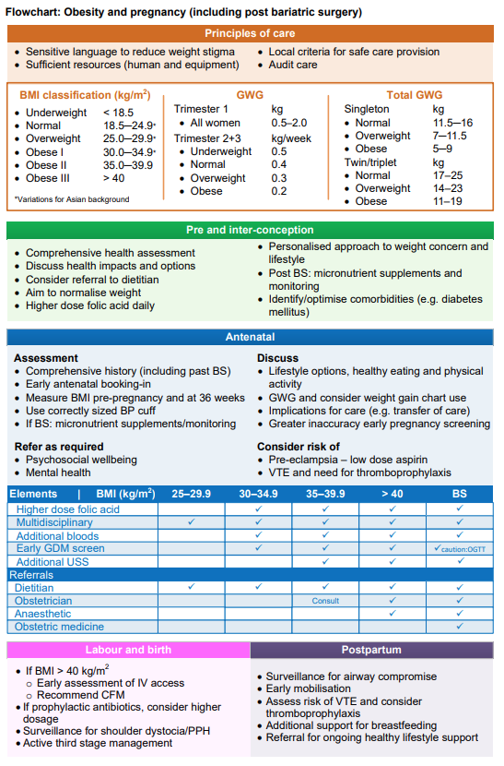
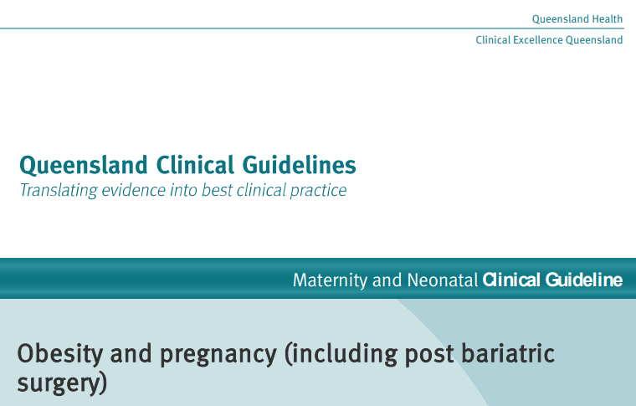
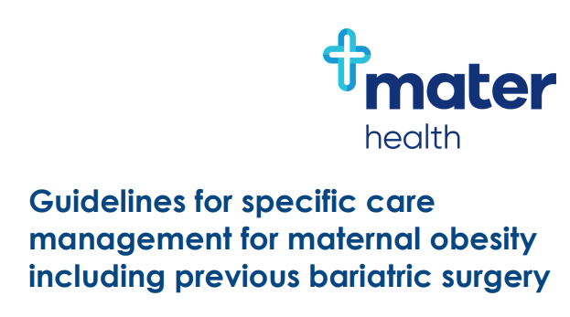

Slide 22

Gestational diabetes (GDM) update – ADIPS 2025
Notes:
The rates of recorded GDM have risen significantly over the past 15 years from 6.1% in 2011–12 to 19.3% in 2021–22.
Previous change in 2014

Slide 23
What's new?
Overt diabetes in pregnancy (overt DIP) should be diagnosed at any time in pregnancy if one or more of the following criteria are met:
  fasting plasma glucose (FPG) ≥ 7.0 mmol/L;
  two‐hour plasma glucose (2hPG) ≥ 11.1 mmol/L following a 75 g two‐hour pregnancy oral glucose tolerance test (POGTT); and/or
  glycated haemoglobin (HbA1c) ≥ 6.5% (≥ 48 mmol/mol).
Irrespective of gestation, gestational diabetes mellitus should be diagnosed using one or more of the following criteria during a 75 g two‐hour POGTT:
  FPG ≥ 5.3–6.9 mmol/L;
  one‐hour plasma glucose (1hPG) ≥ 10.6 mmol/L;
  2hPG ≥ 9.0–11.0 mmol/L
  The Consensus recommendations for BGL targets are:
  Fasting—less than or equal to 5.2 mmol/L
  1 hour after commencing meal—less than or equal to 7.4 mmol/L
  2 hours after commencing meal—less than or equal to 6.7 mmol/L

Slide 24
Women with risk factors for hyperglycaemia in pregnancy should be advised to have the HbA1c measured in the first trimester.
  Women with HbA1c ≥ 6.5% (≥ 48 mmol/mol) should be diagnosed & managed as having overt DIP.
Before 20 weeks’ gestation, and ideally between 10- & 14-weeks’ gestation, if tolerated, women with a previous history of gestational diabetes mellitus or early pregnancy HbA1c ≥ 6.0‐6.4% (≥ 42–47 mmol/mol), but without diagnosed diabetes, should be advised to undergo a 75 g two‐hour OGTT.
All women (without diabetes already detected in the current pregnancy) should be advised to undergo a 75 g two‐hour POGTT at 24–28 weeks’ gestation.

Slide 25
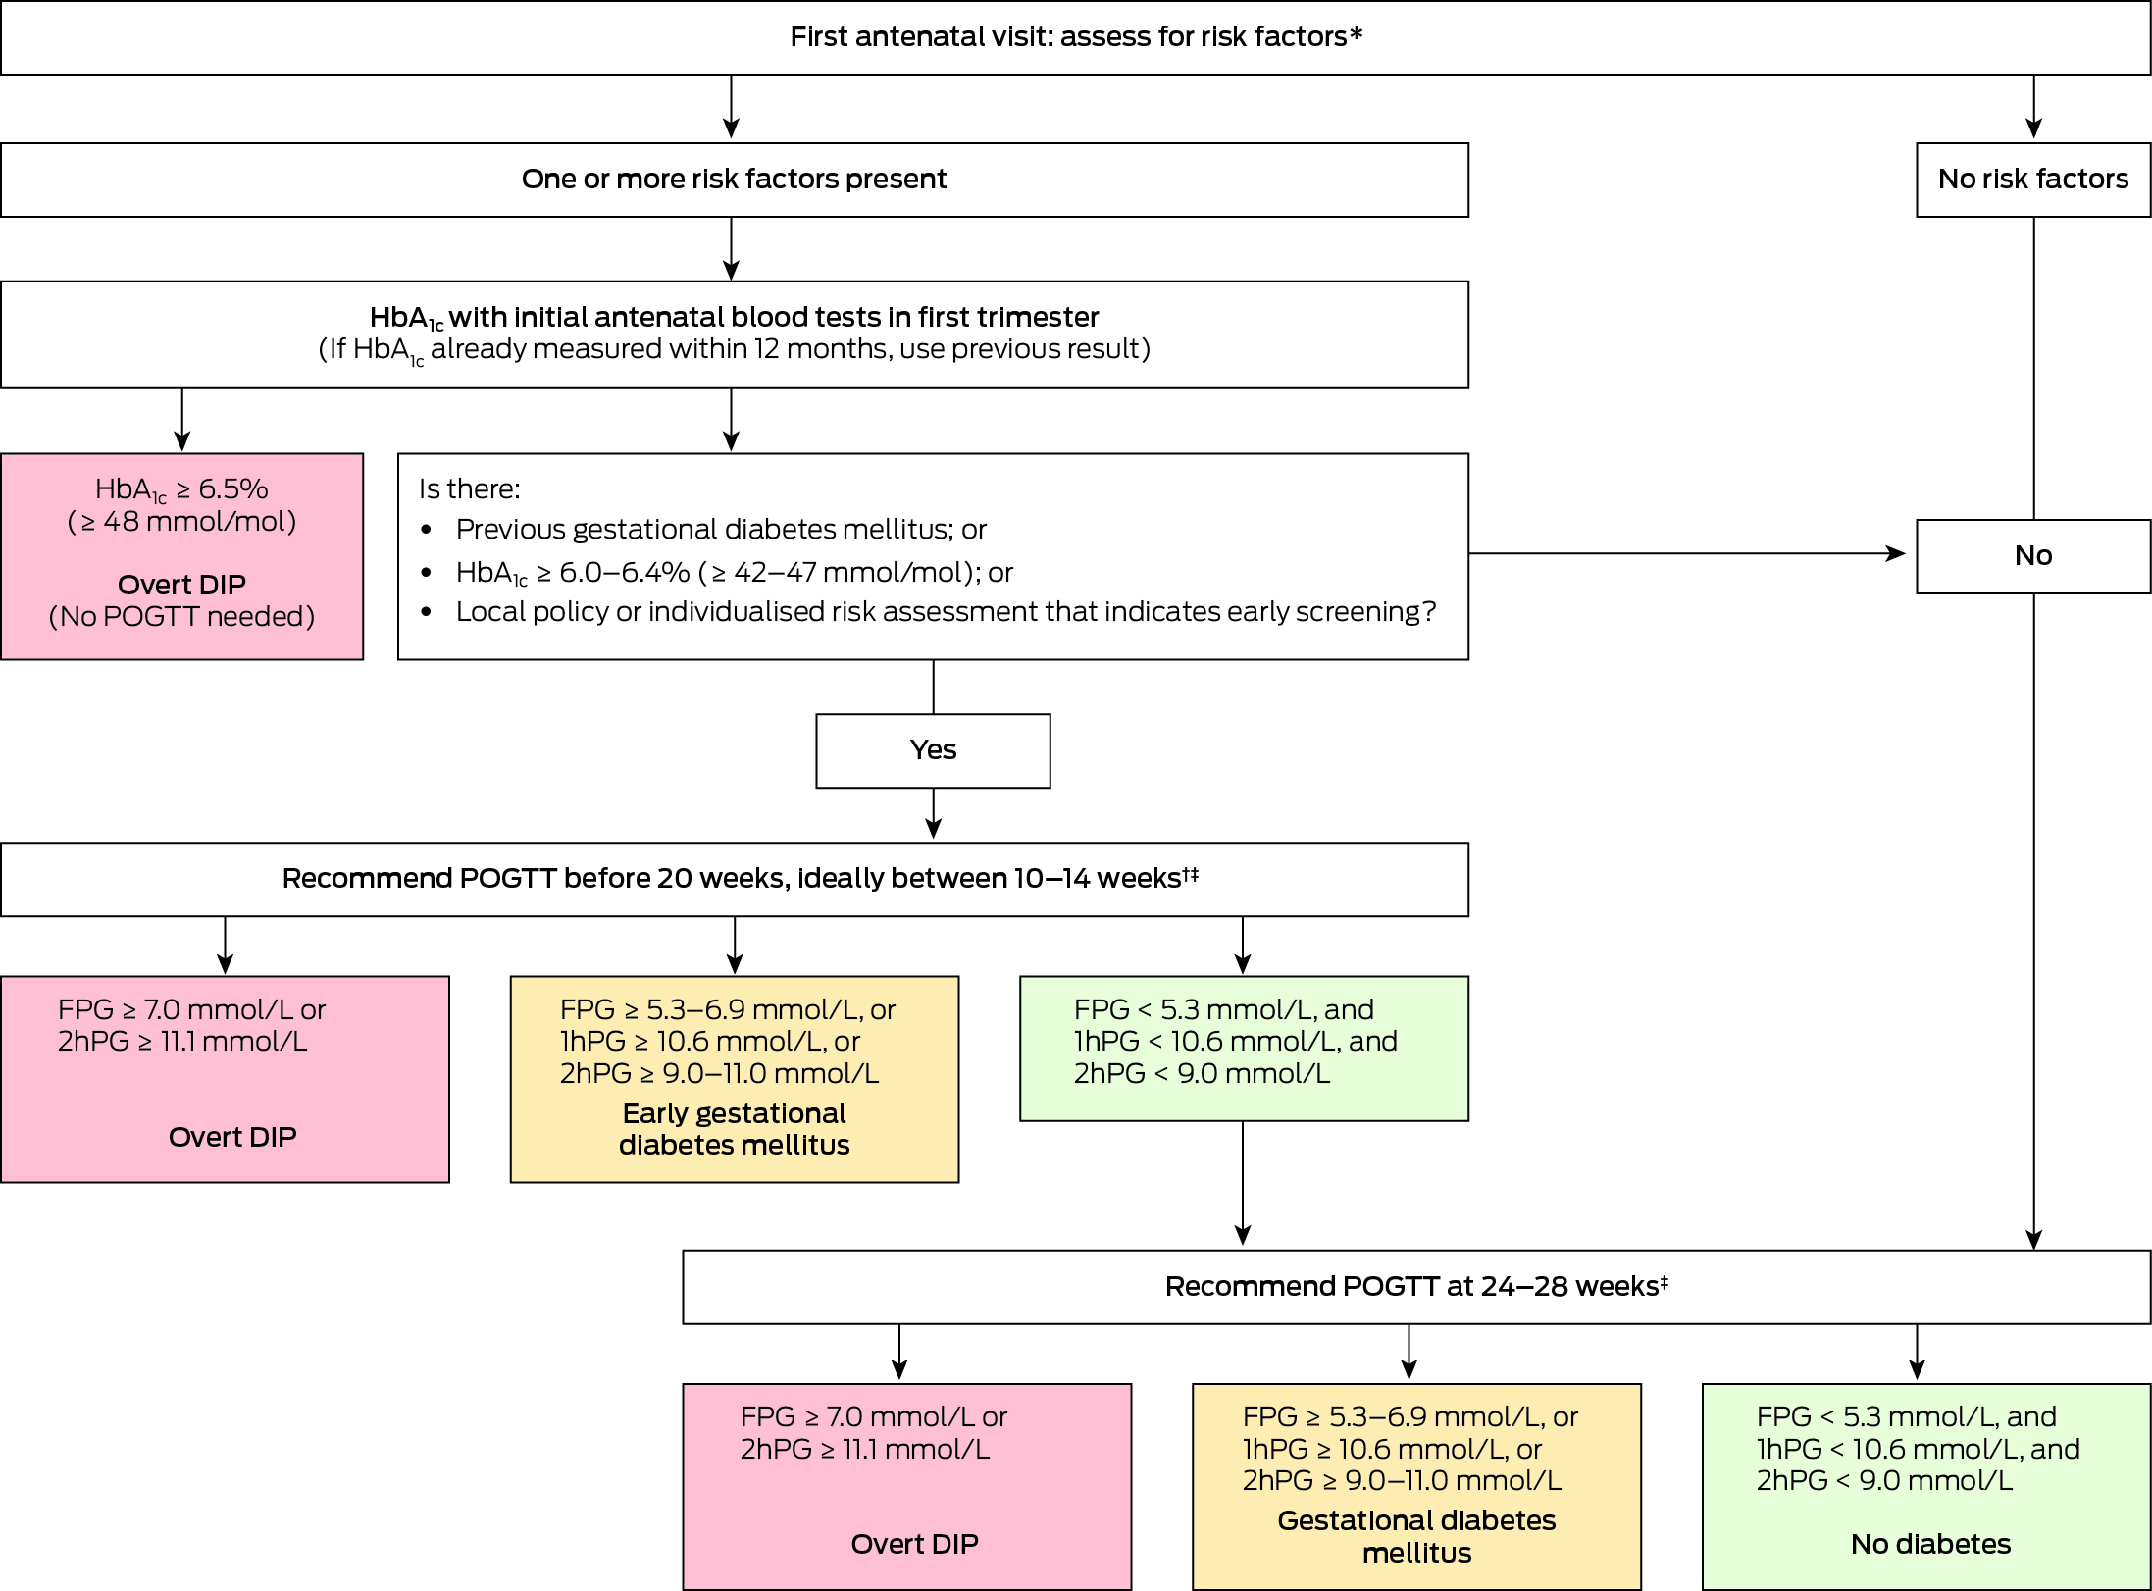

Slide 26


