Slide 1
Paediatric simulation and DELTA GP introduction
Ben Powell
Nadine Edwards

Slide 2
Outline
DELTA GP
Simulation
Anaphylaxis definition
GP management of anaphylaxis
Available resources
Questions

Slide 3
DELTA GP
Collaboration between WMHHS and DD/WM PHN
Delivering in-situ emergency simulation training in GP clinics
Themes are driven by local data
Reactive and open to feedback
2–3 hour sessions
No cost to individual clinics/providers
Taking bookings!

Slide 4
DELTA GP – session outline
General introduction and state of play in Ipswich
LMA skill station
IO skill station
Cardiac arrest simulation
Paediatric simulation
Debrief/questions

Slide 5
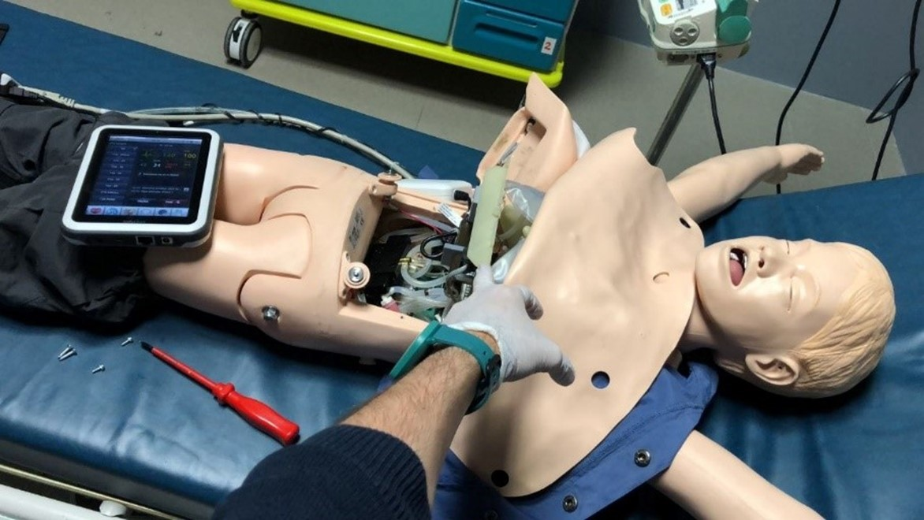
Simulation
Notes:
Sim will be our usual paediatric anaphylaxis:
6 month old boy Billy presents post 6/12 immunisations
Initially well, then called by mother – noisy breathing, pale, looks unwell
Progression to stridor / decreased level of responsiveness/ central cyanosis
Expectation is that candidate will identify anaphylaxis and provide IM andrenaline 100mcg IM
Stop point to ask logistics of where this is / how to draw up / how to administer / how to check the dose.
Case progresses, minimal improvement in child
Expectation is that the candidate would provide another dose of IM adrenaline
Continue to not improve – consideration of neb adrenaline, vascular access
If they go for a PIVC assume successful and check knowledge about IV adrenaline
Progression towards arrest if possible
Debrief

Slide 6
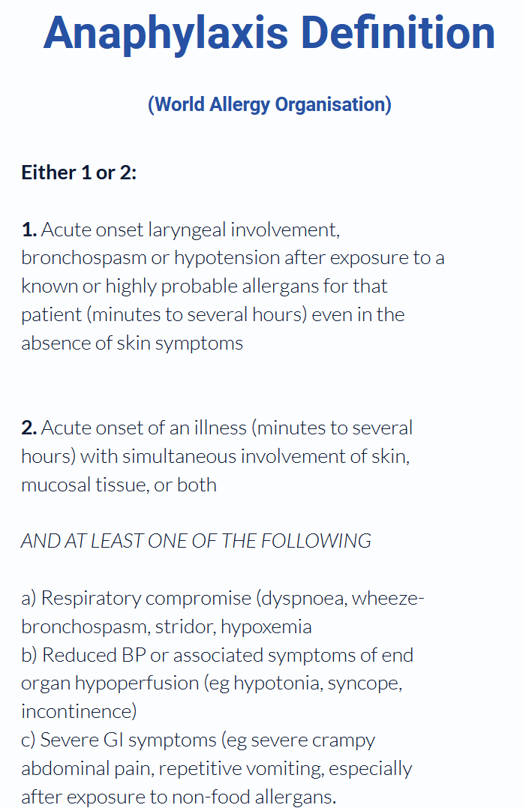

Slide 7
Anaphylaxis management
Adrenaline
10mcg/kg IM Adrenaline
Further IM doses are indicated if inadequate response
In extremis / failure to respond, IV adrenaline is indicated – appropriate to seek advice contemporaneously in this situation
Oxygen
Normal saline
If IV/IO access established
10 – 20 mL/kg

Slide 8
Adrenaline
If you think it is anaphylaxis
If you think it probably is
If you’re not sure but worried
If you cannot rapidly convince yourself that it is not

Slide 9
Adrenaline administrations
Where is the adrenaline in your clinic?
What concentration is it?
How do you calculate the dose?
How would you draw it up?
How would you dilute/administer adrenaline?
What point-of-care resources can you use?
What if the first dose does not work?

Slide 10
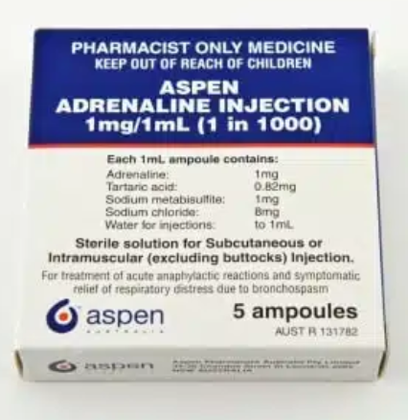
Adrenaline
10mcg/kg = 0.01mL/kg 1:1000 undiluted
CREDD book advise is <10kg to give 100mcg (ease of administration, reduces error)
Undiluted = less time delay to absorption
How can we make this easier in stressful situations?

Slide 11
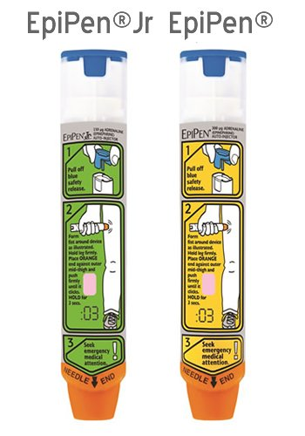

Slide 12
CREDD book

Slide 13
Assessing effectiveness
Looking for rapid resolution of symptoms
Expect respiratory and haemodynamic improvement
Skin manifestations will take longer to resolve

Slide 14
Infants with anaphylaxis may retain pallor despite 2–3 doses
of adrenaline, and this can resolve without further doses.
More than 2–3 doses of Adrenaline in infants may cause
hypertension and tachycardia, which is often misinterpreted as an
ongoing cardiovascular compromise or anaphylaxis. Blood pressure measurement can provide a guide to the effectiveness of treatment, to check if additional doses of adrenaline are required

Slide 15
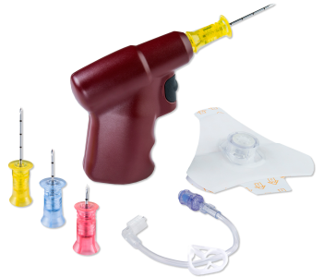
Vascular access
How long / how many attempts for PIVC?
Other options?
Familiarity with IO access
Key skill station in DELTA GP

Slide 16
Questions to consider
How do you identify anaphylaxis in a paediatric patient?
What does of adrenaline do you give in paediatric anaphylaxis? Where is your adrenaline stored? How do you make up this medication up? How do you administer it?
How do you assess effectiveness of an adrenaline dose? What do you do if the first dose does not work?
When would you consider IV access in a paediatric anaphylaxis case? How would you achieve this?
What resources are available for you to check doses in paediatric emergencies?

Slide 17
Emergent clinical concerns?
0800 to 2230:
3810 1487
Direct Ipswich ED SMO line

