Slide 1
GP Symposium Day
Palliative Care
Dr John Pietsch FRACGP Clin Dip Pall Med
Sarah Northfield BN, Grad Cert (Cancer Care), MAppSci

Slide 2
What (is palliative care?)
Palliative care is specialised, person- and family-centred care for people living with an active, progressive, life-limiting illness, aiming to optimise quality of life rather than cure the disease.
It can be provided alongside curative or life-prolonging treatments at any stage of a serious illness, not just at end-of-life.
It addresses physical symptoms (like pain and breathlessness), as well as emotional, social, cultural and spiritual needs for both patients and their families.
Care is delivered by a multidisciplinary team (doctors, nurses, allied health, spiritual care) and can occur in various settings — including home, hospital, residential aged care, or hospice.
Early referral is encouraged and can lead to better symptom management, improved quality of life, and support for decision-making and coping for patients and families

Slide 3





Time...
GPs don't have it.
Patient is running out of it.
Patient and their family need more of it.
(and GPs aren't paid adequately for it)

Slide 4

Advance Care Planning
Prompts for End of Life Planning (PELP) Framework
Great ACP conversation starter video – “Love is Not Enough”, ACP Australia:
https://youtu.be/hsZ287okI8c?si=5TrPLAHcoNH48s8F
PALLCONSULT End of Life Care GP Packs
The Queensland Health electronic hospital record (The Viewer) provides quick access for all healthcare professionals (including QAS) to ACP documents, ARPs and discussions.
    Can access via Health Provider Portal

Slide 5
What
Palliative Care Outpatient Clinics – Mondays & Thursdays
Renal supportive care
Inpatient Specialist Palliative Care Consulting & Admitting Rights Services
Palliative Care Community Outreach Program
Specialist Palliative Care in the Aged Care Setting (SPACE Project)
Areas outside our catchment area are covered by Gold Coast SPaRTa service, soon to be Gold Coast Toowoomba SPaRTa amalgamation
SPaRTa provides specialist pall care advice via telehealth or phone
Operating hours: Monday – Friday, 8am – 4:30pm
SPaRTa Weekend Service
Moving to Toowoomba on August 4th 2025

Slide 6
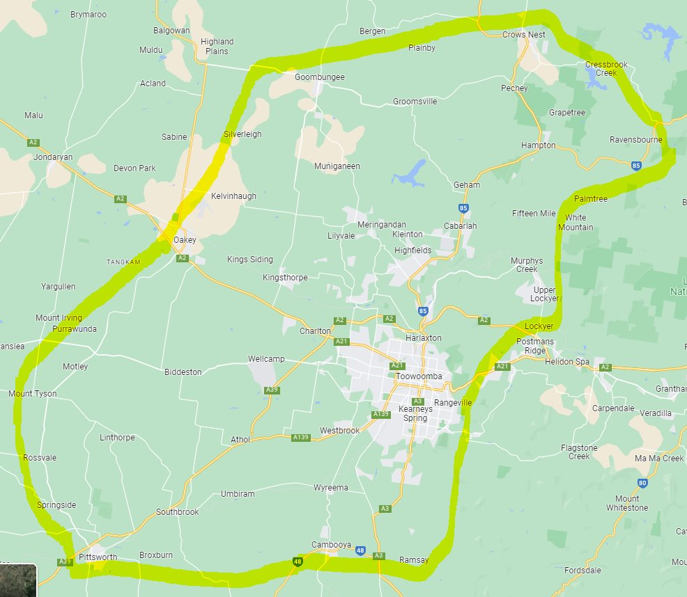

Where?
Catchment area for referrals to Toowoomba Palliative Care Community , SPACE and OPD
West to Oakey
North to Crows Nest
South to Pittsworth
East (the Range)*

Slide 7
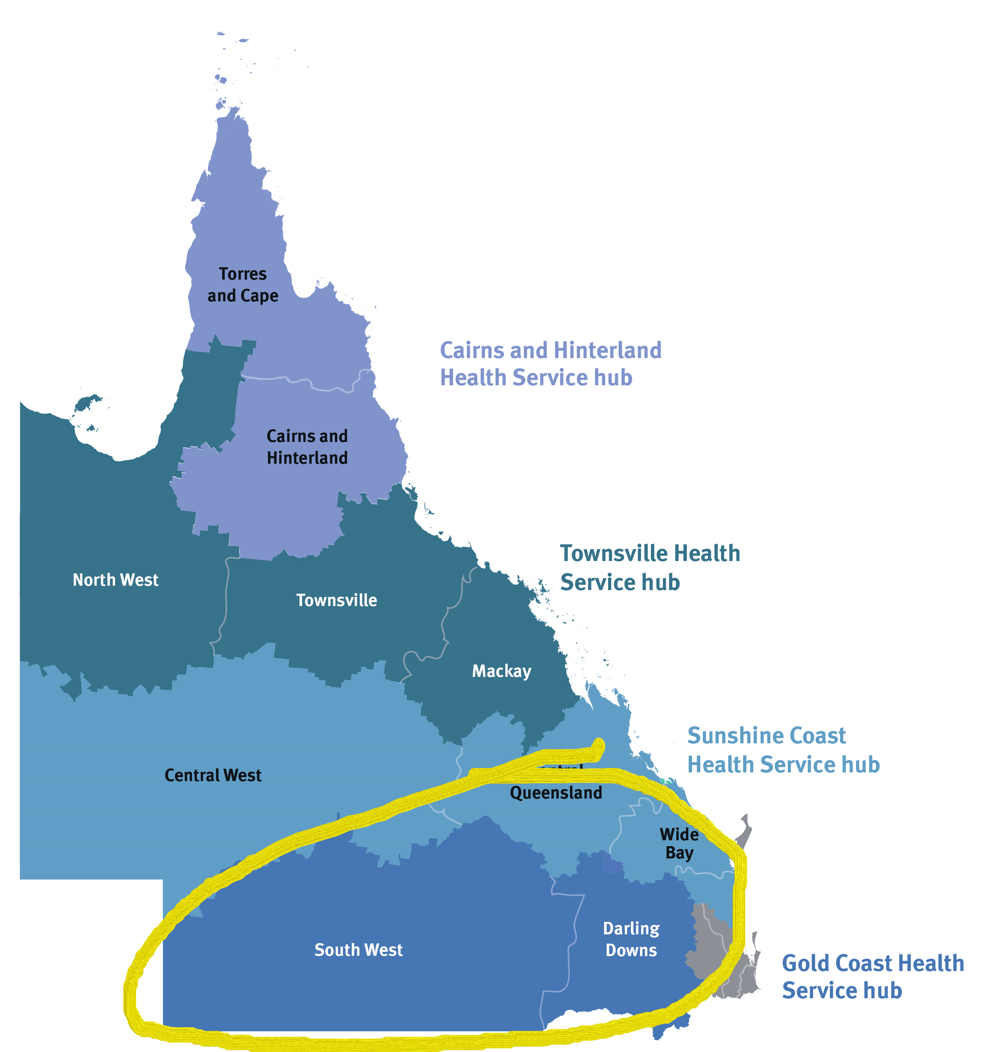

Where?
SPARTA catchment area

Slide 8
Who? – staffing
Clinical Nurse Consultants x 3 FTE
Clinical Nurses x 5 FTE – Community Outreach Program + SPACE
Palliative Care Consultants x 4.2 FTE
Palliative Care Registrars x 3 FTE & Resident
Psychologist 0.5FTE
Occupational Therapist 1.0FTE
Pharmacist 0.5FTE
ATSI HW 1.0FTE (rotational)
AO 1.0FTE
Social Worker 0.6FTE

Slide 9
Referral Criteria
Any adult patient with an active, progressing life limiting diagnosis (malignant or non-malignant)
+
Unmet or anticipated challenging symptom burden
Psychosocial needs require specialist assessment – consider earlier referral

Slide 10
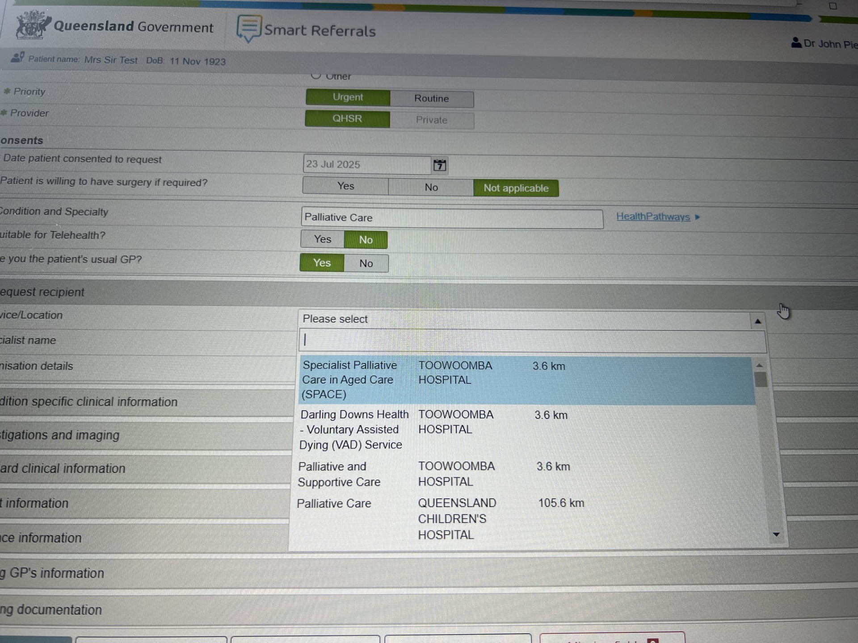
How and when (to refer)
SMART Referrals (or Medical Objects) – triaged to OPD/Community or SPACE (soon also SPARTA)
SPACE referrals often can be initiated and completed by RACF with GP permission
Urgent referrals – call Pall Care CNC (clinical) on 0428 957 963 & fax referral to 4616 5704
Can use SPCS referral form
Refer early as planning and anticipation of problems can make all the difference

Slide 11

Example
Renal Supportive Care
84 yr old
CKD V – GFR 7
Opting against dialysis after discussion with renal team and family (or deciding to come off dialysis)
Wishes for comfort cares approach going forward
Referral often initiated internally via Renal OPD. Referrals from external source via Smart Referrals – Palliative Care OPD

Slide 12


Example Community patient
63 yr old in Pittsworth
End stage Idiopathic Pulmonary Fibrosis
Supportive spouse and family wish to pursue end of life at home
Seen at home by Pall Care Dr, regular follow up by phone/in person between Dr visits by CNC/RNs
OT - navigate needs and funding for hospital bed, shower chair, rails
Psychologist – support for patient and family
SW – navigate NDIS/My Aged Care application *

Slide 13
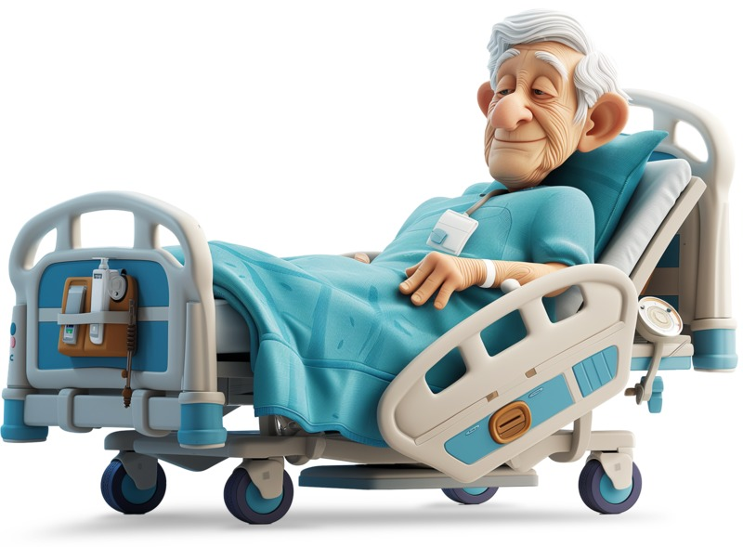

MASS PCEP
Eligibility criteria:
Permanent Qld resident
Have Medicare Card
Prognosis of < 6 months, as per palliative care staff specialist
Supports palliative patients to stay at home.
Provides access to range of equipment loans - daily living and mobility aids, home oxygen, & continence aids, depending on assessment of palliative care needs. Loans up to 6 months.
No cost to pt

Slide 14

SPACE
Specialist Palliative Care in Aged Care

Slide 15
SPACE Project Goals are to:
Improve access to palliative care for residents with complex end- of-life needs
Increased opportunity to enable people to die in their place of choice, supported by improved capacity in aged care services and care coordination
Support and enhance the care already being given through direct and indirect support of the clinicians already providing this care
Streamlined care for residents who require treatment in acute hospital facilities, including admission and discharge processes
The governance of the resident's care will remain with the current providers – the residents GP and the RACF nursing staff

Slide 16
Referral Criteria
Patient and family/carer agree with palliative goals of care and consent to referral
Life limiting diagnosis not receiving curative treatment
Has a current or anticipated complex symptom burden unresolved by generalist care
May be stable but clinically assessed as likely to deteriorate soon / rapidly
Resident and their family require end of life support and terminal care
Complex bereavement risk of family/carer

Slide 17

Example SPACE patient
95 yr old
RACF resident
Advanced Dementia with BPSD otherwise well
Large PR bleed in middle of night, sent to ED via QAS, Hb 72, markedly deranged LFTs. Unable to tolerate CT
NOK/EPOA opt for comfort approach at RACF
AGES referral to SPACE following brief ED admission

Slide 18

Example (recurrent) inpatient/OPD
on
38 yr old metastatic pancreatic cancer with young children
Remains on palliative chemotherapy prognosis 12-24 months
Previous IVDU, significant PTSD from prison, long standing substance abuse, epilepsy
Recurrent pain crises triggered by partial bowel obstructions affecting absorption
Requires 2x syringe drivers with hydromorphone, methadone, clonazepam, haloperidol , dexamethasone, keppra and ketamine to get symptoms under control before transition to oral/transdermal for discharge as obstruction is resolved conservatively
Liaise with metro pain service to facilitate coeliac plexus block

Slide 19


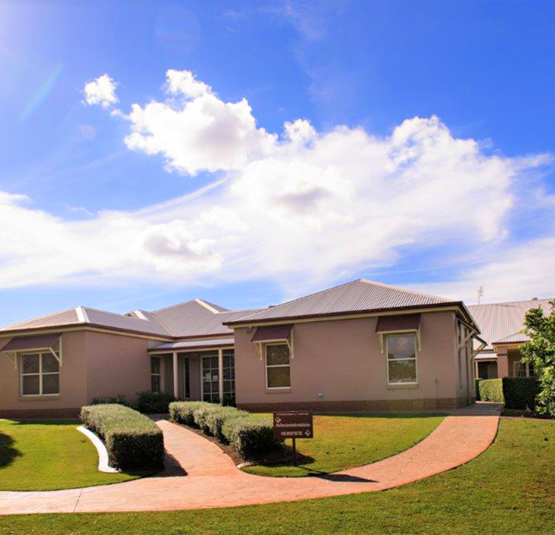
Online referral form
Specialist 6 bed palliative care facility aimed at providing quality end of life care for terminally ill clients
Bereavement up to 12 months post death
Not-for-profit
Private licenced hospital
24/7 365-day facility
Free service
Adults 18+
Accredited with ACHS, QLD PRU
Director of Nursing: Mrs Eugenie Corbett
Website: https://www.toowoombahospice.org.au/

Slide 20

Community Based Palliative Care

Slide 21
Blue Care Service offerings.
Clinical
Allied Health-All disciplines
Numerous funding options
Rural and remote palliative care contract, Supported by Queensland health – contact Palliative Care CNC, BlueCare, Kimberley Wilson: 0417 828 559
Email referrals to: palliativecare@bluecare.org.au
Notes:
Blue care is a leading provider of in home community based services, including clinical, All disciplines of allied health and Lifestyle services.
There are numerous funding options for palliative client’s to access services, including Commonwealth Home Support, Home care packages (soon to be support at home), DVA, Scripted services and fee for service.
Clients can access all but R&R funding at any stage of their journey.
The Rural and remote palliative care service, is a block funded service, free to the clients with an estimated prognosis of less than 12 weeks. All activities including clinical, Allied health and lifestyle services are covered under this funding type.
Blue care provides collaborative, person centred care to all of its clients leveraging all specialist disciplines.
Support at home with its specific palliative care funding, will be a point if further planning over the coming weeks.
Please send your referrals through at any stage and we will allocate the most appropriate funding type.

Slide 23

St Andrew’s Specialist Palliative Care
Team – NP Olivia O’Dempsey and Dr Etleva Harizaj
Expert, compassionate care for patients navigating complex medical journeys — whether they are receiving treatment, living with advanced cancer, or approaching end-of-life care.
Pain and other symptom control
Emotional and psychological support for patients and carers.
Guidance and support with organizing home services, allied health assessment and management and equipment.
Direct links and collaboration with Toowoomba Hospice and Brodribb at Home.

Slide 24
Symptoms approaching End of Life
Pain
Nausea and vomiting
Agitation
Distressing Breathlessness
Respiratory secretions
Seizures
Constipation
Mood disturbance
Fatigue
Anorexia
Notes:
https://static.tvtropes.org/pmwiki/pub/images/family_med.jpg

Slide 25
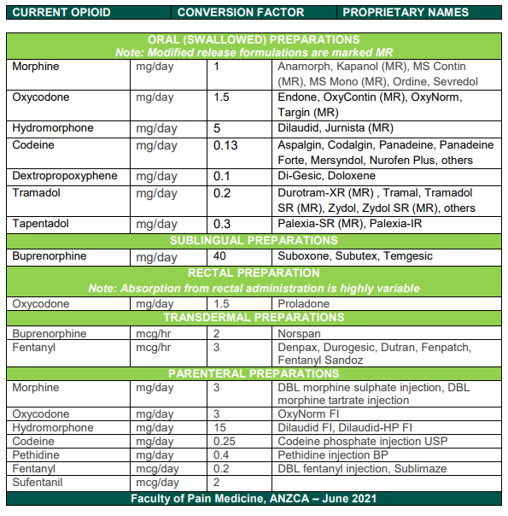
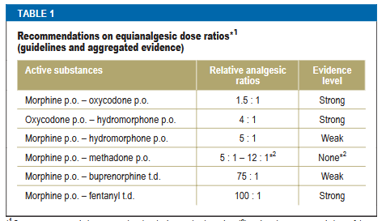
Analgesics
Adjuvants
Neuropathic agents
Pregabalin, gabapentin, duloxetine, amitriptyline
NSAIDS*
Corticosteroids*
PS01(PM)-(Appendix)_-Opioid-Dose-Equivalence-Calculation-Table.PDF (anzca.edu.au)
Notes:
Vegan Big Mac - Thee Burger Dude
https://www.hungryjacks.com.au/Upload/HJ/Media/Menu/product/Main/HJD0042_Whopper_Cheese_Triple_ALC_WEB_800x600px.png
https://images.foxtv.com/static.fox35orlando.com/www.fox35orlando.com/content/uploads/2023/08/932/524/The-X-Burger-Wayback.jpeg?ve=1&tl=1

Slide 26
Antiemetics
Metoclopromide (occasionally domperidone) - gastric stasis/ early satiety
Haloperidol (+ olanzapine off label) - toxic/metabolic
Dexamethasone – increased IOP
Cyclizine/Prochlorperazine – vestibular, Parkinsonism
Rarely long-term use of ondansetron (highly constipating)

Slide 27
Anxiolytics
Clonazepam – drops, subcutaneous
Midazolam – s/c
Lorazepam, diazepam, etc
Don't overlook antidepressants in patients with a longer-term prognosis - (i.e. anxiety caused by breathlessness)

Slide 28
Breathlessness
Don't overlook non-pharmacological approaches
Handheld fan
Relaxation and positioning techniques
PRN Liquid morphine/oxycodone/hydromorphone *
PRN Benzodiazepines – e.g. clonazepam drops
Long-acting opioid – e.g. Kapanol, MS Contin

Slide 29
End of Life prescribing
Anticipatory medications +/- syringe driver infusion
Analgesic (Opioid)
Antiemetic
Anxiolytic (Benzo)
Antisecretory/anticholinergic (Buscopan)
+/- Antipsychotic (Haloperidol)

Slide 30
Syringe Driver Infusion example
Opioid naïve 75 yr old
PRNs:
Morphine – 2.5-5mg q1h (pain/SOB)
Midazolam 2.5-5mg q1h (agitation)
Haloperidol 1mg q1h (max 5mg 24 hours) (nausea/agitation)
Buscopan 20mg q3h (max 120mg/24 hours) (respiratory secretions)
Syringe driver infusion over 24 hours:
Morphine 10mg
Midazolam 5mg
Metoclopramide 30mg

