Slide 1
Obstetric Medicine
High-Risk Pregnancy
Vishwas Raghunath
Nephrologist & Staff Specialist Obstetric Medicine,
Mater Mothers' Hospital and Ipswich Hospital, WMHHS

Slide 2
Acknowledgement of Traditional Owners
I would like to acknowledge the Aboriginal and Torres Strait Islander peoples as the Custodians of this land on which we are meeting today and recognise their continuing connection to land, waters and community.
I would like to pay my respects to elders’ past, present and emerging.
Mental Health Acknowledgement
I would also like to take this opportunity to acknowledge those here today who are living with a mental illness, and those providing care to people with a mental illness.

Slide 3
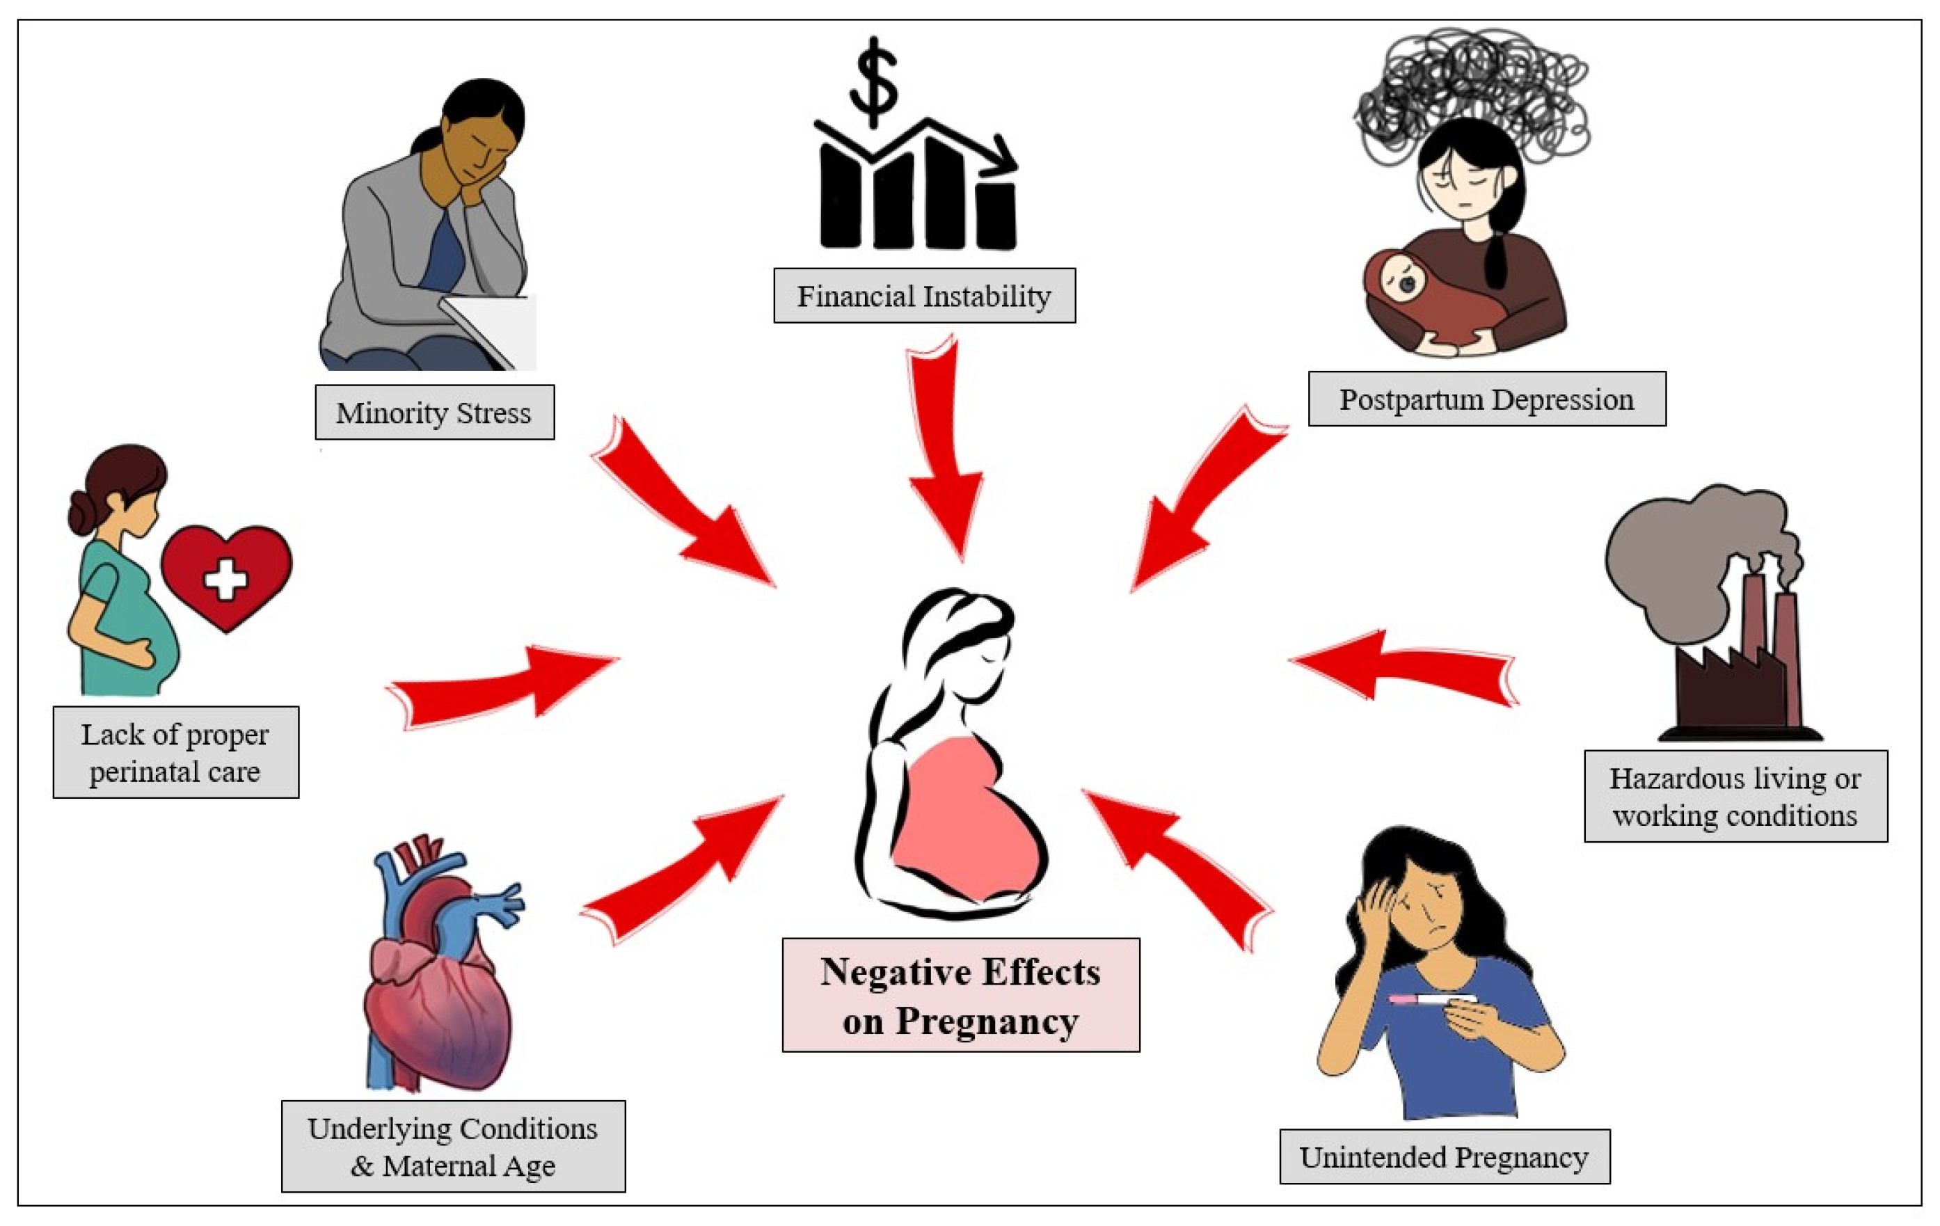
What women want..?
To have a healthy baby.
To have a normal pregnancy & delivery
To have maternity care focussed on wellness.
What actually happens….​
Unplanned pregnancy rates high.​
Can have a poor understanding of disease.​
Change/stop medications w/o consultation.

Slide 4
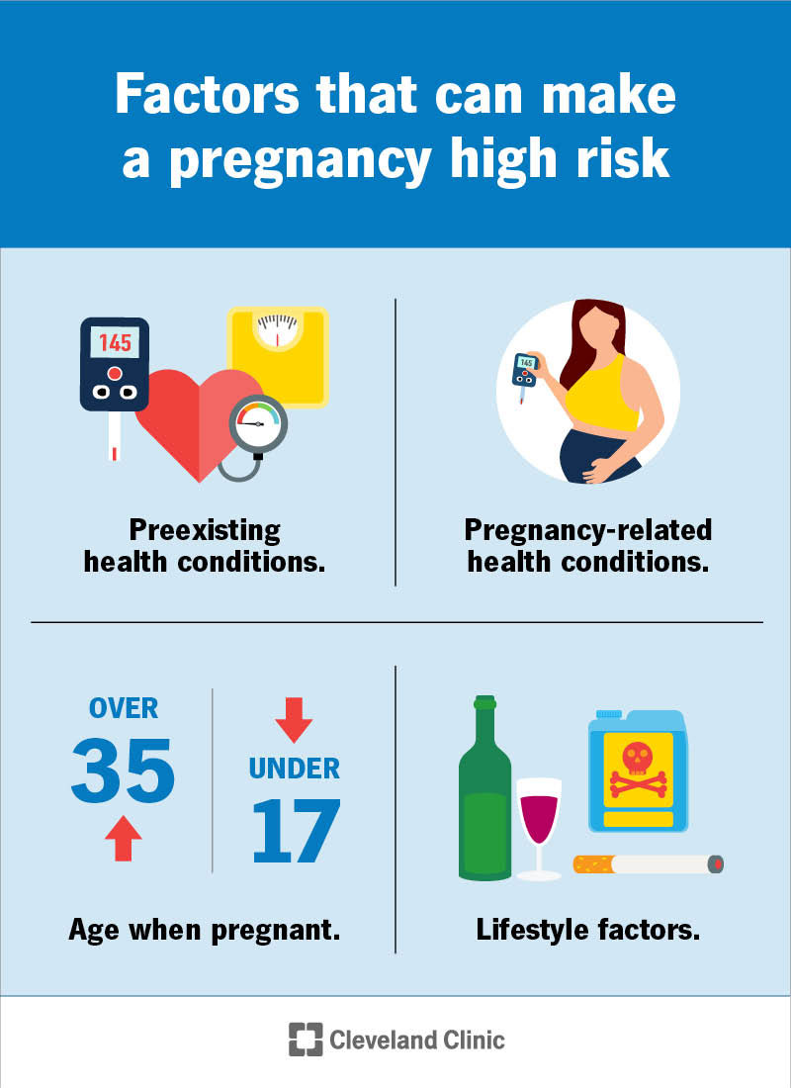
What is a High-Risk Pregnancy?
All pregnancies carry risks.
The definition of a “high-risk” pregnancy is any pregnancy that carries increased health risks for the pregnant person, fetus or both.
Bhaskar Narayan, and Catherine Nelson-Piercy Clin Med 2016;16:s110-s116
Notes:
The three aspects of managing women with medical problems in pregnancy.

Slide 5
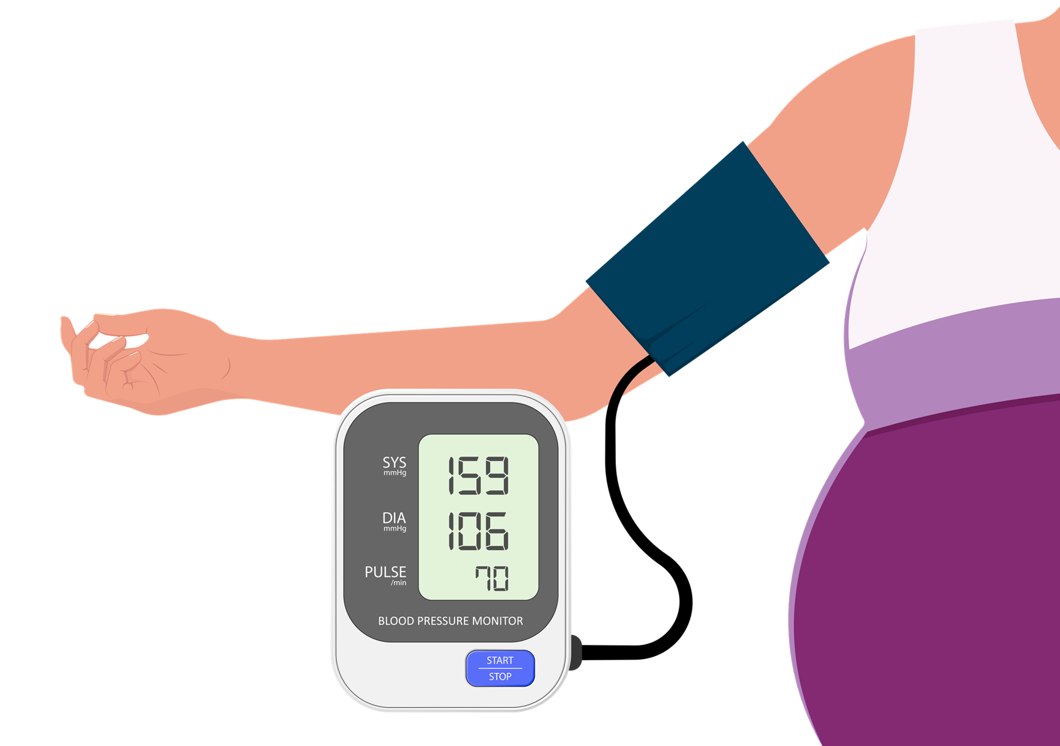
Hypertension and pregnancy

Slide 6
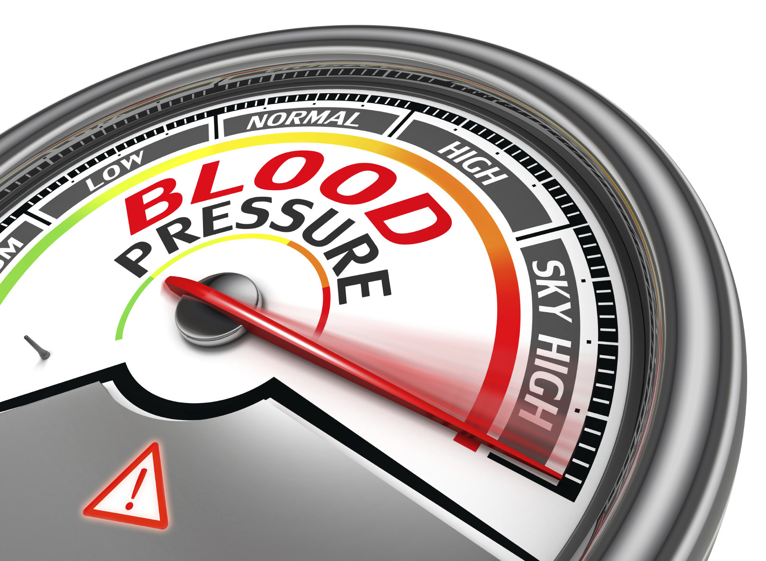
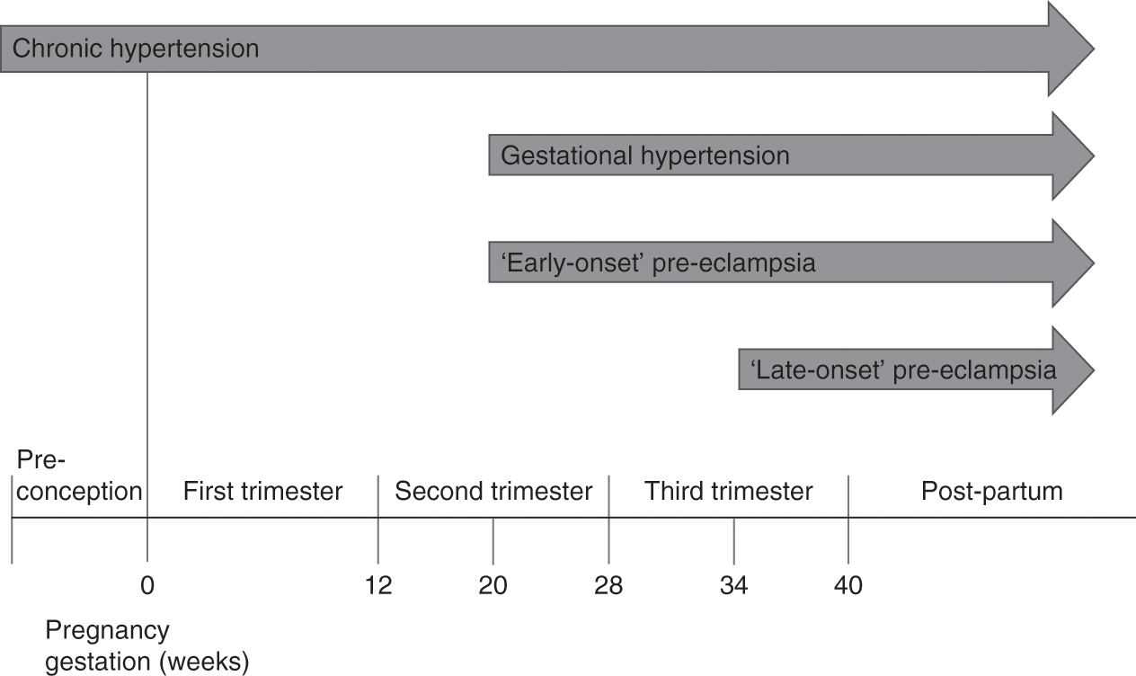
Hypertension & Pregnancy
White-coat hypertension –
elevated office/clinic (≥140/90 mm Hg) BP, but normal BP measured at home or work (<135/85 mm Hg)
not entirely benign - increased risk for preeclampsia & SGA.
Masked hypertension –
normal BP at clinic/office visit; elevated at other times
form of chronic HTN but significance in pregnancy less studied.
Transient gestational hypertension (TGH) -
usually detected in the clinic but then settles with repeated BP readings (role of MDAU).
TGH is associated with a 40% risk of developing true gestational hypertension or preeclampsia.
Mark A. Brown, Laura A. Magee, Louise C. Kenny, S. Ananth Karumanchi, Fergus P. McCarthy, Shigeru Saito, David R. Hall, Charlotte E. Warren, Gloria Adoyi, Salisu Ishaku. Hypertensive Disorders of Pregnancy ISSHP Classification, Diagnosis, and Management Recommendations for International Practice(Hypertension. 2018;72:24-43. DOI: 10.1161/HYPERTENSIONAHA.117.10803.)
Rely mostly on the BP in T1 to define normal or high BP.
Most automated home BP devices are accurate in pregnancy, but ≈25% differ from standard sphygmomanometer devices.
Role of ABPM and HBPM

Slide 7
What is preeclampsia?
Pre-eclampsia is new onset hypertension developing after 20 weeks’ gestation with one or more of the following: proteinuria, maternal organ dysfunction (including renal, hepatic, hematological, or neurological complications), or fetal growth restriction.
this definition does not require proteinuria to meet the diagnostic criteria.
inclusion of fetal growth restriction in this definition a significant change.
Tranquilli AL, Dekker G, Magee L, et al. : The classification, diagnosis and management of the hypertensive disorders of pregnancy: A revised statement from the ISSHP. Pregnancy Hypertens. 2014;4(2):97–104. 10.1016/j.preghy.2014.02.001.

Slide 8
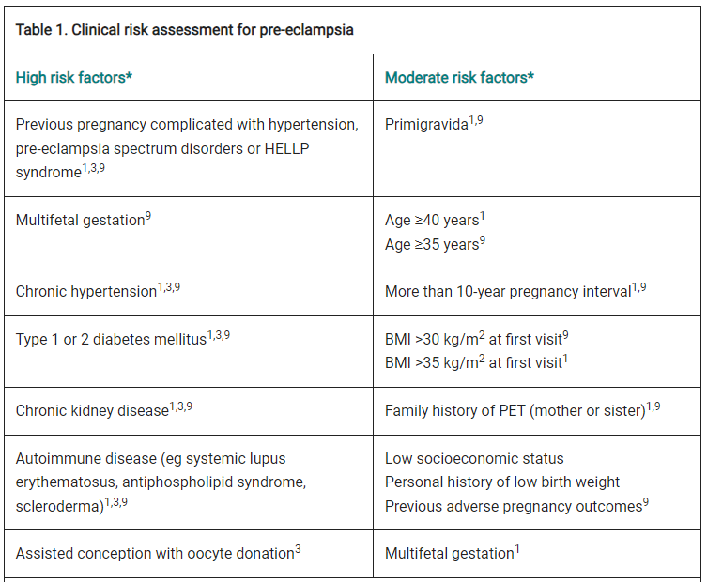
Early in pregnancy, assess all women for clinical risk factors for pre-eclampsia.
(NHMRC October 2017)
Previous preeclampsia (PE)
Previous early onset PE and preterm delivery at <34 weeks’ gestation
PE in more than one prior pregnancy
Chronic kidney disease
Autoimmune disease such as SLE or APLS
Heritable thrombophilias
Type 1 or type 2 diabetes
Chronic hypertension
First pregnancy
Pregnancy interval >10 years
New partner
Reproductive technologies
Family history of PE (mother or sister)
Excessive weight gain in pregnancy
Infection during pregnancy
Gestational trophoblastic disease
Multiple pregnancies
Age >40 years
Ethnicity: Nordic, Black, South Asian, or Pacific Island
BMI > 35 kg/m2 at first visit
Booking SBP>130mmHg or DBP>80mmHg
Increased pre-pregnancy triglycerides
Family history of early onset cardiovascular disease
Lower socioeconomic status
Cocaine and methamphetamine use
Non-smoking
AJGP Vol. 51, No. 10, October 2022
Notes:
USPTF Risk Stratification
High risk
Previous pregnancy with preeclampsia, especially early onset and with an adverse outcome
Multifetal gestation
Chronic hypertension
Type 1 or 2 diabetes mellitus
Renal disease
Autoimmune disease (antiphospholipid syndrome, systemic lupus erythematosus)
Moderate risk
Nulliparity
Obesity (body mass index [BMI] >30 kg/m2)
Family history of preeclampsia in mother or sister
Age ≥35 years
Sociodemographic characteristics (African American, low socioeconomic level)
Personal risk factors (eg, history of low birth weight or small for gestational age, previous adverse pregnancy outcome, >10-year pregnancy interval)

Slide 9
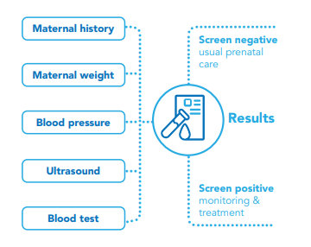
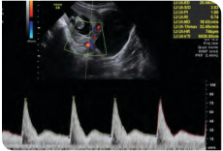
Screening for preeclampsia
Women should be screened for their risk of preeclampsia early in the pregnancy.
At a minimum (in the absence of combined first trimester screening), risk stratification should be done based on maternal risk factors (maternal characteristics, medical and obstetric history
The use of a combined first trimester screen (combined maternal features, biomarkers and sonography) to identify women at risk of developing preeclampsia is conditionally recommended based on local availability and access to the required resources.
SOMANZ 2023

Slide 10
Prediction and Prevention of Preeclampsia (ISSHP statements)
No first or second trimester test or set of tests can reliably predict the development of all cases of preeclampsia; however, a combination of maternal risk factors, BP, PlGF, and uterine artery doppler can select women who may benefit from aspirin to prevent preterm (<37 weeks gestation) but not term preeclampsia.
First trimester screening for risk of preeclampsia when this can be integrated into the local health system.
Women with established strong clinical risk factors for preeclampsia should be treated, ideally before 16 weeks, with low-dose aspirin.
We recommend at this stage against the routine clinical use of rule-in or rule-out tests (eg. sFLT-1/PlGF ratio).
Women considered at increased risk for preeclampsia as above should receive supplemental calcium (1.2–2.5 g/d) if their intake is likely to be low (<600 mg/d), in addition to aspirin.
Women should exercise during pregnancy to maintain health, appropriate body weight, and reduce the likelihood of hypertension.

Slide 11
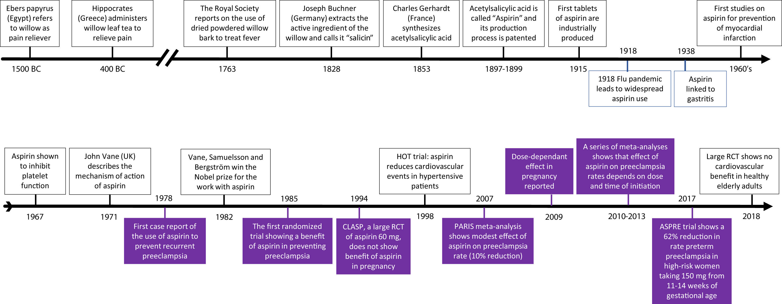
Figure 1
Aspirin is one of the oldest medications that is still in widespread use.
Rolnik. Aspirin for the prevention of preeclampsia. Am J Obstet Gynecol 2022
American Journal of Obstetrics & Gynecology 2022 226S1108-S1119DOI: (10.1016/j.ajog.2020.08.045)
Notes:
Timeline of events in aspirin history and specific aspects of its use in pregnancy (purple boxes)
ASPRE, Aspirin for Evidence-Based Preeclampsia Prevention; CLASP, Collaborative Low-dose Aspirin Study in Pregnancy¹⁷; HOT, Hypertension Optimal Treatment study¹⁸; PARIS, Perinatal Antiplatelet Review of International Studies; RCT, randomized controlled trial.

Slide 12
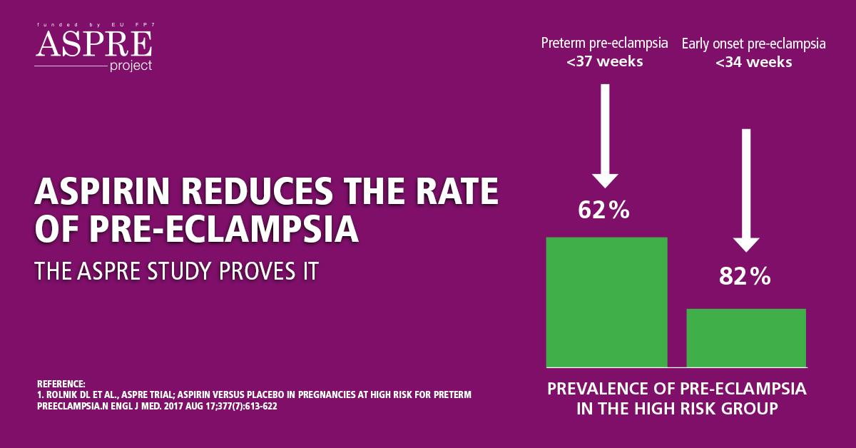
Aspirin and preeclampsia
979 - women who had taken aspirin regularly during pregnancy were less likely to have preeclampsia than women who had not.
Subsequent decades, >30 trials have investigated the benefit of low-dose aspirin (50-150 mg per day) for the prevention of preeclampsia.
ASPRE trial - the Combined Multimarker Screening and Randomized Patient Treatment with Aspirin for Evidence-Based Preeclampsia Prevention trial showed that among women with singleton pregnancies who were identified by means of first-trimester screening as being at high risk for preterm preeclampsia, the administration of aspirin at a dose of 150 mg per day from 11-14 weeks of gestation until 36 weeks of gestation resulted in a significantly lower incidence of preterm preeclampsia (62%) than with placebo.
Rolnik DL, Wright D, Poon LC et al. Aspirin versus Placebo in Pregnancies at High Risk for Preterm Pre-eclampsia. N Engl J Med. 2017, Jun, 28; 377:613-622.
Notes:
Suboptimal trophoblastic invasion leads to an imbalance of angiogenic and antiangiogenic proteins, ultimately causing widespread inflammation and endothelial damage, increased platelet aggregation, and thrombotic events with placental infarcts.
Aspirin at dose <300 mg selectively and irreversibly inactivates the cyclooxygenase-1 enzyme, suppressing the production of prostaglandins and thromboxane and inhibiting inflammation and platelet aggregation.

Slide 13
https://www.somanz.org/hypertension-in-pregnancy-guideline-2023

Slide 14
What does the SOMANZ guideline say?

Slide 15
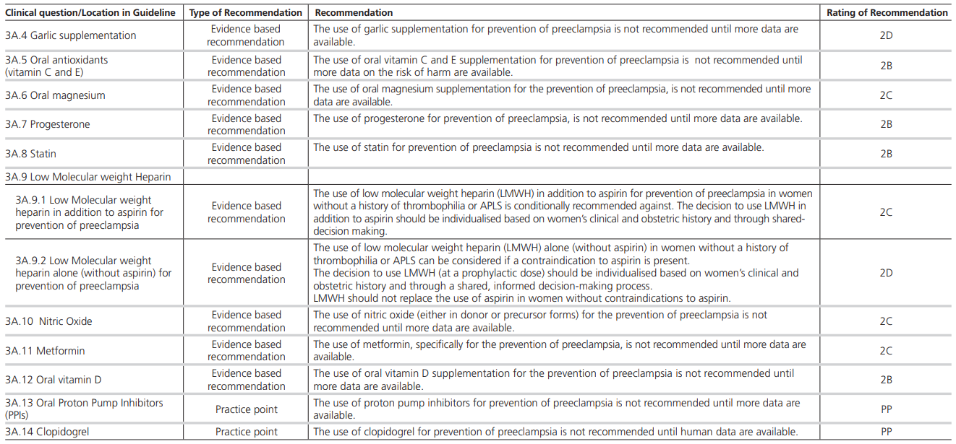

Slide 16
Cases in HTN
Case 1: 25-year patient G1P0 with blood pressure 140/90 mm Hg at 30 weeks. No other symptoms or lab abnormalities and normally grown foetus. Mild oedema. No proteinuria.
Diagnosis: Gestational hypertension.
Case 2: 22-year G1P0 presents with blood pressure 172/90 mm Hg at 33 weeks gestation. No other symptoms or lab abnormalities and normally grown foetus. Mild oedema. No proteinuria.
This patient has severe hypertension defined as a systolic blood pressure ≥ 170 ± diastolic blood pressure ≥ 110 mm Hg requiring urgent treatment.
Case 3: 40-year old woman G1P0 presents at 36 weeks gestation with blood pressure 150/100 mm Hg and right upper quadrant pain. Investigations revealed a raised ALT and AST. There was no proteinuria. Ultrasound revealed foetal growth restriction (FGR).
Diagnosis: preeclampsia
Case 4: 35 year old with IgA Nephropathy. Has hypertension and stable proteinuria (PCR 100 mg/mmol). Antihypertensives stopped in early pregnancy due to hypotension. At 32 weeks, blood pressure 145/90 mm Hg, PCR 220 mg/mmol. No other symptoms, signs or laboratory abnormalities. No FGR.
Diagnosis: This is a challenging case but most likely she just has pre-existing hypertension that, due to physiological drop in blood pressure in the first half of pregnancy, was not present earlier in pregnancy.

Slide 17
Postpartum Care
In early postpartum period, women with preeclampsia should be considered at high risk for preeclamptic complications for at least 3 days.
Treat any hypertension before day 6 postpartum with antihypertensive therapy.
NSAIDs for postpartum analgesia should be avoided in women with preeclampsia.
All women reviewed at 3 months postpartum to ensure that BP, urinalysis, and any laboratory abnormalities have normalized.
There are significant long-term cardiovascular risks for women with chronic hypertension and those who have had gestational hypertension or preeclampsia.
Aim to achieve pre-pregnancy weight by 12 months and to limit interpregnancy weight gain through healthy lifestyle.
Encourage inter-pregnancy intervals of >18mo and appropriate Contraception
Annual medical review is advised...life-long.

Slide 18
Counselling
Clinical case
A 33-year-old woman, obese (weight: 90 kg, height 150 cm, BMI 40 kg/m2 ), presents with a history of chronic hypertension since her last pregnancy two years ago, which was complicated by severe preeclampsia diagnosed at 37 weeks’ gestation, with imminent eclampsia (headache, visual changes, and epigastric pain).
At that time, she was referred to a tertiary maternity hospital, admitted to the intensive care unit, treated with magnesium sulphate, and stabilized.
Labour was induced, leading to vaginal delivery of a small for gestational age but healthy baby.
Postpartum, the patient lost contact with her primary care physician and discontinued antihypertensive medication on her own a few months before this consultation.
Patient’s questions - Can I have a normal pregnancy? Will I have preeclampsia again? What can I do to prevent it?

Slide 19
Case 2
A 25-year-old woman has a third nonplanned pregnancy, with a history of two stillbirths: one occurred at 32 weeks and the other occurred one year ago at 28 weeks because of complications of severe preterm preeclampsia with HELLP syndrome.
She had been lost to follow-up since her postpartum visit and presents with a 14-week pregnancy.
She has no records or reports from previous pregnancies and does not recall any specific investigation related to her adverse outcomes.
Patient's Questions: I didn’t plan this pregnancy. What can I do now? Can I prevent complications? What are the chances of preeclampsia recurring?
HCP - “How can she not have had investigations? How can she be pregnant again already? Why is she so concerned now?”

Slide 20
Some points to talk about
Determine the severity of previous preeclampsia and gestational age at diagnosis and obtain clinical records (when available).
Consider history of other poor maternal/fetal outcomes.
Determine any comorbidities (obesity, chronic hypertension, diabetes, autoimmune disease) and lifestyle.
Perform a complete evaluation to assess baseline medical conditions.
Provide management in conjunction with a multi-professional team when necessary (primary care, internal medicine, rheumatology, cardiology).
Discuss realistic goals (weight loss, glucose control, blood pressure control).
Maintain use of contraception while attempting to control comorbidities.
Inform the patient about needed evaluation and management during a future pregnancy (increased maternal and fetal surveillance, more prenatal consultations).
Based on the particular case, discuss possible interventions to prevent preeclampsia recurrence, such as calcium supplementation (in populations with low intake) and low–dose ASA (especially for cases of previous pre-term or recurrent preeclampsia).
Preeclampsia: Reflections on How to Counsel About Preventing Recurrence Maria Laura Costa, MD, PhD. JOGC October 2015

Slide 21
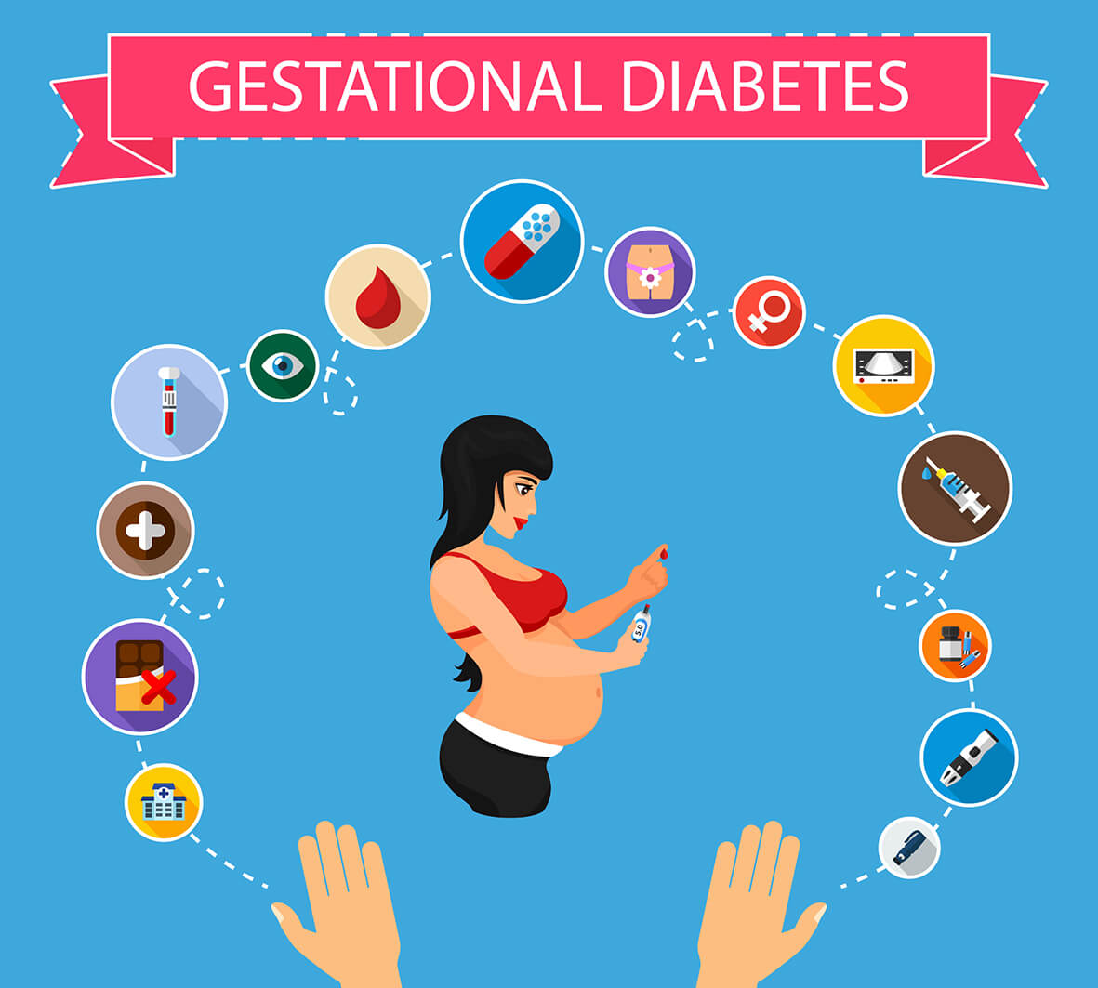

Slide 22
Gestational Diabetes
GDM is the fastest growing type of diabetes in Australia.
Factors contributing to the growing rate of GDM include the age and weight of women becoming pregnant, excessive weight gain during pregnancy and Australia’s changing ethnic makeup.
Recent changes to the diagnostic process and criteria have also contributed.
Average age of women falling pregnant has increased from 26.3 years in 1978 to 30.7 years in 2020
Women with GDM are at a higher risk of serious complications during labour and birth that can have a lifelong impact.
Women who are diagnosed with GDM may experience a range of psychological challenges including anxiety, guilt and distress.
Great pressure on health services, particularly the maternity hospitals – need diagnostic and management pathways tailored to local circumstances.
impact of GDM on the mother and baby varies depending on individual risk level for pregnancy complications
GDM education and care is not covered by Medicare or by many private health insurance funds

Slide 23
Who is at risk?
have had GDM in a previous pregnancy
are older, especially aged 40 years or over
are First Nations women
are from an African, Melanesian, Polynesian, South Asian, Chinese, Southeast Asian, Middle Eastern, Hispanic and South American backgrounds
have a family history of type 2 diabetes or a first-degree relative (mother or sister) with a history of gestational diabetes
are above the healthy weight range
have gained weight rapidly in the first half of pregnancy
have previously had elevated blood glucose levels or insulin resistance
have polycystic ovary syndrome
have previously had a large baby (especially weighing more than 4,500g)
are currently taking some types of antipsychotic or steroid medications
Short- and Long-Term Impacts for Babies/Children
Babies born to mothers with GDM are more likely to experience a range of short-term complications:
premature birth
macrosomia
shoulder dystocia
neonatal hypoglycaemia
respiratory distress syndrome
hypocalcaemia
In the longer term, children born to mothers with GDM are at an increased risk of childhood obesity and developing type 2 diabetes.
Intergenerational cycle - ​
Women with GDM are 7x more likely to develop type 2 diabetes later in life. ​
Children born to mothers with GDM are also at higher risk of developing type 2 diabetes later in life. ​
Babies born to women with GDM are more likely to have longer hospital stays and twice as likely to be admitted to SCNs or NICUs. ​
Position statement – Gestational diabetes in Australia. Aug 2020. Diabetes Australia (endorsed by ADS and ADIPS)

Slide 24
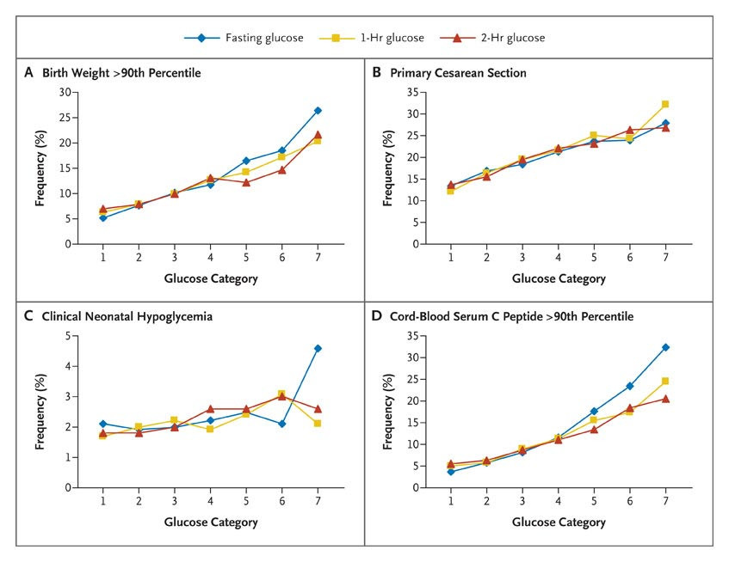
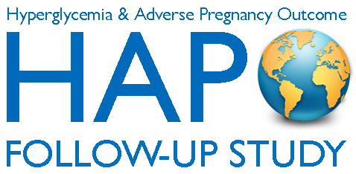
1952 - Jorgen Pedersen postulated that maternal hyperglycemia led to fetal hyperglycemia, which evoked an exaggerated fetal response to insulin.
HAPO Study
25,505 pregnant women,15 centers, 9 countries - underwent 75-g OGTT at 24-32 weeks.
fasting glucose <5.8 mmol/l and 2-hr post-prandial glucose <11.1mmol/l.
Primary outcomes - birth weight >90th percentile for gestational age, primary cesarean delivery, clinically diagnosed neonatal hypoglycemia, and cord-blood serum C-peptide level > 90th percentile.
Subsequent consideration by the International Association of Diabetes and Pregnancy Study Groups (IADPSG), resulted in the formulation of new consensus guidelines for the testing and diagnosis of GDM.
Notes:
HAPO-FUS
4,160 children ages 10–14 years who completed all or part of an OGTT and whose mothers had a 75-g OGTT at ∼28 weeks of gestation with blinded glucose values.
Offspring exposed to untreated GDM in utero are insulin resistant with limited β-cell compensation compared with offspring of mothers without GDM.
GDM is significantly and independently associated with childhood IGT.

Slide 25
Diagnosis of GDM
IADPSG consensus in 2014, based on HAPO data and 75% increased risk of outcomes.
75g OGTT
Diagnosis should be based on any one of the following values:
Fasting plasma glucose 5.1–6.9 mmol/l
1-h >10.0 mmol/l
2-h = 8.5–11.0 mmol/l .
Notes:
History:
June 2008, the IADPSG sponsored an International Workshop - Conference on Gestational Diabetes Diagnosis and Classification in Pasadena, California.
IADPSG Consensus panel GDM is “any degree of glucose intolerance with onset or first recognition during pregnancy”
Objective of the HAPO study was to clarify associations of levels of maternal glucose lower than those diagnostic of diabetes with perinatal outcome. There were continuous graded relationships between higher maternal glucose and increasing frequency of the primary outcomes, independent of other risk factors.
In Pima Indians, Pettitt et al. found that maternal plasma glucose concentration during pregnancy (measured 2 h after a 75-g load) had a continuous association with adverse pregnancy outcomes (LGA and cesarean section).
Danish study of pregnant women with mild glucose intolerance but without GDM found a linear association between maternal 2-h glucose and cesarean delivery, spontaneous preterm delivery, shoulder dystocia, and macrosomia after adjustment for confounders.
Toronto Tri-Hospital Study showed continuous associations between maternal glycemia and adverse pregnancy outcomes.
Sacks et al. found associations between FPG and the 2-h value on a 75-g OGTT and macrosomia in a mixed ethnic U.S.
Evidence:
2 large RCTs have demonstrated the benefits of treating hyperglycaemia in pregnancy using treatment targets of fasting < 5.3 and 5.5 mmol/L and 2-hour values of < 6.7 or 7 mmol/L respectively.
There is level 1 evidence for a two-hour value of 6.7 mmol/L.
The fasting target of < 5.1 has been chosen from observational data.
There is level 1 evidence for a value of < 5.3 mmol/L.
The one-hour target of < 7.4 mmol/L is based on a small study.
1-hr vs 2-hr?
diet control in GDM managed by 1-hour PPG measurements had decreased rate of insulin therapy.
Long-term control of blood sugar was superior among the subjects managed with 1st-hour postprandial blood sugars with a statistically significant reduction in foetal macrosomia.

Slide 26
QLD Health Guidelines

Slide 27
What about "early" GDM? (eGDM)
Most associations recognize the importance of screening for hyperglycemia early in pregnancy.
Primary purpose of this strategy is to detect preexisting hyperglycemia.
Compelling need to Dx "overt" DM - first proposed by IADPSG – suggested fasting or A1c or random glucose.
WHO (2013) and FIGO (2015) also endorsed need for early screening - recommended the OGTT (with the IADPSG cut-offs) to screen for DM in early pregnancy.
ADIPS advocated using IADPSG criteria but suggested a risk-based approach.
ADA and the ACOG proposed risk-based screening in early pregnancy but have not clarified the specific methodology.
NICE suggested 75-g OGTT with cut offs fasting >5.6 and 2-hr post-prandial >7.8 mmol/l in high-risk women.
Bhattacharya, S.; Kalra, S. et. al. Early Gestational Diabetes Mellitus: Diagnostic Strategies and Clinical Implications. Med. Sci. 2021, 9, 59.

Slide 28
Fasting plasma glucose for eGDM
IADPSG initially suggested >5.1mmol/l (2010) but later withdrew due to lack of evidence.
Current evidence suggests that first-trimester FG and the risk of conventional GDM have a linear relationship - higher values strongly correlate with an increased risk. (BMI, CRP and TGs further add to risk).
FG >5.6 mmol/l - higher rates of pregnancy hypertension, macrosomia and prematurity irrespective of routine OGTT.
Summary - While FPG is accepted as a simple and accurate screening tool to rule out overt DM, its usefulness in diagnosing eGDM is debatable.
HBA1c for eGDM
HbA1c ≥6.5% is used to define the presence of overt DM in pregnancy
From the available evidence, HbA1C values ≤4.8% and ≥5.9% in early pregnancy seem to be reasonable cut-offs to rule out and predict the risk of cGDM.
OGTT for eGDM
A first-trimester OGTT with IADPSG cut-offs is not an accurate predictor of cGDM.
Close to half of the patients with a deranged first-trimester OGTT revert to normoglycemia at 24–28 weeks without any intervention.
A deranged OGTT in the first trimester could also be a marker of metabolic dysfunction in obese women.
An OGTT performed later toward the end of the second trimester more closely corresponds to cGDM.
Bhattacharya, S.; Kalra, S. et. al. Early Gestational Diabetes Mellitus: Diagnostic Strategies and Clinical Implications. Med. Sci. 2021, 9, 59. ​
Notes:
Physiological changes in pregnancy trigger a reduction in insulin sensitivity by 12–14 weeks. A further decline occurs by the end of the second trimester to finally reach the last trimester level of around 40–60% lower than the non-gravid state.
Continuous glucose monitoring system profiling in normoglycemic pregnancies demonstrated that even though FPG values are unchanged, the postprandial glucose levels increased around the 16th week and stay elevated till the 36th week. The levels normalized in the postpartum phase.

Slide 29
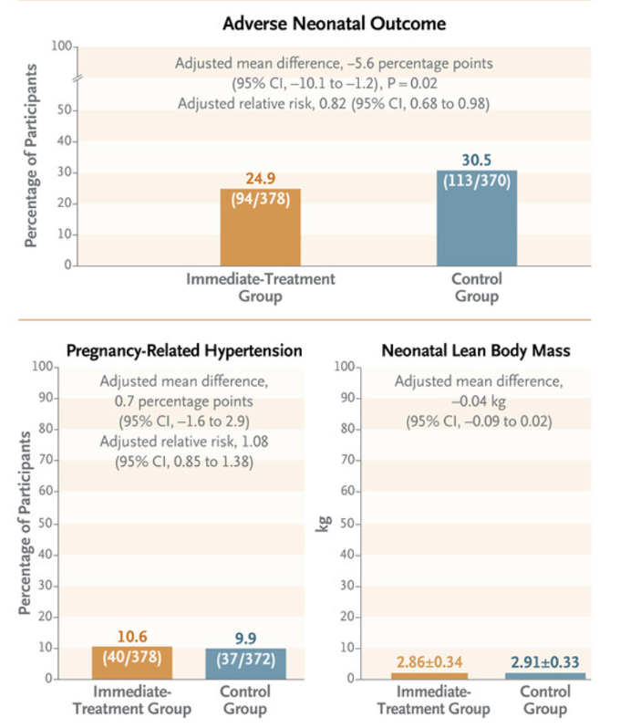
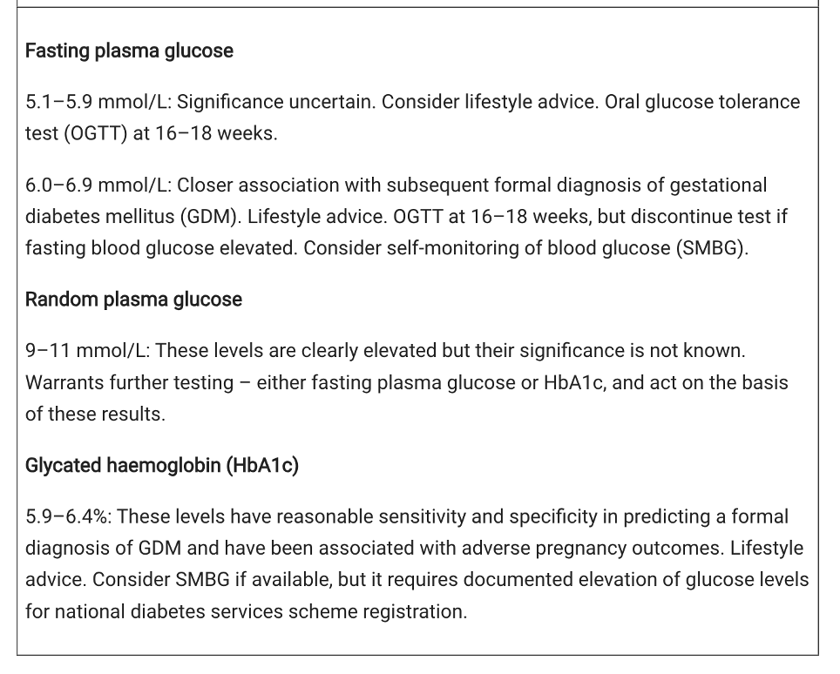
eGDM - summary
Dysglycemia in early pregnancy a/w greater adverse outcomes.
No test offers satisfactory alignment with a subsequent definitive diagnosis of GDM or reliably predicts outcomes.
Fasting glucose levels rise in early pregnancy, and GDM diagnosed on these levels is poorly replicated at routine 24–28 weeks’ testing.
A random plasma glucose level has low specificity, and the OGTT is not necessarily predictive of later GDM.
HbA1c with levels of 41–46 mmol/mol (5.9–6.4%) may identify women at higher risk of adverse pregnancy outcomes.
A Nankervis, S Price. AJGP VOL. 47, NO. 7, JULY 2018
Notes:
NEJM - 802 women
Conclusion - Immediate treatment of gestational diabetes before 20 weeks’ gestation led to a modestly lower incidence of a composite of adverse neonatal outcomes than no immediate treatment; no material differences were observed for pregnancy-related hypertension or neonatal lean body mass.

Slide 30
MoTER App
Mobile technology solution: MoTHer GDM App and web-based clinician portal.
Developed at CSIRO’s Australian e-Health Research Centre
Initial development at Redlands Hospital (MSHHS) -> Mater Mothers' hospital -> Ipswich Hospital
Components
Blood glucose monitoring (via Bluetooth from blood glucose meter with option for manual entry) - graphed and trended
Body weight - graphed and trended
Clinical symptoms and measures - e.g. stress, blood pressure
Dietary indicators record - serves fruit, serves vegetables etc.
Exercise indicators - steps per day etc.
Key educational information and tools - e.g. multimedia educational resources

Slide 31
Testing for 'diabetes in pregnancy'
The diagnosis of ‘diabetes in pregnancy’ is made if World Health Organization (WHO) criteria for the diagnosis of diabetes outside of pregnancy are met.
OGTT preferred but poorly tolerated in early pregnancy.
HbA1c: preferred test in the first trimester for women at high risk of GDM
GDM : HbA1c ≥5.9% or 41mmol/mol
Diabetes in Pregnancy : ≥ 6.5% or 48mmol/mol
HbA1c can also be used for the long term follow up of women with a hx of GDM, or preconception testing in high-risk women.
When testing women on high-dose corticosteroids or metformin (PCOS), results should be interpreted cautiously.
A single fasting BGL of 5.1-5.5 mmol/l in the first trimester does not diagnose GDM.
Request HbA1c if <k12 or GTT if > k12
Early OGTT if high risk of GDM and presents >K12
Routine OGTT (24 – 28 weeks) for all women not previously noted as abnormal

Slide 32
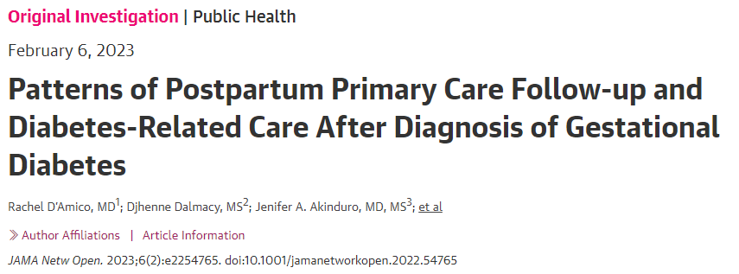
Gone but not forgotten...
Postnatal Counselling
The individuals with GD had lower rates of primary care and diabetes-related care compared with those with preexisting type 2 diabetes, and only 36% of those with GD received guideline-recommended blood glucose testing in the first 12 weeks postpartum.
This illustrates a missed opportunity for early intervention in diabetes surveillance and prevention
Adding prenatal counseling to routine, early-postnatal counseling significantly increased the rates of glucose screening and contraceptive use by 6 weeks postpartum among pregnant women with gestational diabetes mellitus.
70% increase postpartum glucose screening and 90% increase in the uptake of highly effective contraceptive methods by 6 weeks postpartum.

Slide 33
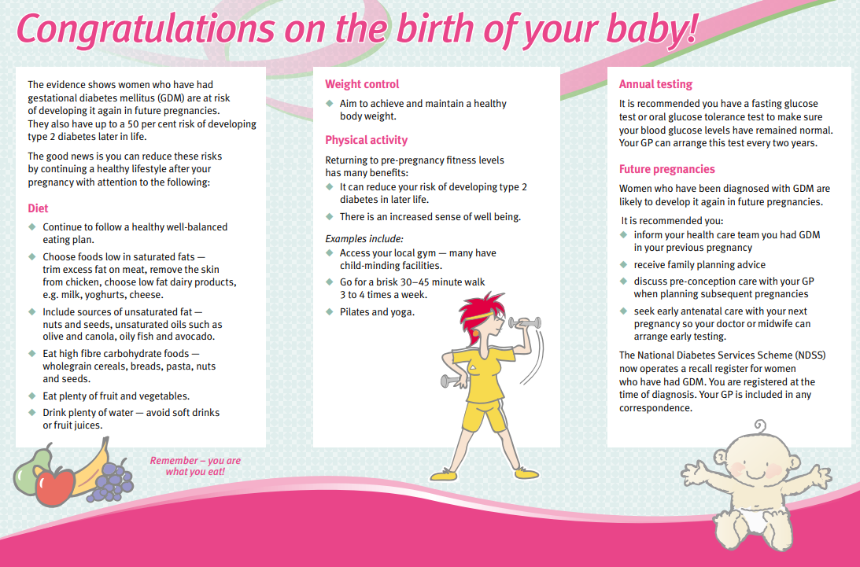

Slide 34
Preconception care – T1DM/T2DM in pregnancy

Slide 35
‘Challenges arise in managing two lives – the mother and the baby – sometimes leading to a state of clinical inertia.’
Acute Care Toolkit RACP UK

Slide 36
Thanks for listening. Any Questions?
It takes a TEAM…

